Slide 1
To put the drafting volunteers informal writing into a science perspective
Grounded Theory – a qualitative inductive methodology for developing theories
Submitted by the expert from Sweden
Presentation 1
6th GE.3, 4-5 May 2023
Provisional agenda item 3

Slide 2
Verification
Discovery

Slide 3
What is grounded theory (GT)?
A method of generating theory based on patterns found in data (everything is data)
Glaser och Strauss (1967) believes that a produced theory always must be grounded in data:
”the basic theme in our book is the discovery of theory from data systematically obtained from social reserach”

Slide 4
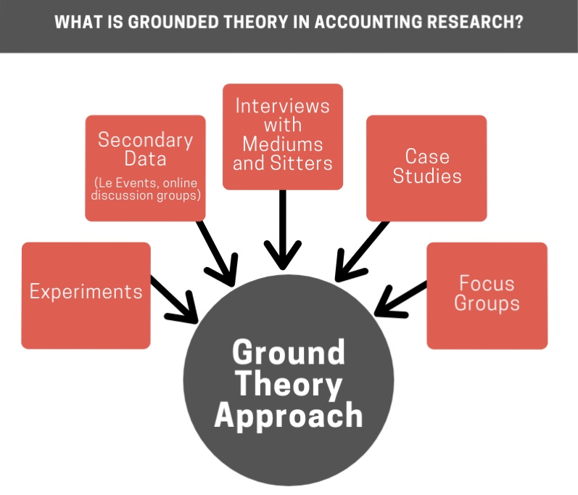
An example from another research area
From: https://statswork.com/blog/what-is-grounded-theory-in-accounting-research/

Slide 5
The GT specifies how to map the data collected. Eneroth (1994) writes that:
"This method means that when you are faced with a lot of clarified data, you systematically try to group and regroup them, until you have made as complete a mapping of the phenomenon as possible based on these given data"

Slide 6
It is important to have:
an empty head but an open mind…..!

Slide 7
The principle: from detail to general…

Slide 8
The Swedish data (”the road forward to self driving vehicles” and ”liability when automated driving”)

Slide 9
Using the scoping draft text which is grounded in data by expert interviews
Example from the scoping draft_230404 and the chapter II, articles 4, 5 and 6

Slide 10
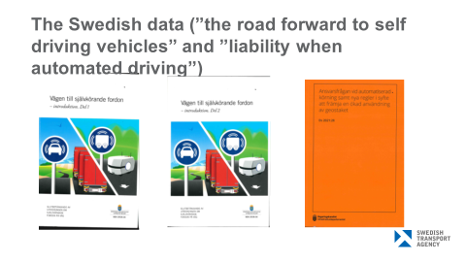
An example of grounded theory result…..
Data from other countries, WP.29, WP.1, GE.3 etc……

Slide 11
From induction to deduction
How to use the theory/model that the voluntary writing group has produced?
The summary of all domestic proposals may not work to 100% globally
A verification phase?

Slide 12
Verification
Discovery

Slide 13

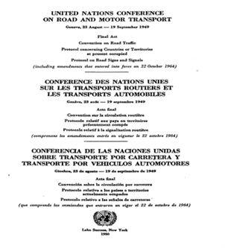
Continue with a verification phase?
Terms of reference of the Group of Experts on drafting a new legal instrument on the use of automated vehicles in traffic
This Group of Experts is established to prepare a draft new legal instrument on the use of automated vehicles in domestic and international traffic.
ECE/TRANS/WP.1/2020/2
Input to scoping papers?
Input to GAP-analysis?
Focus/content of a new legal instrument?
Type of instrument?
Converting the aggregated levels of chapters/articles to principles?
Etc.?

Slide 14
Thank you!

