Slide 1
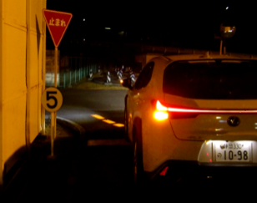
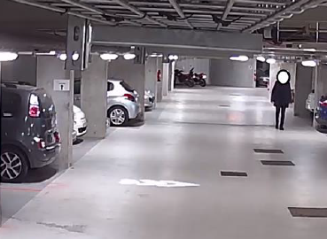
Informal document GRE-88-11
(88th GRE, 25-28 April 2023, agenda item 10 (c))
“Signal Road Projector” (SRP)
Main aspects of the proposal
88th GRE session
25-28 April 2023
- WG-SL TF-SRP -

Slide 2
Signal Road Projector (SRP)
Definition
We propose “Direction indicator projector” and ”Reversing projector”, as a new independent light-signalling function.
"Direction indicator projector” means a lamp to provide enhanced recognition of
direction indication to other road users by illumination of the ground surface.
It is operated in conjunction with Direction Indicator Lamp.
“Reversing projector” means a lamp to provide enhanced recognition of reversing
indication to other road users by illumination of the ground surface.
It is operated in conjunction with Reversing Lamp.
- WG-SL TF-SRP -

Slide 3
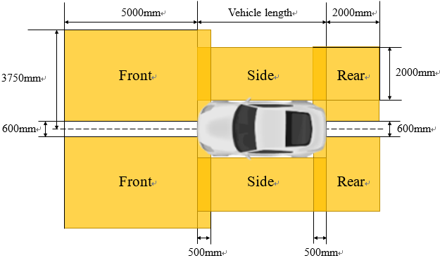
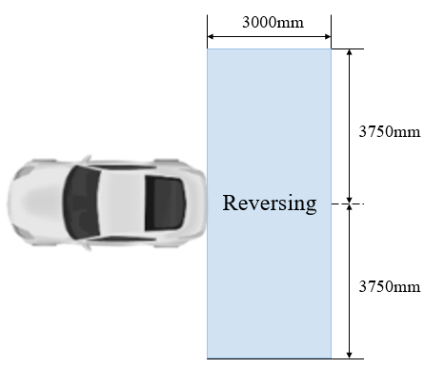
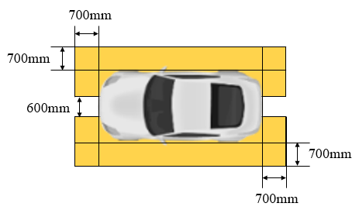
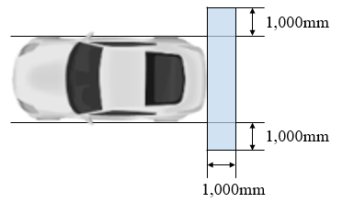
Signal Road Projector (SRP)
Main aspects – UN R48
 | Direction Indicator Projector | Reversing Projector
Presence | Optional | Optional
Number | 2 front DI projectors, 2 rear DI projectors, side DI projectors quantity depending on vehicle length | 1 or 2
Color | Amber | White
Projection area
Maximum distance between projection start and vehicle
- WG-SL TF-SRP -

Slide 4
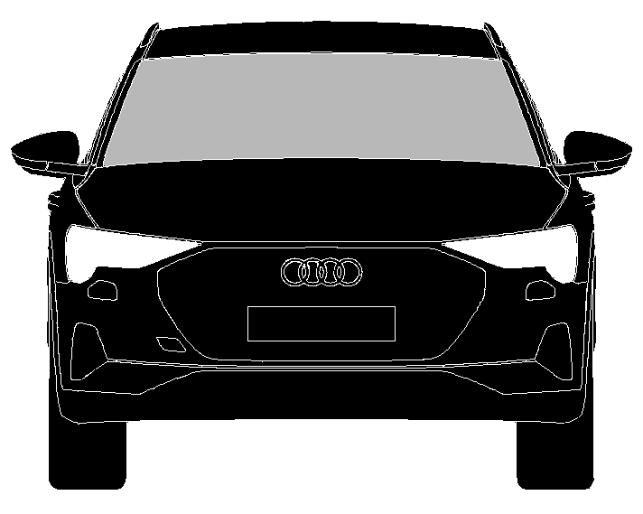
Signal Road Projector (SRP)
Main aspects – UN R48
 | Direction Indicator Projector and Reversing Projector
Examples of Elements of Projection Pattern
Non-visibility/non glare | - Apparent surface of separate projector shall not be visible in the area, as shown figure a) below. (Same requirement as Manoeuvring lamp in UNR48) - For combined projectors, the intensity is limited outside the projection area, as shown in figure b) below measured in the component approval acc. to UN148.
a)
b)
- WG-SL TF-SRP -

Slide 5
Signal Road Projector (SRP)
Main aspects – UN R48
 | Direction Indicator Projector | Reversing Projector
Operating condition | - May be operated only when DI lamp is operated. | - May be operated only when Reversing lamp is operated.
 | - Flashing is allowed. | - Flashing is allowed.
 | - Sequential activation is allowed. | - Sequential activation is not allowed.
 | - Pattern of projection is not allowed to vary. | - Pattern of projection is allowed to vary.
- WG-SL TF-SRP -

Slide 6
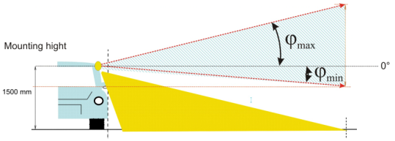
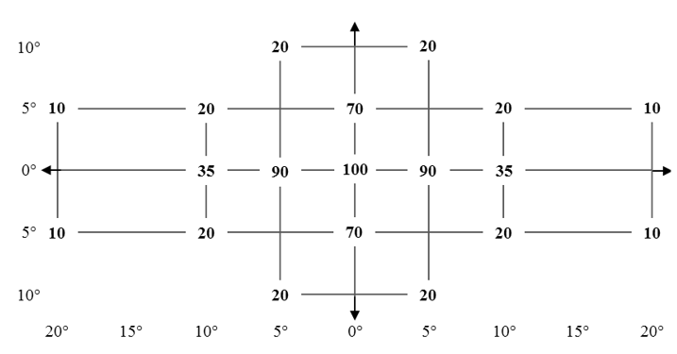
Signal Road Projector (SRP)
Main aspects – UN R148
 | Direction Indicator Projector | Reversing Projector
Photometry (1) | - 12,000 cd max within the defined projection area | - 12,000 cd max within the defined projection area
Photometry (2) | - 0.5 cd max in the area, as shown in the figure a) below. (Same requirement as Manoeuvring lamp in UNR148) However, if the distance between the apparent surface of DI projector and DI lamp respectively Reversing projector and Reversing lamp does not exceed 75 mm they may be visible, but intensity limits outside the projection area are defined by parameters of the corresponding signal lamp acc. to UN148, as shown in figure b) below as example.
a)
b)
- WG-SL TF-SRP -

Slide 7
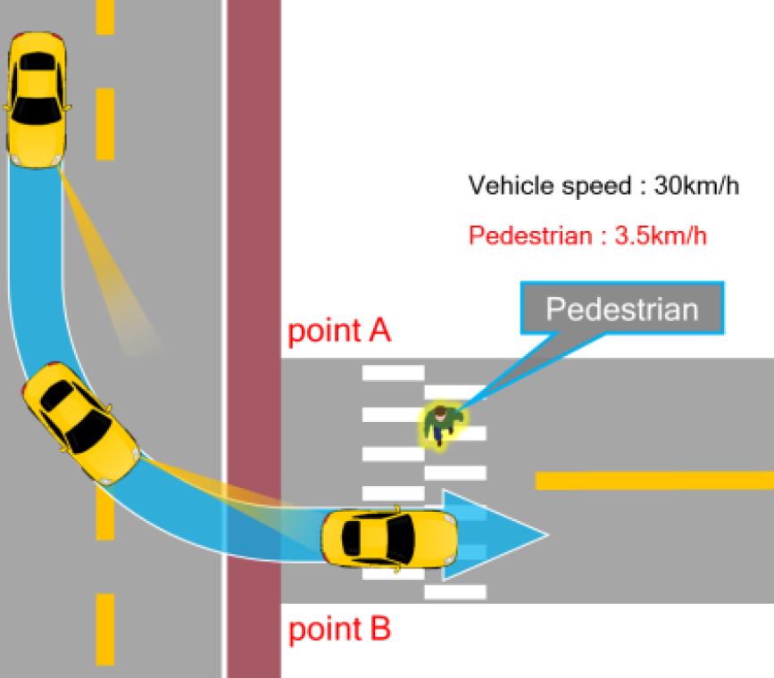
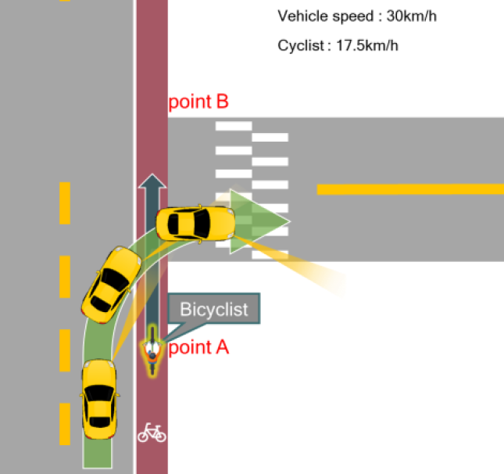
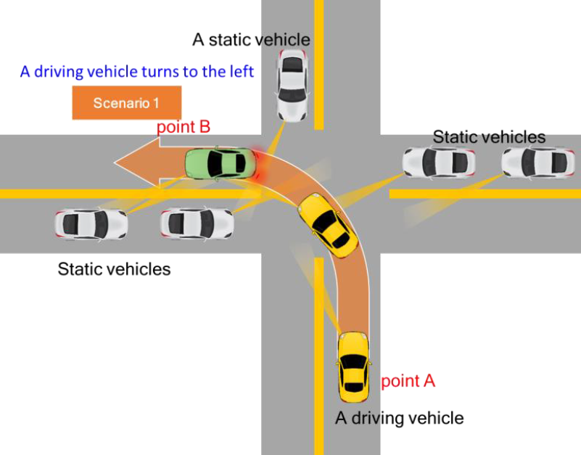
GTB Signal Road Projector (SRP) Study_1 - Overview
Research Institute : | Yeung-Nam University (South Korea)
Research Method : | VR-based study, Simulator-based study, Field study with mock-up sample
Research content: | Multiple scenarios of direction indicator projection including Driver, Cyclist and Pedestrian related tests.
Example Vehicle to pedestrian scenario
Example Vehicle to bicycle scenario
Example Vehicle to vehicle scenario
- WG-SL TF-SRP -
- WG-SL TF-SRP -

Slide 8
GTB Signal Road Projector (SRP) Study_1 – Summary of Results
Signal projection by approaching/turning vehicles provides better visibility to other road users (especially for Cyclist).
The reaction time to the behavior of other road vehicles is not compromised by signal projection (brake reaction time of following vehicles was even reduced).
Questionnaire survey shows positive response of participants to signal projection.
The study is available upon request to the GTB Secretariat (secretary@gtb-lighting.org)
- WG-SL TF-SRP -
- WG-SL TF-SRP -

Slide 9
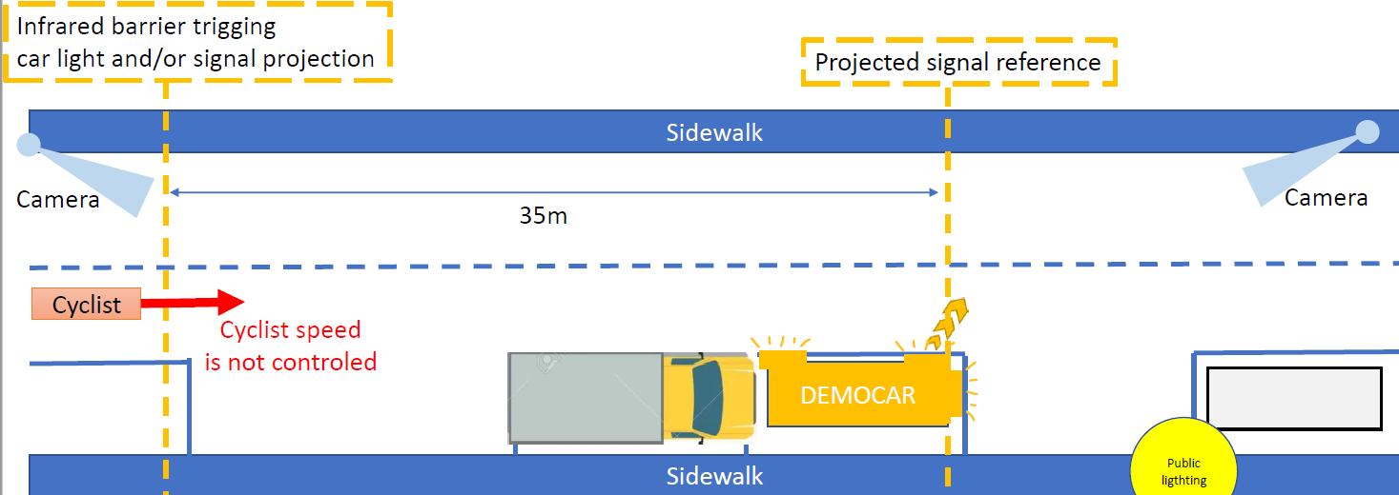
GTB Signal Road Projector (SRP) Study_2 - Overview
Research Institute : | Embedded Lighting Systems (France)
Research Method : | Field study with mock-up sample
Research content: | Cyclists exposed to a vehicle departing from a parallel parking place in a street at night time
- WG-SL TF-SRP -

Slide 10
GTB Signal Road Projector (SRP) Study_2 – Summary of Results
The projector provides information about forward situation to cyclists.
Through the information, the cyclists stopped pedaling, slowed down or moved away from the
projecting vehicle better than the situation the vehicle without the projector.
Qualitative results (questionnaire survey) shows that the majority of the cyclists stated that:
- the projected light signal is visible and is not dangerous
- the situation is fully understandable
- the projected light signal is very useful
- they would feel safer with such equipment
The study is available upon request to the GTB Secretariat (secretary@gtb-lighting.org)
- WG-SL TF-SRP -

Slide 11
Signal Road Projector (SRP)
GRE Delegates Guidance Request
Based on impressions from the live presentation we would like to ask for guidance about the view of the delegates on three topics:
1) number of simultaneously activated projections
2) limitations for the projection activation
3) activation of projection related to the vehicle direction
- WG-SL TF-SRP -

Slide 12
Signal Road Projector (SRP)
GRE Delegates Guidance Request
Limitation to the number of projections
GTB identifies that projections are voluntary and that the maximum number of projections could be aligned to the number of signal lamps, which includes an increase of the maximum number of projections for long vehicles.
The updated draft Chinese standard for light signalling devices does not limit the number of projections.
GTB seeks confirmation from GRE about the number of projections.
- WG-SL TF-SRP -

Slide 13
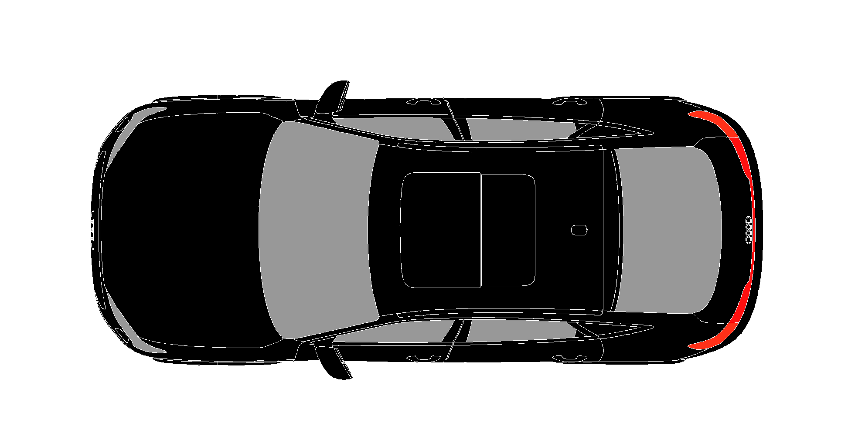
Signal Road Projector (SRP)
GRE Delegates Guidance Request
Examples of maximum number of direction indicators allowed acc. to R48:
M₁, N₁ < 9m
3 per side
M₃ > 9 m
6 per side
O₄ > 9m
4 per side
GTB request for confirmation:
The maximum number of direction indicator projections may be aligned up to the number of installed direction indicators
- WG-SL TF-SRP -

Slide 14
Signal Road Projector (SRP)
GRE Delegates Guidance Request
2) Limitations to traffic condition
The areas for the signal projection defined by GTB makes the projection suitable for urban traffic.
GTB is convinced that signal projection is beneficial in all other traffic conditions as well.
GTB does not identify any reason to introduce a restriction by speed or urban condition, even if the updated draft Chinese standard restricts the activation of the projection to a certain speed limit.
GTB seeks guidance from GRE that there is no need for restrictions on projections for any traffic conditions or speed limits.
- WG-SL TF-SRP -

Slide 15
Signal Road Projector (SRP)
GRE Delegates Guidance Request
(a)
Narrow lanes, short distances, slow speed
(b)
Wide lanes, long distances, high speed
GTB request for guidance between the following options:
Signal projection may be used in all traffic conditions: (a) & (b).
OR
II) Signal projection may only be used in specific driving conditions with similar characteristics as urban conditions and below a certain speed (a)
- WG-SL TF-SRP -

Slide 16
Signal Road Projector (SRP)
GRE Delegates Guidance Request
3) Limitations for projection activation
GTB identifies that direction indicator projections are not likely to interfere with the recognition of the vehicle direction of motion, due to the colour standardisation for lamp functions.
The updated draft Chinese standard restricts the direction of sequential activation to the direction of vehicle movement.
GTB seeks guidance from GRE whether restrictions on the sequential activation in relation to the travel direction are necessary.
- WG-SL TF-SRP -

Slide 17
Signal Road Projector (SRP)
GRE Delegates Guidance Request
(a) Sequences may be used in all directions of motion
(b) No rear sequence in forward motion
(c) No front sequence in rearward motion
Flashing projection
Sequentially activated projection
GTB request for guidance between the following options:
Sequences of direction indicator projection may be used regardless of the direction of vehicle motion: (a) & (b) & (c)
OR
II) Sequences of direction indicator projection must be aligned to the direction of vehicle motion: (b) & (c)
- WG-SL TF-SRP -

