Slide 1
Status report to the 77th session of GRBP (February 2023)
Transmitted by the chair of the TF-SL (Sound Limits)/VS (Vehicles’ Sound)
Informal Document GRBP-77-25
77th GRBP, February 07-10, 2023,
Agenda item 7
Task Force Vehicles’ Sound
(TF-VS)
NB: previous name of this TF was TF-SL for Sound Limits

Slide 2
TF Vehicles‘ Sound
Reminder
“The experts from EC, ETRTO and OICA reported on their studies on sound level limits (GRBP-73-23, GRBP-73-11 and GRBP-73-25, respectively). To coordinate such initiatives, GRBP decided to establish a taskforce (TF) and sought a volunteer among the experts from Contracting Parties to take the leadership of TF, while OICA agreed to act as secretary. GRBP considered that TF should address the sound level limits of UN Regulation No. 51 and, at a later stage, No. 41. To kick-off the TF activities without delay, the Chair pointed out that he could take the lead of TF on a temporary basis, if needed.”
Roles
Chair: France
Secretariat: OICA
TF-VS homepage
Task Force on Sound Limits (TF SL) - Transport - Vehicle Regulations - UNECE Wiki

Slide 3
TF Sound Limits / Vehicles‘ Sound: Facts and Figures
Meetings were held in hybrid or virtual depending on the pandemic situation at that time
11
~60-70
Number of Meetings
Participants (Contracting Parties, NGOs, Guests)
01st TF SL: March 24, 2021 (TFSL-01-07)
02nd TF SL: May 26, 2021 (TFSL-02-12)
03rd TF SL: July 12-13, 2021 (TFSL-03-08)
04th TF VS: September 13-14, 2021 (TFVS-04-16)
05th TF VS: October 26-27, 2021 (TFVS-05-07)
06th TF VS: December 17, 2021 (TFVS-06-04)
07th TF VS: February 07, 2022 (TFVS-07-15)
08th TF VS: April 04, 2022 (TFVS-08-10)
09th TF VS: May 24, 2022 (TFVS-09-08)
10th TF VS: July 12, 2022 (TFVS-10-08 in progress)
11th TF VS: September 09, 2022 (TFVS-11-09)
CPs: China, European Commission, France, Germany, India, Italy, Japan, Spain, Switzerland, The Netherlands, United Kingdom
NGO‘s: CLEPA, ETRTO, EUWA, IMMA, ISO, OICA
GUESTS: Aristotle University, ATEEL, BRUITPARIF, FEDRO, FEV, HS Data analysis & Consultancy, IDIADA, JARI, TNO, Brussels Env., …

Slide 4
TF VS – in addition to the discussions to be continued, main works done & ongoing
Guidelines of this Task Force:
From 1st discussions at the 01st Session, a subgroup was decided to build a proposal
The proposal has been approved at the 03rd Session & updated at the 04th session
Change of the name of this TF from TF-SL (Sound limit) to TF-VS (Vehicle Sound)
Informal document
GRBP-74-03 Rev.1
Need to identify where the noise issues lie e.g. through a cross-matrix to get a reference scenario as close as possible of real life
Agreement of the TF group for a subgroup for Cross-matrix of this TF accordingly
Volunteers:
CPs: EC, France, Germany, The Netherlands, UK, Japan, China
NGO: IMMA, OICA, ETRTO, ISO
On going
TFVS-02-07
TFVS-04-14
TFVS-05-06
TFVS-07-08
TFVS-06-03
TFVS-06-05
TFVS-07-05
TFVS-07-13
TFVS-08-06
TFVS-09-06
Impact of AVAS (UN-R138) on Noise Emissions (UN-R51) at low speeds
Thoughts from some Noise experts related to UN-R138 & UN-R51 matching
Actions to be defined through the documents related to the UN-R138
→ To be followed with the new TF-QRTV (UN-R138-02)
On going with the UN TF-QRTV
TFVS-04-12
TF-QRTV (UN-R138-02)

Slide 5
TF VS – in addition to the discussions to be continued, main works done & ongoing
EC study on sound level limits of M, N, L-cat. Veh. → Analysis & comparison between the different studies :
A lot of different points have been discussed and highlighted (for details see UNECE TF-VS Website) → work to be continued
EC Report for M/N
EC Report for L
ATEEL(OICA) Report (GRBP-75-16)
GRBP-76-14 ATEEL/OICA Comparison
TFVS-11-06 ETRTO comments
→ Possible to upload on the UNECE Website the GRBP-76-14 as « Doc. for Ref. only » ?
On going
A lot of material about vehicles, tyres, roads, methods, enforcement … presented during the 11 sessions of the TF-VS (see UNECE TF-VS Website) with a potential to improve the noise in real life
Agreement of the TF group for a subgroup to prepare a Report to give an overview and a common view of what is the situation
Volunteers: CPs with France, The Netherlands, Japan, and NGO with IMMA, OICA, ETRTO, ISO
TFVS-11-09 (report TFVS 11th)

Slide 6
TF VS – in addition to the discussions to be continued, main works done & ongoing
Topics still open for the next Sessions:
Update of national presentations (EC, Japan, UK, China, Germany, Belgium …) and others (OICA, IMMA, ETRTO …)
Cross-matrix
Report from the 11 TF-VS Sessions
Next steps to be decided
Possible to upload the GRBP-76-14 as « Doc. for ref. only » ?
…
To be continued
On going
The next 12th Session should be scheduled in March/April 2023

Slide 7
Work progress of the sub-group
REPORT OF THE 11 TF-VS SESSIONS

Slide 8
TF Sound Limits / Vehicles‘ Sound: Facts and Figures
Other Meetings
SUBGROUP on
the report of the 11 sessions
Volunteers
(Contracting Parties, NGOs, Guests)
01st Subgroup: October 21, 2022
02nd Subgroup: November 04, 2022
03rd Subgroup: November 29, 2022
04th Subgroup: December 14, 2022
05th Subgroup: January 16, 2023
06th Subgroup: January 26, 2023
07th Subgroup: February 15, 2023
08th Subgroup: March 02, 2023
09th Subgroup: March 10, 2023 (tbc)
CPs: France, Japan, The Netherlands
NGO‘s: ETRTO, IMMA, OICA

Slide 9
GENERAL GUIDELINES OF THE SUB-GROUP
Target: full report ready by April 2023 to be ready for next TF-VS Session
“Rules”:
Need to remain factual, objective & neutral + take care for having the same ‘level’ of information in each document:
cross-reading of the different documents between the members of our subgroup, and then
getting feedback from the authors of the various TFVS presentations
A full overview of the works/report will have to be summarized in a ‘UN-format’

Slide 10
STRUCTURE OF THE REPORT & APPROACH
DONE
54 Documents/presentations
PART 4.
Grouping by subject/theme & distribution of the work between subgroup’s experts
General introduction
Executive summary
Analysis to identify the general findings/ statements for further consideration
Identification of the
Main messages,
Summary &
Open issues
of the 54 documents/ presentations
25 subjects/themes → 25 Individual sheets
ONGOING
Feedback from the authors to be get
Identification of the key domains & Classification
DONE
31 Key domains identified
Grouping by subject/theme & work split between the subgroup experts
PART 3.
5 main key domains identified & defined
Analysis distributed by pair between the subgroup experts
ONGOING
Identification of the general findings & open issues
PART 2.
Executive Summary
PART 1.
General introduction

Slide 11
PART. 4
SHORT SUMMARY OF
PRESENTATIONS DONE UP TO THE 11TH SESSION OF THE UN TF-VS

Slide 12
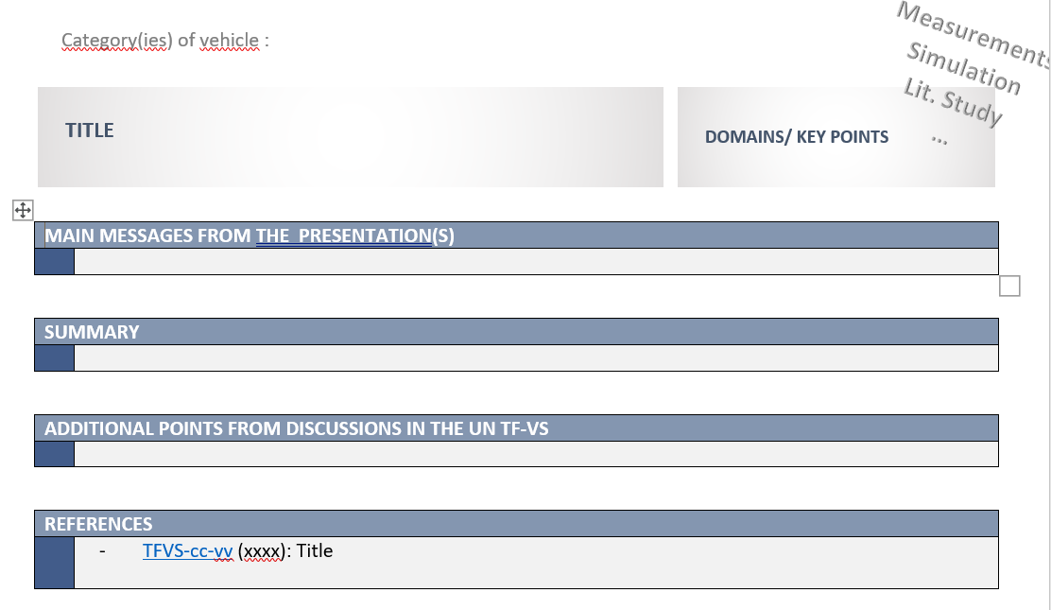
IMPLEMENTATION PROPOSAL
Start with last PART 4. Identification of the Main messages, Summary & Open issues”
Concept = 1 double-sided page per ‘individual sheet’
Ongoing: After feedback from the authors, to be published progressively on the UN website TF-VS
‘Additional points from discussions in the UN TF-VS’ are coming from the TF-VS minutes as approved

Slide 13
Grouping of the topics/themes → FOR SHARING THE WORK
TFVS-11-07 Rev.2 - Table of the 54 documents/presentations
One color per subgroup’s expert
GENERAL IDEAS:
TFSL-01-05 Rev.1 (Germany)
TFSL-01-06 & TFSL-02-09 (Japan)
GENERAL CONSIDERATIONS:
TFVS-02-10 Rev.2 (OICA)
TFVS-04-12 R51 vs. R138 (OICA)
TFVS-04-11 Rev.1 (ETRTO)
EC/EMISIA Study
(GRBP-73-23), TFSL-02-08, TFVS-07-11, TFVS-09-03 Rev.1
TFVS-10-06 (Japan) & TFVS-11-03 (Emisia)
ROAD SURFACE Studies:
TFVS-04-04 & TFVS-04-09 (FEDRO)
TFVS-11-04 (STEER)
GENERAL Studies:
TFSL-03-04 (TNO) & TFSL-05-03 (EC DG/ENV.) (PHENOMENA)
TFVS-08-08 Rev.1 (LEON-T)
Other Studies linked to Emisia:
TFSL-03-06 (Japan – Ph.3) & TFVS-08-04 Rev.1 (Japan)
TFVS-04-10; TFVS-07-03 & TFVS-07-04 (OICA/ACEA/ATEEL)
TFVS-10-04 Rev.1 & TFVS-11-05 (Comparison Emisia vs. ATEEL)
TFVS-11-06 (ETRTO)
TFVS-10-07 (Japan/N2)
TEST METHOD: TFSL-05-05 (ISO)
NOISE MAPPING & SONAR:
TFSL-03-05 Rev.1 (Bruitparif)
TFSL-04-08 (Japan)
TFSL-04-06 & TFVS-08-03 (UK)
TFSL-05-04 (SIA)
TFVS-07-07 Rev.1 (France)
TFVS-08-05; TFVS-09-05 & TFVS-09-07 (Brussels Env.)
EC/IDIADA Study (L-cat.)
TFVS-04-15, TFVS-09-03 Rev.1, TFVS-09-04, TFVS-10-03, TFVS-11-08
IMMA Study/ Analysis:
TFSL-03-06, TFVS-07-09 Rev.1, TFVS-07-10, TFVS-07-12, TFVS-08-07, TFVS-08-09
CAMPAING: GRBP-76-27 (Germany)
CROSS-MATRIX:
TFVS-05-06, TFVS-06-03 (Japan), TFVS-06-05, TFVS-07-05, TFVS-07-08, TFVS-07-13

Slide 14
WORK PROGRESS MONITORING for PART 4.
→ 25 Individual Sheets
All finalized
Cross-reading done
Ongoing: Feedback by the authors
→ target mid/end-Feb.

Slide 15
PART. 3
IDENTIFICATION OF THE KEY POINTS/DOMAINS
GENERAL FINDINGS & OPENED ISSUES

Slide 16
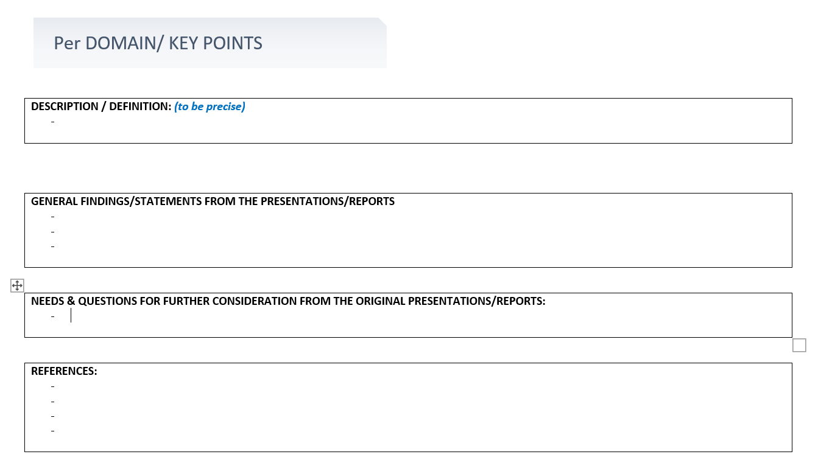
IMPLEMENTATION PROPOSAL
Then continue with PART 3. Analysis to identify the general findings/ statements for further consideration”
5 main domains fixed: definition/description done
Ongoing: Per domain identify the general findings/statements & further consideration

Slide 17
Identification & Definition of the main key-domains
Then continue with PART 3. Analysis to identify the general findings/ statements for further consideration”
5 main domains fixed: definition/description done
Ongoing: Per domain identify the general findings/statements & further consideration

Slide 18
PART. 2 & 1
EXECUTIVE SUMMARY & GENERAL INTRODUCTION

Slide 19
IMPLEMENTATION PROPOSAL
PART.2 Executive summary
PART.1 General Introduction
General idea
TO BE CONTINUED
General idea
TO BE CONTINUED

Slide 20
NEXT STEPS - TIMELINE

Slide 21
NEXT STEPS – TIMELINE 2022-2023
 | OCTOBER |  | NOVEMBER |  |  |  |  | DECEMBER |  |  |  | JANUARY |  |  |  |  | FEBRUARY |  |  |  | MARCH/ APRIL
 | W.42 | W.43 | W.44 | W.45 | W.46 | W.47 | W.48 | W.49 | W.50 | W.51 | W.52 | W.01 | W.02 | W.03 | W.04 | W.05 | W.06 | W.07 | W.08 | W.09 | W.10+
INITIALISATION | X
PART.4 ‘Ind. Sheet’ Int. POINT |  |  | X 04th |  |  |  | X 29th
Cross-reading |  |  |  |  |  |  |  |  | X 15th |  |  |  | X 10th | X 16th | X 26th
Feedback from authors |  |  |  |  |  |  |  |  |  |  |  |  |  |  | X 25th | X 03rd |  | X 17th | X 24th
Cross-reading |  |  |  |  |  |  |  |  | X 15th |  |  |  | X 10th |  | X 26th
DOMAINS/ KEY PTS. Def./Identif. |  |  | X Start disc. |  |  |  | X |  | X |  |  |  | X 11th | X 16th | X 26th
PART.3 ‘Key points' |  |  |  |  |  |  |  |  |  |  |  |  |  |  | X 26th |  |  | X 15th |  | X 02nd | X
PART.2 (Ex.Sum.) |  |  |  |  |  |  |  |  |  |  |  |  |  |  |  |  |  | X 15th |  |  | X
PART.1 (Gal.Int.) |  |  |  |  |  |  |  |  |  |  |  |  |  |  |  |  |  |  |  |  | X
CLEAN VERSION |  |  |  |  |  |  |  |  |  |  |  |  |  |  |  |  |  |  |  | X 01st | X
PPT FOR TFVS-12 |  |  |  |  |  |  |  |  |  |  |  |  |  |  |  |  |  |  |  | X 01st | X
PUBLICATION |  |  |  |  |  |  |  |  |  |  |  |  |  |  |  |  |  |  |  |  | X

Slide 22
Agreement of GRBP to upload the document GRBP-76-14 as ‘Document for Reference only’?
We hope the subgroup’s approach can be supported by GRBP
Feel free for any comments / suggestions
Feel free for contacting our subgroup to get any additional information and/or contribute to the work of our subgroup
Thank you!

Slide 23
Back up documents

Slide 24
TF Sound Limits / Vehicles‘ Sound: Facts and Figures
~15-20
Other Meetings
SUBGROUP on Cross-matrix
Volunteers (Contracting Parties, NGOs, Guests)
01st Subgroup: October 26, 2021
06th TF VS: December 17, 2021 (TFVS-06-04)
02nd Subgroup: January 19, 2022 (UNECE Website)
03rd Subgroup: February 03, 2022 (UNECE Website)
04th Subgroup: March 31, 2022 (UNECE Website)
05th Subgroup: April 22, 2022 (UNECE website)
CPs: China, European Commission, France, Germany, Japan, The Netherlands, United Kingdom
NGO‘s: ETRTO, IMMA, ISO, OICA

Slide 25
TF Sound Limits / Vehicles‘ Sound: Presentations
Table of Presentations done during the 10 Sessions → TFVS-11-07 (classification per item still under review)
Tyre
Interaction
Tyre/Road
Road
A lot of interdependency between the different parameters
→ Need for a
holistic approach
→ Study(ies) & evidence associated to a technical report needed before any new decisions
Environment
Env./Safety
balance
Prediction model
Vehicle
Test method
Sound limits
…….
Traffic flow
Identification noise pb
Driving
behaviour
Speed
Single event
Identification
Sound sources
Test method
Sound radar
Manipulation
Exhaust system
After-martket

