Slide 1
GSIM-variables
Modernisation Comittee on Strandards

Slide 2
Background
The Generic Statistical Information Model (GSIM) Concepts most established and elaborated
Other models can be implemented in different ways
May happen to GSIM unless there is a common understanding on how to interpret and use the model
Risk for use in CSPA
Notes:
The Generic Statistical Information Model (GSIM) contains a number of groups. Of these, the Concepts Group is the most established and elaborated. The main reason for this is because the Concepts Group is the area influenced by traditional statistical metadata development in statistical organizations.
These organizations have developed a lot of experience over the years, and several organizations are now using GSIM in development projects. Earlier experiences with models such as ISO 11179 show that the implementation of standards can be quite different due to differences in their interpretation.
There is a risk that the same thing will happen to GSIM unless there is a common understanding on how to interpret and use the model.
Discussions regarding GSIM variables and related concepts (concept systems, concept, variable, represented variable and instance variable) are showing that they can all be interpreted in different ways in different GSIM implementations: If this continues, the potential gain from CSPA and other projects on tools and methods will suffer. The issues may be solved in different ways in the varying uses as a result.
The Generic Statistical Information Model (GSIM) contains a number of groups. Of these, the Concepts Group is the most established and elaborated. The main reason for this is because the Concepts Group is the area influenced by traditional statistical metadata development in statistical organizations.
These organizations have developed a lot of experience over the years, and several organizations are now using GSIM in development projects. Earlier experiences with models such as ISO 11179 show that the implementation of standards can be quite different due to differences in their interpretation.
There is a risk that the same thing will happen to GSIM unless there is a common understanding on how to interpret and use the model.
Discussions regarding GSIM variables and related concepts (concept systems, concept, variable, represented variable and instance variable) are showing that they can all be interpreted in different ways in different GSIM implementations: If this continues, the potential gain from CSPA and other projects on tools and methods will suffer. The issues may be solved in different ways in the varying uses as a result.

Slide 3
What is a variable?

Slide 4
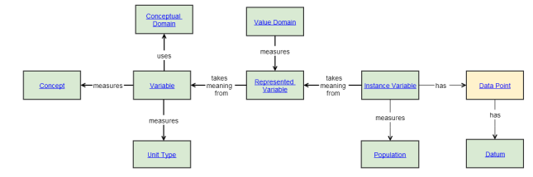
Definitions
The use of a Concept as a characteristic of a Population intended to be measured
A combination of a characteristic of a population to be measured and how that measure will be represented.
The use of a Represented Variable within a Data Set. It may include information about the source of the data.
Unit of thought differentiated by characteristics

Slide 5
Example
Variable | Represented variable | Instance variable
Sex of person | Gender m, male - f, female | Gender: Dan Gillman has gender <m, male>, Arofan Gregory has gender<m, male>, etc.

Slide 6
How do we handle…
Sex of Mother - Concept, variable, represented variable? Combination of unit type and variable?
Micro – macro (link to GSBPM)

Slide 7
From a CPSA perspective

Slide 8
…if each statistical organisation works by themselves…..

Slide 9
…we get this….
Collect
Process
Analyse
Disseminate
Canada
Sweden

Slide 10
This makes it hard to share and reuse!
Collect
Process
Analyse
Disseminate
Canada
?
Sweden
?

Slide 11
…but if statistical organisations work together?
Notes:
HLG sponsor project: Desired Project Outcomes
Increased:
interoperability in Official Statistics through the sharing of processes and components
ability to find real/genuine collaboration opportunities
ability to make international decisions and investments
sharing of architectural/design
knowledge and practices

Slide 12
This makes it easier to share and reuse!
Collect
Process
Analyse
Disseminate
Canada
?
Sweden
?

Slide 13
Project objectives
Create a GSIM annex on GSIM-Variables
Help of how to interpret and implement GSIM-Concepts, how to link across the GSBPM
Reduce the risk of high costs and comprehensive hands on work in order to implement CSPA components developed by other organizations due to different interpretations of GSIM-Concepts
Map the GSIM Concepts with DDI and SDMX

Slide 14
Work Packages
1: GSIM-Variables annex
2: Best practices in managing variables in a statistical system
3: Enhancing Interoperability

Slide 15
Summary
helping to underpin interoperability of CSPA components
increasing understanding for users
mapping to DDI and SDMX
Sharing…
Notes:
Variables and their roles within GSIM-Concepts, based on experiences from GSIM-implementations
Variable’s roles in a statistical process, GSIM and GSBPM
Concept systems and Concept management in GSIM
Mapping to DDI or SDMX is an important deliverable of this work

