Slide 1
Integrated view of modernisation models Project proposal
Marina Signore
on behalf of the Supporting Standards Group

Slide 2
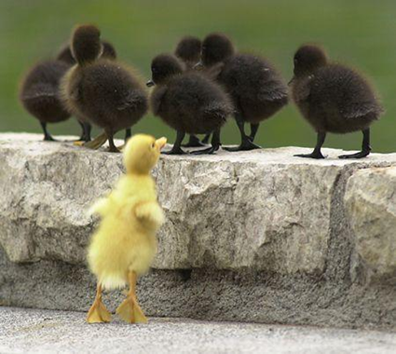
Integrated view of modernisation models
The business case was prepared by Supporting Standards Group and is submitted to the HLG-MOS for their approval

Slide 3
Purpose
The purpose of this project is to provide countries with:
Better communication on what is available, purposes and uses
Better understanding of the relationships among the different frameworks and models for a more effective implementation of them
Better documentation and guidance for the coordinated implementation of the various standards

Slide 4
State of the art
The modernstats models
A number of models, namely GSBPM, GSIM, GAMSO and CSPA have been developed and are currently maintained with the endorsement of the HLG-MOS.
In 2016, a Modernisation Maturity Model and the Roadmap for Implementing Modernstats Standards were released

Slide 5
Some Issues (1)
Communication and implementation
The level of knowledge and implementation of the models varies in different countries
In the same NSI, the level of knowledge of the models varies across different areas
Some recent models or developments are not yet well known (e.g. Roadmap, Maturity Model, QIs for GSBPM)

Slide 6
Some Issues (2)
Support for a coordinated implementation
Countries have difficulties in understanding the inter-relationships and the dependency of the different models
Countries ask for guidance in implementing the models (where to start from, what comes first,…)
Modernisation Maturity Model and the Roadmap help countries to implement GAMSO, GSBPM, GSIM and CSPA on an individual basis
Need for an integrated view of the models

Slide 7
Description of the activity (1)
Activity 1: Relationships between GAMSO, GSBPM, GSIM and CSPA
Investigation of countries needs and experiences to understand the relationships among the models
Countries which implemented more than one model
Preliminary findings presented at ModernStats World Workshop in April 2018
Presentations and discussions at the Workshop will provide further inputs.

Slide 8
Description of the activity (2)
Activity 2: Communication materials
Communication materials will be produced as a result of activity 1
Target different audiences for different maturity levels
Support better understanding of each standard by making the relationships to other ones more explicit
Support better understanding why, how and expected benefits deriving from implementing the models

Slide 9
Description of the activity (3)
Activity 3: Update of the Modernisation Maturity Model and the Roadmap
As a result of activity 1, the MMM and the Roadmap will be updated
Better reflect the interdependences among the various models

Slide 10
Alternative considered (1)
No action – this is not a viable response
Not supporting the models implementation
Lower visibility of the available models and their potential benefits
Not responding to countries needs to better understanding the relationships among the models
Missing opportunity to increase efficiency
Increased risk of discouraging people to implement the models because of lack of understanding of the whole picture

Slide 11
Alternative considered (2)
The alternative is to set up a virtual task team under the Supporting Standards Modernisation Group.
With fewer resources, the team would try to achieve the same outcomes.
However, there would be less communication materials produced and the team would need a longer timeframe.

Slide 12
Time frame and costs
Time-frame
Start: December, 2017
End: October, 2018
Expected costs
A project team composed by people from the Supporting Standards and the Sharing Tools Groups
A project manager for 3 person months
Travel for a sprint of 10 -15 participants in the margins of the ModernStats World Workshop in April 2018.

