Slide 1
HLG method of work
Projects, Modernisation Groups and Innovative processes

Slide 2
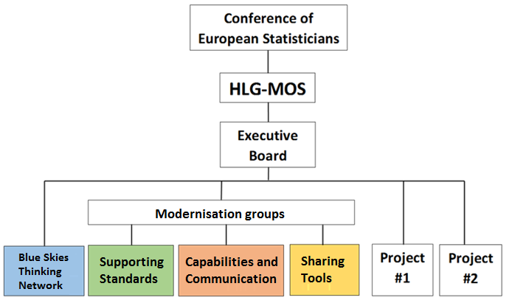
High-Level Group for the Modernisation of Official Statistics - structure
Workshops:
Dissemination and Communication
Data Collection
Data Editing
Data Confidentiality

Slide 3
Modernisation groups and Task Teams
Main work is progressed by Modernisation Groups (MG) through their monthly Webexes and offline work
Task teams can be set up as needed for focused work
Participation in MGs is open to all, with the expectation of active participation
Monthly reports to Executive Board (EB)

Slide 4
Modernisation groups and Task Teams - process
Set up work
Once work is agreed, there is a call for participation and work begins
Works progresses through the year
MGs plan and set priorities for next year
Presented at Workshop, approved by EB
Project proposals
Report progress at Workshop each year
Finalize work
Jan
Dec
Feb
Nov
March
Oct
April
Plan for next year
Sept
Execute work
May
Aug
June
July

Slide 5
Blue Skies Thinking Network – the idea factory
Idea
Possible outcomes of the investigation:
Project done
Possible to complete project in short timeframe with little resources
No
Maybe
Yes
Project proposal
Idea
Idea
Aligned to strategic framework?
Interest in countries?
Yes
Set up small team with short timeframe to investigate

Slide 6
Blue Skies Thinking Network – issues
Idea
Idea
Where do the ideas come from?
Idea
Experts from NSOs
UNECE Workshops, suggestions for future work
Chief statisticians’ priorities
…?

Slide 7
HLG Projects
PM sets up project plan
Deliver final output
Project teams set up
Projects on high priority topics proposed by Blue Skies Network and MGs
1-2 projects/yr., run time 1 yr.
Project manger to ensure delivery
Participation open, but active
Face-to-face sprints and virtual work
Report to EB monthly
Jan
Dec
Feb
Report on final output
Nov
March
Oct
April
Evaluate need for further work
Sept
Execute work
May
F2F meeting?
F2F meeting?
Aug
June
July
Draft output for comments

Slide 8
Main points
MGs to plan and set clear priorities for work
EB oversees work
Task teams set up as needed
Open participation in MGs and projects, members are expected to actively contribute to work
Projects proposals from the MGs and the Blue Skies Thinking Network
Challenges
How to increase idea creation?
How to keep HLG work relevant to needs of organizations?

