Slide 1
Supporting Standards Group Activities and Challenges
Marina Signore and Eva Holm
on behalf of the Supporting Standards Group

Slide 2
The Supporting Standards Group
The goal of the group is to find ways how to develop, enhance, integrate, promote, support and facilitate implementation of the range of standards needed for statistical modernisation.
Operational responsibility for the maintenance and development of:
GAMSO - Generic Activity Model for Statistical Organizations
GSBPM - Generic Statistical Business Process Model
GSIM - Generic Statistical Information Model
Documentation of
CSPA - Common Statistical Production Architecture

Slide 3
The Members
Member | Country | Organisation
Marina Signore - Chair | Italy | ISTAT
Al Hamilton | Australia | Australian Bureau of Statistics
Alice Born | Canada | Statistics Canada
Guillaume Duffes | France | INSEE
John Dunne | Ireland | CSO
Mauro Scanu | Italy | ISTAT
Francesco Bosio | Italy | ISTAT
Juan Muñoz | Mexico | INEGI
Manuel Cuellar | Mexico | INEGI
Becky Collett | New Zealand | Statistics New Zealand
Janusz Dygaszewicz | Poland | Statistics Poland
Anna Dlugosz | Poland | Statistics Poland
Klas Blomqvist | Sweden | Swedish Research Council
Nilgün Dorsan | Turkey | Turkstat
Dan Gillman | United States | Bureau of Labor Statistics
Márta Nagy-Rothengass |  | Eurostat
Dana Müller |  | German Federal Employment Agency (DDI)
Joachim Wackerow |  | GESIS (DDI)
Edgardo Greising |  | ILO
David Barraclough |  | OECD

Slide 4
Workshop on Integrating Geospatial and Statistical Standards
6 - 8 November
Stockholm
Activities in 2017
GSIM Revision
GSBPM Revision
Metadata Glossary
Workshop on Integrating Geospatial and Statistical Standards
6 - 8 November 2017
Stockholm
Quality Indicators

Slide 5
The revision process for GSIM and GSBPM
Why?
GSBPM v5.0 and GSIM v1.1 were released in 2013
Need to take into account the changes in the statistical production environment
Take advantage from countries implementing the standards
Ensure greater alignment with new developments (e.g. GAMSO)

Slide 6
The revision process for GSIM and GSBPM
How?
Two dedicated task teams (first joint meeting last April)
Discussion forum
Inputs from other Supporting Standards Task Teams
Take advantage from countries implementing the standards
Survey to collect users feedbacks (September 2017)
Ensure that there is a strong business case if major changes are made.

Slide 7
GSIM revision
Specific features
The Review Team went over the list of compiled comments
The Team agreed that it is not possible to develop one GSIM that could address needs of every user with different backgrounds, hence the current cycle of revision should try to provide clearer definition and examples so that different users would know how to apply the model for different needs.
The Team acknowledged that GSIM is already being used in several organizations hence agreed that there should be a strong business case if major change is going to be made

Slide 8
GSIM revision
Review input
Over 70 improvement proposals
The proposals
cover all GSIM Groups – Base, Business, Exchange, Structure and Concept
concerns all from small details to adding information objects

Slide 9
GSIM revision
Specific features
Work done on Logical Information Model (LIM) to date should be included in the new GSIM release
LIM-variables will be included
LIM will remain as a development stream between GSIM revisions.
Recommendations to fix inconsistencies
Requests to add more detail based on implementation experience (e.g. in the Business part)
Improvements in how to explain GSIM
Making sure GSIM meets new ways of producing statistics
Better explanations on relationship to other models.

Slide 10
GSBPM revision
Specific features
The Review Team identified general and specific issues and is analysing users feedback
General issues concern the alignment with GAMSO, particularly for the GSBPM overarching layers (Quality and Metadata management)
How to reflect processes related to non-survey data sources in GSBPM

Slide 11
GSBPM revision
Specific features
Requests to share adaptations of GSBPM (e.g. national accounts)
Improvements in how to explain GSBPM
Better explanations on relationship to other models.

Slide 12
Metadata Glossary
Purposes
Develop a general glossary of metadata covering the modernisation terminology and standards
Develop a glossary for those modernisation standards which did not have one yet
Combine existing glossaries (GSIM, CSPA ...)
Achieve synergies with existing glossaries (e.g. SDMX)

Slide 13
Metadata Glossary
Main activities
A glossary for GAMSO terms was developed last year
A glossary for the GSBPM is to be completed by 2017 covering GSBPM phases and sub-processes
Definitions and explanatory text
Supporting the GSBPM revision by proposing improvements to text

Slide 14
Quality Indicators for the GSBPM
Results
Quality Indicators for the Generic Statistical Business Process Model were developed for Statistics derived from Surveys (v1.0 released May 2016)
The work has been completed by adding quality indicators for administrative data sources
Quality Indicators for the Generic Statistical Business Process Model (GSBPM) - For Statistics derived from Surveys and Administrative Data Sources (Version 2.0, November 2017)
Support from the Communication Task Team in order to reach out relevant targets of potential users

Slide 15
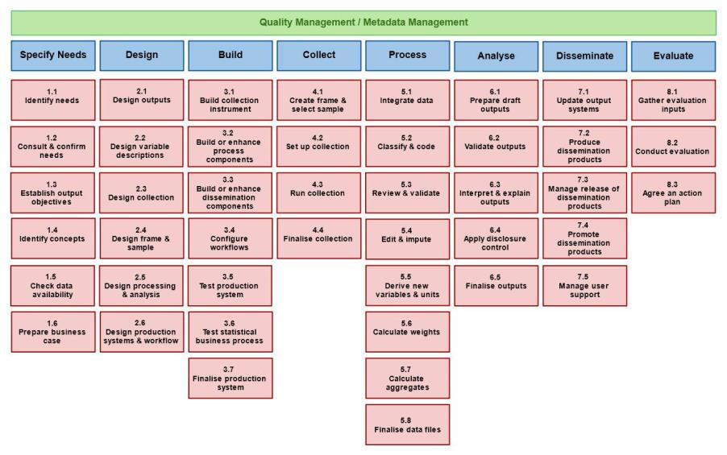
Quality Indicators for the GSBPM
Quality and metadata management overarching process
Quality indicators were developed for each phase (1 to 8) and all sub-processes

Slide 16
Structure and characteristics of the QIs
Quality Dimension | Indicator | Notes
………. | …………….. | ………………….
- Generic indicators to reflect the nature of GSBPM
- Quantitative indicators whenever possible
- Quality Indicators were harmonised with other international quality frameworks
- The UN NQAF dimensions were taken as reference for relating QIs to the corresponding quality dimension but mapping to the ES CoP was indicated only in case of discrepancies

Slide 17
Quality Indicators for the GSBPM
Main uses
Complementing GSBPM with Quality Indicators supports a process-oriented approach in the organisations and in quality management
Can be tailored by Statistical Organisations according to their needs
Avoid duplication of work in different sectors within the organisation
Can be used to map/fill in gaps with QIs already in use in a Statistical Organisation

Slide 18
Future activities and challenges (1)
GSBPM and GSIM revision
Business cases prepared by the Supporting Standards Group and submitted to the HLG-MOS for their approval
Proposed dates:
Start: November, 2017
End: September, 2018

Slide 19
Future activities and challenges (2)
Metadata Glossary
Business cases prepared by the Metadata Glossary Task Team and submitted to the HLG-MOS for their approval
GSBPM completed by December 2017
GSIM by July, 2018
CSPA by December, 2018
Proposed dates:
Start: December, 2017
End: December, 2018

Slide 20
Future activities and challenges (3)
Integrated view of modernisation standards
Support to the implementation of the modernisation standards by taking advantage of their interrelationships
Provide answers to recurring questions (e.g. relationship between different standards, How to implement them together, which standard comes first)
Connect to the Maturity Model and the Roadmap so to enhance their usefulness
Proposal submitted for discussion tomorrow.

Slide 21
Future activities and challenges (4)
ModernStats World Workshop 2018
11-13 April 2018
Purposes: facilitate the sharing of the ideas and plans for modernising statistical production by implementing the standards; increase the understanding of standards and their interrelations
Steering Committee of the ModernStats World Workshop
15 people from Supporting Standards and the Sharing Tools Modernisation Groups
First meeting 10 November 2017

Slide 22
Future activities and challenges (5)
Promoting standards
Encourage the greater visibility and use of standards within statistical organisations
Advertise the release of new products (e.g. Quality Indicators for the GSBPM)
Getting support from the Communication Task Team
Maintain cooperation with international organisations (Eurostat, OECD, ILO,…) to ensure the maximum of convergence

