Slide 1
Strategic Framework and New Governance Structure
Bert Kroese and Trevor Sutton Co-chairs of the HLG-MOS Executive Board

Slide 2
Rationale
HLG-MOS activities are:
Agile
Demand-driven
Mostly bottom-up
But – this can lead to a wide portfolio and a lack of focus

Slide 3
A Virtual Sprint
Executive Board members
Facilitator provided by ABS
3 days of Webex and wiki work
2-hour plenary Webex each day
Aim – Develop a Strategic Planning Framework and associated governance structure

Slide 4
Strategic Planning Framework
The framework within which all new activities should be formulated
Only pursue activities that fit the framework
Challenge:
Innovation
Focus

Slide 5
4 Key Priorities
Take cost out of our organisations to reinvest in more value added areas such as analysis and data integration
Explore new areas collectively and leverage each other’s research investments in specific areas
Provide whole of government data ecosystems based on international standards, for better estimates in key policy areas
Renew our governance and operating processes

Slide 6
Putting this into Practice
New templates:
Project proposals
Activity proposals
New process:
Review of drafts by Executive Board before November workshop
New governance structure

Slide 7
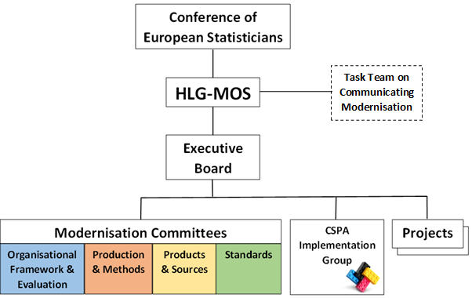
Current

Slide 8
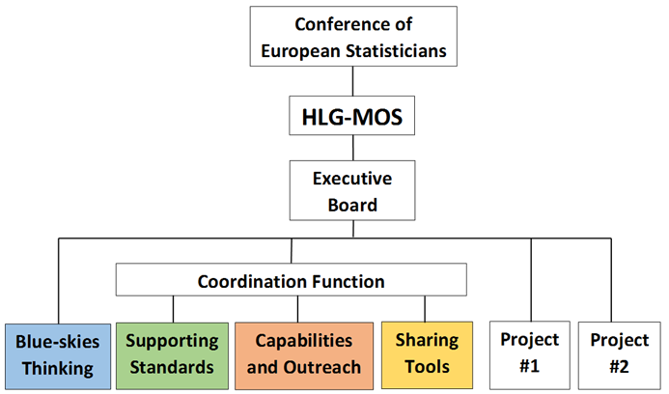
2017-

Slide 9
Blue-skies Thinking Network
“Ideas factory" for HLG-MOS activities
Creative and agile structure to identify and evaluate new opportunities for official statistics
Flexible pool of researchers, who will consider new ideas in brief evaluation projects (max. 6 months)
Any topic that is in line with the Strategic Framework and is supported by at least 3 statistical organisations
Outcomes assessed by the Executive Board
May lead to future activities

Slide 10
Supporting Standards Group
Maintaining and developing GAMSO, GSBPM and GSIM, and the documentation of CSPA.
Supporting implementers of HLG-MOS standards and models:
Developing and publishing complementary materials such as case studies, good practices, etc.
Organising workshops and training
Managing reviews of the standards and models
Following developments in geospatial standards where relevant for modernising official statistics

Slide 11
Capabilities and Outreach Group
Identifying barriers to effective international collaboration, and how to overcome them
Reviewing governance models for efficient sharing of common tools, and promoting best practices
Communicating modernisation activities
Promoting the use of the Modernisation Maturity Models and Roadmap
Other human resources elements of modernisation, e.g. skills development and change / risk management

Slide 12
Sharing Tools Group
Supporting CSPA implementation projects in NSOs
Updating the CSPA Services, Investment and Capabilities layers of the CSPA Catalogue
Identifying opportunities for collaborative design and/or development of CSPA services
Assessing services for CSPA compliance
Further developing the CSPA Logical Information Model

Slide 13
New structure
Leaner and more focused:
4 expert groups instead of 6
More emphasis on coordination
Terms of reference to be discussed by HLG-MOS tomorrow
New groups in place by 1 January 2017

Slide 14
Comments and Questions?

