Slide 1
Sharing Tools
What we did in 2017
STATISTICS

Slide 2
Sharing Tools: who did it
Cambodia - Kimhor Meng
Canada – Alice Born, Falvio Rizzolo, Francine Kalonji, Jason Blackwell & Robert McLellan (chair CSPA Workshop)
Colombia - Luis Edgar Sanchez & Juan Carlos Paz
France - Franck Cotton & Romain Tailhurat
Italy - Carlo Vaccari, Marco Silipo, Mauro Bruno & Mauro Scanu
Mexico - Juan Alfonso Mireles & Juan Muñoz
Netherlands - Matjaz Jug
New Zealand - Rosemary McGrath (chair Sharing Tools)
Norway – Jenny Linnerud & Trygve Falch (chair Patterns subgroup)
Poland - Anna Dlugosz
Serbia - Mira Nikic
Slovenia - Tomaz Speh
Sweden - Eva Holm, Jakob Engdahl & Klas Blonqvist (chair LIM Variables)
United Kingdom – Colin Bowler, Eric Deeben (ONS), James Gamgee (Scotish Government) & Neville Demendonca (ONS)
United States – Dan Gillman & Lorna Drennen
Eurostat - Jean-Marc Museux & Pierre Peyronnel
OECD - David Barraclough
UNECE - Taeke Gjaltema & Thérèse Lalor
CSPA Workshop: +Anne-Claire Lauraent-Zuani, Lucas Quensel-von Kalben & Marta Nagy-Rothengass

Slide 3
CSPA Promotion and Communication
CSPA Application Architecture Patterns
CSPA Logical Information Model - Variables
CSPA for Digital Transformation Workshop
Assess Compliance of CSPA Services
Practical Technical Assistance to CSPA Implementers
CSPA Catalogue

Slide 4
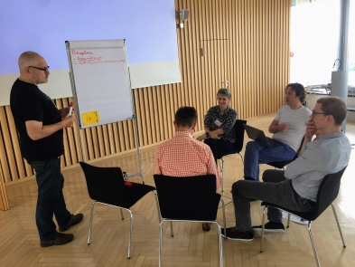
Assess Compliance of CSPA Services
ModernStats CSPA Statistical Services Definition Template
CSPA Promotion and Communication
What does it mean to be CSPA Compliant?
ModernStats CSPA Statistical Services Specification Template
CSPA Workshop
Promote use, sharing ideas, identify opportunities for cooperation
Hackathon: create output for core activities

Slide 5
Trygve Falch - CSPA Application Architecture Patterns
Eva Holm - CSPA Logical Information Model - Variables
Pierre Peyronne - CSPA Catalogue

