Slide 1
CSPA meets Sandbox

Slide 2
CSPA + Sandbox = ?
CSPA strength: framework for development of reusable services (including statistical methods)
CSPA challenge: practical implementation environment (not constrained by legacy)
Sandbox strength: platform for practical collaboration on harnessing (Big) Data
Sandbox challenge: how to reuse/replicate new methods between different (internal and external) environments

Slide 3
Example: algorithmia.com
Gartner: “It's Not Just About Big Data; It's What You Do With It: Welcome to the Algorithmic Economy“

Slide 4
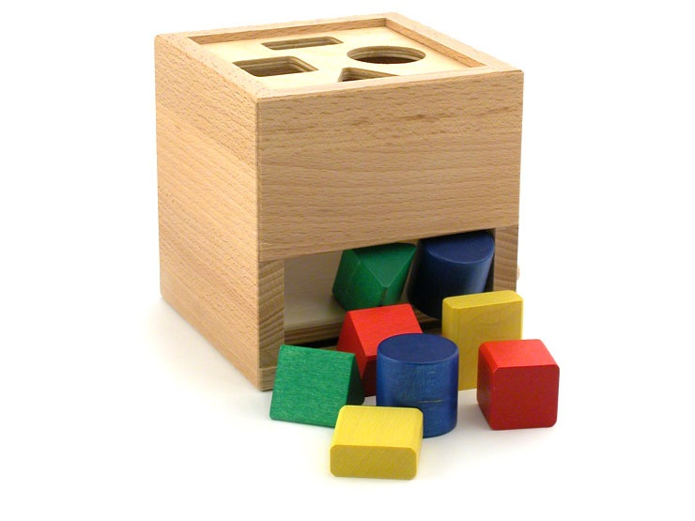
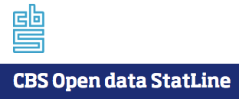
CSPA + Sandbox =
Collaboration Platform(s)
Statistical Service (method, algorithm)
GSIM object structures
(formats)
GSBPM -process
GSIM object instances

