Slide 1
New data sources (such as Big Data) and Traditional Sources
Work Package 2

Slide 2
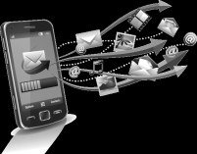
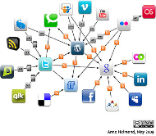
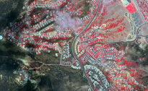
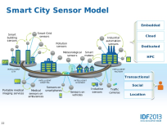
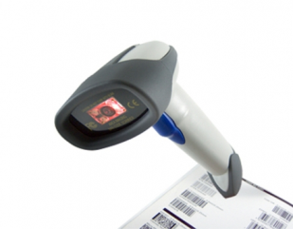
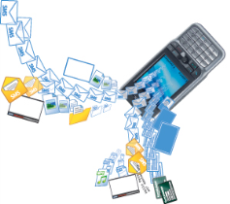
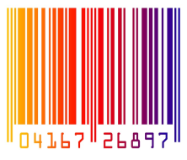
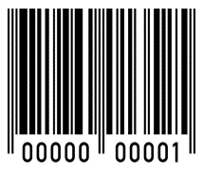
Context & scenarios
Mobile
phone
data
Social
networks
Satellite
imagery
Integration of data sources that traditionally have not been used by most organizations.
Web
pages
Credit
cards
transactions
Smart
sensors
Twitter
&
Mobile phones
Scanner data…
Tourist surveys
Mobility surveys
…can update Consumer Price Indices
New or more frequent updates of statistics.

Slide 3
Challenges & issues
How to use new sources of data for the purpose of integrating them with traditional statistical datasets, namely administrative sources, surveys and statistical registers.
Goal
All the issues will be investigated both theoretically and experimentally on a specific domain, namely Enterprises Web sites.
Variety of site structure, which allows to experiment with different kind of techniques for processing Internet-scraped data.
Amount of Web sites, which is very huge.
Features
Definition of the statistical framework for using the Internet-scraped data, e.g. population, unit characteristics, quality metadata, etc.
Entity extraction and recognition from the Internet-scraped data, according to the defined statistical framework.
Object matching between Internet-scraped data and traditional statistical datasets.
Design of statistical analyses starting from the result of the Object matching activity.
Issues

Slide 4
Activities
1
Definition of statistical framework and boundaries of the work
Identification of web sites
Identification of traditional statistical datasets to integrate with them
2
Design and test of the integration between Internet-scraped data and traditional statistical datasets.
Entity extraction and recognition
Object matching activities will be carried out
3
Design and evaluation of statistical outputs obtained from the integration/ combination/fusion of Internet-scraped data and traditional statistical datasets.

