Slide 1
Report From Production and Methods Committee HLG Modernisation Workshop 22-23 November 2016
November 2016

Slide 2
Outline
Terms of Reference, Membership
Report on Work Undertaken
Activities (CSPA Workshop, Statistical Editing Work Session)
Products (Methodological Architecture)
Shaping work (Machine Learning, Next Generation Data Management)
General Reflections

Slide 3
Terms of Reference
To oversee the organisation of relevant workshops and expert group meetings, and the preparation of guidelines on the topics of the management of statistical information systems, statistical methodology (including data editing), and the components of an “industry architecture” for official statistics.
To monitor developments in these areas within and beyond official statistics, and inform the HLG of any important issues.
To provide input as needed to HLG projects through the Executive Board.
To prepare a report for the HLG on results, key issues, and outreach activities.

Slide 4
Current Membership
Vince Galvin (New Zealand) (Chair)
Anders Holmberg (Norway)
Gillian Nicoll / Michael Meagher (Australia)
Claude Poirier / Rob McLellan (Canada)
Elaine Lucey (Ireland)
Alessio Cardacino (Italy)
Matjaz Jug (Netherlands)
Janusz Dygaszewicz (Poland)
Jan Jones (United Kingdom)
Hubertus Cloodt / Pal Jancsok (Eurostat)
Bruno Urban / David Barraclough (OECD)
Valentin Todorov (UNIDO)

Slide 5
CSPA Workshop
CSPA Workshop in July 2016 :it created good connections and buy-in for CSPA collaboration opportunities and provided a good forum to test ideas about directions Subsequent work has been subsumed into CSPA projects.
Next steps:
CSPA Workshop 2017 (Germany)
CSPA Services Implementation projects
HLG Project Linking CSPA to Implementation Standards

Slide 6
Statistical Editing Work Session
Underway after some deliberations about scope and purpose.
The work session will identify:
methods to manage risks arising from the use of new data sources,
develop approaches for standardizing statistical editing functions, and
consider how methodologists can contribute to the wider modernization work programme.

Slide 7
Methodological Architecture
Deliverables:
Overview “pitch” for the value of Methodological Architecture. This was a response to a great deal of questioning about the purpose and broad structure of a methodological architecture.
Template for developing a methodological architecture. The resulting template makes good use of international standards (GSBPM, GSIM, CSPA). It is designed to link Methodology Architecture with System Architecture.
Next steps:
The template has been reviewed by 4-5 agencies, and several of them had agreed to try and use it in guiding their transformation work.
The Methodological Architecture Template is ready to be trialed in a more production environment. As well as the trialing that will be done in various agencies as part of their transformation programmes, it would be good understand how this work can be made more valuable to the CSPA process.

Slide 8
Machine Learning
Work has been progressed on:
(i) foundations of ML in official statistics: techniques currently in use or in consideration (including related software tools) and
(ii) studying and prototyping of machine learning techniques for web scraping.
Presentations and reports will be finalised in December
Next steps:
The Machine Learning process is really only at an exploratory phase. It has been difficult to get people to commit to joint work, with many people who indicated enthusiasm for a range of tasks subsequently turning out to have too many commitments or being recruited by other agencies in their jurisdiction. There is an articulated work programme of investigations to be followed but this work needs to have a more substantial team built around it.

Slide 9
Next Generation Data Management
Approach:
Identification of a common reference model to establish the generic functions associated with data and metadata management
Assessment of next generation data and metadata technical capabilities in the marketplace (and open-source community)
Discussion of the vision and current activities of one of the participants (Statistics Netherlands) as a valuable case study
Proposing a series of next steps

Slide 10
Next Generation Data Management
…require…
Agility - the ability to respond to quickly to emerging stakeholder needs to ensure relevance
Discovery - supporting the creation of innovative new statistical products based on data exploration and experimentation
Efficiency - effective use of storage, compute resources
Quality - enhanced repeatability, reliability, reversibility, interpretability, coherence
Flexibility - support for alternate means of production, taking advantage of new and emerging data sources
Scalability - ability to deal with large data sets in a variety of activities
Model – how one identifies and agrees on information objects, how in turn they are designed and defined for digital (electronic) representation
Search – information assets are not very useful unless they can be “found” and used
Publish - information sets can be produced and consumed within a specific organization, team or survey, but for data reuse we need catalogue (register) of these datasets and their associated metadata
Standardize – in order to ensure that information objects can be produced, managed, and consumed reliably and without ambiguity it is important to develop a means of standardizing both the structure, their representation, and their content (semantic harmonization).
Manage Lifecycle – an often overlooked function is to put in place an effective means of manage the lifecycle of information elements from creation through to mature use, retention, and ultimately disposition and archive.
Strategic outcomes
Business Functions (examples)
capabilities, enabled by new methodology, technology, skills..

Slide 11
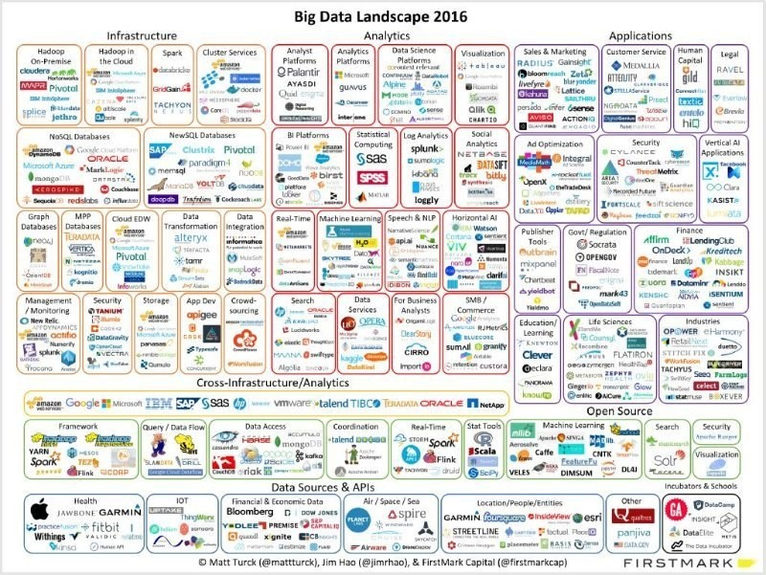
Next Generation Data Management
Landscape is changing…
and we are scratching the surface
http://mattturck.com/big-data-landscape-2016-v18-final/

Slide 12
Next Generation Data Management
Deliverables:
Next Generation Data Management White Paper (Draft end of November, Final version January)
Community of Practice in main areas of common interest
Next steps:
Work on statistical use cases and reference data architecture (Data Architecture Project)
"Blue Sky" activities to explore relevant "proofs of concept" that help advance knowledge and provides return on investment (example: Semantic linked data)

Slide 13
General Reflections
It has not been easy to progress these activities. The staff who are knowledgeable in these areas are in high demand and in some cases left their NSO in the course of the year.
There will be a great deal of activity in the most “modern” areas of tools and methods across the wider Official Statistical community, and there seems to be a good deal of sense in attempting to summarise what is being learnt and avoid every agency rediscovering these experiences separately.
This may take the form of agencies collaborating to maintain knowledge bases in a number of these sorts of areas, and it may be that it would be worth considering some more generic approaches to how to summarise this sort of knowledge.
The collaboration of IT and Methodology specialists was improved through the increased number of methodologists among the committee membership. This helped in ensuring a blended program at the CSPA workshop.

