Slide 1
Starting Point
Statistical Methods Refer to how we carry out statistical activities.
Statistical Methods are used in statistical production, as well as statistical design and analysis.
Key to describing how statistical products are conceived, built and maintained.

Slide 2
Methodology Architecture
Statistical method architecture is needed to:
Explain statistical methodology to external users
Provide common language within & across NSOs
Interface between methodologists & other roles
Support statistical production & data analysis
Facilitate interoperability
Support transformation design
Plan statistical methodology development & statistical methodology support

Slide 3
What are the gaps?
What activities are relevant for statistical methods?
How are statistical methods described?
How do they relate to applications?
What is a statistical method lifecycle?
How do we invest and plan?
What statistical methods exist?
How are they related to each other?

Slide 4
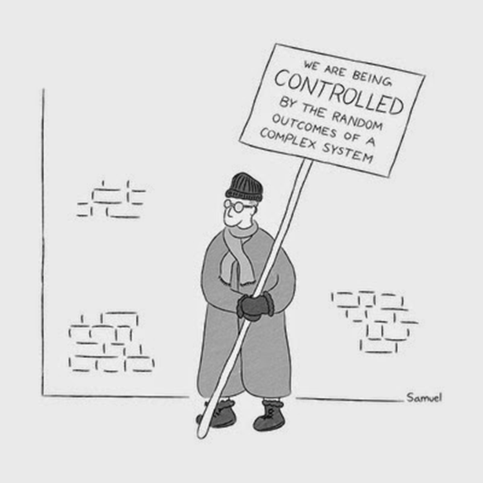
What Can We do to Provide Clarity ?

Slide 5
General Observations
Great individual pieces of work (Norway, Canada, ABS….)
Plenty of Framework thinking
Plenty of reference to methods in the context of other architectural elements.
Maybe not quite so much confidence about which work has proved useful to whom
Need something that can be built upon
Sense that it is more important to illuminate structure and connections than focus on specifics
Making governance of methodologies explicit is a potential new area

Slide 6
Proposed Work Packages
Categorisation of methods
“family” tree of related methods
Impact on business process
Contribution to business goals
Methods library
Short , simple descriptions in a wiki based format.
Incorporate into Standards
CSPA, GSIM, LIM, GSBPM and SPRA
What line of sight helps someone make a more informed choice

Slide 7
Benefits
More effective comparison of methods between NSIs
Identify Collaboration Opportunities
Facilitate sharing of CSPA compliant systems and services
Accelerate adoption of new methodologies

Slide 8
Where should we put our efforts
Investing in Methods
What methods are good enough, and what might be a clue that they need upgrading
What, if any, do new methods replace and how exactly will this work (what don’t we know how to do)
Where should research efforts be focussed
Implementing Methods
What “end to end” connections need to be understood
What re-use can be exploited

Slide 9
Where is this going
Idea is to be practical in the first instance. Trying to surface what links between methods in end to end process, or across other architectural elements would provide useful clarity.
Not rewriting text books – trying to illustrate structure and connections
Learn from agencies undertaking modernization efforts what was most challenging and what methodological understanding can most usefully be codified in a structured way.

