Slide 1
Modernization Committee on Products and Sources
2014 – 2016
2017?
Notes:
Direct Result of Sprint

Slide 2
MCPS- Terms of Reference
Objectives
Proposals on how to develop the range of sources
As well as products to meet increasing demands of users
Related practical work on data collection and dissemination.
Activities and Output
Organisation of relevant workshops
Monitor interesting developments
Provide input to HLG projects

Slide 3
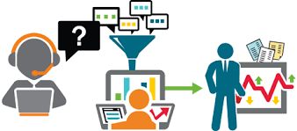
Way of Working
MCPS WebExes
Regular monthly meetings
Dedicated subgroups
Finding new topics
WebEx brainstorms
Identify topics from workshops
Follow-up work
Collect best practices through wiki
Surveys to gather more extensive information
Project Proposals → Projects
Coordination
Within HLG-MOS structures
With other international stakeholders
With national and bilateral projects

Slide 4
Topics Covered by MCPS
Mixed Mode
Mobile Devices
Data Integration
Big Data
Administrative Data
Open Data
Quality Frameworks
Linked Statistical Metadata
Marketing and Communication
Branding and Value of Official Statistics
CSPA implementation
Geospatial Data

Slide 5
Output 2014-2016 (1): surveys
Big Data
Three surveys: 2014, 2015 & 2016
Jointly with UNSD/GWG on Big Data
Results fed into online Big Data Inventory
Communication
Two surveys: 2015, 2016
Extensive analysis
Presentations at CES and DissCom

Slide 6
Output 2014-2016 (2): papers
Marketing the NSO value proposition – a call to action and examples of good practice (Paris, CES 2014)
Communicating the NSO value proposition – ensuring that official statistics is a well recognized brand (UNECE DissCom, Geneva 2014)
Survey of National Statistical Offices on communication and promotion activities: First Results (UNECE DissCom, Washington 2015)
Measuring the value of official statistics – a tale of two surveys (UNECE DissCom, The Hague 2016)
Several papers at 2014, 2015 and 2016 SemStats workshops on Linked Metadata and Web Ontology Language (OWL) for CSPA and GSIM
Several presentations at international conferences about work and outcomes of the Modernisation Committee on Products and Sources
HLG Workshops reports

Slide 7
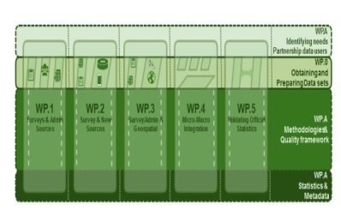
Output 2014-2016 (3): proposals
Project Proposals
Data Integration (2015)
Linked Statistical Metadata (2015)
Both adopted by HLG-MOS as projects for 2016

Slide 8
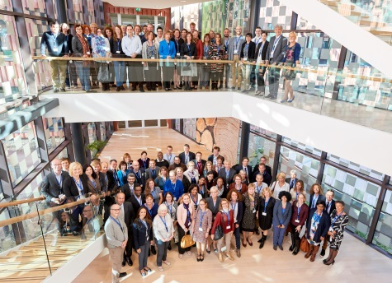
Output 2014-2016 (4): workshops
Statistical Dissemination and Communication
Disscom 2015, 2016
Data Collection
‘Riding the Wave of the Data Deluge’ (2016)
‘Visions on Future Surveying’ (2016)
Joint DissCom/DataColl days
Communication of data collection
Special event
SemStats (co-located with the International Semantic Web Conferences)
2014, 2015 and 2016
Participation in various international meetings

Slide 9
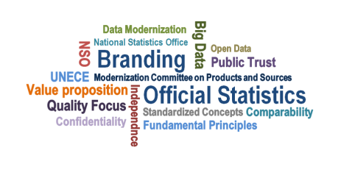
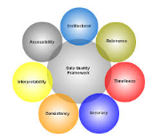
What are we proud of?
Putting branding and the value of official statistics on the agenda
Creating a platform for Big Data projects in the statistical community
Foster collaboration and sharing of experiences on data integration
Making HLG standards available as Linked Statistical Metadata (including development of OWL ontologies)
Creating synergies between national, regional and international activities in data collection and dissemination/communication of statistics
Developing quality indicators for admin sources, working on open data strategies, porting applications for mobile devices, sharing mixed mode strategies, stimulating CSPA implementation, and more …

Slide 10
Who made it possible: the members!
Australia: Jenine Borowik (Chair until July 2015)
Canada: Julie Trépanier
Colombia: Arleth Saurith, Ricardo Valenzuela and Mara Bravo
France: Franck Cotton (co-Chair)
Ireland: Richard McMahon and Eoin McCuirc
Italy: Monica Scannapieco and Stefano De Francisci
Netherlands: Barteld Braaksma (Chair from July 2015)
New Zealand: Amy White, Jean Watt, Felipa Zabala and Anapapa Mulitalo
Poland: Anna Dlugosz
South Africa: Luxolo Lengs and Koketso Moeng
USA: Michael Levi
Eurostat: Michail Skaliotis, Roberto Barcellan and Martina Hahn
OECD: David Barraclough, and Yuri Gyomai
UNECE Secretariat: Fiona Willis-Núñez (setup), Taeke Gjaltema and Steven Vale
Many more contributors!!!
Thank you all for your contributions!

Slide 11
Topics Covered
Mixed Mode
Mobile Devices
Data Integration
Big Data
Administrative Data
Open Data
Quality Frameworks
Linked Statistical Metadata
Marketing and Communication
Branding and Value of Official Statistics
CSPA implementation
Geospatial Data

Slide 12
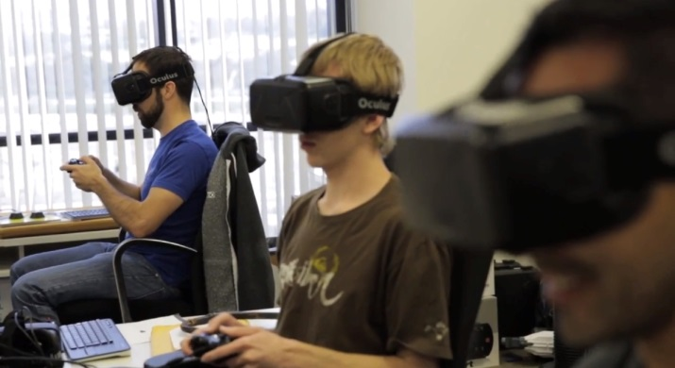
New HLG Structure: Where next?
Blue Sky Thinking Network
Monitoring, development of new ideas and project proposals
Mixed mode, communication, mobile devices, open data, administrative data, geospatial data: Blue Sky Thinking
Workshops on data collection and dissemination/communication (oversight)
Supporting Standards
Linked statistical metadata, further development
Quality metadata for linked and integrated data (w/Eurostat)
Quality indicators for Admin and Big Data
Sharing Tools
Linked statistical metadata, maintenance and support
CSPA implementation
Follow up of the CES TF Value of Official Statistics
Value of official statistics
Follow-up project
Data integration
SMM Unite UNECE Statistical Division
Big Data Inventory
HLG secretariat
List of international events

