Slide 1
Modernization Committee on Products and Sources: Future Work
5th High -Level Group Workshop on the modernization of Production and Services, Den Haag -24-26 November 2015

Slide 2
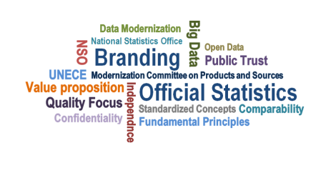
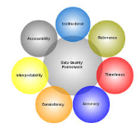
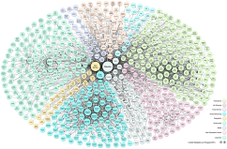
MC Products and Sources- Outlook 2016

Slide 3
MC Products and Sources- Priorities 2016 (preliminary)
Communication (follow up surveys)
Open Data (product-oriented)
Big Data Inventory
Workshops

Slide 4
MC Products and Sources- Project Proposals 2016
Data Integration
Linked Open Metadata

Slide 5
MC Products and Sources- Other Activities 2016 (preliminary)
Quality frameworks
CSPA compliance
Mobile devices
National activities on modernisation of statistics
Wiki maintenance
Coordination (internal + external)

Slide 6
MC Products and Sources- Big Data 2016
Big Data: Inventory
Update current project list
Add selected GWG projects
Promotion
Coordinate activities (Eurostat, OECD, GWG/UNSD, World Bank etc.)

Slide 7
MC Products and Sources- Communication 2016
Analyse Surveys on Value of Official Statistics
Work on metrics on value of OS
Prepare presentation DissComm Workshop
Add information to Knowledge Hub
Encourage and support DissComm project
3rd Survey??

Slide 8
MC Products and Sources- Data Integration 2016 (if adopted)
Follow up on HLG Project Proposal
Identify opportunities
Coordinate activities (Eurostat, OECD etc)

Slide 9
MC Products and Sources- Open Data 2016
Follow up on Linked Open MetaData project proposal (if adopted)
Open Data implementation strategies:
Analyse experiences from CA, IE, IT and NL
Prepare proof-of-concept note
Test in more countries
Add information to Knowledge Hub
DissComm + Data Collection Workshop (potential topic)

Slide 10
MC Products and Sources- Mobile devices 2016
Share Apps (e.g. SA-NL)
Promote CSPA compliance
Collect best practices
Share through knowledge hub
Data Collection and DissComm Workshops

Slide 11
MC Products and Sources- Workshops & Seminars 2016
Oversee UNECE workshops and seminars
Data Collection
Dissemination and Communication of Statistics
Statistical Data Confidentiality
Maintain public list of workshops and seminars related to data sources and statistical products
http://www1.unece.org/stat/platform/x/uYPNBQ

Slide 12
MC Products and Sources- Constraints & Challenges
Large variety of topics
Limited and shifting capacity
Initiation of new members
“Silent” members
Other actors in same area
Inter-MC communication and coordination

Slide 13
MC Products and Sources- Way Forward
Changes proposed
Internal organisation of MCPS
Create sub-groups for specific activities (ad-hoc members)
Invite active participants of workshops
Contributing organisations (via HLG)
Formal time allocation in work programme of members
Administrative/secretarial support from NSO staff
HLG
Promote inter-MC collaboration

Slide 14
Extra slides

Slide 15
MC Products and Sources: Terms of Reference
Develop access to and use of the range of data sources needed to support modernisation
Develop products to meet increasing demands of users
Operational responsibility for work on statistical data collection, including maintaining the wiki and sharing ideas and experiences through case studies
Notes:
Terms of References as presented at the 2013 HLG Workshop.

