Slide 1
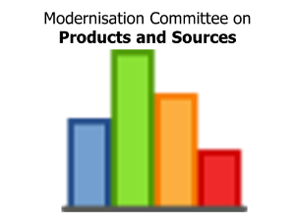
Implementing ModernStats Standards Linked Open Metadata
Franck Cotton, Insee
Monica Scannapieco, Istat
Notes:
Direct Result of Sprint

Slide 2
Implementing ModernStats Standards
Project proposed by the MC on Products and Sources at HLG Workshop on November 2015
Launched in 2016 with three workpackages
WP1
Classifications and
Vocabularies
Linked Open Metadata
WP2
Models and Services
WP3
Maturity Model and
Roadmap

Slide 3
Linked Open Metadata: Objectives
Building proofs to show the value of Linked metadata
Complete IT systems implementing significant use cases
Learn by doing
Design Guidelines
Feasibility of application of Linked metadata to statistical domain
Evaluation and sustainability plans

Slide 4
Linked Open Metadata: What
OWL
Semantic Web technologies
OFFICIAL

Slide 5
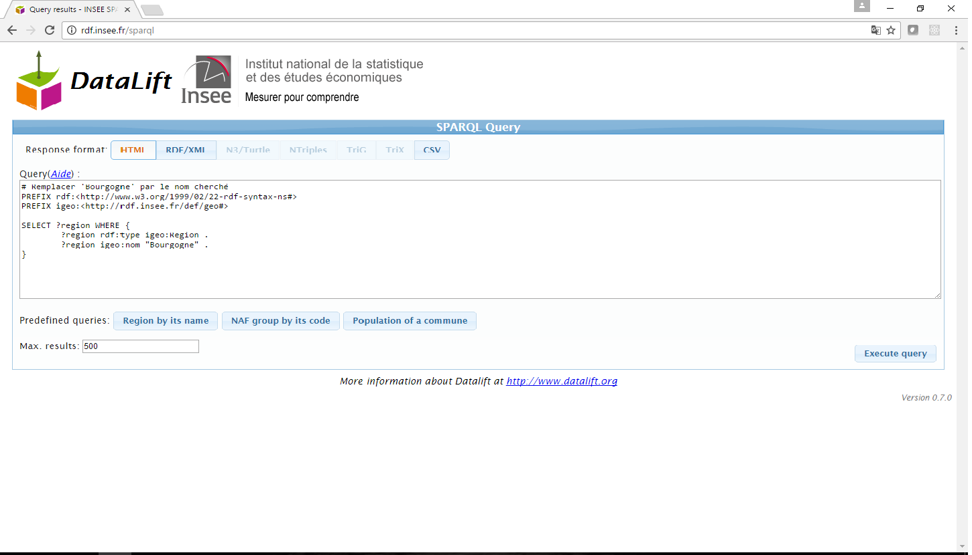
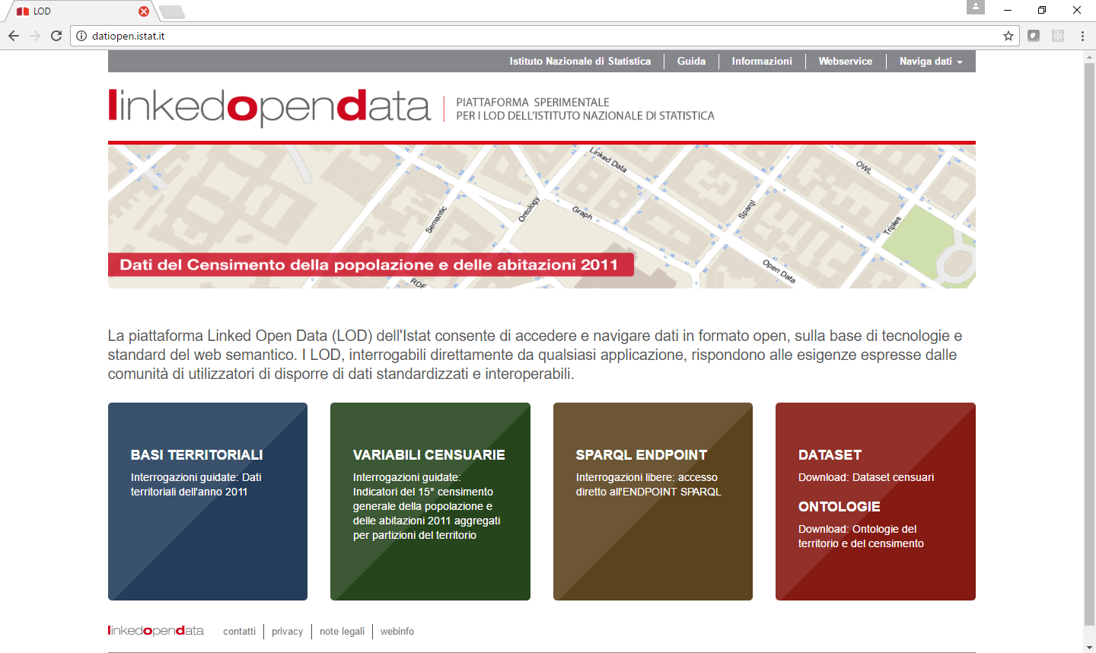
Linked Open Metadata: Why
Comparable and interoperable statistics
OWL
Insee LOD Portal: http://rdf.insee.fr/sparql
Istat LOD Portal: http://datiopen.istat.it
Japan e-Stats LOD Portal:http://data.e-stat.go.jp/lodw/

Slide 6
Project Workflow and Milestones
Set up of sandbox technological environment
Sharing of initial design guidelines
RDF artefacts database: setup and integration
Sprint in Rome to finalize results
SemStats workshop to communicate results
Jan-Feb
March-April
May-August
September
October

Slide 7
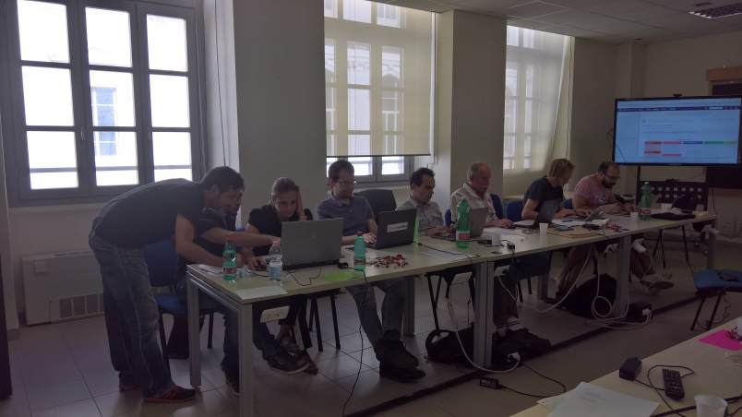
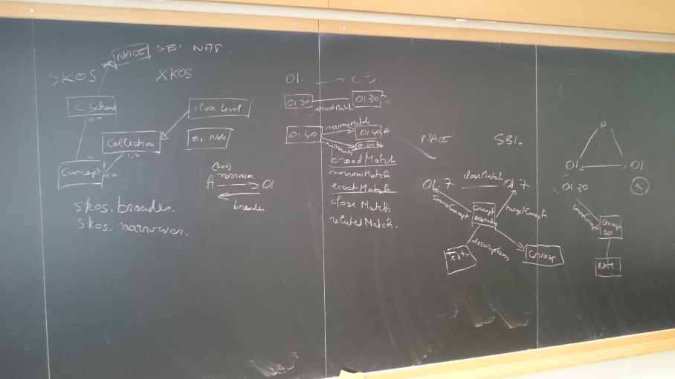
Rome Linked Open Metadata Sprint
Duration: 3 days, 12-14 September 2016
Participants: 15
Organizations:
Physical participation: Istat, Insee, CBS, Eurostat, UNECE
Virtual participation: Mexico
Location: SAPIENZA - University of Rome (neutral)
Sprint type: Agile/SCRUM development (Sprint Master:Taeke Gjaltema)
Hard programming…
…but also blackboard thinking!

Slide 8
Project Outputs: RDF Artifacts
Classifications
UN classifications (with history): ISIC and CPC
Eurostat classifications (with history): NACE and CPA
National classifications: NAICS, Ateco, NAF and CPF
Correspondence Tables
SDMX measure_unit code list
Ontologies: GSIM, CSPA, GSBPM
Data on CSPA services
RDF Triple Store (Stardog) on the Sandbox

Slide 9
Project Outputs: Web clients
Classification Explorer
Browsing
Cross-Navigation btw classifications
Searching/Exporting
Awarded by Oracle
at SemStats 2016
Best Challenge
RDF Triple Store (Stardog) on the Sandbox
Model Explorer
Browsing
Cross-Navigation btw models
Edit CSPA services

Slide 10
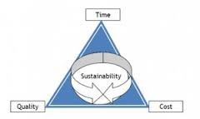
Project Outputs: reporting for design, communication, sustainability
Design Guidelines
How to model and implement Linked data classifications
Two papers at SemStats 2016 (reviewed by Academic and Official statistics representatives)
An OWL Ontology for the Common Statistical Production Architecture by
A.Dreyer, F.Cotton, G.Duffès
An OWL Ontology for the Generic Statistical Information Model (GSIM): Design and Implementation by
A.Dreyer, G.Duffès, D.Gillman, M. Scannapieco, L. Tosco
Recommendations for projects results’ sustainability

Slide 11
DETAILS ON WORKPACKAGES Franck Cotton

Slide 12
Project Follow-Up (1)
Issue 1: Maintainance of project artefacts
RDF Classifications and correspondence tables
GSIM, GSBPM, CSPA ontologies
Data on CSPA services
How to solve Issue 1: suggestions
Sandbox platform could remain accessible
until new facilities for sharing RDF artefacts are available
HLG involvement, e.g. through the Supporting Standards group and the Sharing tools group
Coordination with Eurostat DIGICOM project

Slide 13
Project Follow-Up (2)
Issue 2: Extending the work on design guidelines
How to solve Issue 2: suggestions
HLG involvement, e.g. through the Supporting Standards group and the Sharing tools group
Coordination with Eurostat DIGICOM project
European ISA² program (SEMIC - Semantics
Interoperability Community)
Notes:
The ISA² programme supports the development of digital solutions that enable public administrations, businesses and citizens in Europe to benefit from interoperable cross-border and cross-sector public services. ISA² will run from 1 January 2016 until 31 December 2020.

Slide 14
Project Follow-Up (3)
Details on project resources
Main contribution for manpower by Insee and Istat
Both technical management and implementation
Contributions by CBS, Eurostat and UNECE at the Rome sprint
Organizational aspects (Webex organization and reporting) by UNECE
Sandbox fee

Slide 15
Wrapping-up: Advantages
Statistical artefacts represented as Linked data have several advantages
Defined once for all and shared for actual semantic interoperability
Structure and content harmonization
«Is the definition of the Business Process concept consistent and complete among GSIM, GSBPM and CSPA?»
Correctness (consistency and completeness) checks:
Formal representation of statistical metadata and models
World wide technological standards
Tools available off-the-shelf, technology independence, etc.

Slide 16
Final Remarks (1)
However, besides the shown and discussed advantages, there are some risks involved by the adoption of the linked data paradigm:
Dedicated technological stack and specific skills needed
Technological standards still keep on (slowly) changing: changes in versions, performance issue, etc.
A question could be:
We are talking about metadata harmonization and sharing since many years, even decades, so… what’s new now?

Slide 17
Final Remarks (2)
Technology as an enabler
+
Consolidate metadata management experience
Insee LOD Portal: http://rdf.insee.fr/sparql
Japan e-Stats LOD Portal:http://data.e-stat.go.jp/lodw/
Istat LOD Portal: http://datiopen.istat.it
Notes:
Ready to reap the benefits

Slide 18
Thank you for your attention!

