Slide 1
HLG-MOS Moving to the Next Level
Pádraig Dalton Chair of the HLG-MOS

Slide 2
What am I going to talk about?
Where are we now?
What have we accomplished together?
How should we go forward?
How is the role of the HLG-MOS evolving?

Slide 3
Where are we now?
HLG-MOS has been active for 6 years
Activities have involved around 1,000 people in over 50 countries
Increasing global interest in our activities and outputs

Slide 4
What have we delivered?
For the official statistics community:
GSBPM
GSIM
GAMSO
CSPA
Knowledge and experience on Big Data
Knowledge and experience on Data Integration
GSDEMs
Many papers, presentations, videos, wikis, …
Notes:
Here are some of the main outcomes from previous years
GSDEMs = Generic Statistical Data Editing Models

Slide 5
What have we delivered?
For users of statistics
Greater coherence through standardized production processes
Reduced costs / improved quality
But – the real benefits are still to come
So how do we accelerate their delivery?

Slide 6
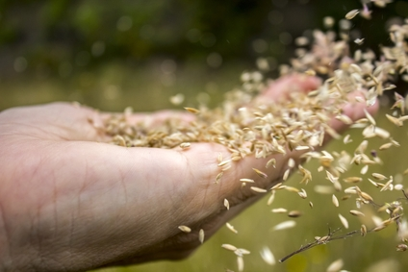
Analogy: Creating an orchard 1. Scattering the seeds
Many ideas
Which ones will flourish and bear fruit?

Slide 7
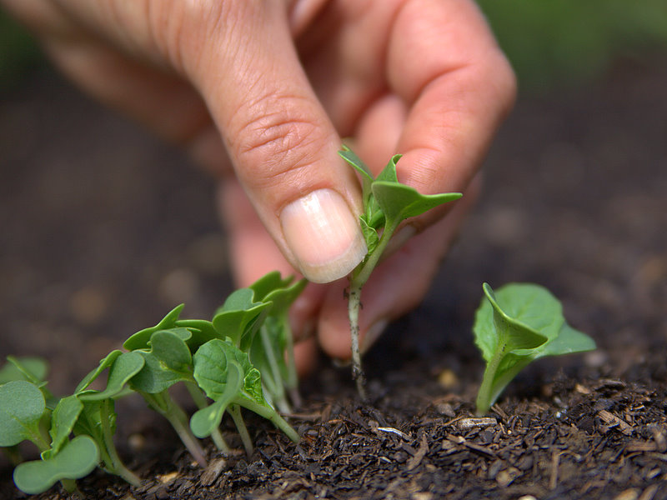
Analogy: Creating an orchard 2. Thinning the plants
Some are growing better than others
Competition for resources
Need to decide which ones to keep
Create space for more innovation

Slide 8
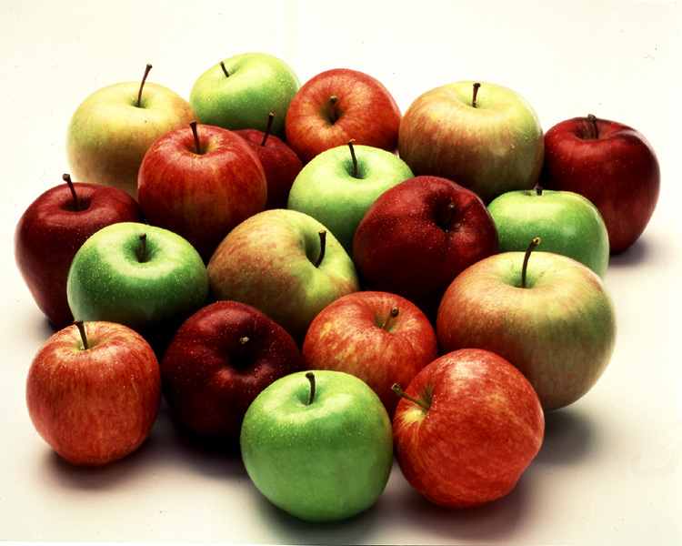
Analogy: Creating an orchard 3. Harvesting
Reaping the benefits of our work
A few at first, but many more in the years to come

Slide 9
Where are we?
We supported many ideas
Some grew faster than others (GSBPM, CSPA)
Some were a learning experience (Big Data)
As the first fruits appear, it is time to thin out the lower priorities and focus more on those that will bear most fruit in the future

Slide 10
Picking the priorities
New “Strategic Framework” – June 2016
Future projects and activities must align with this
Less groups, narrower range of “value-add” activities, greater focus on strategic priorities
But still some room for innovation!
Notes:
Strategic Framework developed during an Executive Board virtual sprint in May 2016, approved by HLG-MOS in June.
Moving to a leaner structure – more information in the presentation by Bert and Trevor tomorrow

Slide 11
How is the role of the HLG-MOS evolving?
Growing interest in joining our activities
How big is too big?
Must everybody be involved in everything?
How to be open to all, but keep a cutting-edge focus?
Coalition of the willing – or
Coalition of the willing and able?
Leave a road-map for others to follow and share knowledge and experience
High demand for capacity building
Is this part of our role?
If so, how can we support this effectively
Notes:
Some strategic issues to be discussed by the HLG-MOS when it meets on Thursday
Partnerships may be an answer to the capacity building issue

Slide 12
Beyond statistical production
We are modernising processes, systems and methods
What about the underlying concepts?
Do they need modernising too?
Or is this the type of work that is best covered elsewhere or indeed is already being addressed elsewhere?
Notes:
A chance to give a personal perspective – if you want to!

Slide 13
Celebrating success
A huge amount of work this year:
Data integration
Modernisation maturity models and roadmap
Linked open metadata
Risk management guidelines
Barriers to international collaboration
GAMSO version 1.1
Methodology architecture
Next generation data management
…..

Slide 16
Comments and Questions?

