Slide 1











Intentions Catalogue
Current and Planned Capability Investments in Statistics
STATISTICS

Slide 2

Why Investment Catalogue
Identify areas for collaboration: reduce cost/improve quality
Identify shared priorities
Focus on (Business) Capabilities
Part of Modernization philosophy:
  Sharing
  Collaboration
  Based on Standards (Models/Frameworks/Common Language)
Investment Intention Survey 2016, 2017 (pilot 2015)
You can also update online (https://statswiki.unece.org/display/CSPA/Investment+Database)

Slide 3
Investment Information available
Name and Description of Investment, Contact information
Capability to enhance: level 0 & level 2 ESS Business Capabilities model
Type of Activity: Innovative, Transformational or Harvesting
IT Risks: High, Medium or Low
Business Impact: High, Medium or Low
Maturity Level: Plan, Specify Needs, Design and Develop, and Implement
Filterable and Searchable Content on:
  32 countries & Eurostat/ESS
  481 ongoing investment activities (533 in total)
Notes:
Level 2 of Statistical Production Management model ESS Business Capabilities model
Level 0: Strategy Management, Corporate Support Management & Statistical Production Management
Innovation activity: Activities that are mainly about research and innovation to develop new capabilities or new types of output.
Transformational projects: Activities that are mainly about updating or re-engineering existing processes, tools methods, sources or outputs.
Harvesting projects: Applying existing methods or tools to additional processes. This includes activities to reduce the number of methods and tools used for similar purposes.
Business Impact: measures the value that the completion of this capability will bring to the organisation. This is measured in term of the number of staff affected.

Slide 4
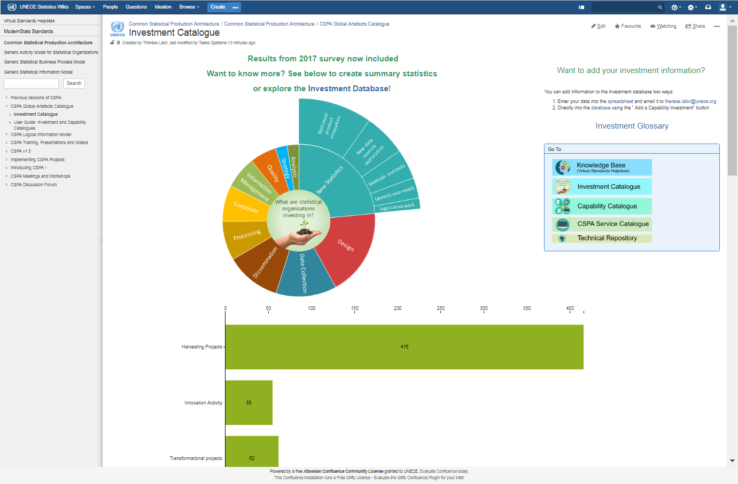
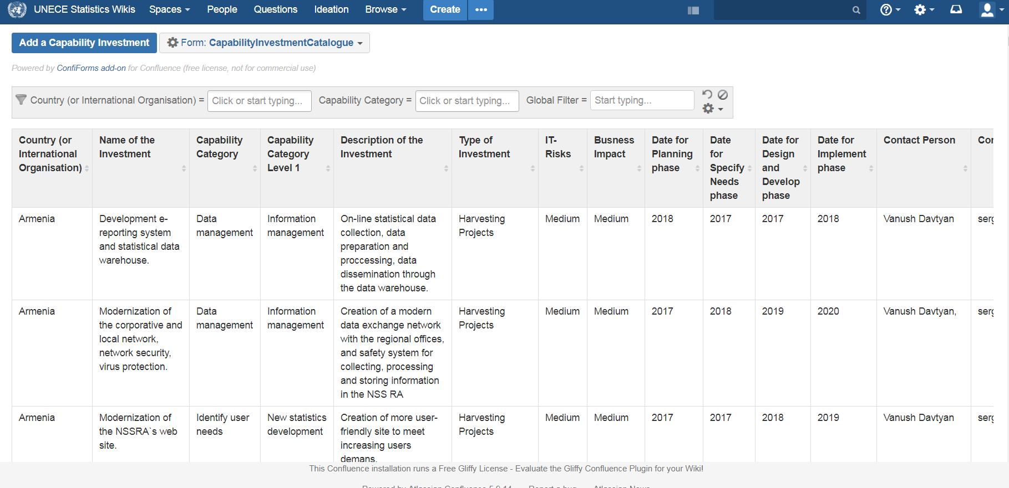
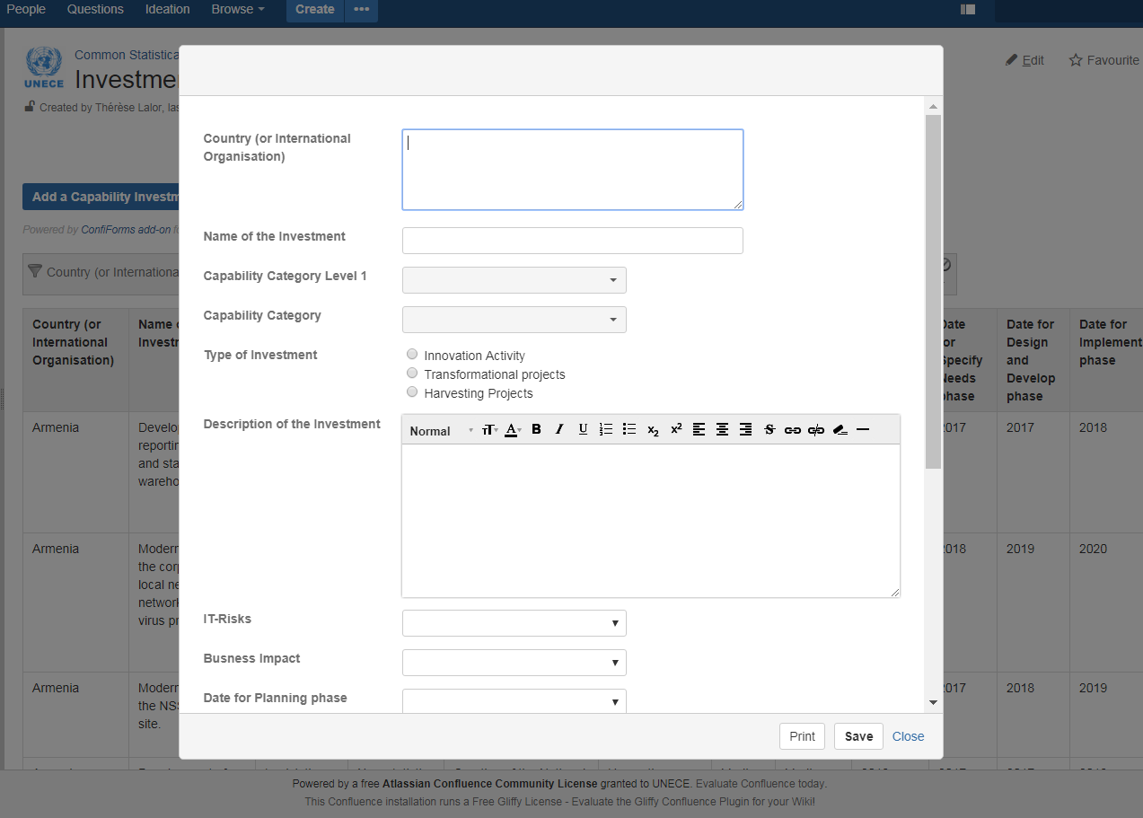
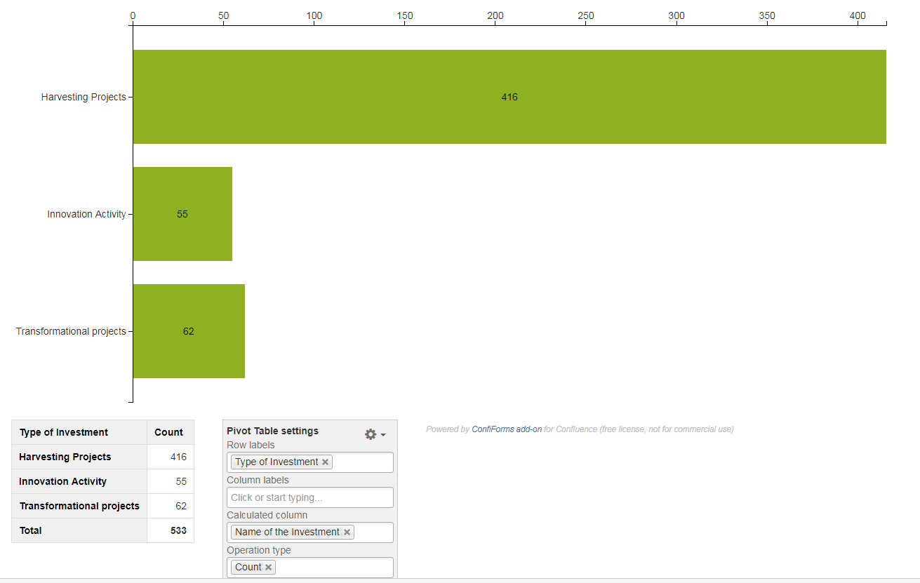
On-line Investment Catalogue
Notes:
Animated, keep clicking

Slide 5
Capability we are investing in
23% are in New Statistics Development of which 42% are in statistical product innovation
Together with (Statistical) Design, Data Collection and Dissemination they count for 2/3 of all entries
Find more details in the online Investment Catalogue
Share New Statistics and Data Collection lower than last year
Grow Share information Management highest
Notes:
Projects with implementation before 2017 excluded

Slide 6
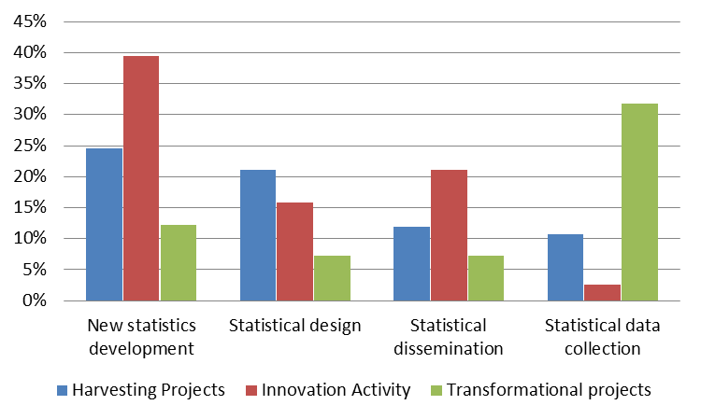
Capability by Type of Investment
Innovation Activities high among New Statistics Development
Transformational projects dominant in Statistical Data Collection
Harvesting projects highest in Statistical Design
Notes:
Projects with implementation before 2017 excluded

Slide 7
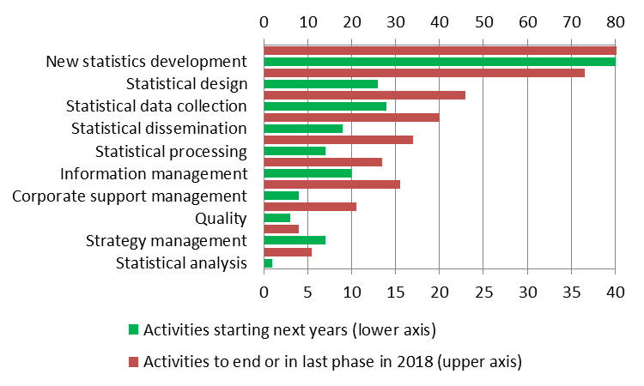
Collaborate and Share
Check and join your colleagues to Share Resources
Check and contact colleagues to Learn from Experience
Notes:
Projects with implementation before 2017 excluded

Slide 8
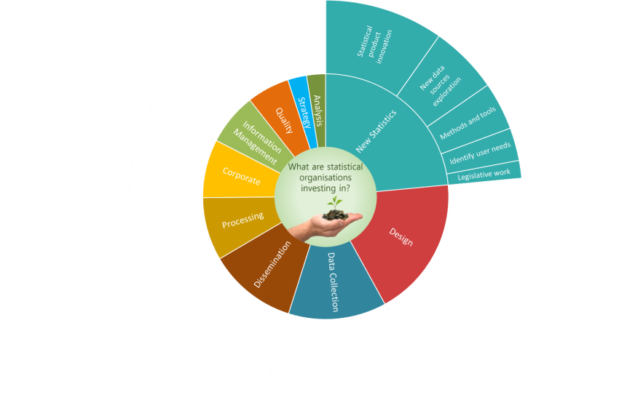

For example, the Catalogue shows that:
In the coming years, Armenia, France, Hungary and Romania all plan to (re)design their metadata management system while Australia, Chile, Georgia, Germany and Iceland have or are about to finish activities on it
Azerbaijan and Belarus both will embark on a project to produce interactive tables, while Germany is already working on this
Armenia, State of Palestine and Lithuania are currently working on SDMX based data dissemination or transmission systems while others have already established them
There are 25 entries on activities related to administrative data and 16 related to CPI/price statistics

Slide 9
Share
Consult
Collaborate

Slide 10
Appendix

Slide 11
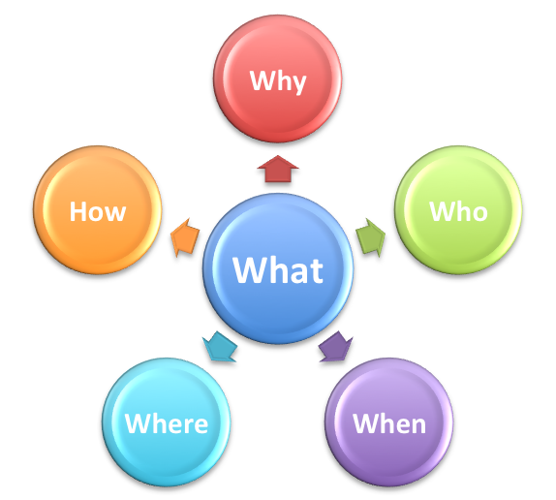
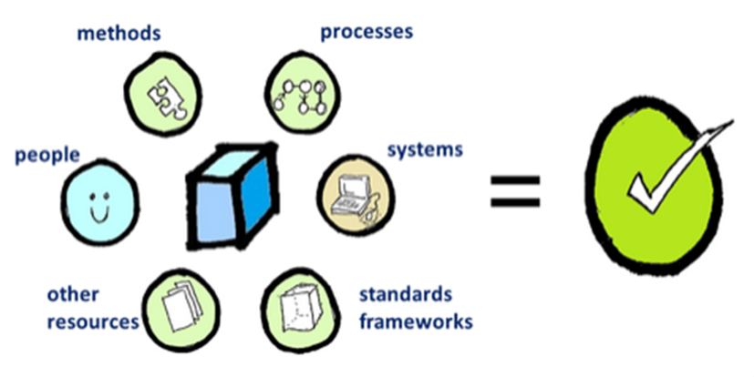
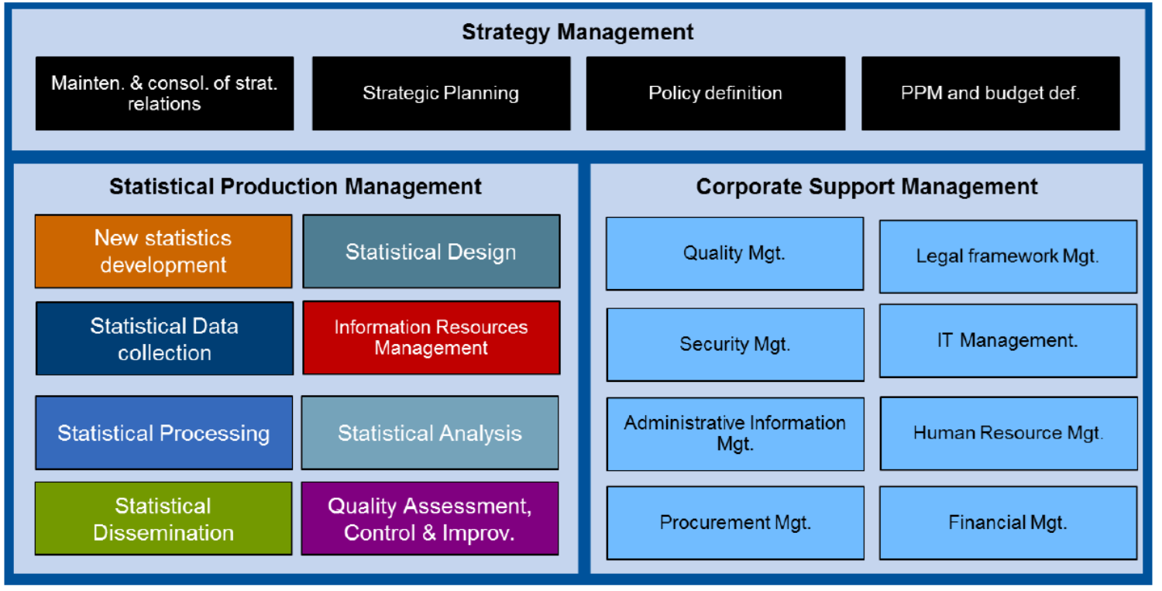
Capabilities:
Abilities that an organization, person or system possesses
It requires a combination of people, technology, processes, methods, systems and standards to achieve certain actions or outcomes
Business Capabilities Model (ESS Enterprise Architecture Reference Framework)
  Three levels
  Common language
  Strategic planning/
  portfolio management
Notes:
What we do or need to do
Capabilities are like the business functions as defined in GSIM and CSPA and can be linked to GAMSO/GSBPM
It allows for integrating perspectives from the human, technological, business, methodological and standardization side

Slide 12
Strategy Management
Statistical Production Management
New statistics development
Statistical Design
Information Resources mgt
(Re)Design statistical outputs
Process & workflow design
Process methods design
Design production system, service and rules
Statistical Data mgt
Metadata mgt.
New data sources exploration
Statistical Data Collection
Quality assessment, control & improv.
Legislative work participation
Provision agreement management
Primary data collection
Secondary data collection
Metadata collection
Statistical Registers Management
Statistical product innovation
Statistical Processing
Statistical Analysis
Quality assessment
Statistical data preparation
New variables and units derivation
Calculation and finalization of output
Statistical output analysis
Methods and tools dev. for new statistics
Quality control mechanisms mgt.
Statistical Dissemination
Identify user needs
Release mgt.
Products and services promotion
Flexible data access provisioning
Statistical content mgt.
Quality improvement mgt.
Corporate Support Management
Notes:
Level 2 (&Level 0)

Slide 13
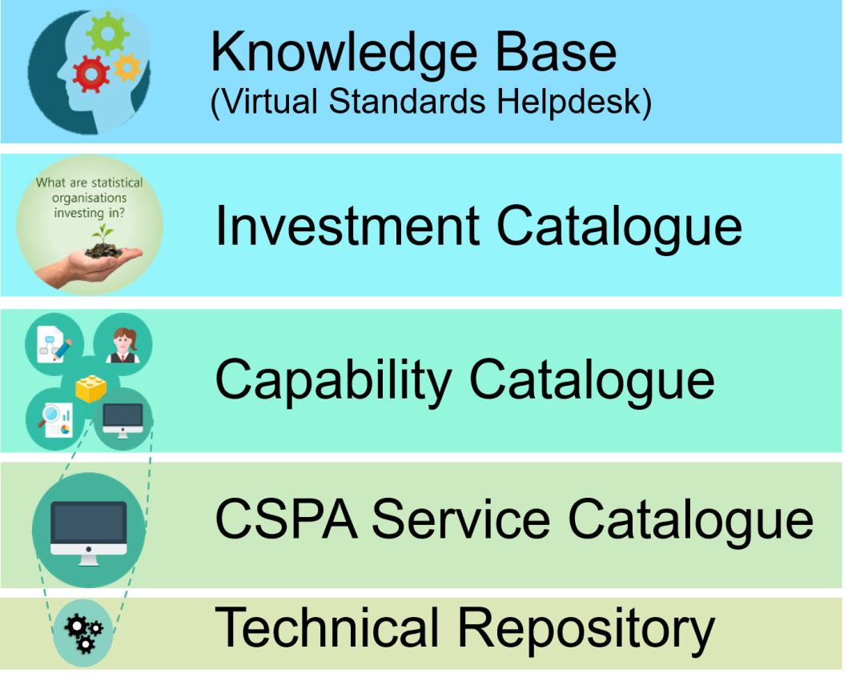
CSPA Global Artefact Catalogue
Access to HLG and other Standards
Development of new Capabilities (planned or in progress)
Existing Business Capabilities
CSPA (statistical) services available or under development
Supporting Services
Notes:
5 Layers of Global Artefact Catalogue
3 Capabilities: GSBPM/GSIM level

Slide 14
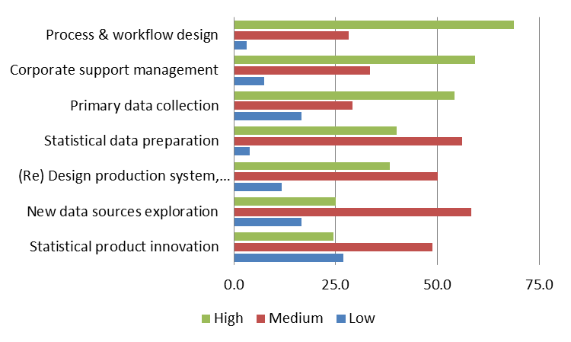
Capability by Business impact
High business impact for
Transformational projects dominant in Statistical Data Collection
Harvesting projects highest in Statistical Design
Notes:
Projects with implementation before 2017 excluded

