Slide 1
Data Integration in Official Statistics 2017 Project Report
UNECE Data Integration Project

Slide 2
Data Integration Project Proposal 2017
Develop an online, adaptive, practical guide to Data Integration for Official Statistics which supports successful data integration projects; using lessons learnt within the project and in related work.
Undertake further joint experiments in high priority practical interest areas. The project has identified a number of areas where working together should bring faster results than working alone.

Slide 3
WPA: Develop an online, adaptive, practical guide to Data Integration for Official Statistics (WPA)
AIM: Support successful projects and common approaches
Distil lessons learnt from practical experiments and other initiatives
Organise knowledge into simple, easy to consume and adaptable guidance
Cover how to get started on a data integration project
Describe suggested processes to follow, based on GSBPM.
Obtaining datasets, forming partnerships, assessing quality and securing ongoing access (WP0).
Promote use of ModernStats standards and approaches
Provide a catalog of methods described using the Modernstats standards
Be available online (probably using the UNECE Wiki system)
Support easy adaptation as new experiences are added.

Slide 4
Further develop common approaches in areas of statistics through practical projects
Provide experience for the guide
Some projects being undertaken by project members, some by other groups
Must include work already being done within and between institutes
Priority should be given to those with active support and commitment from countries and ‘sharp’ and concrete deliverables

Slide 5
Work Packages
Citro, Constance F. (2014), From multiple modes for surveys to multiple data sources for estimates. Survey Methodology, December 2014 137 Vol. 40, No. 2, pp. 137-161. Statistics Canada

Slide 6
Definition of Success
Future
Support HLG strategic priorities
Common strategic approach (‘spines of integration’)
Common approaches for particular areas of statistics
Approaches for ‘quick response’ integration
Sources secured and risks managed
New sources easily incorporated into our statistics
Guidance easy and effective to use
‘Guide’ easy to maintain and keep relevant
?
High
One or more concrete statistics produced
Methods developed
Guidance and quality frameworks created
Modernstats standards used
Minimum
Countries share their experience
Collaborate on approaches in WP1-5

Slide 7
What the project has worked on
Structure and content of guide
Face to face workshop
Intersections with other projects
Development of survey to inform the guide
Preliminary survey results
Steps to be completed
Next steps –sustaining the value of the work

Slide 8
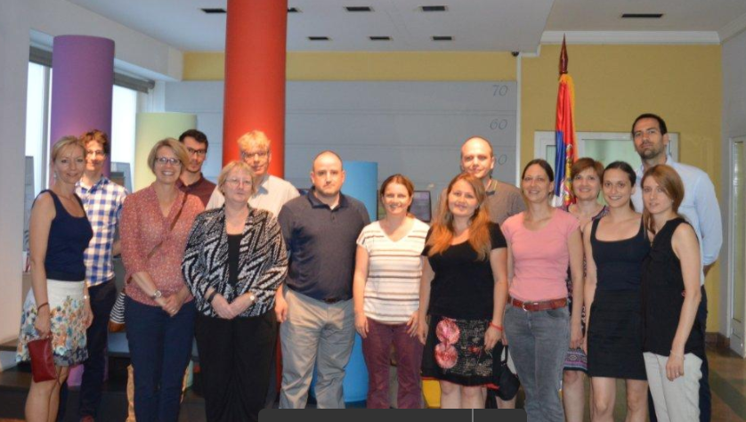
Face to face meeting
Hosted by Statistical Office of the Republic of Serbia
27-30 June 2017 Belgrade
Active participation and discussion
Aims –
Share results and make further progress
Understand how Data Integration relates to other work and standards such as GSBPM, CSPA, the Data Architecture project, geospatial standards and other groups
Gather experience and lessons learnt from project participants
Progress work on individual work packages
Review and enhance the guide
Develop content for topics not yet covered in the guide
Develop a survey and request for case studies on data integration

Slide 9
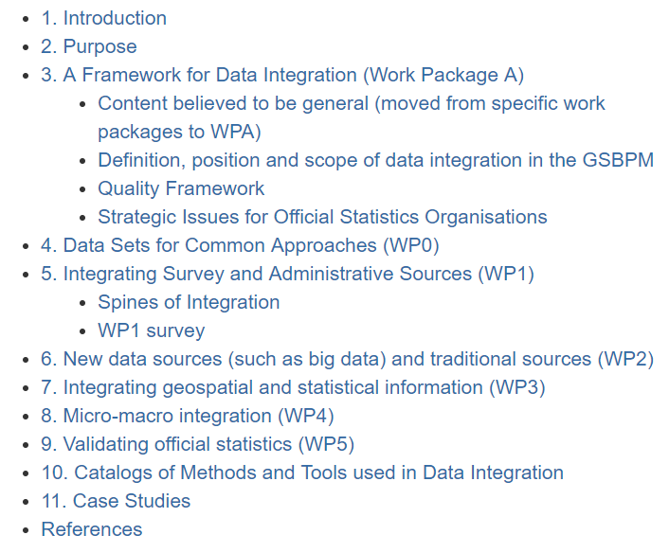
Some findings/decisions from the workshop
Need to give every statistical office/group the opportunity to contribute to the guide through the survey and case studies
Determine the survey questions and why they should be asked
Determine which topics are related to individual work packages and which are more general in nature
Determine topics missing from the guide and how to complete them
Agree who does what

Slide 10
The survey and request for case studies
Topic coverage – informing the guide
Strategies
Barriers
Legislative environment
Identifiers
Institutional environment
Statistical domains
Information Technology
Methods
Quality
Skills
Geospatial data
Different aspects are of interest to different people
A lot of categorical questions to aid analysis
Free text fields and case study requests to get more detailed information
All questions optional to avoid deterring response
Specifications developed as wiki version
Technical design and logistics provided by Statistical Office of the Republic of Serbia (SORS)

Slide 11
The technical solution
Technical development team
Mira Nikic
Uros Rajcevic
Jelena Markovic (Monstat)
Very agile development and quick response
Microsoft Azure and Integrated Survey Technology (IST)
Respondents did not need wiki id and could reopen survey so multiple people within the organisation could contribute
Also a wiki version for people with ids
All data will be migrated to wiki
(data integration pages)

Slide 12
Preliminary Survey Results
27 responses to date (3 unidentified)
4 Case studies submitted (more to come)
About 7 additional countries have indicated that they will also respond (need more time)
Now starting to analyse results and incorporate into Guide

Slide 13
Number of employees

Slide 14
Data Integration Strategies

Slide 15
Units/functions responsible for data integration

Slide 16
Barriers

Slide 17
Laws/Legislative Environment

Slide 18
Identifiers

Slide 19
Pre-integration practices

Slide 20
Prominent reasons to integrate data

Slide 21
Types of data being integrated

Slide 22
Tools used for linking and/or matching data

Slide 23
Methods

Slide 24
Quality measures

Slide 25
Quality framework

Slide 26
Have the required skilled resources

Slide 27
Areas where training is most required

Slide 28
Geospatial data used in statistics

Slide 29
Geospatial data meets needs in terms of -

Slide 30
Type of registers used with geospatial data

Slide 31
Geocoded level of address database

Slide 32
Main barriers to geocoding

Slide 33
Main threats to current geocoding practices

Slide 34
Lowest possible geographical level for geocoding

Slide 35
Next steps
Complete analysis of all material gathered (including survey, case studies, and other material)
Complete guide by end of year
Propose (tomorrow) a way to sustain the value of the work

Slide 36
Thank you Comments and Questions
?

