Slide 1
Data Integration in Official Statistics 2017 Project Proposal
UNECE Data Integration Project

Slide 2
Data Integration Project Proposal 2017
Develop an online, adaptive, practical guide to Data Integration for Official Statistics which supports successful data integration projects; using lessons learnt within the project and in related work.
Undertake further joint experiments in high priority practical interest areas. The project has identified a number of areas where working together should bring faster results than working alone.

Slide 3
Definition of Success
Future
Support HLG strategic priorities
Common strategic approach (‘spines of integration’)
Common approaches for particular areas of statistics
Approaches for ‘quick response’ integration
Sources secured and risks managed
New sources easily incorporated into our statistics
Guidance easy and effective to use
‘Guide’ easy to maintain and keep relevant
?
High
One or more concrete statistics produced
Methods developed
Guidance and quality frameworks created
Modernstats standards used
Minimum
Countries share their experience
Collaborate on approaches in WP1-5

Slide 4
WPA: Develop an online, adaptive, practical guide to Data Integration for Official Statistics (WPA)
AIM: Support successful projects and common approaches
Distill lessons learnt from practical experiments and other initiatives
Organise knowledge into simple, easy to consume and adaptable guidance
Cover how to get started on a data integration project
describe suggested processes to follow, based on GSBPM.
Obtaining datasets, forming partnerships, assessing quality and securing ongoing access (WP0).
Promote use of ModernStats standards and approaches
Provide a catalog of methods described using the Modernstats standards
Be available online (probably using the UNECE Wiki system)
Support easy adaptation as new experiences are added.

Slide 5
Further develop common approaches in areas of statistics through practical projects
Provide experience for the guide
Some projects have been proposed by project members
Others may be proposed at workshop or in the next few months
Can/should include work already being done within institutes
Priority should be given to those with active support and commitment from countries and ‘sharp’ and concrete deliverables

Slide 6
Align approaches to apply new data sources to integrated price measurement (WP0 and WP2)
ABS scanner data in production and planning full-coverage soon
improve quality of the CPI in terms of coverage and real-time quantity.
Several data providers operate in many countries -> opportunity for common approach
Extend range of products and data sources
Sprint of NSOs and data providers -> mutual understanding and develop data supply agreements
Test comparability of data across countries and time
Develop ICT skills to receive load and explore data into the sandbox
Define common methods required
Coordinate with related work (e.g. by UN, IMF etc.)
CBS Netherlands actively researching online data and using scanner data in production
Statistics Canada considering Price Stats data in production; use of an API
Statistics NZ is using online/scanner data in production.

Slide 7
Create set of synthetic datasets for sandbox experiments (WP0)
will allow countries to collaborate on developing common methods, removing issues of confidentiality and encouraging use of the same data formats.
reuse outputs from the Big Data Project already lodged in the Sandbox.
may provide a practical base/examples of the proposed CSPA Data Architecture.

Slide 8
Develop practical guidance for integrating survey, administrative data and big data (WP1 and WP2)
During 2016, participants investigated current work in this area (within their own organisations and in other groups (eg ESSNET and the HLG Big Data project)
specific interest focussed on job vacancies statistics, employment registers and labour force, and geographic location of schools.
Use the work being done within participating organisations to enrich the guide (including case studies)
Encourage the involvement of other participants and projects
Describe the steps needed using the GSBPM.

Slide 9
Develop practical guidance on integrating geospatial and statistical information (WP3)
Develop decision tree - practical questions to assess maturity
Incorporate work of GEOSTAT 2 project and Australia to reference geospatial capabilities and data standards in GSBPM and GSIM.
Collaborate with UNGGIM, Europe and Americas to avoid overlap and support
Analyse the results of surveys conducted in different regions. Conduct additional surveys based on GEOSTAT2 if required
Analyse common points and divergence between geospatial objects used in statistics and in other geospatial applications and try to harmonise the two reference frameworks
Identify common risks
Face to face sprint in conjunction with proposed workshop on geospatial and statistical standards (Sweden)

Slide 10
Develop practical guidance on using additional sources to validate official statistics (WP5)
2016 work identified and documented different applications, methods and issues for validating official statistics
initial guidelines in the use of admin data to validate official statistics
approaches and modelling techniques to resolve issues identified.
2017 work
Investigate ESSNET Rules Repository and ESSVIP validation definitions handbook as tools for validation
Test recommended approaches and modelling techniques
Expand guidelines and include quality indicators to report on validation process.
Communicate findings with HLG GSBPM Quality Indicators work

Slide 11
Estimated resources
Volunteers from NSOs to work together on common priority areas, to contribute case studies and content and to assess and critique the usefulness of the guide.
Volunteers from modernisation groups (Blue Skies thinking, Supporting Standards, Processes and Skills, Sharing Tools) to contribute to the work packages and the guide in their areas of expertise
6 person months for Project Manager/Editor for Guide
Costs associated with 12-16 participants to attend Integrated Price Measurement and Integrating Geospatial and Statistical Data Sprints (if possible back to back with other meetings)
Costs associated with 10-12 participants to attend Face to Face project sprint in 2017.

Slide 12
Your chance to influence and shape the project and outcomes
Direction / priorities
Evaluation/Trial use of guide
Expert Group member
Sharing experience of work already done/underway in your organisation
Participation in practical work
Expertise/responsibility for particular sections of the guide
What can you contribute?

Slide 13
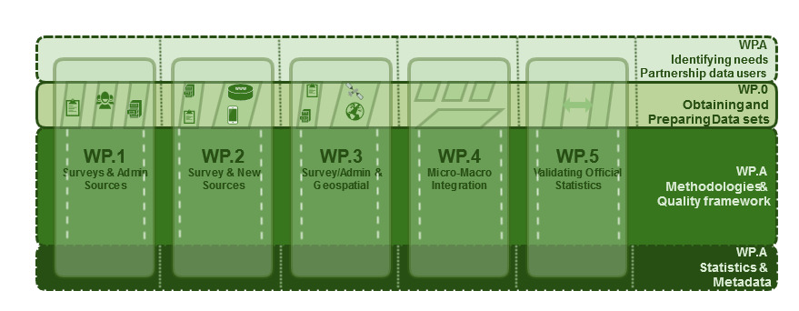
Work Packages – different WPs needed?
Citro, Constance F. (2014), From multiple modes for surveys to multiple data sources for estimates. Survey Methodology, December 2014 137 Vol. 40, No. 2, pp. 137-161. Statistics Canada

Slide 14
Some considerations/ideas to stimulate discussion
Sharp goals and focus - Year 2 – majority of activities should deliver something concrete
Maintaining the guide long term
Wikipedia-like? Crowdsourcing? Maintained by the community?
Form of the guide (Lydia’s question) – Formal version?
Expert group to assess and lead evolution?
Online inventory of best practices /methods / case studies
Mutual support between this project and other work (Link to revision of the standards?)
Evaluating success
A future MOOC (Massive Open Online Course)? Collaboration with academia?
Community broader than official stats?
Next step to develop project plan.

