Slide 1
Data Integration in Official Statistics – Collaborating for Success 2016 Results
UNECE Data Integration Project

Slide 2
Data Integration Project
Proposed by the Modernisation Committee on Products and Sources
Main objectives:
gain experience by collaborating on joint practical activities (experiments)
translate experience into general recommendations
provide initial guidance for a quality framework
12 countries involved so far: Australia, Brazil, Canada, Colombia, Hungary, Italy, Mexico, New Zealand, Netherlands, Poland, Serbia, Slovenia

Slide 3
Data Integration Project
Motivation:
Integrating different types of data can
Provide more timely & more detailed statistics
Provide new official statistics
Meet new and unmet data needs
Lower response burden
Overcome effects of reducing response rates
Address quality and bias issues in surveys
“We must move from a paradigm of producing the best estimates possible from a survey to that of producing the best possible estimates to meet user needs from multiple data sources” (Connie Citro)

Slide 4
Many challenges:
Partnerships with data providers and others
Moving from research to production
Set up and ongoing costs
Speed of adoption
Governance
Public perceptions and communication
Duplication of efforts
Different forms of integration
Producing stable output with unstable inputs
New skills, methods, IT approaches
Different Concepts
Minimum and ideal metadata required
Quality measurement and management

Slide 5
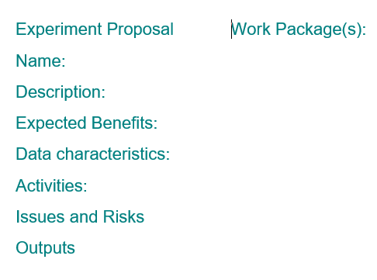
Project approach
PROJECT
WORK PACKAGES
Template for proposing experiments
11 Experiments proposed
Group reviewed and expressed interest in experiments
Both single and multi-country experiments
Face to face sprint in August 2016, hosted by Hungary
Synthesize learnings for Work Package A

Slide 6
Face to Face Sprint Workshop
Progressed understanding of individual work packages and experiments
Developed structure and initial content of a guide to data integration (Work Package A – Synthesize lessons learnt from new working methods)
Discussed and developed proposals for further work
Used wiki and webex to:
Allow virtual participants
Automatically document results

Slide 7
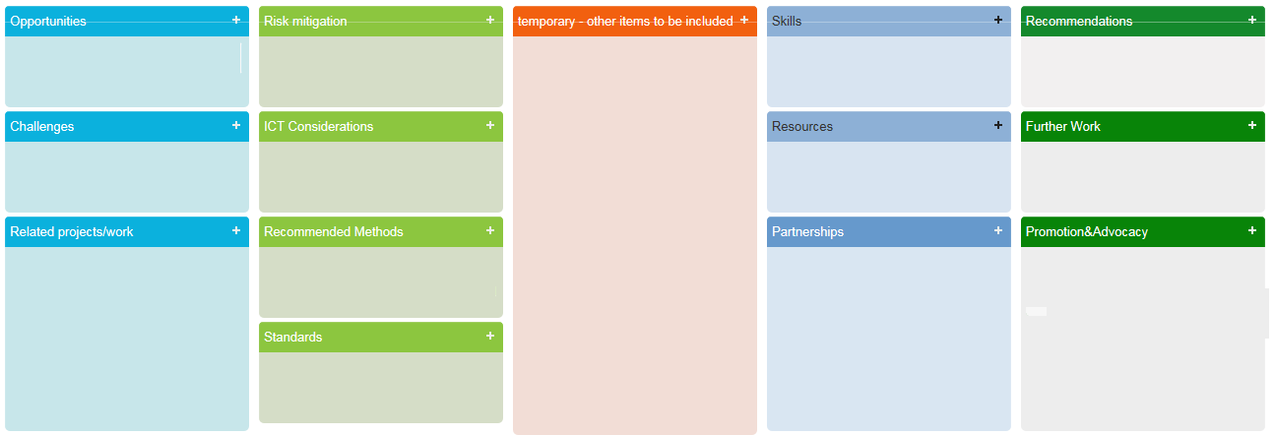
Structure of a practical guide

Slide 8
Structure of a practical guide
Opportunities
Challenges
Risk mitigation
Standard Processes
Recommended methods
ICT considerations
Quality
Standards
Related work in other projects/organisations
Skills
Resources
Partnerships
Governance
Promotion and advocacy
Recommendations
Expected Outputs 2016 and 2017.

Slide 9
Work Packages – Structure
Citro, Constance F. (2014), From multiple modes for surveys to multiple data sources for estimates. Survey Methodology, December 2014 137 Vol. 40, No. 2, pp. 137-161. Statistics Canada

Slide 10
WP0 Data Sets for Common Approaches
Participants
Frances Krsinich Statistics New Zealand (Coordinator)
Gergely Bagó HCSO Hungary
Zoltán Csányi HCSO Hungary
Tiziana Tuoto ISTAT Italy
Jon Wylie Statistics Canada

Slide 11
WP0 Data sets for common approaches
Activities
Identify and obtain data sets that can be used for testing in a collaborative environment
Prepare and make data sets available, in the Sandbox environment, if possible
Experiments
Online and scanner data for integrated price measurement
Results to date
Confirmed with providers that they would provide experimental data
Started familiarization with Sandbox
Provided initial guidance for approaches

Slide 12
WP1 Integrating survey and administrative sources
Participants
Kaja Malesic SURS Slovenia(Coordinator)
Zvone Klun SURS Slovenia
Ton de Waal CBS Netherland
Zoltán Vereczkei HCSO Hungary
Gergely Bagó HCSO Hungary
Zoltán Csányi HCSO Hungary
Julieth Solano DANE Colombia
Miodrag Cerovina DANE Colombia
Sinisa Cimbaljevic DANE Colombia
Mara Brigitte Bravo DANE Colombia
Melinda Tokai SORS Serbia
Katarina Marjanovic SORS Serbia

Slide 13
WP1 Integrating survey and administrative sources
Activities
Literature review on data integration methods
Design expected outputs of the integration
Design and test of transformation of the administrative dataset into the statistical dataset
Design and test of the integration of administrative data and survey data.
Evaluation of statistical outputs obtained from the integration of administrative datasets and survey datasets
Producing recommendations (initial guideline)

Slide 14
WP1 Integrating survey and administrative sources
Experiments
Integrating potential information sources for the statistical data production on job vacancies
Linking the Statistical Register of Employment and the Labour Force Survey
System of Consultation & Geographic Location of Schools (also WP3)

Slide 15
WP1 Integrating survey and administrative sources
Results to date
Three countries identified benefit of working together on common approaches for JVS
Tentative list of the steps of the involvement of secondary sources has been prepared
Test dataset has been accessed /Hungary/
Evaluation is under process

Slide 16
WP2 New data sources (eg big data) and traditional sources
Participants
Tiziana Tuoto ISTAT Italy (Coordinator)
Zoltán Vereczkei HCSO Hungary
Gergely Bagó HCSO Hungary
Julieth Solano DANE Colombia
Tijana Comic SORS Serbia
Anapapa Mulitalo Statistics New Zealand
Frances Krsinich Statistics New Zealand
Ricardo Lujan INEGI Mexico
Juan Munoz-Lopez INEGI Mexico
Jon Wylie Statistics Canada

Slide 17
WP2 New data sources (eg big data) and traditional sources
Activities
Design and test integration between Internet‐scraped data and traditional statistical datasets.
Include entity extraction and recognition and object matching
Explore new techniques - record linkage -> object matching (i.e. where an object can have a looser structure than a record)
Experiments
Integrating potential information sources for the statistical data production on job vacancies
Linking the Statistical Employment Register and abour Force Survey
A System of Consultation and Geographic
Location of Schools

Slide 18
WP2 New data sources (eg big data) and traditional sources
Results to date
Dependent on sourcing the appropriate data (in progress)
Haven’t used the big data lab this year but participants are keen to use it in the next 12 months
Created an initial list of the issues for the guide
Initial consideration of methodological changes required (eg if item attributes are missing from new sources) (Statistics Canada Paper)
Recognised changes required anyway because of changes in shopping habits (eg towards online sales)

Slide 19
WP3 Integrating Geospatial and Statistical Information
Activities
Review other efforts (like Eurostat’s GEOSTAT,GISCO,UN’s GGIM)
An inventory of sources and projects
Determine what valuable information could be produced by integrating statistical and geographical information
Research methodologies to produce new information products
Conduct some experiments and pilots to assess the value and adjust scope
Not expected to cover all the activities in just one year.

Slide 20
WP3 Integrating Geospatial and Statistical Information
Participants
Monika Sekular CSO Poland (Coordinator)
Julieth Solano DANE Colombia
Angel Alberto Arellano Rincon DANE Colombia
Sandra Patricia Rincón Méndez DANE Colombia
Mara Brigitte Bravo DANE Colombia
Ricardo Lujan INEGI Mexico
Juan Munoz-Lopez INEGI Mexico

Slide 21
WP3 Integrating Geospatial and Statistical Information
Experiments
Conduct work in purpose to inventory the level of integration spatial objects used in statistics and geodesy - The 10 Level Model for harmonization of statistical and geodesy reference framework
Analysis over a scheme of integration of geospatial and statistical information
Aim: “To establish one model or schema that allows countries to compare, analyze and monitor socio-economic phenomena, not only at national level but global level.
The project proposes the study of the existing models so that it can be determined which one is of better qualities to be applied globally, or which schemes or mixtures of them could be more adequate.”

Slide 22
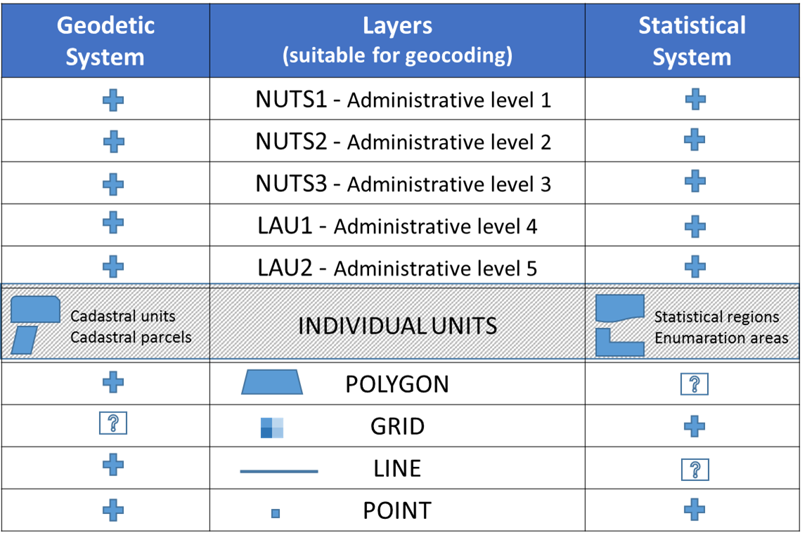
WP3 Integrating Geospatial and Statistical Information

Slide 23
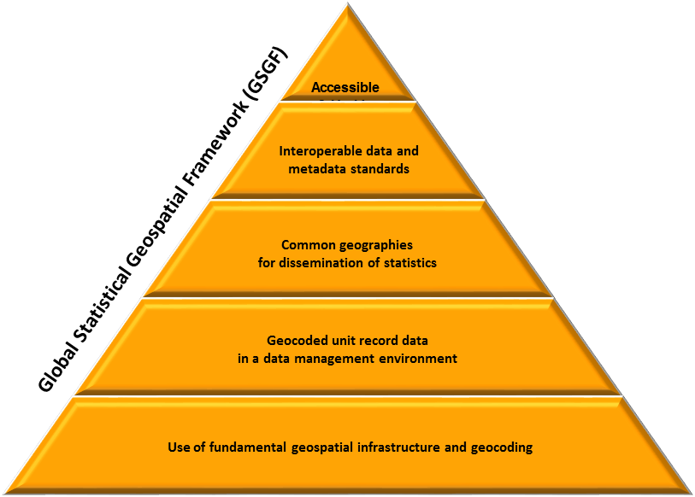
WP3
The proposal submitted by Colombia fits within the Polish proposal, because ‘The 10 level model’ is referenced to the three lower components of the Statistical Spatial Framework (SSF):

Slide 24
WP3 Integrating Geospatial and Statistical Information
Results to date
The assumption of the project notified by Poland was to carry out work aimed at making the synchronization of the cadastral and statistical division, which in consequence will unify the two systems.
This work was concentrated on examining whether a unified model is universal and possible to acceptable by other countries and to what extent it is possible to make it spread within creation the spatial at the national level.
A coherent model would increase the consistency of statistical data based on the integration of geospatial information.

Slide 25
WP3 Integrating Geospatial and Statistical Information
Results to date
This work was preceded by collecting the necessary information about the status of digitization through a questionnaire similar to which was carried out in Europe in Geostat 2 project.
In the first step work is consist on answering to the questions in the survey by the project’s participants.
These countries will be the coordinators to carry out the same survey among the countries of South America and possibly North and Central.

Slide 26
WP4 Micro – Macro integration
Activities
Identify potential sources and statistics that can benefit from micro‐macro integration
Road test existing guidelines in particular national settings and review, refine and further develop them
Experiments
Nil in 2016

Slide 27
WP5 Validating Official Statistics
Participants
Felipa Zabala Statistics New Zealand (Coordinator)
Zvone Klun SURS Slovenia
Kaja Malesic SURS Slovenia

Slide 28
WP5 Validating official statistics
Activities
Identify issues related to systematically using data from other sources in the validation of official statistics
Recommend potential approaches and modelling techniques
Experiments
A comparative analysis of income data from New Zealand Income Survey with administrative data
Linking the Statistical Register of Employment and the Labour Force Survey

Slide 29
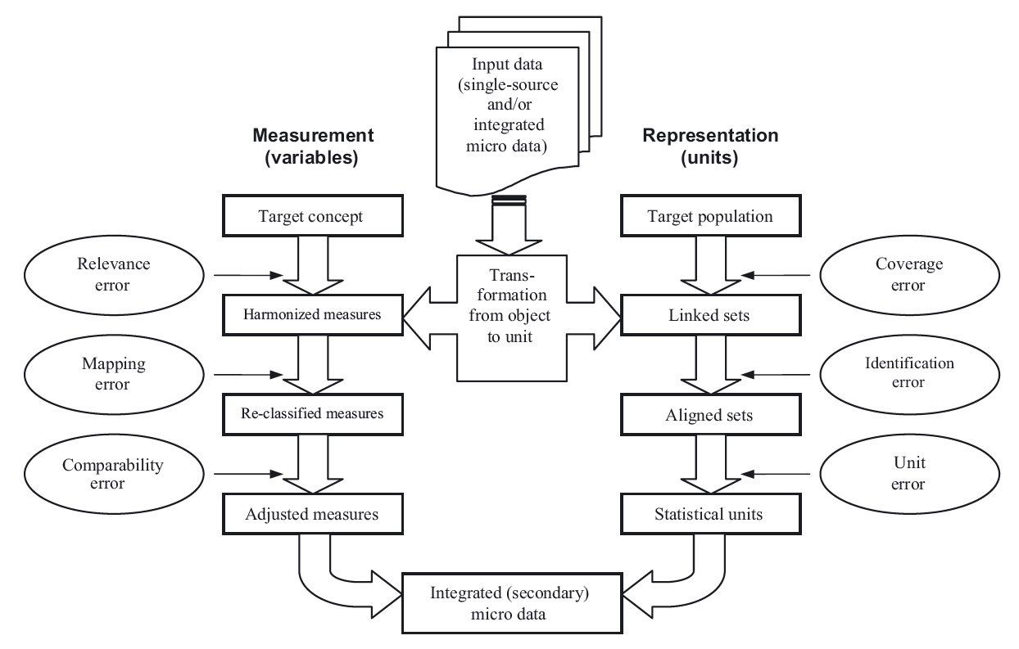
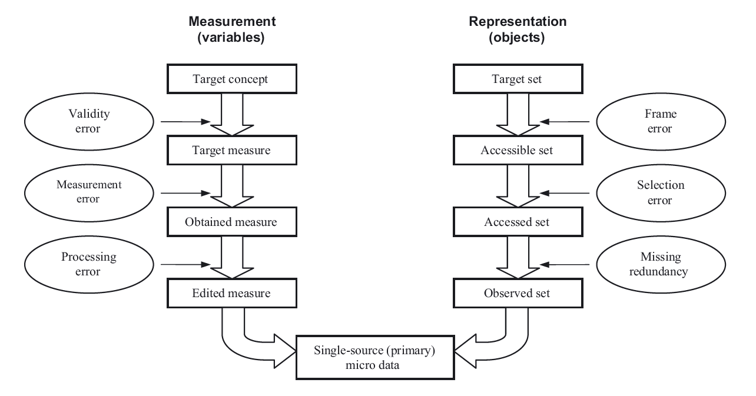
WP5 Validating official statistics
Results to date
Use of the Total Survey Error framework as implemented in Statistics NZ’s quality assessment framework: based on Li-Chun Zhang’s two-phase life-cycle model for integrated statistical microdata
Phase 1 error framework
Phase 2 error framework

Slide 30
WP5 Validating official statistics
Results to date
Identified some different applications and methods for validating official statistics.
Documented issues with use of administrative data to validate official statistics and lessons learnt from experiments and other validation projects to provide
initial guidelines in the use of administrative data to validate official statistics
recommend approaches and modelling techniques to resolve issues
Some examples of issues
Need for a weight to adjust for missed links
Better method to estimate linkage errors
Methods to adjust for linkage errors

Slide 31
WPA Synthesize lessons learned from new working methods
Activities
Synthesize in a clear and standard structure (guideline)
Seek input from others with experience
Results to Date
Group agreed on structure for a Guide to Data Integration for Official Statistics
Initial content provided

Slide 32
WPA Synthesize lessons learned from new working methods
Produce an online, adaptive, practical guide
Give a starting point
Simple structure if possible
Cover all relevant issues, risks etc
Promote the modernstats standards
Promote the international work on integrating geospatial and statistical information
Reuse not redevelop!
Case studies

Slide 33
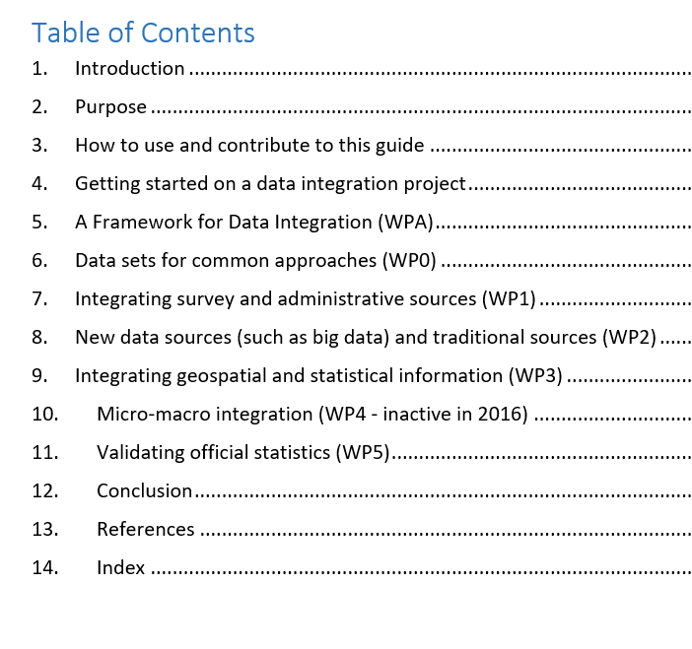
Structure of Guide

Slide 34
Definition of Success
Future
Common approaches for particular areas of statistics
Sources secured and risks managed
High
One or more concrete statistics produced
Guidance and quality frameworks created
Minimum
Countries share their experience
Collaborate on approaches in WP1-5
Methods developed
New sources easily incorporated into our statistics
Modernstats standards used
Guidance easy and effective to use

Slide 35
Concluding Messages
Enormous range of potential data sources
Need new methods and approaches to quality
Many countries are working on integrating multiple data sources
Working together can speed up modernisation
Opportunity to leverage the research and approaches in all of our countries
May be additional types of data integration that should be considered
Do you:
face similar issues?
work on similar experiments?
Have knowledge to share?
Please provide input for the guide!

