Slide 1
Pádraig Dalton Chair of the HLG-MOS

Slide 2
A look back…
Original Drivers:
limited funding, full work programs, aging infrastructure, and the challenges of a rapidly evolving environment
Original Response:
consolidation of efforts
increase the relevance of statistical frameworks to contemporary issues
work to evolve and share technology

Slide 3
Moving from inside-out to outside-in?
We maintained our assets (GSBPM, GSIM, CSPA etc.)
Increased the use of them
Explored how to access and use new data sources
Developed risk and training frameworks
Product
Statistical Organisation Statistical Organisation
Data
ü
Process
ü

Slide 4
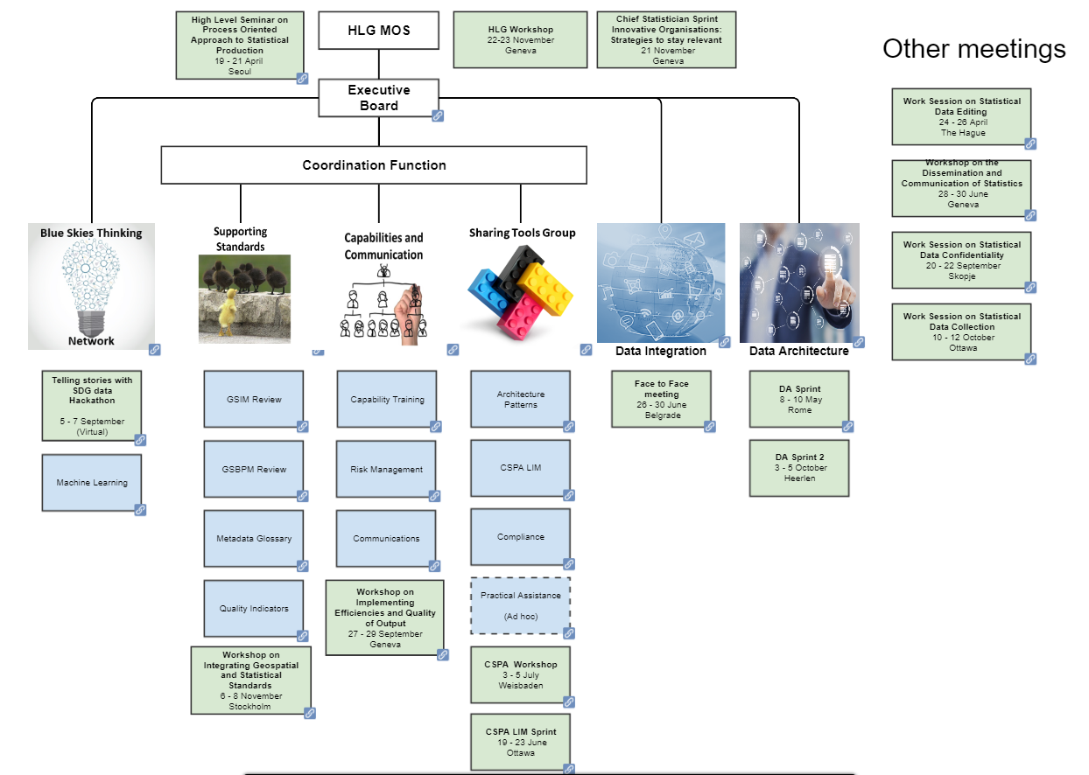

Slide 5
What have we accomplished?
Sharing Tools
CSPA Service Catalogue
Capabilities and Communication
Capabilities Development Training Framework
Risk Management Training
Supporting Standards
Began the review of GSBPM and GSIM
Metadata Glossary: GSBPM phases and sub-processes
GSBPM Quality Indicators for surveys and Admin data sources
LIM Variables
Architecture patterns
Understanding CSPA compliance

Slide 6
What have we accomplished?
Blue Skies Thinking Network
Telling stories with SDG data Hackathon
Workshops and Work Sessions
Work Session on Statistical Data Editing
Reference Data Architecture
Projects
Workshop on Statistical Data Dissemination and Communication
Work Session on Statistical Data Confidentiality
Workshop on Statistical Data Collection
Data Integration Guidelines
Position paper on Machine Learning

Slide 7
Great job!

Slide 8
And a look forward…
Statistical Organisation ? Statistical Organisation ?
Product
?
Data
ü
Process
ü

Slide 9
What are the next key priorities?
[Add content after sprint?]

Slide 10
Comments and Questions?

