Slide 1
INTERNATIONAL COLLABORATION TO MODERNISE OFFICIAL STATISTICS
WORKING TOGETHER TO REMAIN RELEVANT IN A CHANGING WORLD

Slide 2
Cross-cutting task team on communicating modernisation

Slide 3
The objective
to improve the way that modernisation activities are communicated within the official statistics community
to increase the visibility of the HLG-MOS and its MC and projects
to explain HLG-MOS activities

Slide 4
Modernisation path
Low visibility of modernization process among NSIs
Task team
WTO + UNECE
+ 9 NSI
→Branding
→Communication strategy
→Promotional activities

Slide 5
recognizable brand → increased visibility
The short name HLG-MOS and the associate brand: modernstats
LOGO & AVATAR for social media (twitter, YouTube)

Slide 6
Communication strategy
to increase awareness and understanding of the modernization process related to statistics
to better inform audience on future developments
to promote understanding to how these developments impact on the work of national statistical organisations

Slide 7
PROMOTIONAL ACTIVITIES VIDEOS
5 videos in one- HLG-MOS

Slide 8
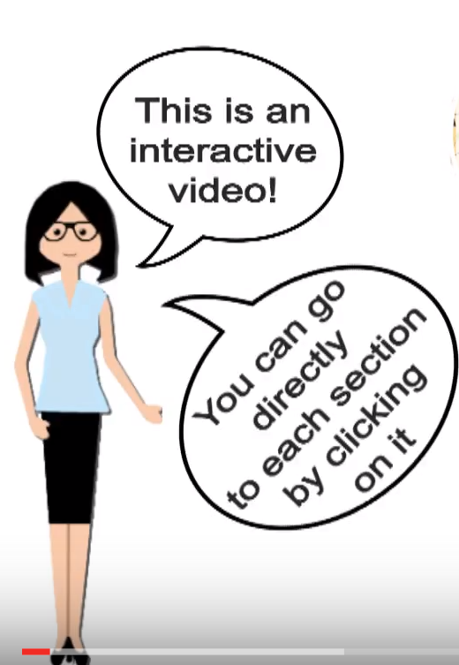

Slide 9
Video- the Fundamental Principles of Official Statistics

Slide 10
Video – Modernisation- challenges

Slide 11
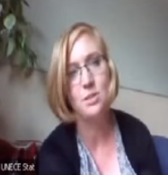
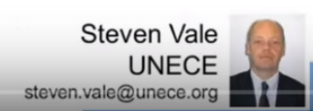
Promotional activities webinars
Thérèse Lalor therese.lalor@unece.org
GSBPM and GAMSO
Generic Statistical Information Model (GSIM)

Slide 12
Promotional activities social media
@modernstats
information on the modernization of official statistics

Slide 13
Other promotional activities
Articles
Questions to the expert/Answers
Presentations
Ready to be translated, re-used
How to find this basic kit of info?

Slide 14
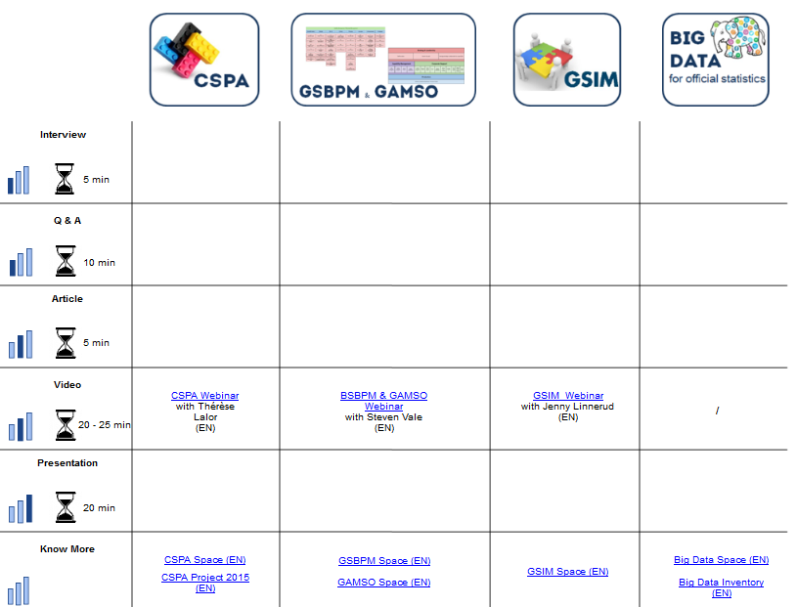
Basic kit of information for a project
Based on expert level & time available (from 5 minutes)
Information to share, translate, re-use

Slide 15
Promotional activities through 2015
Brown bag lunches
Seminars
Dissemination Working
Group

Slide 16
Lessons learnt
Many people from NSOs DO NOT know:
HLG-MOS
Modernisation Committees
Modernisation projects
Even in NSOs involved in modernisation

Slide 17
Future
Closer cooperation between project experts and the communication team
Basic-kit of information easily available for each project
Create new possible products: e.g. Newsletter, Leaflets
Active participation in the Social media
Regular webinars (to keep up to date)
Promotion through different Modernisation Committees

Slide 18
Basic-kit of information example

Slide 19
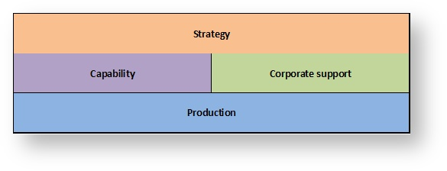
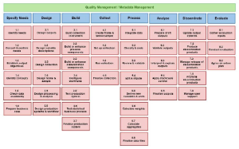
More info http://www1.unece.org/stat/platform/x/xIR8Aw
BIG DATA
GAMSO
CSPA
GSBPM

