Slide 1
The Sandbox 2015 Report
Antonino Virgillito
Carlo Vaccari
Project coordinators, UNECE - ISTAT

Slide 2
INTRODUCTION

Slide 3
Our presentation
Introduction
Activities
Comtrade
Enterprise Web Sites
Wikistats
3
4
Twitter
Future
Conclusions
Notes:
SO1 Sources collection and manipulation
SO2 Production of quality statistics
SO3 Correspondence with existing products
SO4 Cross-country sharing
SO5 CSPA-based sharing

Slide 4
What is the Sandbox
Shared computing environment developed in partnership with the Irish Central Statistics Office and the Irish Centre for High-End Computing (ICHEC)
2
A unique platform where participating organisations can engage in collaborative research activities
3
4
5
Open to all producer of official statistics
Notes:
SO1 Sources collection and manipulation
SO2 Production of quality statistics
SO3 Correspondence with existing products
SO4 Cross-country sharing
SO5 CSPA-based sharing

Slide 5
Sandbox background: 2014
Big Data project 2014: four Work Packages
Social Media
Mobile Phones
Prices
Smart Meters
Job Vacancies
Web scraping
Traffic Loops
1
Work Package 1: Issues and Methodology
2
Work Package 2: Shared computing environment ('sandbox') and practical application
3
Work Package 3: Training and dissemination
4
Work Package 4: Project management and coordination
Notes:
SO1 Sources collection and manipulation
SO2 Production of quality statistics
SO3 Correspondence with existing products
SO4 Cross-country sharing
SO5 CSPA-based sharing

Slide 6
Sandbox 2015 goals
Publish a set of international statistics based on Big Data, before the end of the year
Choose 2-3 Big Data sources
Collect Data
Compute multi-national statistics
Organize press conference
Conclude 2014 experiments on the Sandbox

Slide 7
The Sandbox 2015
Installed Software
— Hadoop (Hortonworks Data Platform)
— R – Rstudio
— RHadoop
— Spark
— ElasticSearch
and growing…
4 Data/Compute nodes
— 2 x 10 core Intel Xeon CPUs
— 128 GB RAM
— 4 x 4TB disks
— 56 Gbit InfiniBand network
2 Service/login nodes
— Similar hw as data nodes
— 10Gbit connection to Internet

Slide 8
Participants
More than 40 people from 22 entities
International organisations: Eurostat, OECD, UNECE, UNSD
Countries: at, ch, de, es, fr, hu, ie, it, mx, nl, pl, rs, ru, se, si, tr, uae, uk, us
Active participants: about half of the total
ICHEC Assisted the task team for the testing and evaluation of Hadoop work-flows and associated data analysis application software

Slide 9
Work Groups
Four main activities, for each task one multinational group
Wikistats - Wikipedia hourly page views: use of an alternative data source
Twitter - Social media data: experiences comparison in tweets collection and analysis
Enterprise websites: the Web as data source - web scraping and business registers
Comtrade - UN global trade data: use of Big Data tools on a traditional data source

Slide 10
ACTIVITIES
Wikistats

Slide 11
Description
Statistics on hourly page views of articles in the several language versions of Wikipedia
Download and process to obtain manageable data
UNESCO heritage sites
Cities and Beaches
Popularity
Touristic potential
3
Wikipedia page views is a potential source for many domains: tourism, culture, economic, …

Slide 12
Data Characteristics
Wikipedia
seventh website (Alexa)
Public source
(contents and metadata)
3
Digital traces left by people in their activities
Widely used:
44% of EU 16-74
69% of EU 16-24

Slide 13
Activities
Pre-processing: scripts in shell and Pig to filter data and change time-series format
Extraction: MapReduce, shell and python to filter articles and time aggregation (hourly to daily, weekly and monthly)
3
Analytics: R and RStudio for web scraping, selection of articles and Data analysis

Slide 14
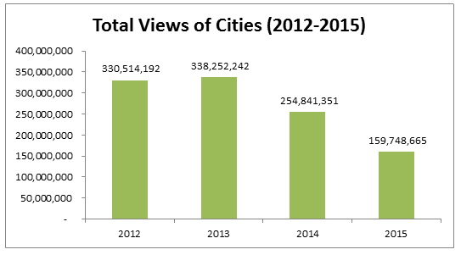
Outputs
3
More than one billion views!

Slide 15
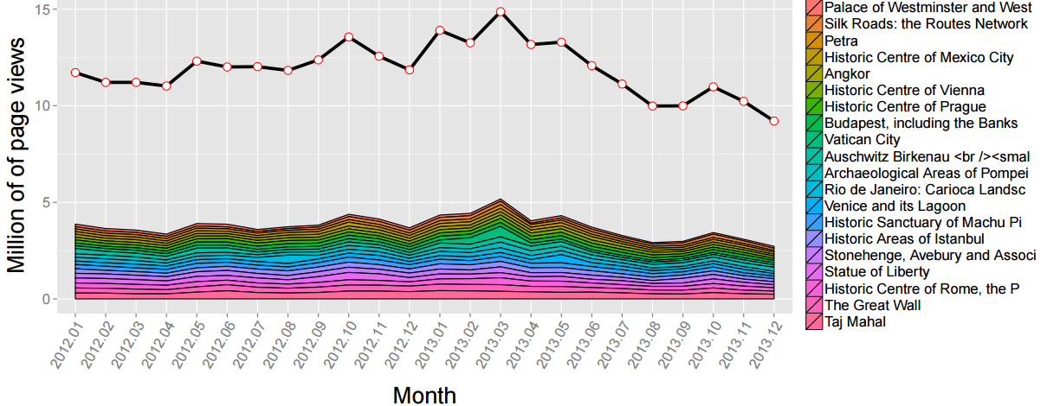
Outputs
3
See peak for Vatican City in 2013 March for pope Francis election

Slide 16
Findings
Relevance:
Good for culture and regional statistics
New topics uncovered so far
Many other potential topics
Unprecedented temporal detail
3
Technology:
Experience: scripts, Pig and RStudio
Try NoSQL, Spark, Elasticsearch
Problems with Java integration
Need resource-scheduling system

Slide 17
Findings
Source
Good potential, need more investigation
Data available, adequate IT needed
No privacy concerns also on individuals
Continuity: substantial, not guaranteed
More mobile users: need to investigate
3
Quality
Accuracy (bot excluded), categorization
Timeliness: good, data few hours later
Comparability in space and between languages
Crowd-sourced: improve completeness
Can improve statistics: new phenomena

Slide 18
How far are we from something that can be published?
a) Concerning the results of the experiment
Almost ready for publish first experimental statistics with 30 languages (Issues on encoding)
b) Concerning statistics based on this data source in general
Results data source well received by domain experts (page views)
No issues of accuracy, but interpretability issues need validation
New statistics like ”index of consumption of digital cultural products” require methodological development and conceptual frameworks
3

Slide 19
What case has been made for the future of the Sandbox?
Sandbox fundamental to experiment with this data source (desktop computers are simply not able to process this source)
Present and future existence of the sandbox is important to develop further the work done, with tools which can increase the process efficiency (HBase Elasticsearch)
Sandbox is also important to make the system available for other statisticians: the code is available in GitHub, but not the data. In the sandbox, where the data is available, statisticians can re-use the code, try and build other applications on those data.
3

Slide 20
ACTIVITIES
Twitter

Slide 21
Description
Geolocated tweets
2015: two approaches:
Public stream (Mexico , UK)
Buy data (UK)
Source instability with technological changes
Comparison of Data Preprocessing
Data analysis: distinct targets, methods and tools
3

Slide 22
Data characteristics
 | UK ONS | Mexico INEGI
Period | April - August 2014 (API) August - October (gnip) | February 2014 – Today (running)
Method | Public Twitter API Purchased from GNIP | Public Twitter API
Percentage of Twitter Active Users | 5.6% | 3.0%
Percentage of Geo-Referenced Tweets | 1.57% (London) | 1.03% (Mexico City)
No-SQL Database | CSV, MongoDB | Elastic Search
Total Records: | ~106 million collected ~81.4 million used | ~150 million collected ~74 million used
3

Slide 23
Outputs
Procedures for collecting geolocated tweets from public stream:
Mexican version
Sandbox version
3
Data Collection in progress on the Sandbox for tweets geolocated in Rome (Italy) for future study on Jubilee 2015-2016

Slide 24
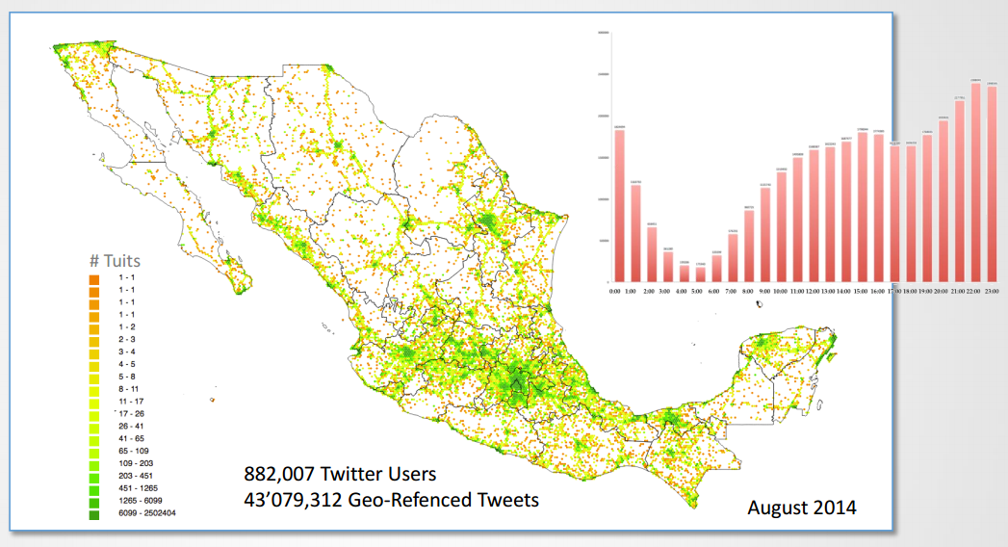
Outputs
3

Slide 25
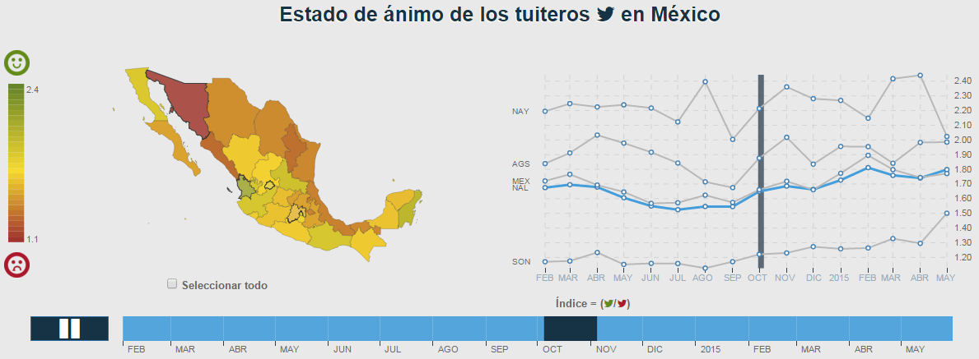
Outputs
3

Slide 26
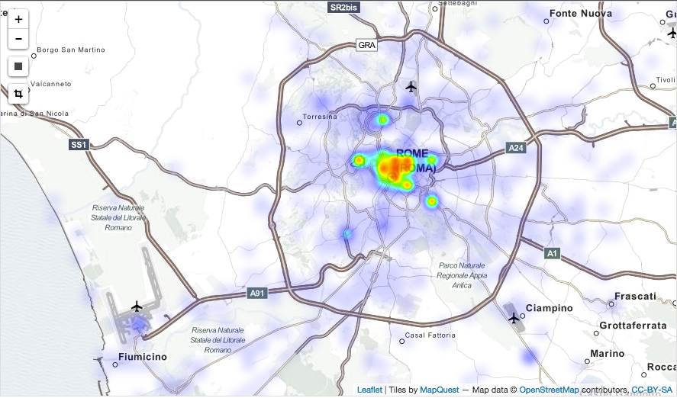
Outputs
3

Slide 27
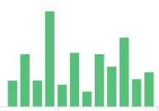
Outputs
Number of tweets generated in the Rome area (each bar = 12 hours)
Filtered on tweets containing the words “Paris” or “Parigi”

Slide 28
Findings
Technology
Elastic (Elasticsearch) good tool to collect and index data
Kibana is a good tool to visualize data
Source
Continuity: technology outside NSOs control
Continuity depends on even small changes to technology
Rules for Data collection: fragile legal basis, better acquire data (cost UK £25,000/year)

Slide 29
How far are we from something that can be published?
For people mobility we are close to “official usage” in Mexico
Sentiment analysis Twitter data quite officially used in Netherlands
What case has been made for the future of the Sandbox?
Procedures to collect data from Twitter ready on the Sandbox, together with tools ready to analyze those data
Data collection already active on Rome geolocated tweets, ready for analysis on tourists mobility during Jubilee

Slide 30
ACTIVITIES
Enterprise Web Sites

Slide 31
Description
Objective: using web sites of enterprises as a source to create statistics
Issues
Obtain from registries/survey
Obtaining URLs of web sites
Different approaches were experimented
Obtain from search engines
Implementing a method for scraping data from web sites
Different approaches were experimented for both scraping and analysis phases
Number of enterprises which advertise Job Vacancies broken down by NACE activity and region
Computing the statistics

Slide 32
Data Characteristics
 | Sweden | Slovenia
Websites | 13.000 | 15.000
Websites used in the experiment | 1.500 | 1.335
Web pages | 50.000 | 1.068.000

Slide 33
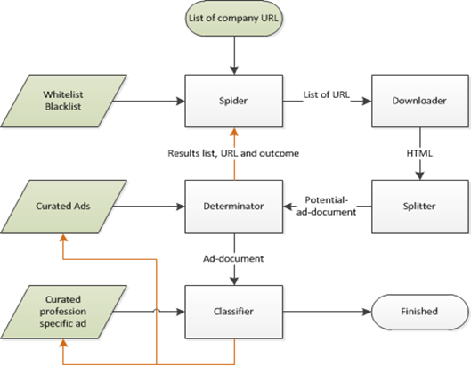
Activities
Development of an application for scraping the job vacancies data starting from URLs of enterprises
- Not tied to language/method
- Developed in Python
- Available in the Sandbox
Spider – Downloader Start from a list of URLs, follow the links and download the content of the employment pages
3
Determinator – Classifier Implement a method for detecting and classifying job vacancies advertisements in the scrapped content

Slide 34
Activities
Developed two different methods for implementing the Determinator module (detection of job vacancies)
machine learning approach: 92% accuracy (Swedish data)
Keyword (phrases)-based: 80 % accuracy (Slovenian data)
Created statistics from scraped data
Tested a technological stack for scraping/analyzing web sites on a large scale
Nutch – Elasticsearch - Kibana
3

Slide 35
Outputs
Program to scrape and analyze web sites
deployed in the Sandbox, can be used in general
Statistics about the number of JV per NACE group, as calculated from the scraped data
Distribution compared with that obtained from the survey
Distribution using survey weights compared with distribution using calibrated weights (by number of employees)
3

Slide 36
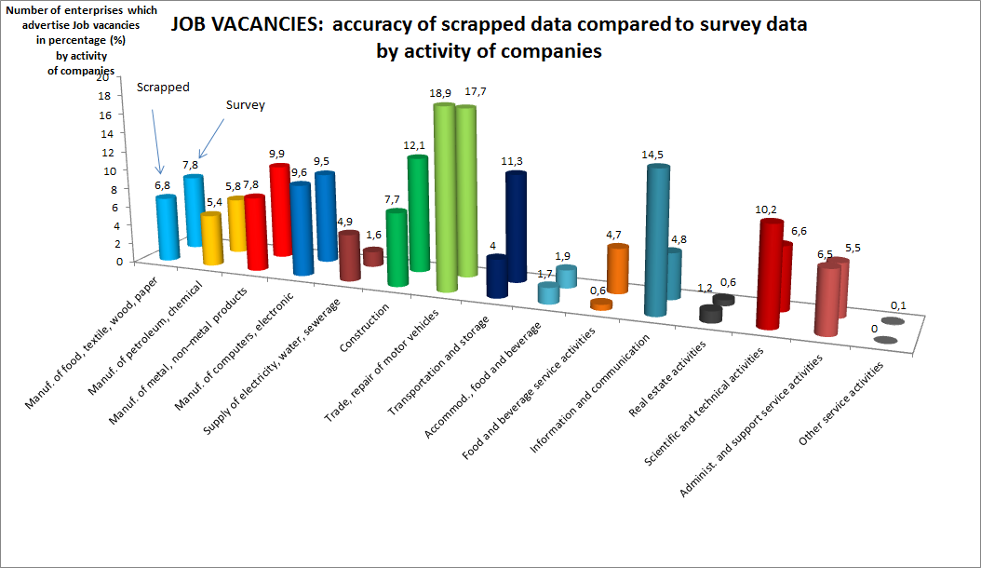
Outputs
Slovenian data

Slide 37
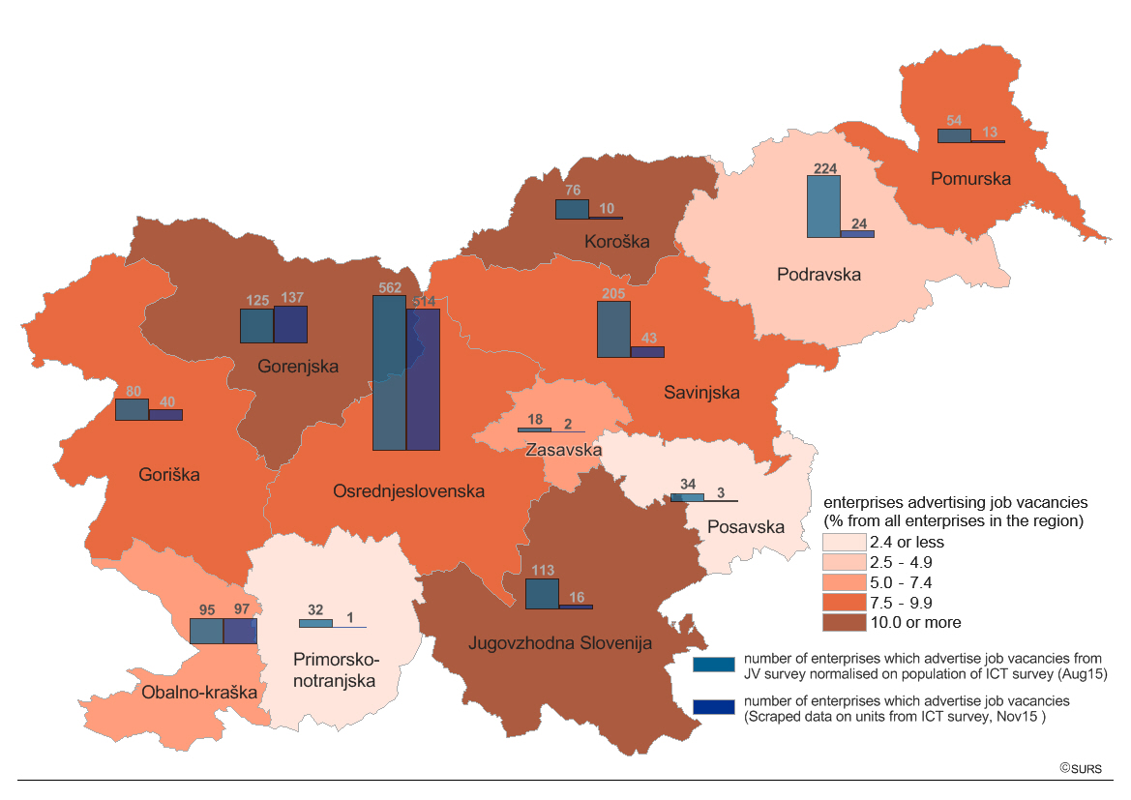

Slide 38
Findings
Privacy
Retrieving and sharing URLs of web sites was not as easy as expected
Still not clear yet whether URLs collected as microdata from Slovenian survey could be used in the Sandbox
Methodology
Promising results from the machine learning approach to identification of job vacancies
3
Methodology
Comparison with distribution of job vacancies per NACE revealed coherence with survey results, indicating that the approach is solid

Slide 39
How far are we from something that can be published?
• The main problem for publishing the results are non existent lists of URLs of enterprises in most of the countries (i.e., impossible to determine population)
• As an experimental activity, we started to get first results only recently. Six further months of activity would be needed to reach solid results
• However, the prototype is producing promising outcomes in two countries
• Reliable statistics will most probably be based on multiple sources (Job portals and administrative data from agency of Employment,..)
3
What case has been made for the future of the Sandbox?
• The prototype of the IT tool for detecting the JV is available in the Sandbox
• It can be used by other countries with small modifications of parameters

Slide 40
ACTIVITIES
Comtrade

Slide 41
Description
UN Comtrade compiles official trade statistics database since 1962 containing billions of records
Due to interest in measuring economic globalization through trade, trade data has been used to analyse interlink between economies
3
This project is intended to exploit the capability of the tools in Sandbox to process large amount of data to perform analysis of the trade network on a wider scale
identify regional global value chain networks and analyse their properties.

Slide 42
Data Characteristics
Dump of the comtrade DB
Each record represents flow of import export between two countries (reporter and partner)
The data that is stored in the sandbox are from year 2000 to 2013 in Harmonized System classification for all available reporters.
The total number of data points is around 325 millions records.
3

Slide 43
Activities
Tools:
Data acquisition
Extraction from UN Comtrade database, transfer via FTP to the Sandbox.
Data loaded into HDFS and made available in Hive
Data cleaned up before it could be fed into Hive (eliminate quotes, commas etc.)
Pig
Hive
Data preparation
Imputation of gaps, present in the data as not all countries regularly report to UN Comtrade for the combination of reporter-period.
Remapping of codes.
Pig
Hive
3

Slide 44
Comtrade - Activities
Tools:
Quality analysis
Measured the coherence between symmetric flows and detect number of missing values.
Tested two different approaches
Hive + Python
RHadoop
Data visualization
Built several visualizations of the trade networks using different tools
Gephi
D3
3
Network analysis
Computed several metrics of graph characteristics analysis of differences and trends in graphs indicators.
Tested two different approaches
Spark
Hive + R

Slide 45
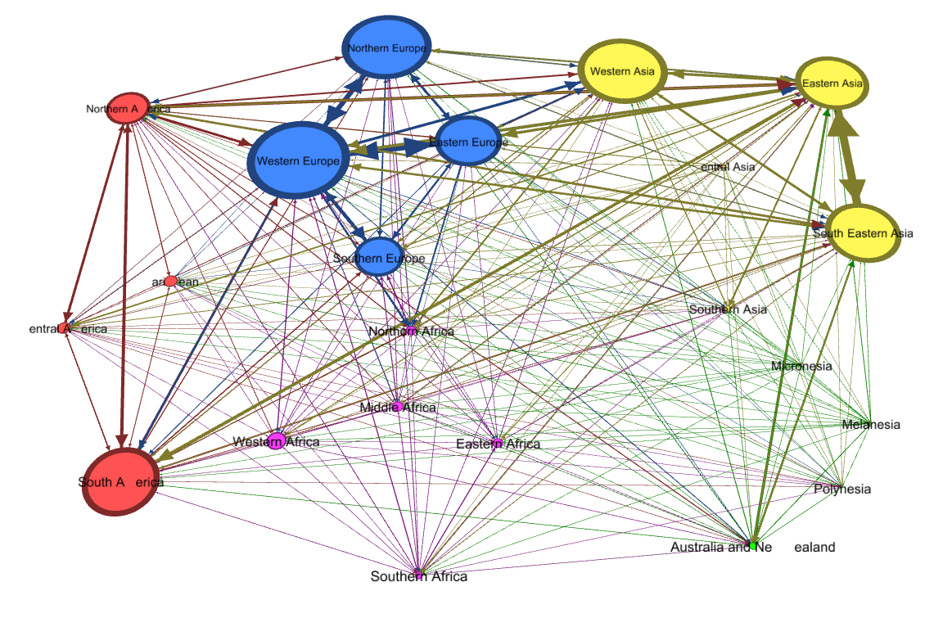
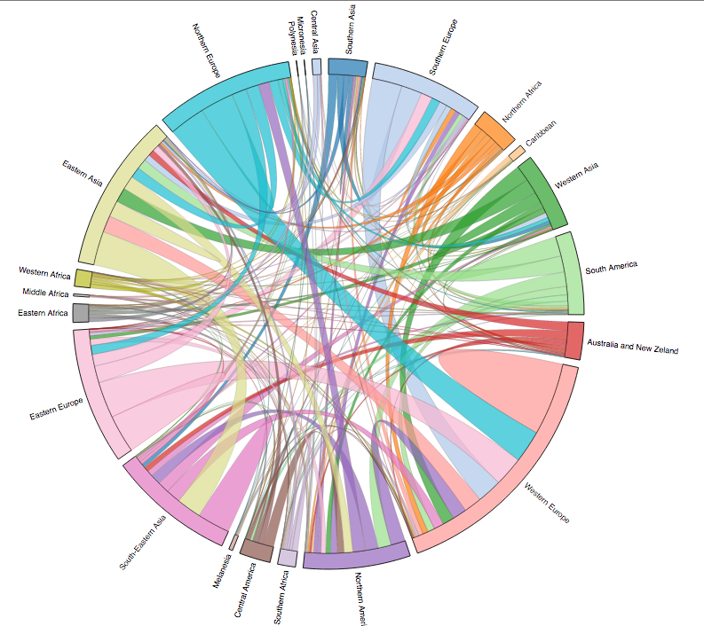
Outputs - Visualizations
Trade of intermediate goods by geographical region
3
Made with Gephi
Made with D3

Slide 46
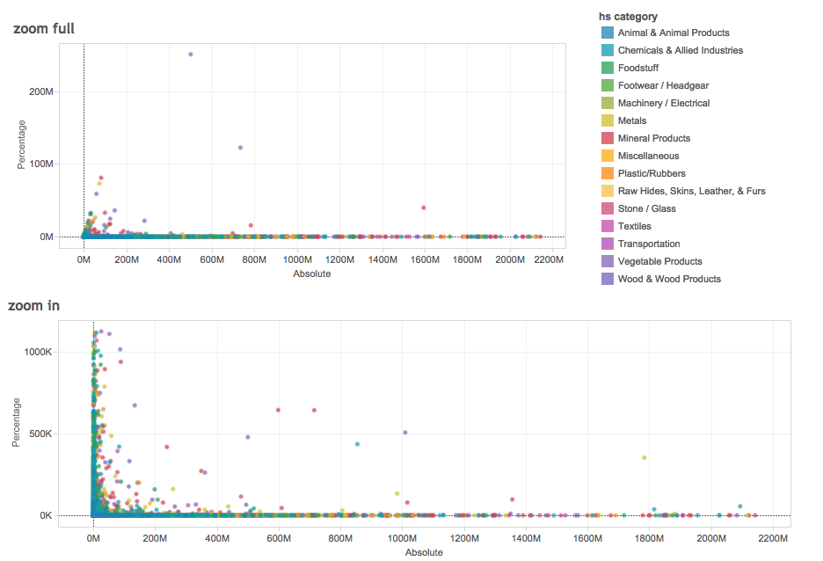
Outputs – Quality Analysis
Differences in symmetric import-export flows (absolute vs percentage)

Slide 47
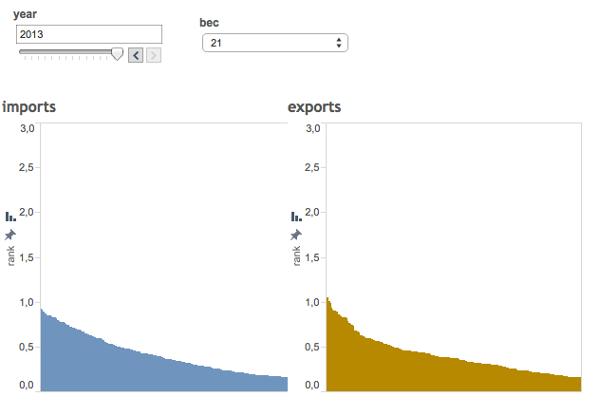
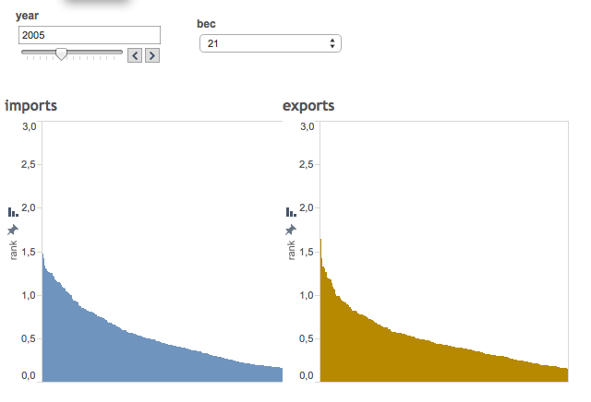
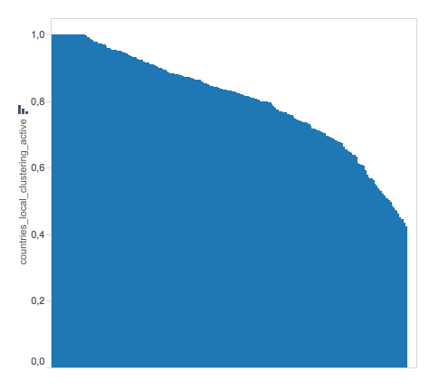
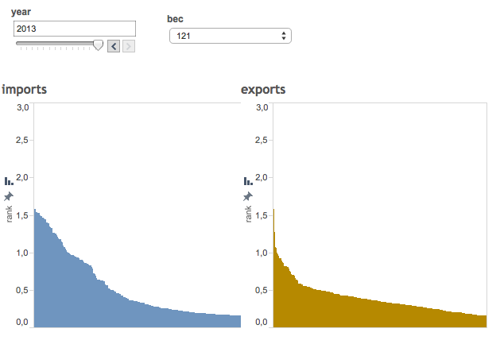
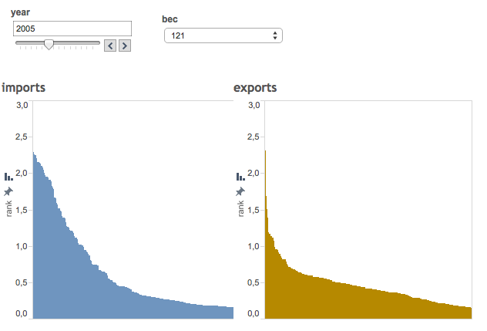
Outputs – Network Analysis
Distribution of PageRank
Computed with Spark
Distribution of local clustering
Computed with Hive + R
import vs export
Different network indicators
2005 vs 2013
Different commodities

Slide 48
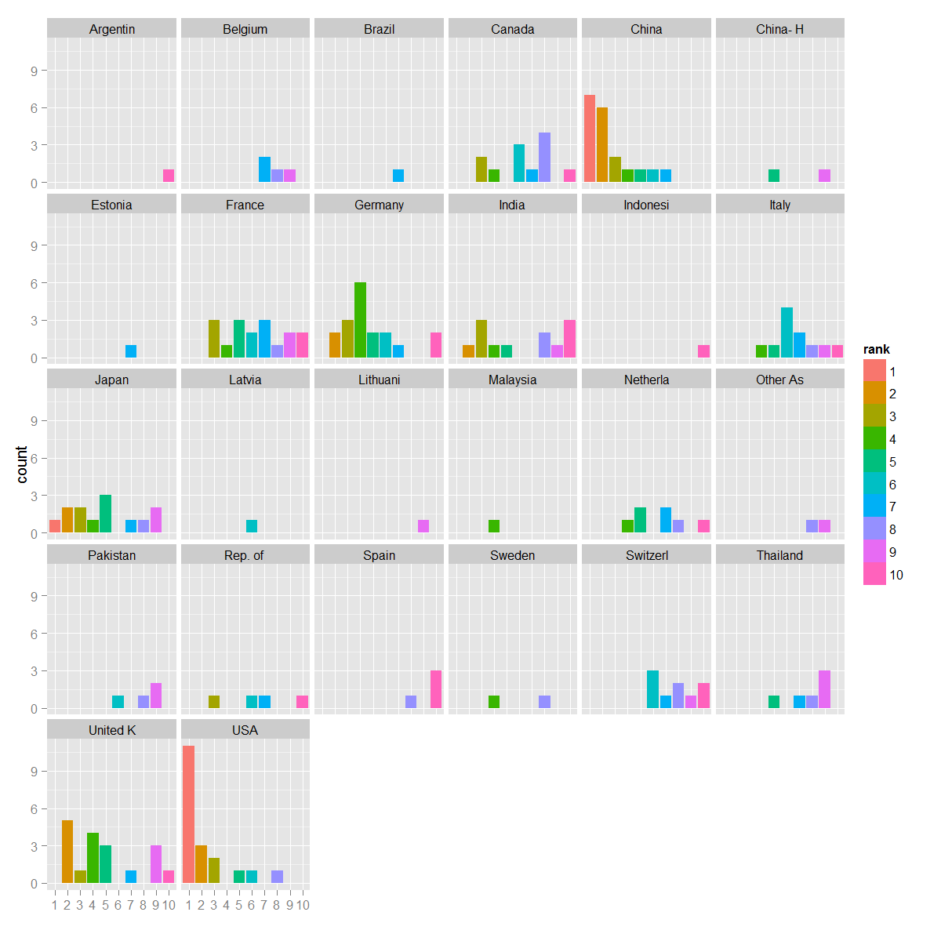
Outputs – Network Analysis
Countries that were counted at least one time in the ten best ranks after application on the PageRank algorithm on each network for 2012
3

Slide 49
Findings
Relevance
Comprehensive analysis of global value chain through trade networks in all economic sectors is crucial part to better understand international trade and new approaches as those we experimented are needed
Technology
8 different tools/languages were used to work with the data
Starting from data in basic text format made easy to switch from one tool to another
3
Technology
Processing data with the Sandbox provided evident advantages in terms of processing time and manageable size wrt current tool used at UNSD (Relational DB)

Slide 50
Findings
Methodology
The methodology used to prepare and analyse trade data is not new but the sandbox environment enables comprehensive analysis of the whole data set
3
Methodology
Novel methods for "automatic" detection of network clusters through machine learning approaches are on the agenda and should be tested before the end of the project

Slide 51
How far are we from something that can be published?
The objective was not to produce statistics. However analysis such as those produced in this experiment are normally published by international research centers and institutions.
What case has been made for the future of the sandbox?
3
It is possible to use big data tools and technologies (Hadoop, Pig, Hive, Spark and Gephi) in processing and analyzing large volume of trade data
The easiness of setting up the data environment, powerful computing power and availability of built-in libraries to analyse networks may change the way trade analysts work

Slide 52
FUTURE OF SANDBOX

Slide 53
Beyond the Big Data Project
Extend access to the Sandbox beyond the current project (December 2015)
Based on strong interest from a number of statistical organisations
ICHEC is willing to continue to provide the Sandbox as a service to the international statistical community, on a non-profit basis
Users will be required to pay an annual subscription to cover the costs of technical support, hardware upgrades and installation of software
below: some use cases for future Sandbox …
3

Slide 54
The Sandbox: Use Cases
Running experiments and pilots
The sandbox can be used for experiments involving creating and evaluating new software programmes, developing new methodologies and exploring the potential of new data sources
3
This use case extends the current role of the sandbox beyond Big Data, and encompasses all types of data sources

Slide 55
The Sandbox: Use Cases
Testing
Setting up and testing of statistical pre-production processes is also possible in the Sandbox, including simulating complete workflows and process interactions
3
The environment could be used also for testing other kind of software, beyond Big Data tools

Slide 56
The Sandbox: Use Cases
Training
The sandbox can be used as a platform for supporting training courses. It can run special software for high performance computing which cannot be installed or run on standard computers
3
Non-confidential demonstration datasets can be uploaded and shared, facilitating shared training activities across organisations
The sandbox environment also allows statisticians opportunities for self-learning, e-learning and learning by doing

Slide 57
The Sandbox: Use Cases
Supporting the implementation of the Common Statistical Production Architecture (CSPA)
3
The sandbox can be used as a statistical laboratory where researchers can jointly develop and test new CSPA-compliant software

Slide 58
The Sandbox: Use Cases
Data Hub
The sandbox also provides a shared data repository
(subject to confidentiality constraints)
It can be used to share non-confidential data sets that cover multiple countries, as well as public-use micro-data sets
3

Slide 59
The Sandbox: Use Cases
Big Data Technologies for Statistics
Big Data technologies have proven to be usable for many of the elaborations standards of statistical data
3
Parallel processing and NoSQL seem to be able to effectively backup the traditional software like RDBMS and old file systems

Slide 60
What you pay
Subscription fee
10k€ per year
What you get
Access to the Sandbox, shared tools, datasets and other resources for your staff
Access to international collaboration projects and opportunities
Technical support to keep the Sandbox infrastructure up to date and relevant to your needs
Support for coordination of experiments between countries and for knowledge sharing
3

Slide 61
How to Subscribe
Expression of interest coordinated by UNECE support.stat@unece.org
Each subscriber will have a seat on the Strategic Advisory Board, a new group which will oversee Sandbox operations
collectively decide, in consultation with ICHEC, on subscription levels and priorities for expenditure on software and hardware
Any organisation producing official statistics can subscribe to the Sandbox
Other organisations may be considered on a case-by-case basis subject to the approval of the Strategic Advisory Board
Because the Sandbox activities are closely linked to the work of the HLG-MOS, the UNECE has been asked to facilitate contacts between the official statistical community and ICHEC, and support the functioning of the Strategic Advisory Board
3

Slide 62
OUTCOMES

Slide 63
Summary of Activities Outcomes
Publishable products | Sandbox value
Yes, as «alternative» statistics | Storage and collection Use of tools
Already published in some countries | Sharing of methods
Further work required | Sharing of methods Use of tools
Yes, as research | Storage and collection Use of tools

Slide 64
Technology
Proved use of big data technology to process “traditional” statistical data more efficiently
Novel trend in statistical organizations
Proved practical advantage in using Sandbox tools over “traditional” ones also when dealing with “medium”-size data
Different tools could be used in the same experiment on the same dataset

Slide 65
Use of Tools
Hive |  |  |  | ✓
Pig | ✓ |  |  | ✓
RHadoop | ✓ |  |  | ✓
Elasticsearch |  | ✓ | ✓
Spark |  |  |  | ✓
Python | ✓ |  | ✓ | ✓
R | ✓ | ✓ |  | ✓
Graph visualization |  |  |  | ✓

Slide 66
Sharing
Consolidated the importance and the advantages of working in a cooperative way
Shared knowledge on tools, methods and solutions
Gathered lessons learned from activity made also outside the project
Great value from Sandbox approach
Common environment ready in zero time, with no need for installations, configurations etc.

Slide 67
“Usable” outcomes
Datasets
wikistat, comtrade, tweets
Tools
web scraping, twitter collection, wikistats preprocessing
Training material on tools and sources

Slide 68
Sources
Difficult to find “quality” sources
Public data is limited in terms of expected quality and/or requires a lot of processing
Privacy issues always present even in apparently public sources (e.g. limitations in the use and sharing of scraped data)
Two kinds of actions needed
negotiations and agreements with providers
political actions at legislative level

Slide 69
Big Data Features
Statistics based on big data sources will be different from what we have today
new sources can cover aspects of reality that are not covered by traditional ones
Methods should adapt to this
accept different definition of quality
wider interpretation of results (e.g. consider distorsions due to events)
We should learn to accept inherent instability of sources in short-long term

Slide 70
Value of the Sandbox
The Sandbox represents the fastest route available to statistical organizations for starting with Big Data
It offers several features that facilitate the approach to Big Data and data science
An infrastructure for big data processing ready for being used at a low subscription cost
Software already installed and proved/tested
Shared datasets instantly available
Tools and material for capacity building
It is driven by the community
Worldwide network of organizations, with a catalogue of initiatives
A place for collaboration on methods and products, not only related to Big Data
A unique container of experience in management of statistical data
3

Slide 71
Concluding Remarks
Huge thanks to all participants and to the HLG
We feel we made great steps ahead from where we started two years ago
Our hope is to not “waste” the experience
tools, methods, knowledge, networking
connect the Sandbox with national experiences and with “other sandboxes”

Slide 72
THANK YOU!

