Slide 1
Introduction of the MC electrical brake technology and regulation applicability discussion
Submitted by the expert from China
Informal document GRVA-15-32
15th GRVA, 23-27 January 2023 Provisional agenda item 9
For the 15th meeting of WP.29/GRVA

Slide 2
Motorcycles (MC) in China

Slide 3
E-MC in China

Slide 4
E-MC Advantages
1）Zero emission
2）Low noise
3）High engery efficency
4）New technology applied(Integrated rim motor, Electrical brake, etc.)

Slide 5
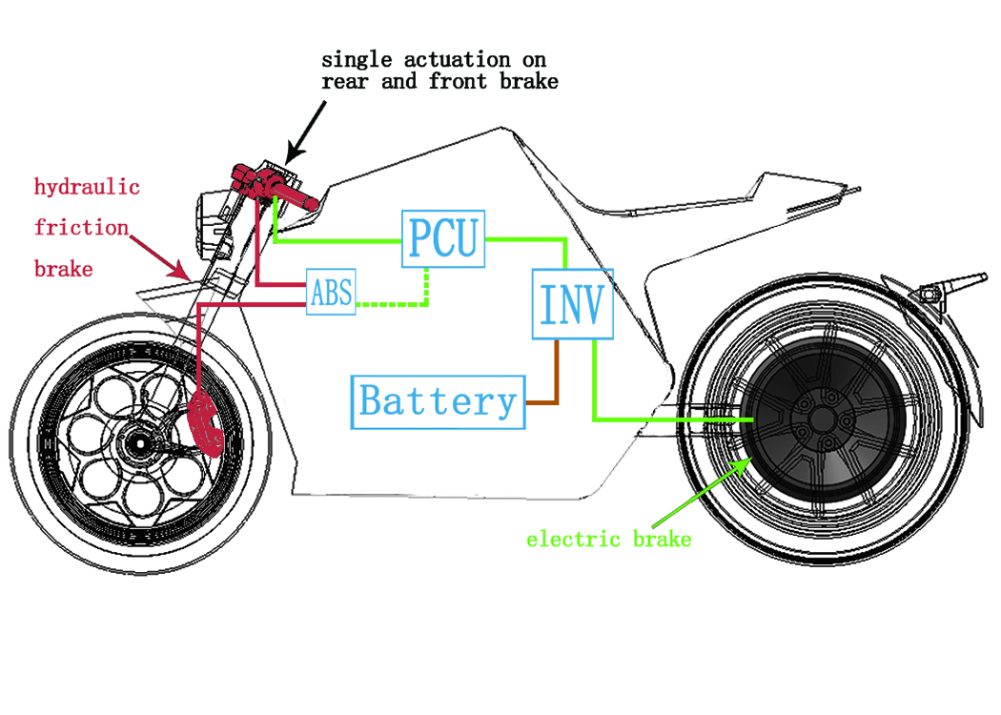
Electrical Brake system principle introduction

Slide 6
MC brake regulations and standards
GB 20073-2008《Performance and measurement method for braking of motorcycles and mopeds》
GTR 3 Global technical regulation No. 3 MOTORCYCLE BRAKE SYSTEMS
UN R78 Concerning the Adoption of Harmonized Technical United Nations Regulations for Wheeled Vehicles, Equipment and Parts which can be Fitted and/or be Used on Wheeled Vehicles and the Conditions for Reciprocal Recognition of Approvals Granted on the Basis of these United Nations Regulations*

Slide 7
MC brake test brief introduction
1. Test based on: UN R78/05.
2. Items done:
Dry stop with single brake control action:complied;
Dry stop with all service brake controls actuated;
High speed test:complied;
Partial failure, for split service brake system:complied;
ABS: complied

Slide 8
Points TBD
Definition of “brake system”
Partial failure test
Wet brake test
Heat fade test

