Slide 1
METR intro
Submitted by the expert from ISO/CEN
Informal document GRVA-15-16/Add.2
15th GRVA, 23-27 January 2023
Provisional agenda item 5(d)
Secure Digital Traffic Regulations

Slide 2
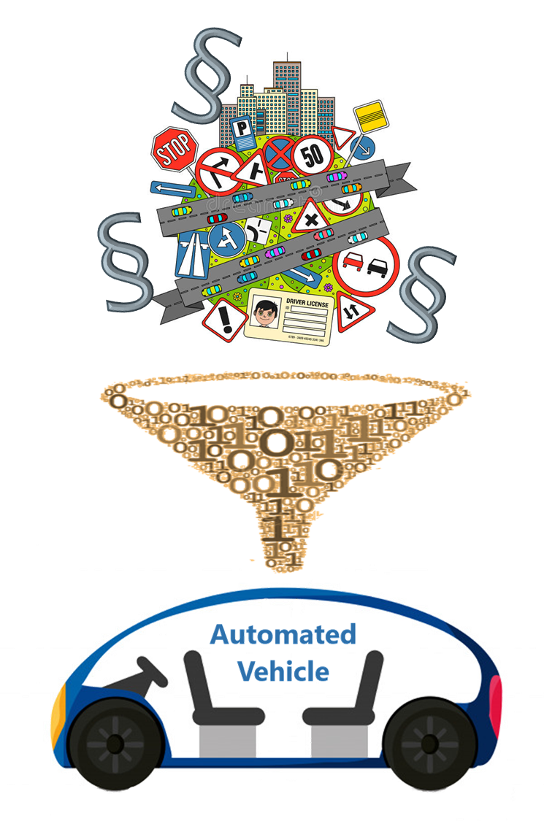
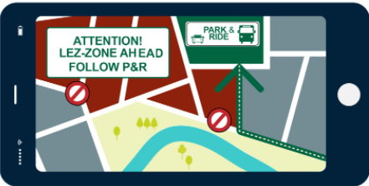



Three parallel tracks – mutual dependence
METR
Digital Traffic
Regulations
Cybersecurity
ENISA
DG JRC

Slide 3
The METR paradigm
Time-and-place delimited signed regulation
Publish/subscribe interface, e.g. AMQT or MQTT
Existing or new
ITS Services
Regulations repackaged in legacy format
Auth 1
Regulation A
(National) Authority Regulation Server
TN-ITS
Users
Re-pack and re-sign
DATEX
Users
Auth 1
Regulation B
Store
Users
Publish/subscribe protocol
C-ITS/CCAM
Users
Transmodel
TPEG
Users
Auth X
Regulation Z
Security
Users
Potential feed in METR native format to end user

Slide 4


Standardisation for Management of Electronic Traffic Regulations (METR)
CEN TC278 ITS
European Committee
ISO TC204 ITS
International Committee
Top level technical committee for all ITS Standards, CEN is for Europe, and ISO internationally
CEN TC278/WG17
ISO TC204/WG19
CEN TC278/WG8
CEN/TS 16157-11:2022
“DATEX II Traffic Regulations”
METR Drafting Team
DATEX II drafting team (UVARBox)
Informal group for authorities coordination

Slide 5
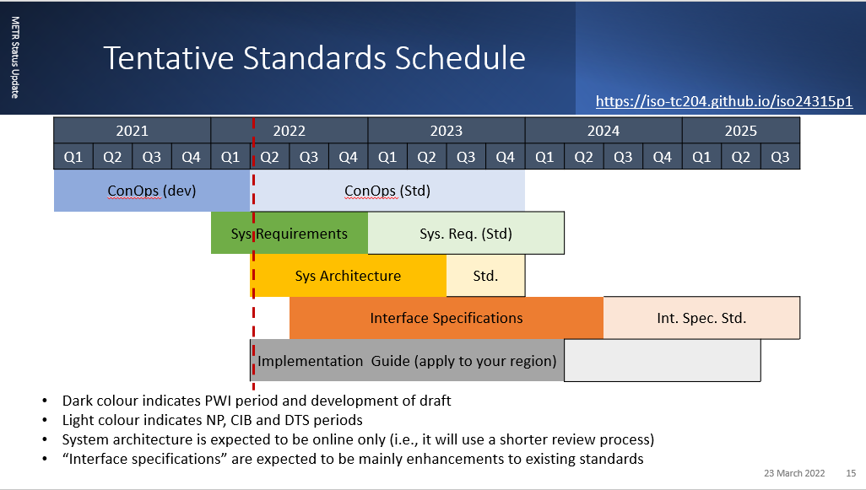
Standardisation for Management of Electronic Traffic Regulations (METR)
CEN/TS 16157-11:2022
“DATEX II Traffic Regulations”
Forms key basis for traffic regulation data exchange in Europe

Slide 6
State of Development
METR activities in CEN/ISO progressing well
Part 1 (Operational Concept) – initial version drafted; expected publication 2023
Vision of full series is a well developed set of global standards for secure robust traffic regulation data
DATEX II activities also progressing well
CEN TS 16157-11:2022 “DATEX II Traffic Regulations” adopted by CEN members; due for publication in June
Further work under the UVARBox preparatory action developing and tuning the specification as a technical basis for European-wide UVAR data publication
Tuning of TS 16157-11 already programmed and scheduled 2022-23 building on the UVAR and national experiences
DATEX II should be the European default approach for traffic regulation data exchange
Approaches are complementary

