Slide 1
Electric Vehicles and the Environment (EVE IWG)
Submitted by the EVE informal working group
Informal document GRPE-87-52
87tf GRPE, 10 January~13 January 2023
Agenda item 9
Report to GRPE 87th Session

Slide 2
Recent EVE Meetings
Virtual meetings
54th EVE IWG February 16th, 2022
55th EVE IWG April 26-27, 2022
58th EVE IWG November 21-22, 2022
In –person meetings
56th EVE IWG - May 30, 2022 in Geneva and virtually (Past)
57th EVE IWG – September 21-22, 2022, Brussels
59th EVE IWG – January 2023, concurrent with GRPE week

Slide 3
Current Work
Hybrid power determination (GTR-21)
EVE continuing to develop the GTR based on the experiences of stakeholders
In-vehicle battery durability (GTR-22) – Light-duty
Consider further development and refinement of GTR 22
New GTR for In-vehicle battery durability – Heavy-duty

Slide 4
GTR-21 Development: Hybrid Power Determination
Efforts on GTR-21 are focused refining the text and test procedures
Consideration of CAN signals in place of direct measurement
Data analysis required
Rational accuracy requirements
Review the source of current values
Measurement alternatives for highly integrated systems
Data analysis required
Add alternative for system bench testing
Develop family concept
Proposal from Japan reflected in the current draft update
Need for Candidate Method – on hold, may not be required
Timing: Informal document for review at June GRPE

Slide 5
GTR-22 Development: LDV Battery Durability
GTR-22 was finalized in 2022
Limited experience with the GTR to-date
Included in the implementation of Euro 7
EVE is focused on several issues
Accounting for energy consumption not related to mobility, with focus on Category 2 vehicles that may have ancillary, non-propulsion electrical loads
Category 2 Minimum Performance Requirements
Temperature data requirements and consideration of CARB requirements

Slide 6
Heavy-duty Durability GTR
Heavy-duty in-vehicle battery durability is now the most significant work being performed by the EVE IWG
While the overall framework of the light-duty GTR is helpful, there is limited technical similarity
Light-duty test procedures with respect to electrified vehicles are more mature
Light-duty vehicle activity is relatively homogenous
Heavy-duty vehicle activity and energy demands can vary significantly between applications
Additional technical experts on HD vehicles have joined the IWG

Slide 7
Heavy-duty Durability GTR
EVE-57-10-Rev1a
Summary of alternatives presented by OICA
Each alternative has pluses and minuses
Goals
Identical procedure for Reference Test and In-service Test
Leverage experience and existing capabilities of manufacturers and regulatory authorities

Slide 8
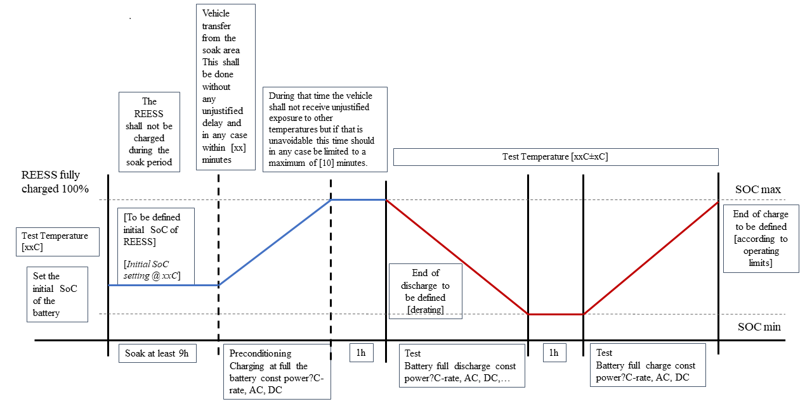
Heavy-duty Durability GTR
EVE-57-07
JRC presented a battery cycling concept
Many details to be resolved over the coming months, including the development of appropriate Minimum Performance Requirements
Cycle test provides a simpler solution that can be adapted to a variety of vehicle applications

Slide 9
Current Timeline
January 2023:
EVE proposes to GRPE the development of a new GTR on in-vehicle battery durability for heavy duty vehicles
January 2024:
IWG on EVE provides a status update and draft copy of the development of the durability UN GTR on heavy-duty vehicles as an informal document for further discussion and recommendation. The IWG on EVE provides updates on the future framework for heavy-duty vehicle related durability UN GTR decisions.
June 2024:
IWG on EVE provides a draft UN GTR to the June 2024 meeting of GRPE as a working document.
June 2021-January 2024:
IWG on EVE continues information gathering on possible modifications to the in-vehicle battery durability UN GTR No 22 and develops amendments to the UN GTR No 22 for consideration by WP.29 and AC.3, as deemed appropriate.
May 2021 - June 2023:
EVE IWG supports the Group of Experts on Energy Efficiency on the method for stating energy consumption from upstream emissions of electrified vehicles.
November 2021 – June 2023:
Consideration of a candidate test method and further validation testing for UN GTR No. 21
Consideration of family concept
Consideration of other GTR amendments as necessary

Slide 10
Proposed Future EVE Meetings
60th: March 2023: Virtual meeting
61st: April 25~26, 2023 – Ann Arbor, MI – USEPA
62nd: June GRPE week – In person and virtual
63rd: Early fall 2023: Virtual meeting
64th: Mid-fall 2023: Ottawa, Canada – ECCC
65th: Late fall 2023: Virtual meeting

Slide 11
Thank you!
Michael Olechiw
EVE C0-chair
olechiw.michael@epa.gov
Penny Dilara
EVE C0-chair
Panagiota.DILARA@ec.europa.eu

