Slide 1
Informal document No. GRPE-87-38
87th GRPE, 11-13 January 2023
Agenda item 14
Status Report of the IWG on Automotive Life Cycle Assessment (A-LCA)
Prepared by
the A-LCA Informal Working Group

Slide 2
1. Establishment of the IWG on Automotive Life Cycle Assessment (A-LCA)
Proposal to work on the clarification of methodologies for the assessment of life-cycle Greenhouse Gas (GHG) emissions of automotives
by Japan and Korea during the 85th GRPE session (January 2022)
→ GRPE secretariat has taken the tremendous initiatives to move forward
Workshop was organized during the 86th GRPE session (May 2022)
→ successfully completed with 20 presentations from a variety of
organisation (https://unece.org/info/events/event/365116)
GRPE agreed to put the A-LCA methodology on its priority list and to create a new Informal Working Group on A-LCA during the 86th session (June 2022)
1/6

Slide 3
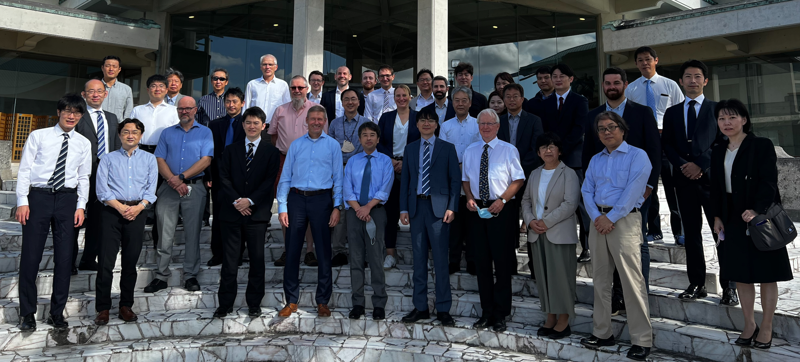
2. A-LCA Meetings up to the 87th GRPE
1st : 26 ~ 28 October 2022, Hybrid meeting @ Okinawa, Japan
<OUTCOMES>
determine Leading Team
develop the initial Terms of Reference
2nd : 6 December 2022, Virtual meeting
<OUTCOMES>
should discuss on overarching aspects prior to subgroup activities
3rd : 9 January 2023, Hybrid meeting @ Geneva, Switzerland
<OUTCOMES>
intensive discussion on the Terms of Reference
discussed on efficient working structure
2/6

Slide 4
3. Key Contents of the ToR
Objective : to develop an internationally-harmonised procedure
to determine the carbon footprint of automotive products
from production to use and disposal,
as a resolution under the framework of WP.29.
Applicable to all types of road automotive products
Working items :
Definition of Scope/Inventory Analysis/Life cycle impact assessment
Timelines :
June 2025 : Adoption of the UN Resolution on A-LCA by GRPE
November 2025 : Adoption of the UN Resolution on A-LCA by WP.29
<still under the development>
3/6

Slide 5
4. Next Actions
Overall
 |  | 2023 |  |  |  | 2024 |  | 2025
GRPE |  | 87th |  | 88th |  | 89th | 90th | 91st |  | 92nd
 |  | progress report and ask guidance when necessary |  |  |  |  |  | Informal Document |  | Working Document
Working phases
 | Overarching aspects
 | Develop methodologies
 | Drafting
Meetings until next GRPE (June 2023)
4th : 13th February 2023, Virtual meeting <feedbacks from IWG member>
5th : tbd April 2023, Hybrid meeting @ tbd* <revise the proposal>
6th : tbd May 2023, Virtual meeting < final feedbacks from IWG member >
7th : tbd June 2023, Hybrid meeting @ Geneva, Switzerland
<1. finalise the ToR, 2. agree on the overarching aspects and the subgroup structure>
request full one day session in conjunction with 88th GRPE session
* seeking a meeting venue
4/6

Slide 6
5. Current Progress
: target level as of January 2023
Progress level (%) items | 20 | 40 | 60 |  | 80 | 100 |  | notes
ToR |  |  |  |  |  |  |  | slight delay due to contradictory discussion on target parameter
Working Organisation |  |  |  |  |  | June 2023 |  | considering the subgroup structure for efficient progress
Overarching aspects |  |  |  |  |  | June 2023 |  | under the discussion on the initial proposal provided by leading team
Subgroup structure |  |  |  |  |  | June 2023
A-LCA Methodology |  |  |  |  |  | January 2025 |  | will be braked down after completion of overarching aspects
Drafting |  |  |  |  |  | June 2025
5/6

Slide 7
Thank you!
Leading Team
<co-Chairs>
Tetsuya NIIKUNI : niikuni@ntsel.go.jp
Charyung KIM : cha1052@kotsa.or.kr
<Secretariats>
Hans NUGLISCH : Hans.Nuglisch@vitesco.com
Romain DENAYER : romain@avere.org
Nick ICHIKAWA : ichikawa@ntsel.go.jp
6/6

Slide 8
Appendix

Slide 9
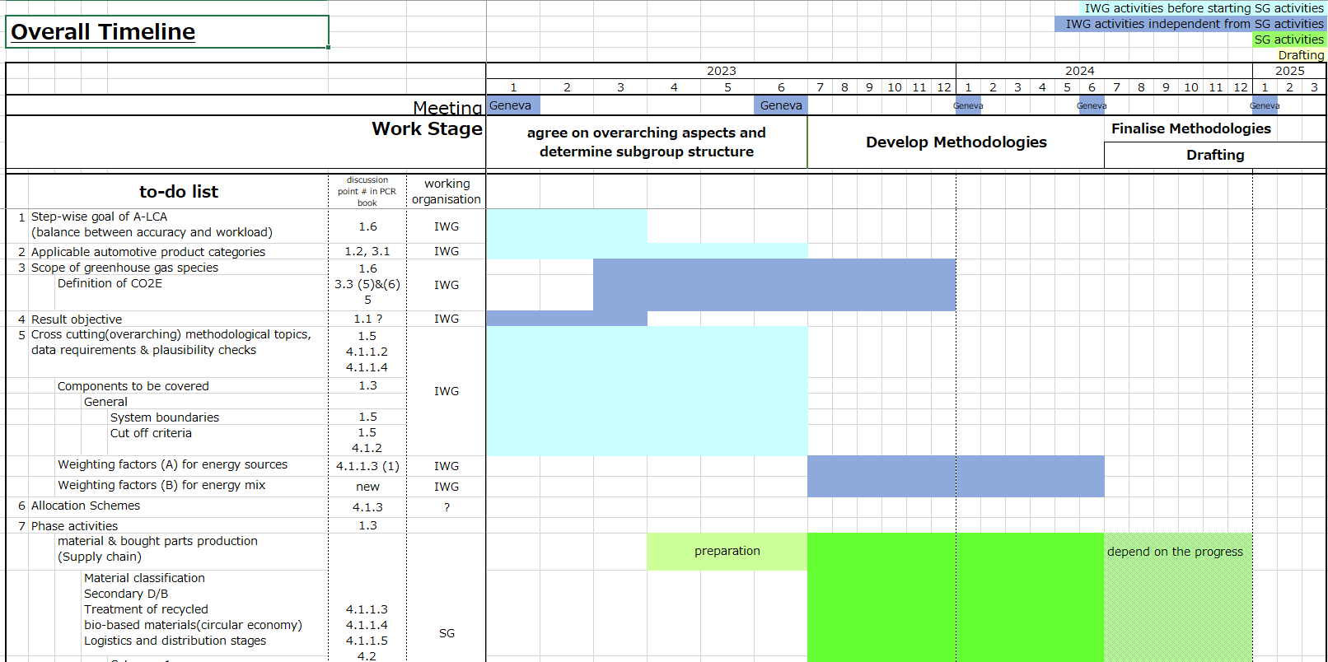
Overall Timeline <detailed “to-do-list” and its timing are under the discussion>

Slide 10
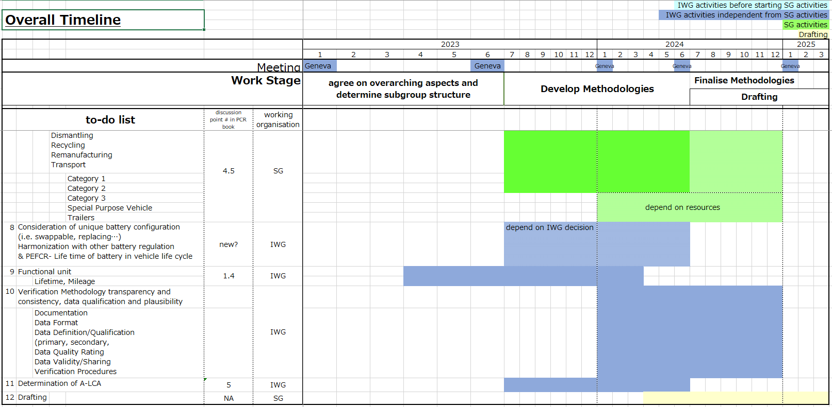
Overall Timeline <detailed “to-do-list” and its timing are under the discussion>

