Slide 1
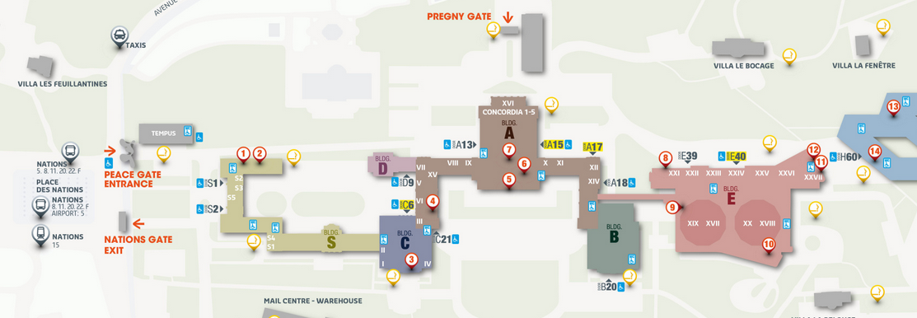
Working Party on Pollution and Energy (GRPE) General information
Note by the secretariat
Informal document GRPE-87-03-Rev.1
87th GRPE, 10 - 13 Jan 2023
Agenda item 1
This 87th session
Back to normal: 3-hours half-days with interpretation -> Silence procedure removed
All COVID measures lifted;
Pregny gate closed, badges to be collected at Villa Les Feuillantines more info: https://www.ungeneva.org/en/practical-information/delegates
Temperature lowered from 21 to 20 degrees Celsius in all UNOG buildings

Slide 2
Working Party on Pollution and Energy (GRPE) General information
Note by the secretariat
Informal document GRPE-87-03-Rev.1
87th GRPE, 10 - 13 Jan 2023
Agenda item 1
Next session
The next (88th) session will be held on 30 May - 2 June 2023
For IWG meetings in conjunction with GRPE, please inform secretariat (Mon 29 May bank holiday at the UN)
Proper session to tentatively start on Wednesday 31 May morning
The deadline for the submission of official working documents is 7 March 2023
Nominations of officers (Chair(s) / Vice-chair(s)) to be submitted to the secretariat (via permanent missions) ten days before the start of the session during which elections will be conducted (ie. 19 May 2023)
More details in WP.29-187-18 and ECE/TRANS/WP.29/1166, paras. 28 and 29
Tentative timetable, subject to change
30 May : 14:30-17:30
31 May - 1 June : 9:30-12.30/14:30- 17:30
2 June : 9:30-12.30

