Slide 1
IWG-MU proposal for R117 C1 tyre rolling noise temperature correction update
Informal document GRBP-77-11
77th GRBP, 07-10 February 2023
Agenda item 5 (e)

Slide 2
Agenda
1
Introduction
2
Temperature sensitivity of C1 non 3PMSF and 3PMSF tyres
3
Proposed updates
4
Summary

Slide 3
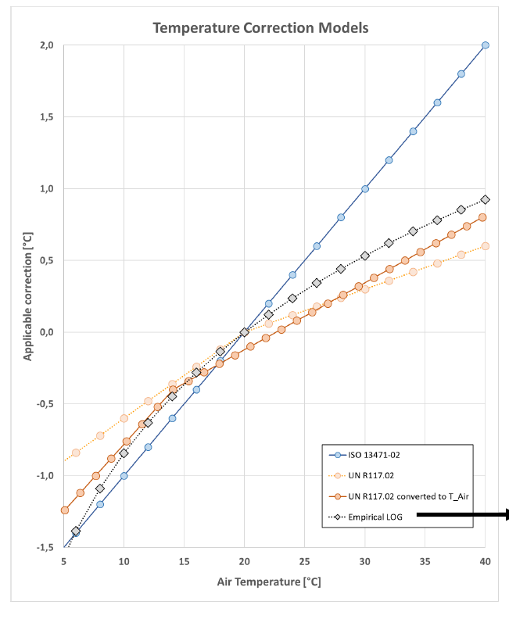
Update of the R117 C1 temperature correction
Tyre rolling noise is affected by changes of the rubber stiffness for different temperatures. Even if the temperature sensitivity is not the main source of measurement uncertainty in R117, there is the need to correct measurement results to consider the temperature influence.
IWG-MU collected data for the following purpose:
Validation of the current R117 temperature correction
Proposals for improvements of the R117 temperature correction.

Slide 4
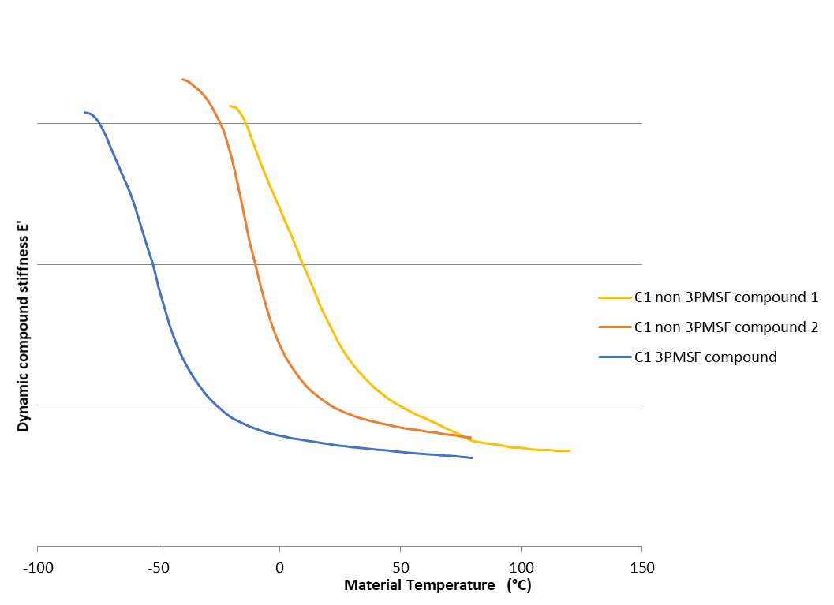
Physical behavior of rubber / Dynamic stiffness E’
Tyre rolling noise is influenced by the stiffness change of the tyre over temperature:
Different rubber compounds can show a wide spread of temperature sensitivity regarding their noise performance.
One of the main influencing factors is the rubber glass transition temperature.

Slide 5
Agenda
1
Introduction
2
Temperature sensitivity of C1 non 3PMSF and 3PMSF tyres
3
Proposed updates
4
Summary

Slide 6
Verifying and updating the R117 C1 temperature correction
In general, the available data of R117 measurements with the same set of tyres at a wide temperature range is very limited and often of a poor correlation between the temperature and the measured rolling noise (e.g., $R^{2}<0,5$)
To improve this situation two test activities were performed in parallel:
①
②
Proving ground investigation with a high effort to achieve a goal of $R^{2}>0,7$ for the correlation between temperature and tyre rolling noise
Experimental drum investigation to exclude as many uncertainties as possible

Slide 7
Proving ground investigation
①
Three sets of C1 non 3PMSF tyres and one set of 3PMSF tyres were tested at different temperatures.
With the exemption of the 3PMSF tyre set, the $R^{2}$of the data is above 0,7.

Slide 8
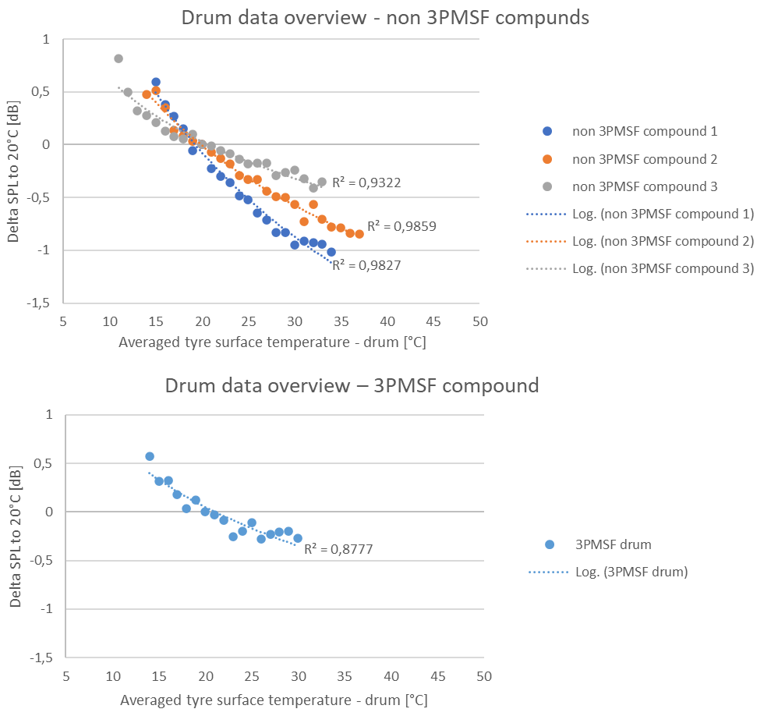
Drum investigation
②
Four C1 tyres were built with identical pattern and identical construction.
Changing only the tread compound:
3x non 3PMSF compounds
1x 3PMSF compound
Tyres were stored at ambient temperatures < 15°C over night.
Mounted at the test stand, using an ISO replica drum surface, measuring:
tyre rolling noise during the warmup
tyre temperature during the warmup

Slide 9
Agenda
1
Introduction
2
Temperature sensitivity of C1 non 3PMSF and 3PMSF tyres
3
Proposed updates
4
Summary

Slide 10
Investigation results
The current R117 temperature correction is well adapted to cover the average temperature sensitivity of non 3PMSF tyres.
Temperature sensitivity is described best using a logarithmic function
3PMSF tyres have a lower temperature sensitivity then non 3PMSF tyres and are over corrected by the current R117 temperature correction.

Slide 11
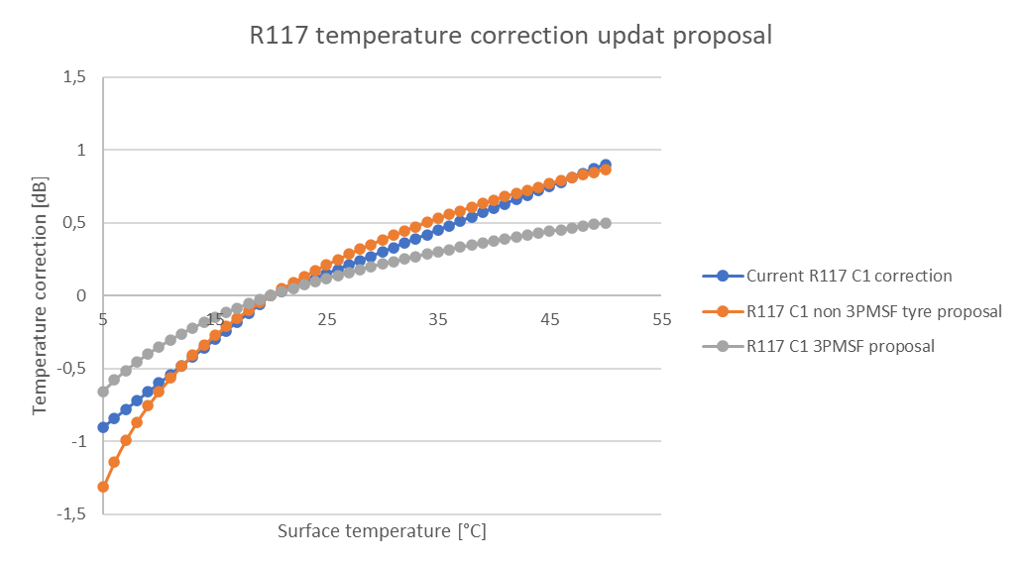
Proposal for R117 C1 temperature correction update
$$L_{i}\left(θ_{\text{ref}}\right)=L_{i}\left(θ_{i}\right)−K_{1}∙\lg\left(\frac{θ_{\text{ref}}+K_{2}}{θ_{i}+K_{2}}\right)$$
 | Summer | 3PMSF
K1 | 2,18 | 1,35
K2 | 0 | 2,29
$$θ_{ref}$$ | 20°C | 20°C
IWG-MU proposal for R117 C1 tyres, based on the collected data:
The collected data from both the proving ground and the drum test confirm a logarithmic shape for the temperature correction as already used in R51
Non 3PMSF tyres: the logarithmic shape shall be introduced in R117, by updating the current correction equation
3PMSF tyres: introducing a dedicated logarithmic temperature correction to better represent the lower temperature sensitivity of 3PMSF compounds

Slide 12
Validation of the proposed C1 temperature corrections
The proposed temperature correction updates have been assessed on 15 data sets using the two following metrics:
Standard deviation
Slope regression
 | Non 3PMSF | 3PMSF
No temperature correction | 0.47 | 0.28
Current R117 | 0.32 | 0.25
Proposed non 3PMSF tyres LOG | 0.32
Proposed 3PMSF LOG |  | 0.19
 | Non 3PMSF | 3PMSF
No temperature correction | 0.06 | 0.026
Current R117 | 0.031 | 0.016
Proposed non 3PMSF tyres LOG | 0.028
Proposed 3PMSF LOG |  | 0.009
The proposed changes reduce the measurement uncertainty for non 3PMSF and 3PMSF tyres.

Slide 13
Agenda
1
Introduction
2
Temperature sensitivity of C1 non 3PMSF and 3PMSF tyres
3
Proposed updates
4
Summary

Slide 14
Summary and next steps
The proposed introduction of a dedicated 3PMSF temperature correction reduces the measurement uncertainty for this category of tyres.
The proposed update from a bi-linear towards a logarithmic function for the temperature correction is in line with the temperature behavior of rubber, observed both in material testing as well as in tyre rolling noise measurements.
In a next step the temperature correction for C2 tyres will be evaluated.
Regarding C3 tyres no changes are planned within R117 due to the low temperature sensitivity of C3 compounds in addition the high thermal inertia of these tyres.

Slide 15
Thank you.

