Slide 1
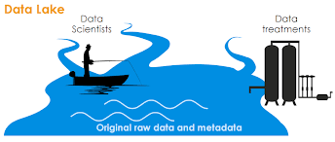
Modernisation of Data Management
in Official Statistics

Slide 2
Problem statement
NSOs have been facing challenges to effectively manage “traditional” data sources & internal data assets.
It is still rather unclear what are data & metadata management requirements for new types of “big” data sources (web, social, IoT…) -> we need to integrate both!
Time to market for new products and services is too long and there will be competition out there; general desire, need & perception that information needs to be delivered in real-time.
New opportunities (and funding) with trend to become data-driven company, smart city, evidence-based government.
Can we do it faster? Cheaper? Better?

Slide 3
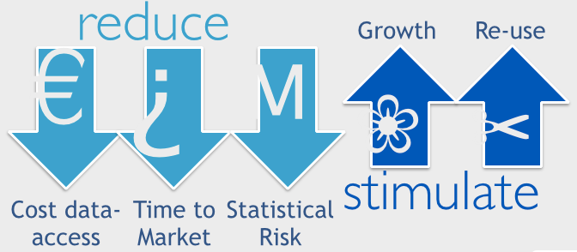
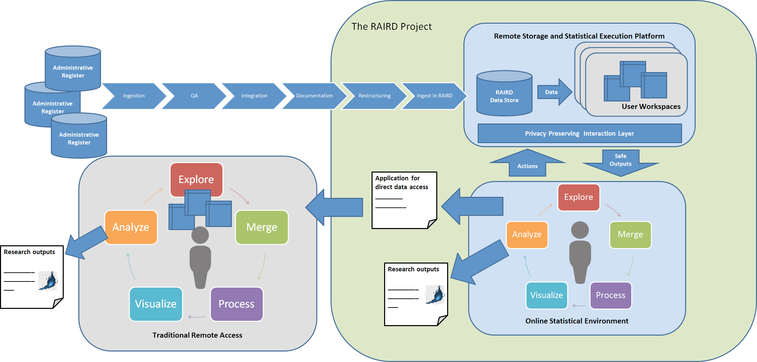
What if we could integrate data and produce outputs on-demand?
Eurostat Data Platform as a Service
StatCan Picasso
ISTAT System of Registers
CBS Data Lake:
Norway Remote Access Infrastructure for Register Data
Statistics New Zealand Integrated Data Infrastructure
http://www.raird.no/whitepaper/

Slide 4
Proposal
Use Next Generation Data Management as common framework to identify new opportunities and new capabilities in data and metadata management.
Link with HLG project on data architecture to identify best practice in NSOs, develop reference architecture and propose PoCs in key areas where practical research is needed.
Areas of collaboration: semantic models and metadata, security and confidentiality requirements, distributed data processing and analysis, data management for new types of data sources, data governance…

