Slide 1
Data Architecture project
2017 report
November 2017
Carlo Vaccari, project leader
Dick Woensdregt, project lead architect
1

Slide 2
Purpose and Scope
Original scope:
To develop a reference framework for data architectures for the official statistics industry, as a part of the Enterprise Architecture which is one of the fundaments of the design of the Common Statistical Production Architecture (CSPA)
Focus on:
Different sources, new sources
Capabilities
Data/metadata
Guidelines and practices
2

Slide 3
Activities
20 people from 11 organisations
2 face-to-face meetings:
May @ISTAT in Rome
October @CBS in Heerlen
Other meetings also at NTTS – Bruxelles and at CSPA Workshop - Wiesbaden
Fortnightly plenary Calls on Webex and other sub-groups Calls
3

Slide 4
Deliverables
Reference Architecture:
First draft available in May
Current version on the wiki
Final version available in December
Use-cases:
Description of 5 different Use-cases with standard template available
Guidelines:
Impossible to get in time: Guidelines need Use-cases and Capabilities that are available in stable version right now
4

Slide 5
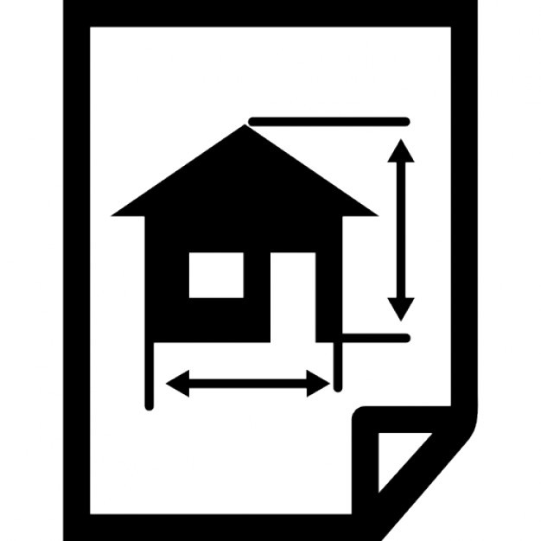
Reference Architecture
Structure of the document:
Management summary
Purpose and scope
Usage and users of Data Architecture
Key principles
Capabilities and Building Blocks:
Core Capabilities
Cross-cutting Capabilities
Notes on
Semantic layer
Categories of data
5

Slide 6
Data Architecture Purpose
Support Statistical Organizations in the design, integration, production and dissemination of official statistics based on both traditional and new types of data sources
How to organize and structure their processes and systems for efficient and effective management of data and metadata, from the external sources through the internal storage and processing up to the dissemination of the statistical end-products
6

Slide 7
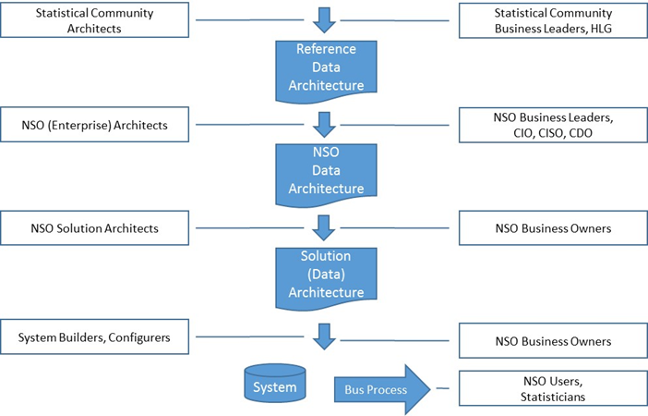
Users and usage
7

Slide 8
Key principles
1. Information is managed as an asset throughout its lifecycle
2. Information is accessible
3. Data is described to enable reuse
4. Information is captured and recorded at the point of creation/receipt
5. Use an authoritative source
6. Use agreed models and standards
7. Information is secured appropriately
For each principle:
some statements detailing the principle
the rationale behind the principle
the implications for NSIs
8

Slide 9
Capabilities
Defining:
Core capabilities in four conceptual layers: Ingestion, Transformation, Integration, Access & Consumption
Cross-cutting (over-arching) capabilities: Metadata Management, Data Governance, Provenance & Lineage, Security & Authorization
Building Blocks (Conceptual and Logical) are used to realize/implement Capabilities
9

Slide 10
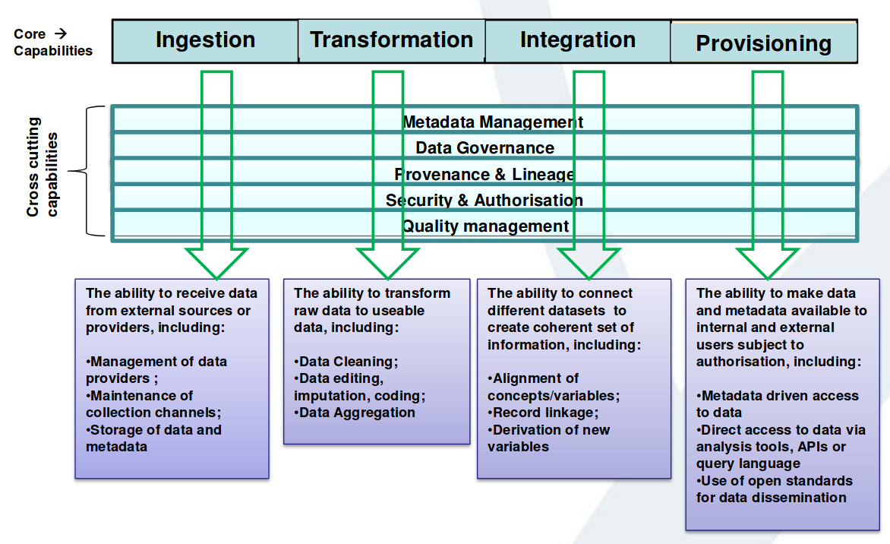
Capabilities
10

Slide 11
Capabilities example
Ingestion: the ability to receive data from external sources or providers
Conceptual Building Blocks:
Channel Management
Channel Configuration
Data Provider Management (e.g. Respondent, ...)
Operate & Monitor Channels
Data Storage
Logical Building Blocks (just some examples):
Create, maintain and withdrawing (data collection) channels
Generate metadata describing new channel
Configure channel for specific data streams (eg surveys)
Generate metadata to describe dataset types
...
11

Slide 12
Diagrams
The following diagrams depict the relationships between the concepts of capabilities and conceptual and logical building blocks that are used to present the DA (in line with other names we call it CSDA Common Statistical Data Architecture).
The CSDA identifies the building blocks at the conceptual level that are mapped to the capabilities that are required to fulfill the activities conducted by a statistical organisation.
12

Slide 13
Capabilities & Building Blocks
13

Slide 14
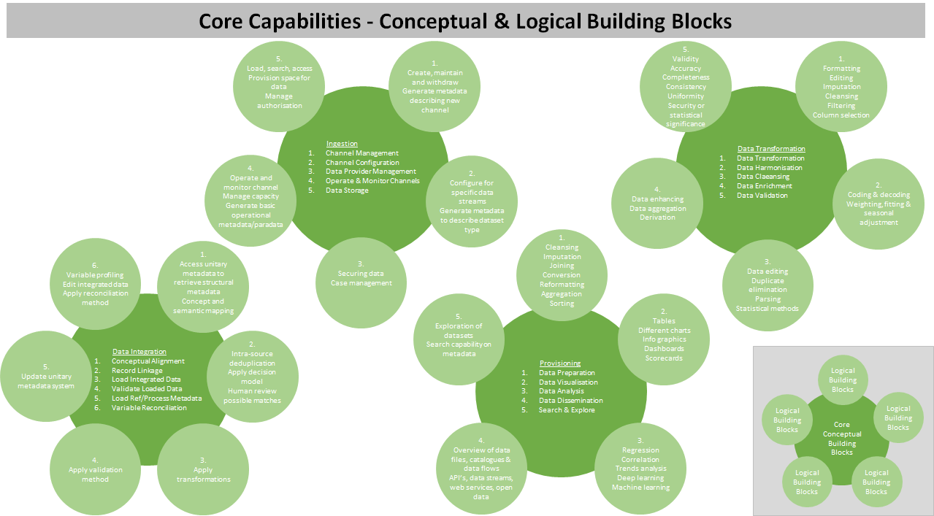
Capabilities & Building Blocks
14

Slide 15
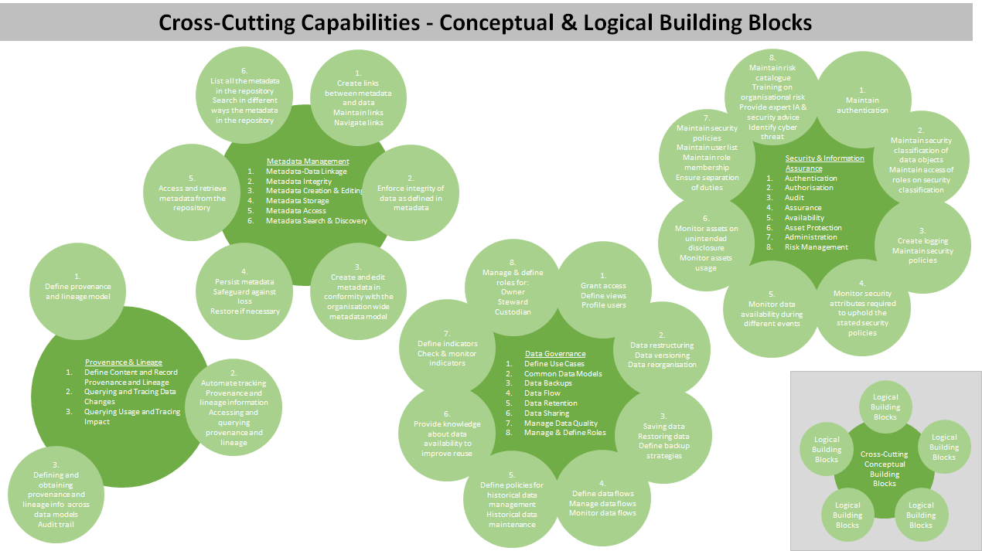
Capabilities & Building Blocks
15

Slide 16
Use-cases
Five use-cases have been described:
Integrate a new CSPA service (INSEE)
Semantic virtualisation (ISTAT)
Privacy preserved processing of Sensitive Data (CBS)
Use-case from UN-GWG
Transformation (ONS)
16

Slide 17
Use-case example
Semantic virtualization (ISTAT)
Istat has engaged a revision of the data architecture to support statistical production, based on a system of integrated statistical registers (ISSR) for all the surveys
To implement the ISSR, ISTAT is setting up a DA consisting of:
1) a semantic layer
2) a mapping layer that decouples from data sources
3) a data source layer
This three layer architecture allows for virtualizing the access to data sources by abstracting from the specific data structures of the sources. The architecture provides an integration layer (semantic layer) that defines a global integrated view over the sources
17

Slide 18
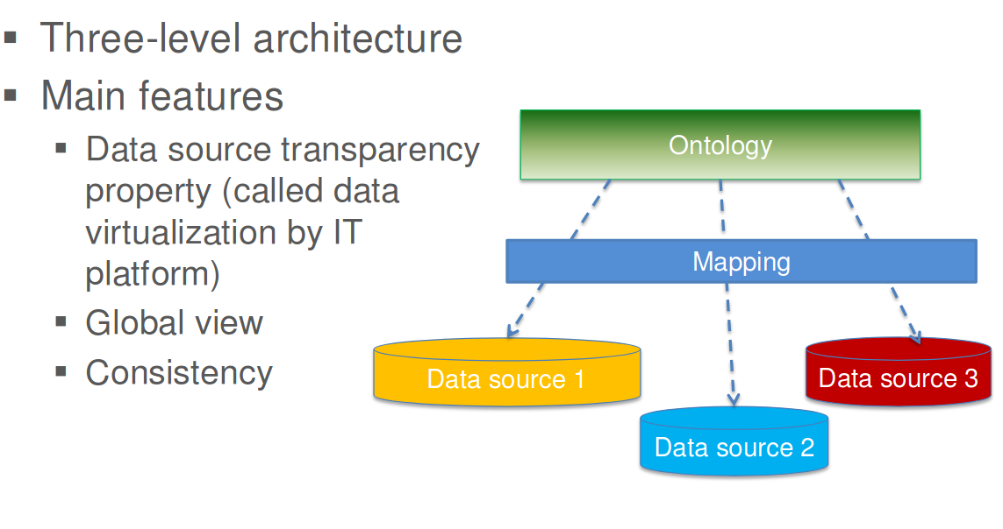
Use-case example
18

Slide 19
Intersections: UN-GWG
The goal of the UNSD Global Platform project is to build a public-private partnership that should extend initiatives to make better use of innovative data sources at the national and regional levels by developing a Business Case and building a PoC platform
DA defines all the capabilities which will be needed by the Global Platform, starting point for the proof of concept.
DA principles can be used to guide the data management process design and development for the Global Platform
DA focus on the integration of new data sources should prove useful input into the development of the Global Platform’s integration and analysis capabilities
The Global Platform can be a particular use-case as example of how the application of DA can benefit a solution development
19

Slide 20
Other intersections
Interesting comparison between ISTAT and CBS vision on metadata:
ISTAT use-case where metadata are used for mapping data coming from different sources, using semantic web standards like OWL
CBS where a formal model is used to implement metadata for Data Lake implementation
More general discussion on the use of standards coming from outside the statistical community (W3C): implications on Open Data policy and more generally on Dissemination policy
Interactions with Data Integration project: adopt DI use-cases? Check them against reference DA?
20

Slide 21
Final self-assessment
Very interesting outputs, even if incomplete: first time Data Architecture
Good interaction between project members
Few NSIs actively involved
Face-to-face meetings essential for the drawing up of deliverables
Importance of project coordination/animation
Fundamental the coordination with other projects
21

