Slide 1

Anna Borowska
Chair of the Capabilities and Communication Group
Central Statistical Office of Poland
Ben Whitestone
Office for National Statistics, United Kingdom of Great Britain and
Northern Ireland

Slide 2
Capabilities and Communication Group
Our main goal
Support the modernisation of statistical organisations
with relevant organisational changes

Slide 3
Capabilities and Communication Group

Slide 4
Capabilities and Communication Group
Anna Borowska – Chair (Poland)
Marie Creedon, Eilish O'Sullivan (Ireland)
Antonio Ottaiano, Fabrizio Rotundi, Marco Tozzi and Alessandro Hinna (Italy)
Anne Trolie (Norway)
Heli Lehtimaki (Eurostat)
Gabrielle Beaudoin (Canada)
Ben Whitestone (UK)
Alberto Valencia, Josue Hiram Suarez (Mexico)
Tetyana Kolomiyets, Heini Salonen, Therese Lalor (UNECE Secretariat)

Slide 5

Task Team on Risk Management in the context of Agile development
The Task Team on Risk Management aims to:
Help organisations implement the new Risk Management guidelines
  On-line publication of the UNECE Guidelines on Risk Management in Statistical Organisations (January 2017)
  https://statswiki.unece.org/display/GORM/Guidelines+on+Risk+Management
  On-line publication of the Russian version of the Guidelines in 2017
  https://statswiki.unece.org/pages/viewpage.action?pageId=132908007

Slide 6
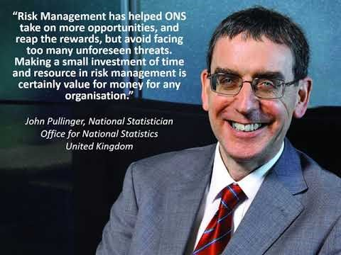
https://youtu.be/IPhH6UN_3oo

Slide 7
Risk Management in the context of Agile development (cont’d)
Developed a training program (basic, intermediate and advance levels) based on global best practices to help statistical organisations increase their experience in risk management.
  A short demonstration of the training was provided in Geneva in September 2017
  Fuller pilot training was conducted in Georgia in October 2017
Overall feedback from the training was very positive

Slide 8
Task Team on Capabilities Training
This Task Team has developed a Capabilities Development and Training Framework based on the phases of the GSBPM.
The Framework includes 13 important statistical skills.

Slide 9
Example of training framework – Index Numbers
Basic level:
I am aware of “the index numbers problem”, that arises when comparing prices (or quantities) between different time periods, and some practical solutions
I understand how index number theory is used in official statistics in the production of some common indices e.g. the Consumer Price Index.
I understand the concepts of base year, reference year, rebasing and chainlinking for indices
I can compare common algebraic methods of index number calculation including Laspeyres and Paasche indices.

Slide 10
Intermediate level:
I know the steps to take to rebase a fixed base series.
I understand and can apply different techniques that can be used to chain link rebased series.
I can calculate aggregate indices from elementary ones by applying weights, and know the difference between gross and net weights.
I understand the challenges in sampling and collecting prices, and how discontinued items may be substituted and incorporated in an index.

Slide 11
Advanced level:
I understand the different approaches to calculating a consumer price index.
I understand the advantages and disadvantages of the main elementary price index number formulae, i.e. the Dutot, Carli and Jevons indices.
I understand the challenges in measuring price changes when there are significant quality changes in the goods being priced, and some common approaches to deal with them, including hedonic regression.

Slide 12
Task Team on Capabilities Training (cont’d)
. The Framework can be used to:
Align training across all statistical processes with the GSBPM, and develop clear learning and career paths
Provide staff with a greater understanding of the range of statistical skills, knowledge and expertise needed to work effectively throughout the end-to-end statistical production cycle
Identify gaps in statistical knowledge within and across statistical organisations
Provide valuable information when considering mobility within and across NSIs, and succession planning

Slide 13
Workshop on Implementing Efficiencies and Quality of Output
Held in Geneva on 27-29 September
49 participants, representing 24 countries or intergovernmental organizations
Purpose: to share knowledge and best practices in implementing efficiencies and improving quality of outputs by using practical approaches such as:
  Change management
  Lean management
  Risk management
  Quality management
Including interactive session on Lean management, RiskCamp on ‘Risk and Quality management: towards an integration’ and Training demo on Risk Management.
Very positive feedback overall

Slide 14
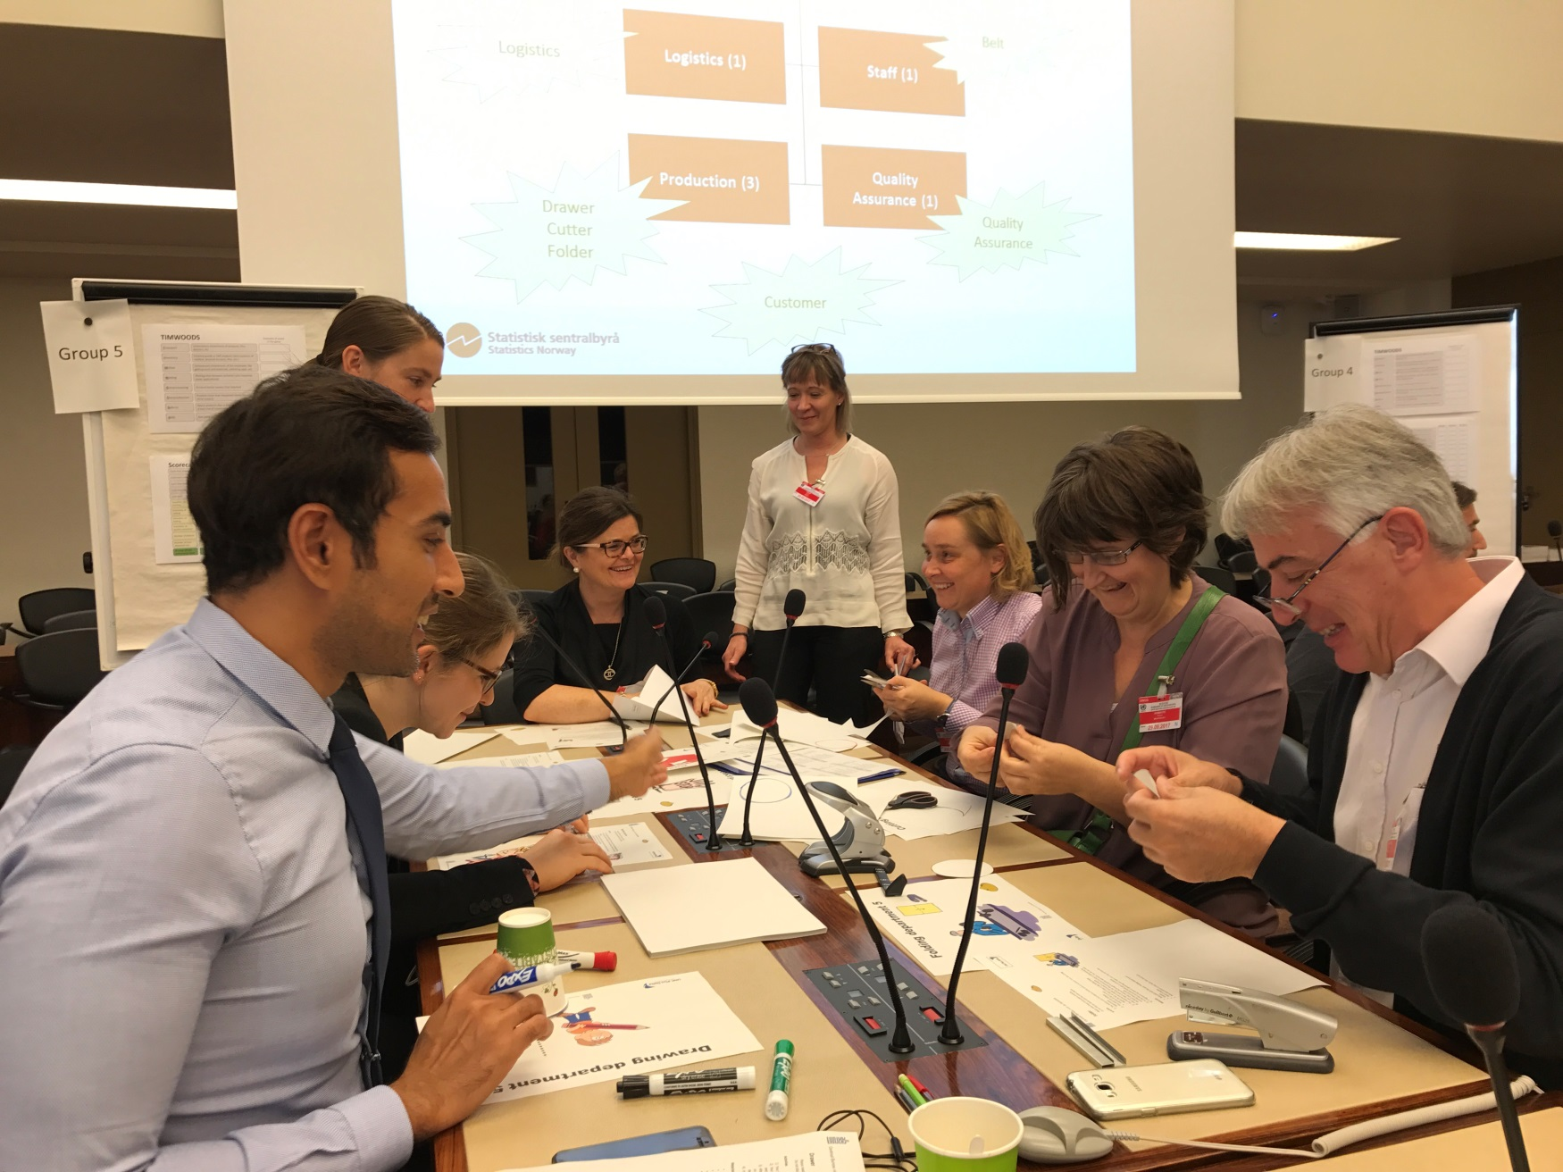
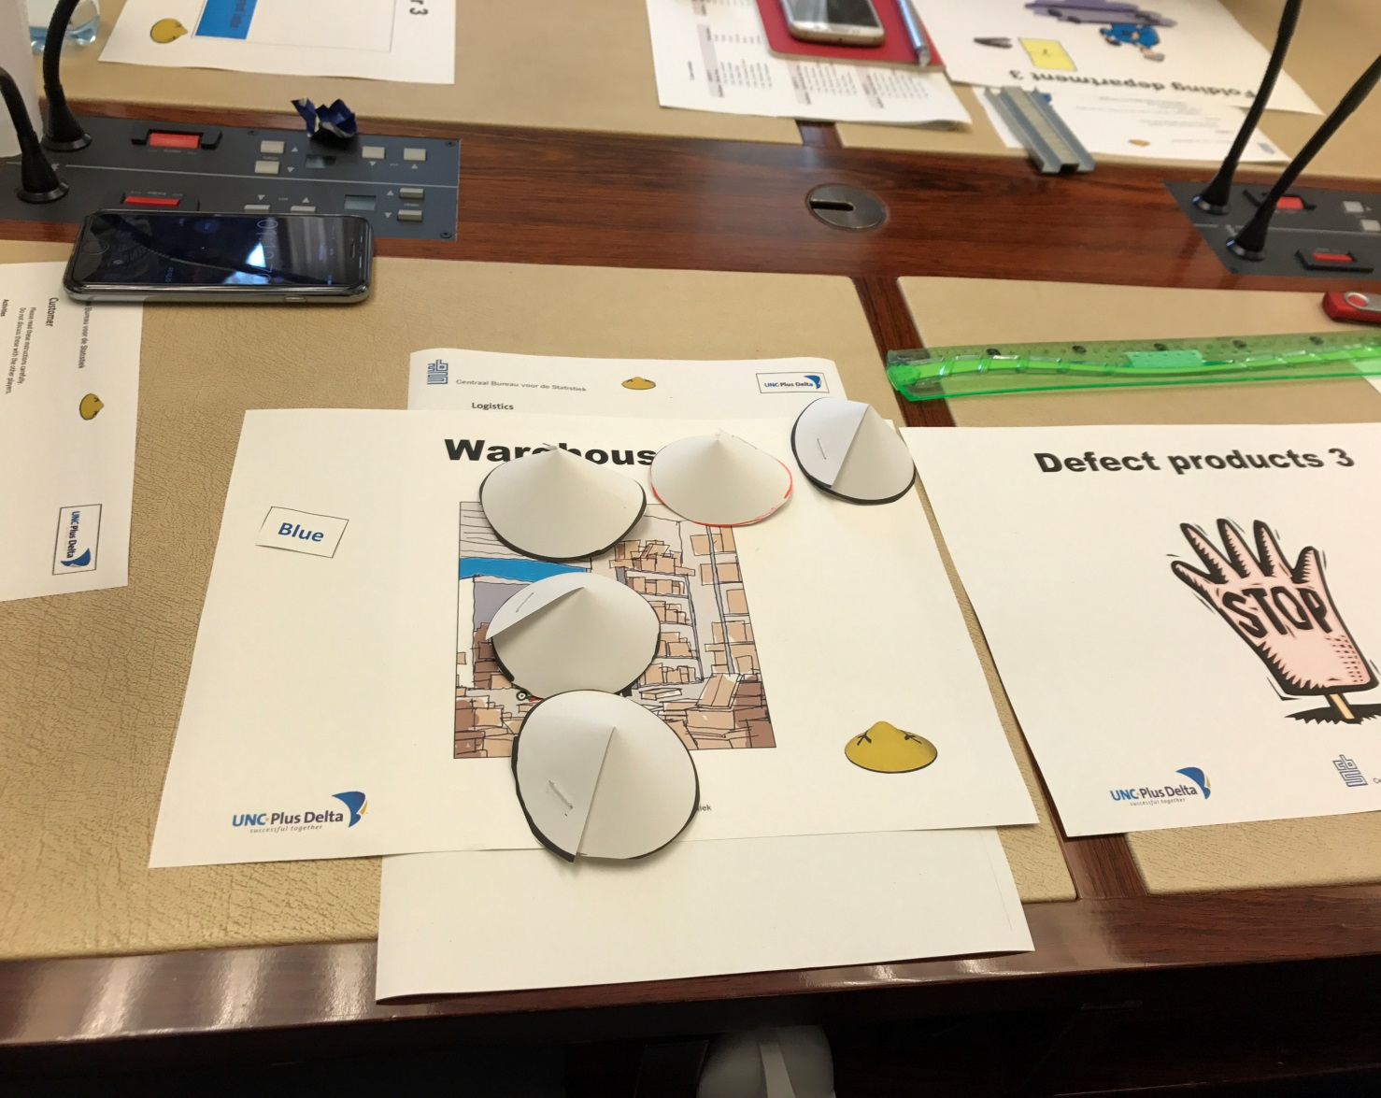

Slide 15

Task Team on Communication
The Task Team on Communication aims to help modernisation groups to effectively communicate about their outputs and achievements.
Develop communication strategies
Design communication materials (e.g. brochures, articles, infographics, videos, and presentations)
Identify audiences and tailor messages
Run communication campaigns, for example on social media
Improve internal communication within NSIs.

Slide 16
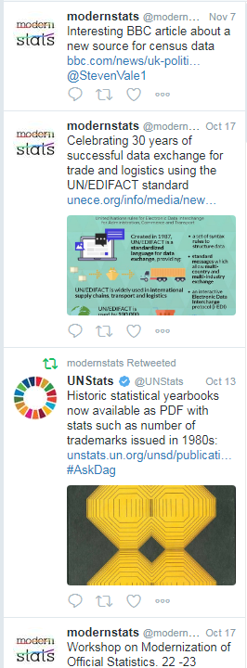
Task Team on Communication (cont’d)
Achievements:
  Blog posts
    https://statswiki.unece.org/pages/viewrecentblogposts.action?key=MCOOFE
  Hackathon promotion materials
  Brochure for the CapComm group
  Brochure on quality indicators

Slide 17
Next steps – activity proposals for 2018
Risk Management phase 2 Activities:
  Develop a course book to complement the training
  Repackage training into a modular format
  Explore opportunities to share and reuse risk management tools
  Share knowledge and best practice on common/cross-cutting risks, and integration of Risk and Quality management
  Ad-hoc activity - Deliver Risk management training if requested and as resources allow

Slide 18
Activity proposals 2018 (cont’d)
Organisational Resilience
In an increasingly changing environment, statistical offices need to do more than just survive. They need to grow and be sustainable in the long term.
The work undertaken by the CapComm is all targeted at building organisational resilience.
Activities:
  A discovery ‘green’ paper on what organisational resilience means in the context of statistical offices
  Collection of case studies on how statistical offices have developed target operating models

Slide 19
Activity proposals 2018 (cont’d)
Capability Development framework in line with GAMSO
This will extend to the current framework to include the skills that need to evolve with organisations that are modernising, such as how to innovate, solve problems, and interact with partners/stakeholders. Often these skills are referred to as “soft” skills.
Activities:
  Identify the skills/capability requirements using GAMSO as a framework.
  Design descriptions of these skills at the basic, intermediate and advanced levels. This will provide common vocabulary and framework to support international collaboration activities

Slide 20

Workshop in 2018:
Workshop on Human Resources Management and Training
  Oslo, Norway 12-14 September 2018

Slide 21
Thank you for your attention!

