Slide 1

Implementation Group
CSPA

Slide 2

Members list
Cambodia - Kimhor Meng
Canada - Robert McLellan, Flavio Rizzolo
Colombia - Luis Edgar Sanchez, Juan Carlos Paz
France - Franck Cotton, Romain Tailhurat
Italy - Marco Silipo, Carlo Vaccari
Mexico - Juan Munoz-Lopez, Lizette Traconis Lugo
Netherlands - Matjaz Jug
New Zealand - Rosemary McGrath (chair)
Norway - Trygve Falch, Jenny Linnerud (LIM)
Serbia - Mira Nikic
Slovenia - Tomaz Speh
Sweden - Eva Holm, Jakob Engdahl, Klas Blomqvist (LIM Variables)
United Kingdom - Eric Deeben
United States - Lorna Drennen
Eurostat - Jean-Marc Museux, Hubertus Cloodt, Pierre Peyronnel, Denis Grofils
OECD - David Barraclough
UNECE - Steven Vale, Alice Kovarikova, Marlen Jigitekov

Slide 3
What will we cover
Administrating CSPA Supporting implementation projects
Filling the gaps
Practical Implementation
Next steps

Slide 4
CSPA Implementation Group
Assess compliance of candidate CSPA services
Maintain / develop the layers of the CSPA catalogue
Practical technical assistance to CSPA implementers
Maintain / develop the CSPA LIM
Maintain/develop the CSPA application patterns
CSPA promotion and communication

Slide 5

Sub-Group Access Compliance - Lead Lorna Drennen
Group Members:
Lorna Drennen, Tomaz Speh, Pierre Peyronnel, Flavio Rizzolo, Jakob Engdahl, Mira Nikic, Jelena Milojkovic, Juan Munoz, Rosemary McGrath and UNECE

Slide 6
CSPA transition
Developed a Governance process workflow
  Created a temporary tacking spreadsheet while an automated workflow is developed
Developed a Draft – Governance Review Document
Reviewing Supporting/Acceptance Documents for the need for additional information
Next Steps

Slide 7
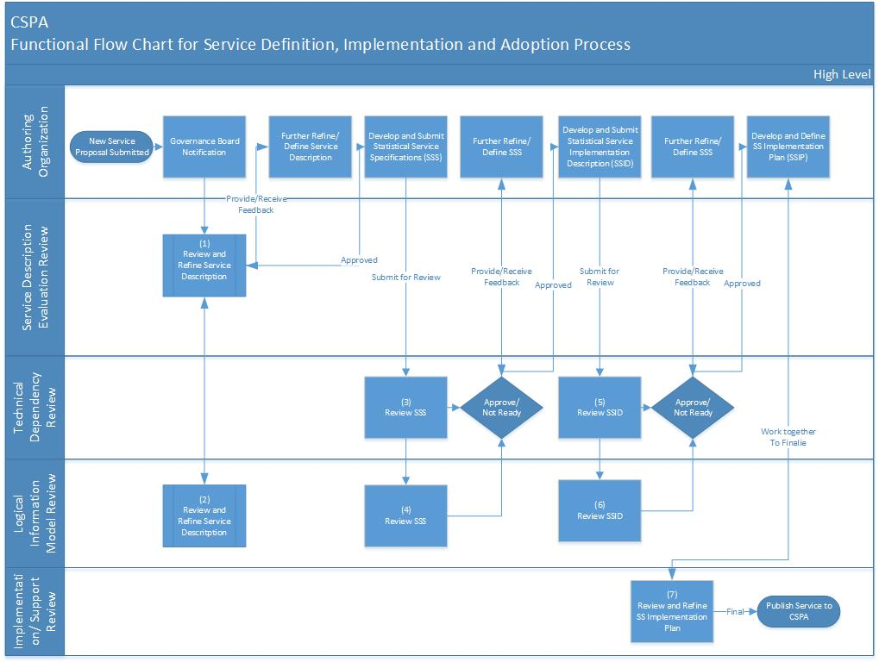
Governance
Process
Flow

Slide 8
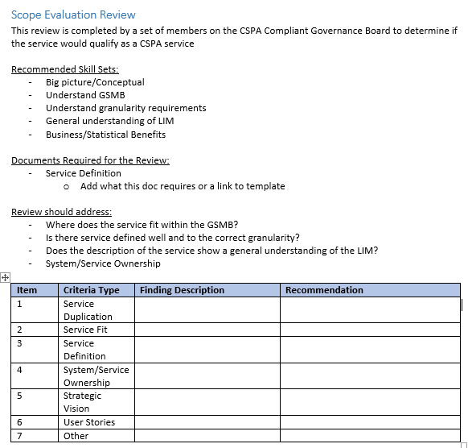
DRAFT – Governance Review
This is a draft of what would be a document to direct the governance review process and observations. The document is completed by each of the governance areas and then saved for future reference of the review process and findings for each service.

Slide 9
CSPA Catalogue Sub-Group
Group Members:
Franck Cotton, Matjaz Jug, Jean-Marc Museux, Pierre Peyronnel, Rosemary McGrath and UNECE

Slide 10
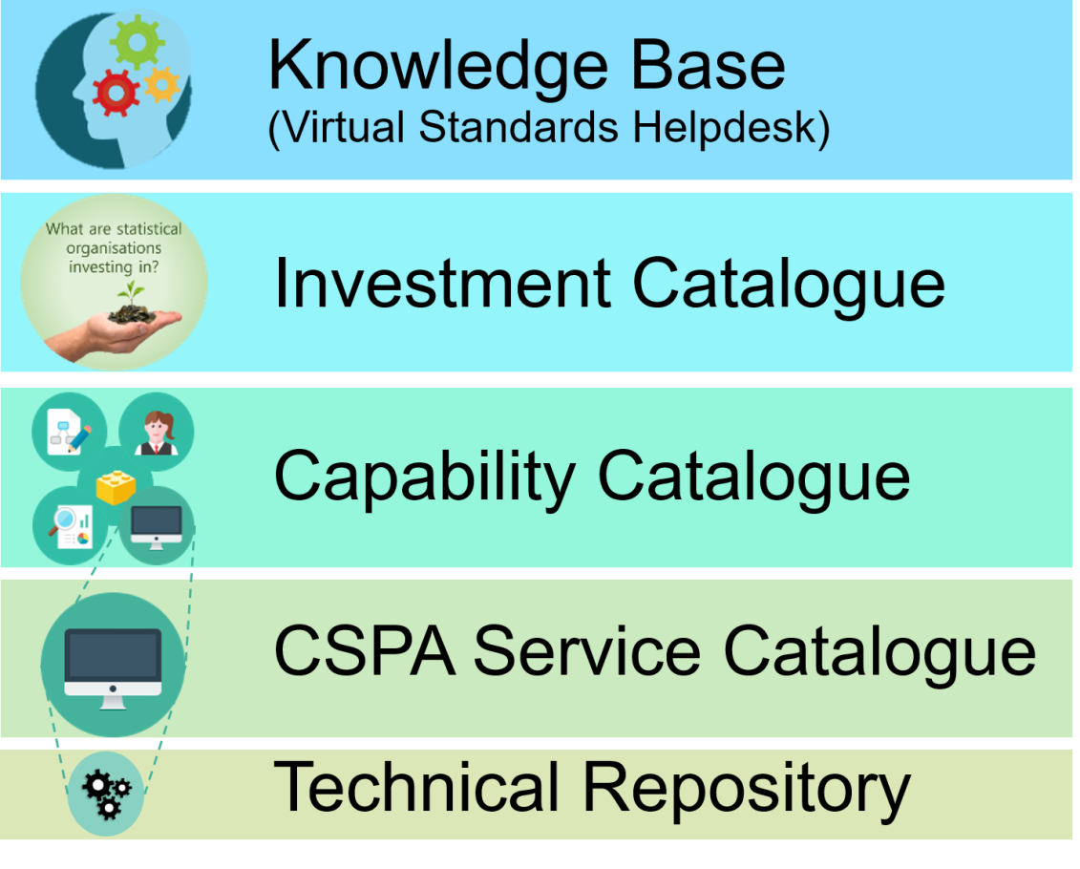
Global Artefacts Catalogue
It is a composite conceptual catalogue representing 5 layers of information
The groups reviewed these layers

Slide 11

Knowledge base
Investment catalogue
These layers have been reviewed and no major changes have been identified
  Knowledge base as an entry point
  Investment catalogue as a forecasting tool
The investment catalogue information needs to be updated on a regular basis to maintain its forecasting ability (being presented day 2)

Slide 12
Capability catalogue
This will host the ESS Vision 2020 Capability Model (this is awaiting finalisation of the GAMSO V1.1 - due shortly)
We are also assessing how this will link to material related to the capability elements – in particular the methodology architecture work (focus for 2017)

Slide 13
Service Catalogue
One single system for public and private (editable) sections of the catalogue
Maintained and hosted by European Commission's Eurostat
Business Process workflows are designed, to integrate with assessment workflows
Layout designs and catalogue workflows agreed in the Catalogue subgroup
Iterative development across Q4 2016 and 2017

Slide 14
Technical repository
Previous CSPA saw it as a central repository (Proof of Concepts used GitHub)
The group sees it as a technical tool needed as best practice in software management
Currently each service has its own repository

Slide 15
Sub-Group
CSPA Practical Technical Assistance to service implementers
Group Members:
Eric Deeben, Marco Silipo, Marco Silipo, Rosemary McGrath and UNECE

Slide 16
Goal
Defining the CSPA support model and Service Level Agreements
Providing practical technical assistance to CSPA implementation projects in statistical organizations when requested – either through their own efforts or through a network of developers in the community
Reviewing the CSPA Technical Implementation guidance and other available documentation that could be of use for CSPA service implementation
Work together with Catalogue subgroup to better define support use cases
Agree on a common project and implement CSPA
Notes:
Actions to achieve goals:
Pilot CSPA services for a specific project
Work on new services with CSPA implementation group
Work with Catalogue group

Slide 17
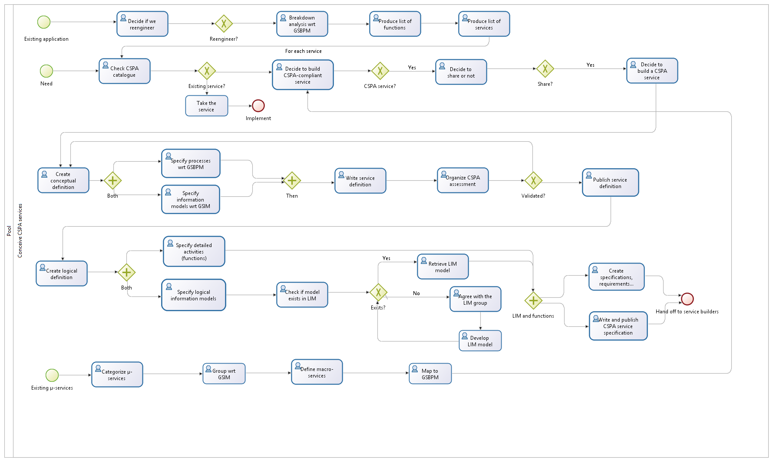
Create CSPA Service

Slide 18
The Support section in the CSPA Catalogue
Status section
SLA section
Licensing section
Maintenance section
Notes:
General notes, this new support model was presented by Pierre at last SERV meeting in Luxembourg, we could look to introduce and run parallel with CSPA support model, need to develop the services, 2/3 other services are under development.
Marco as being part of the TASK Force to provide some further background info on SERV.

Slide 19
Logical Information Model (LIM) variables
Group members:
Flavio Rizzolo, Jenny Linnerud, Eva Holm, Klas Blomqvist, Denis Grofils, David Barraclough, Alice Born, Dan Gillman, Colin Bowler, Mauro Scanu, Jenny Linnerud Rosemary McGrath and UNECE

Slide 20
Background
The Generic Statistical Information Model (GSIM) Concepts most established and elaborated
Other models can be implemented in different ways
May happen to GSIM unless there is a common understanding on how to interpret and use the model
Risk for use in CSPA
Notes:
The Generic Statistical Information Model (GSIM) contains a number of groups. Of these, the Concepts Group is the most established and elaborated. The main reason for this is because the Concepts Group is the area influenced by traditional statistical metadata development in statistical organizations.
These organizations have developed a lot of experience over the years, and several organizations are now using GSIM in development projects. Earlier experiences with models such as ISO 11179 show that the implementation of standards can be quite different due to differences in their interpretation.
There is a risk that the same thing will happen to GSIM unless there is a common understanding on how to interpret and use the model.
Discussions regarding GSIM variables and related concepts (concept systems, concept, variable, represented variable and instance variable) are showing that they can all be interpreted in different ways in different GSIM implementations: If this continues, the potential gain from CSPA and other projects on tools and methods will suffer. The issues may be solved in different ways in the varying uses as a result.
The Generic Statistical Information Model (GSIM) contains a number of groups. Of these, the Concepts Group is the most established and elaborated. The main reason for this is because the Concepts Group is the area influenced by traditional statistical metadata development in statistical organizations.
These organizations have developed a lot of experience over the years, and several organizations are now using GSIM in development projects. Earlier experiences with models such as ISO 11179 show that the implementation of standards can be quite different due to differences in their interpretation.
There is a risk that the same thing will happen to GSIM unless there is a common understanding on how to interpret and use the model.
Discussions regarding GSIM variables and related concepts (concept systems, concept, variable, represented variable and instance variable) are showing that they can all be interpreted in different ways in different GSIM implementations: If this continues, the potential gain from CSPA and other projects on tools and methods will suffer. The issues may be solved in different ways in the varying uses as a result.

Slide 21
What is a variable?
Relation to concept?
  How conceptual
  How to handle Unit types
Micro – Macro

Slide 22
Scope
Clarify the use of statistical variables and their roles within CSPA LIM, based upon the experiences already gained from GSIM implementations and DDI 4 development
Provide a solid foundation to facilitate collaborations using CSPA and within other modernization/standardization initiatives
Using examples from previous GSIM implementations would provide a clear framework that maximises interoperability between statistical organizations

Slide 23
Output
UML models for set of LIM classes related to statistical variables
  including representations (value domains) and associated concepts, conceptual domains, unit types, universe, population and any other classes that might be relevant.
Provide short, preliminary guidance document that covers only the most common use cases
Provide recommendations to extend/amend GSIM based on the activity findings.
Provide full, detail guidance and use cases on how to use the Variable LIM classes across the GSBPM
Develop a Best Practices document

Slide 24
Draft Timetable
June 2017:
Finalize the logical model
Finalize the preliminary guidance document
June 2018:
Finalize GSIM recommendations
Provide a complete guidance of all GSBPM sub-phases deemed to be relevant
Develop a Best Practices document

Slide 25
Sub-group
CSPA Architecture Patterns
Members:
Romain Tailhurat, Trygve Falch, Jakob Engdahl, Jean-Marc Museux, Rosemary McGrath and UNECE
Notes:
Present the subgroup and the members
France - Romain Tailhurat
Norway - Trygve Falch
Sweden - Jakob Engdahl
Eurostat - Jean-Marc Museux
New Zealand - Rosemary McGrath
UNECE - Steven Vale, Alice Kovarikova

Slide 26
Goal
Supply more specific and helpful guidance on architecture
Provide guidance to NSOs that are facing difficult decisions when building services or making use of services
Improve the guidance in the CSPA-standard
Notes:
The goal for the subgroup
Supply more specific and helpful guidance on architecture
Provide guidance to NSOs that are facing difficult decisions when building services or making use of services
Improve the guidance in the CSPA-standard

Slide 27
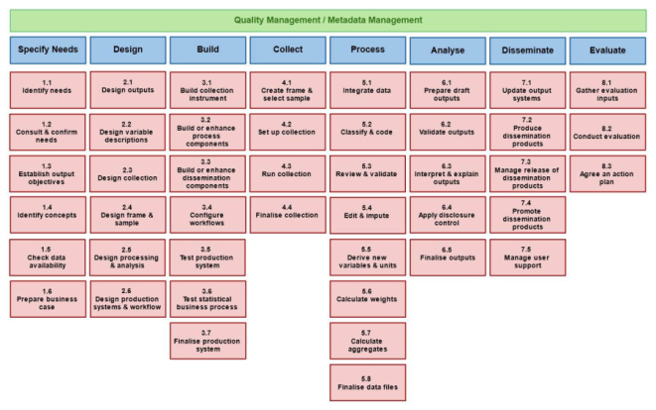
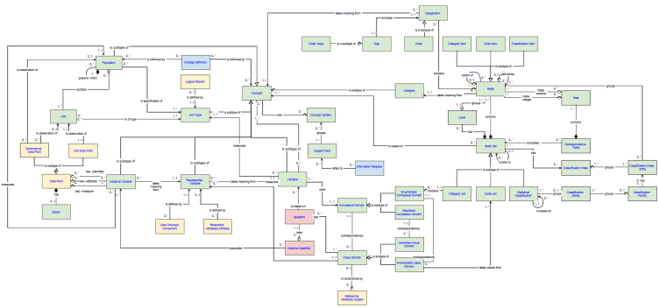







Investing in small or big services
GSBPM
GSIM
?
Technical
Logic
Notes:
Either you are building or using a service built by someone else, there is always a question about ”size” when you’re looking to establish some form of IT-system.
This requires us to be able to define something from a granularity perspective in order to understand the implications of investing in a specific service.
The challenges differ if you intent to invest in a 1x1-lego brick or if you are investing in a 4x2 duplo brick.
The analogy of these lego bricks indicate that the granularity discussion relates alot to the size of the service – as in how big is the codebase or something similar.
There are however several important things related to granularity.
Things like:
Gsbpm-coverage - how many processes/subprocesses etc does the service support
Information - how much of the GSIM is involved in the service
And the Technical perspective - does the service contain GUI-components, datastorage, logic etc

Slide 28
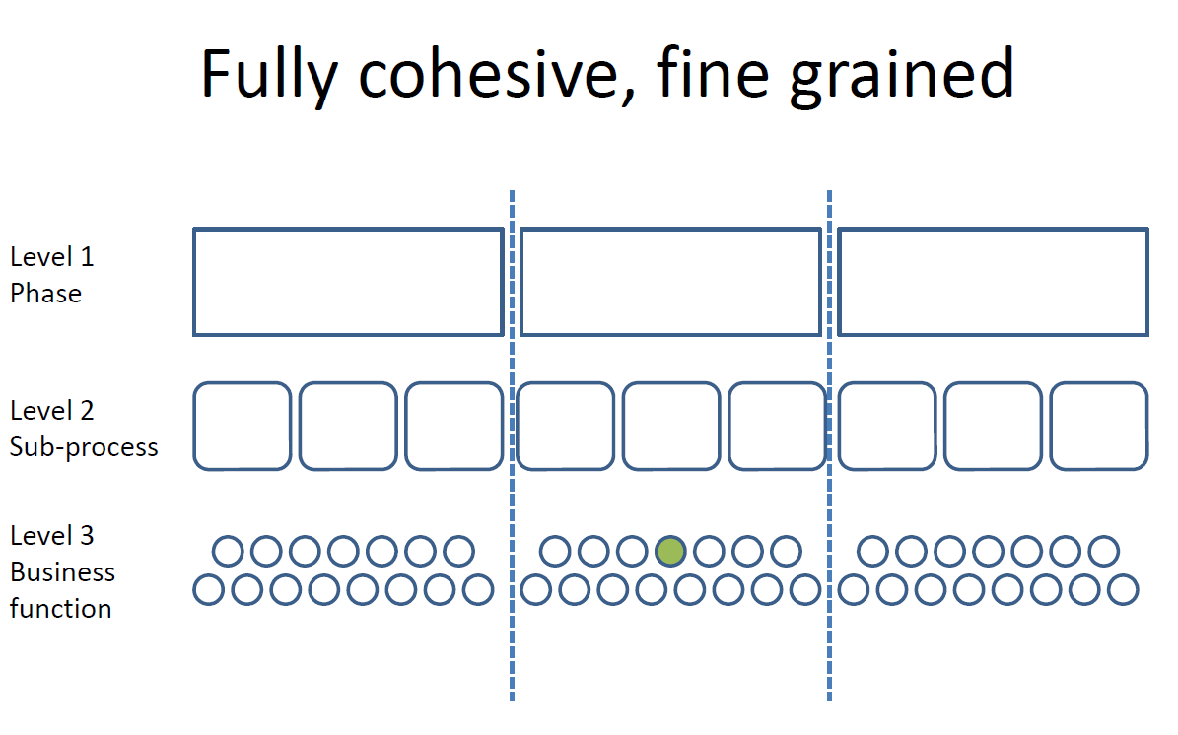
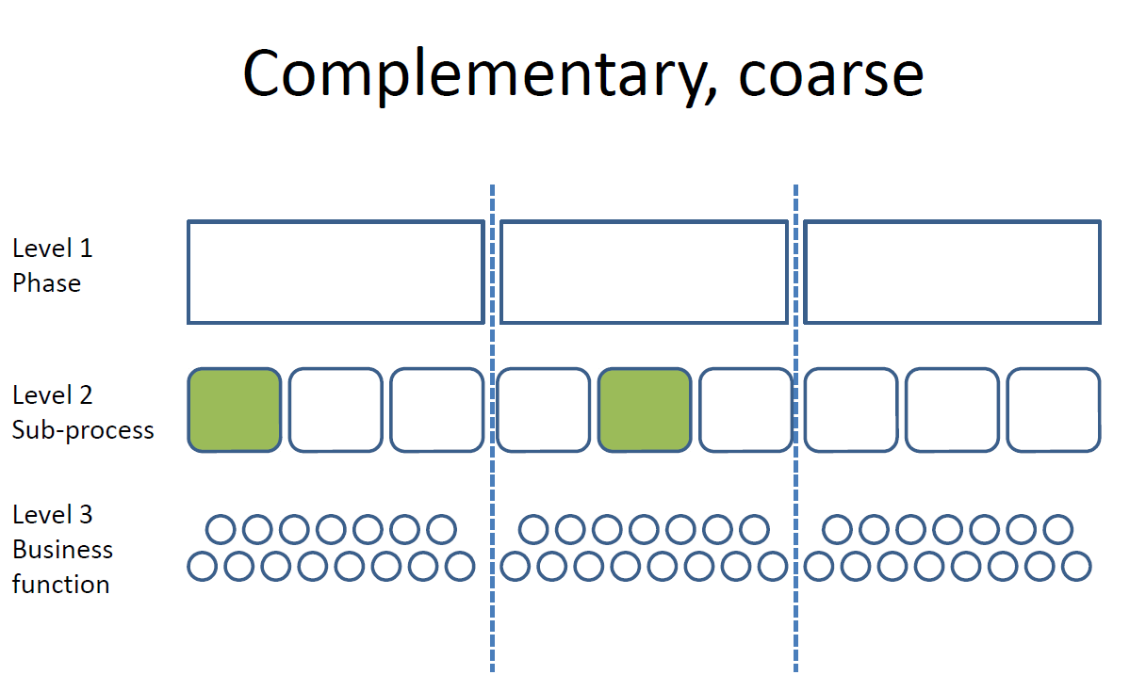
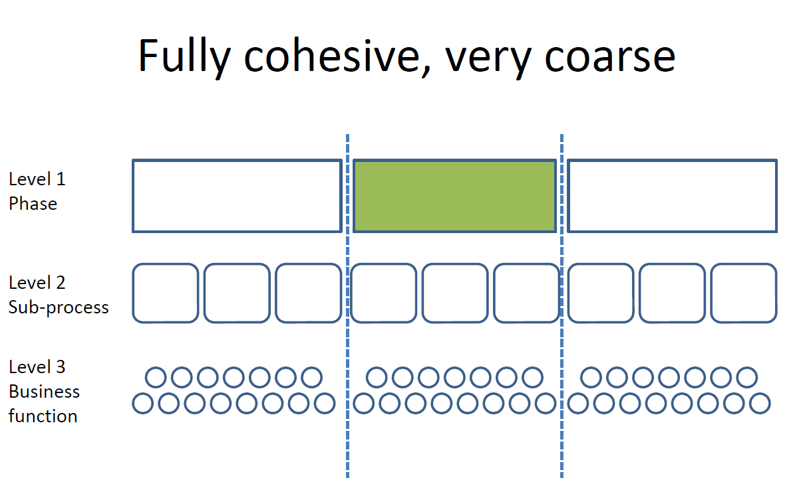
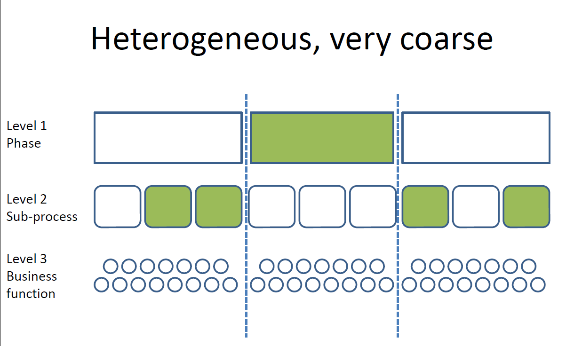
GSBPM and granularity
GSBPM
?
Notes:
Specifically regarding granularity in connection to the GSBPM, the patterns sub-group received input from the ESS.vip-project on ”sharing common functionality” connected to the SERV-project. One dimension could be regarding how large part of the GSBPM-process a service covers but some services also cover other parts of the GSBPM like the design-phaze of the corresponding production phaze that the service supports.
Within the CSPA-community, granularity comes down to being able to communicate between organisations about what the service is and isn’t. The sub-group working with patterns also aim to provide guidance on what could be good practices regarding development of new services.
Locally at a NSO, granularity is about finding services that fit what you are looking to invest into and your organisations capability of integrating a service of a specific granularity into your organisation.
A very large brick – duplo-size, might have the benefit of not requireing to many integration points but the risk is also high of ending up with overlap of existing components or you might need to change your way of working which requires agility from the business side.
Very small bricks might enable your NSO to invest in the very specific things required but large sets of very small services (microservices) requires your organisation to have very evolved capabilities for integration and requires the small bricks to be built very homogeneous.

Slide 29





Possible ways forward
Bundle smaller services
Invest in integration capabilities
Notes:
Some possible ways forward is to internally invest in your NSOs capabilities for integrating smaller services
On UNECE-level a way forward is to develop architectural patterns that allow services to be composed of smaller services where an organisation can decide if they want to implement the whole bundle or just make use of some of the smaller services.

Slide 30


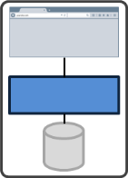



Scenario – Add a service
!
?
CSPA Catalogue
Guidance
Notes:
If a service is available in the CSPA-catalogue and should be implemented into your NSO…
Different NSOs have different capabilities internally so the context that this service should be implemented into differes:
Context 1 - nothing present
Context 2 - something existing (systems and datasources but no CSPA-services and probably not SOA-oriented) but no "infrastructure" (communication platform, ESB, message broker etc)
Provide guidance on (using different main arch patterns):
How to make use of existing data sources (relational databases, files)
How to make use of existing system
How to decide on "main arch pattern"..
Context 3 - Have pre-existing platform and maybe one or more running CSPA/SOA-services
This is where we see the guidance on architectural patterns comes in. The guidance aims to describe realistic scenarios keeping in mind the different setups for different NSOs. The guidance could come in text form but also in more interactive form like demos or a supplied reference environment to try different setups.

Slide 31
Practical Implementation
Confidentialised Analysis - continued
2 x Classification services (Retrieve and List)
4 x Eurostat – in delivery
3 x ESSNet -
Hackathon concept – and the feedback from the w/shop

Slide 32
Challenges:
Moving from the project framework to a ‘group’ format
The size and breadth of the group – sub-group format
Communication and Promotion

Slide 33
Next steps (the challenging areas)
Communication and Promotion
Clarifying the role of CSPA in the commercial (technology, data and analytics) environment
Video Franck!! – this is the start of ‘what we can do’

Slide 34
Next steps
Key focus - CSPA Workshop, 3-5 July 2017, Wiesbaden, back to back with ESSNet project on Sharing Common Functionalities – 3 primary audiences: architecture and IT, investors/decision makers, methodologists – highly practical and interactive
Finish – transitioning – no one asks “what does it mean to be CSPA compliant”, the resources have no significant gaps and are easy to access and use
Notes:
FINISH
Assess Compliance:
Finalize all documents
Continue to run new services through the process
Finalize automated workflow for the catalog
Consider the development of a separate but related automated workflow for tracking services in place of the spreadsheet
Technical Implementation
Improve the technical implementation guidance-
Need more services
Set up recommendations in terms of support material for CSPA implementation
FAQs, tutorials, webinars, etc)
Start reviewing first available services’ documentation and determine what is missing
Identify the service owner
Missing service details,
Configuration of the service, advice, ask for more complete documentation,
Transfer/migrate existing services in CSPA
Update technical guidance
Catalogue

Slide 35
Thank you for your attention!
Comments and Questions?

