Slide 1

CSPA Data Architecture Proposal
Prepared by the Modernization Committee on Standards

Slide 2
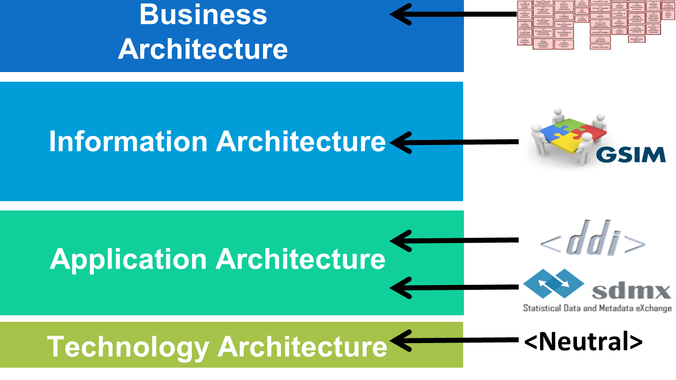
Proposal
To develop a reference framework to build data architectures for the official statistics industry, as a part of an Enterprise Architecture
Data Architecture is being conceived as part of the CSPA

Slide 3
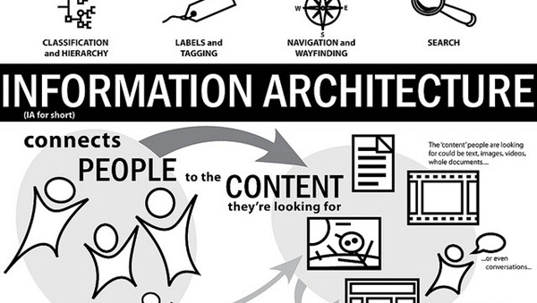
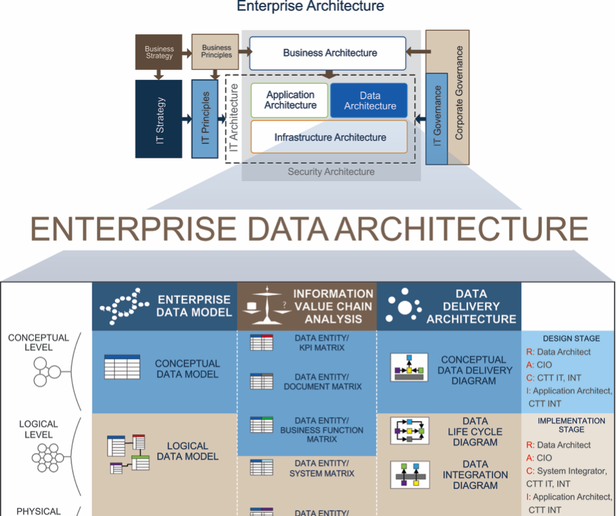
Why “Data Architecture” and not “Information Architecture”?
Both terms have different meanings:
  Information architecture is a design discipline that is focused on making information findable and understandable in the web systems.
  Data architecture is a description of the structure and interaction of the enterprise’s major types and sources of data, logical data assets, physical data assets, and data management resources.
The proposal aims to establish basis to develop strong data platforms, not only web systems

Slide 4
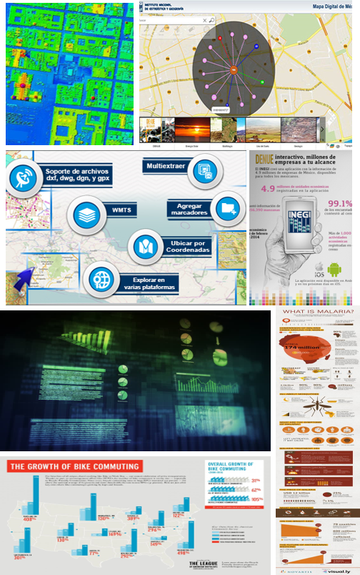
Expected Benefits
Enhanced governance of data inside statistical organizations
  Aligned efforts
  Common understanding
Elimination of internal data silos
  Less redundancy and inconsistency
  More efficient data flows (internal and external)
Easier and faster integration of different kinds of data from different domains
  Data coming from traditional and emergent sources (Big Data, IOT, geodesic and geographical sources, etc.)
  Static and dynamic data
  Capability to fast delivering of new information products and services
Better support for existing standards like GSBPM, GAMSO, GSIM, DDI, SDMX, etc.
  Improved interpretation and knowledge of data and metadata
  Improved comparability and transparency
Common basis to develop and adopt CSPA statistical services
  A common set of information of interest
  Easier to collaborate on common projects
Positioning of statistical organizations to leverage opportunities based on technological developments in linked data and metadata, next generation data storage, analysis, visualisation, new methods and algorithms

Slide 5
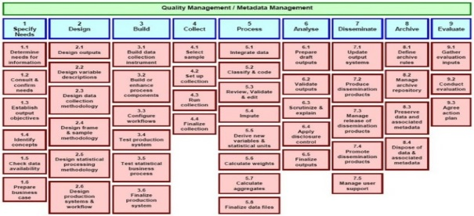

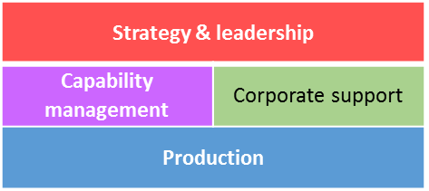
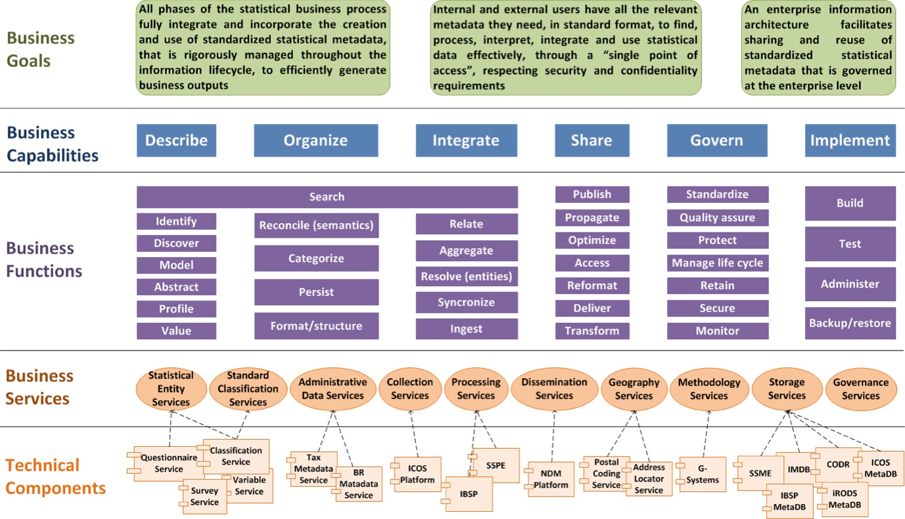


Relations With Other HLG-MOS Activities
It complements and consolidates the CSPA approach, by taking care of the most important assets for statistical organizations, data and metadata.
It applies the business framework provided by GSBPM, and makes concrete use of GSIM and CSPA LIM standards.
It covers the layer between business process and applications defined by an enterprise architecture
It is strongly related with the Next Generation Data Management Vision

Slide 6
Expected Outputs
Description of the structure and interaction of the major types and sources of data.
Guidelines to describe conceptual artefacts like statistical data dictionaries and data catalogues to drive the definition of data structures and metadata
Standardized catalogue of the common logical clusters of data which are relevant to statistical organizations
Guidelines and recommended practices for managing data assets
  Ensure sufficient data quality for statistical organizations
  Collaborate and share technical solutions (like the CSPA services), and knowledge
Architectural Information Capabilities Guide
  Capabilities to implement future-proof data and metadata architectures

Slide 7
Questions?

