Slide 1
Explanatory presentation to …/GRSP/2022/25: Section B of Justification - Harmonising UN R129 vertical head excursion limit
Informal document GRSP-72-35
72nd GRSP, 05-09 Dec. 2022
Agenda item 10
Submitted by the experts from CLEPA
72nd session of GRSP, 05 – 09th December 2022

Slide 2
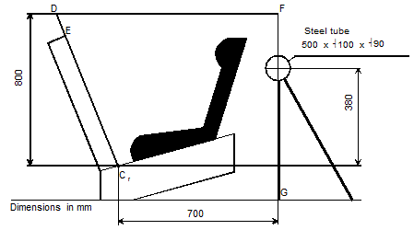
Harmonising R129 vertical head excursion
Overview
UN R129 Vertical head excursion | Q3 |  | Q6 | Q6 | Q10
 | RF CRS | FF CRS | RF CRS | FF CRS
Current limit (mm) | 840 | 800 | 840 | 800 | 840
CLEPA proposal limit (mm) | 840 |  | 840 |  | 840
RF = Rear-facing; FF = Forward-facing
E
500

Slide 3
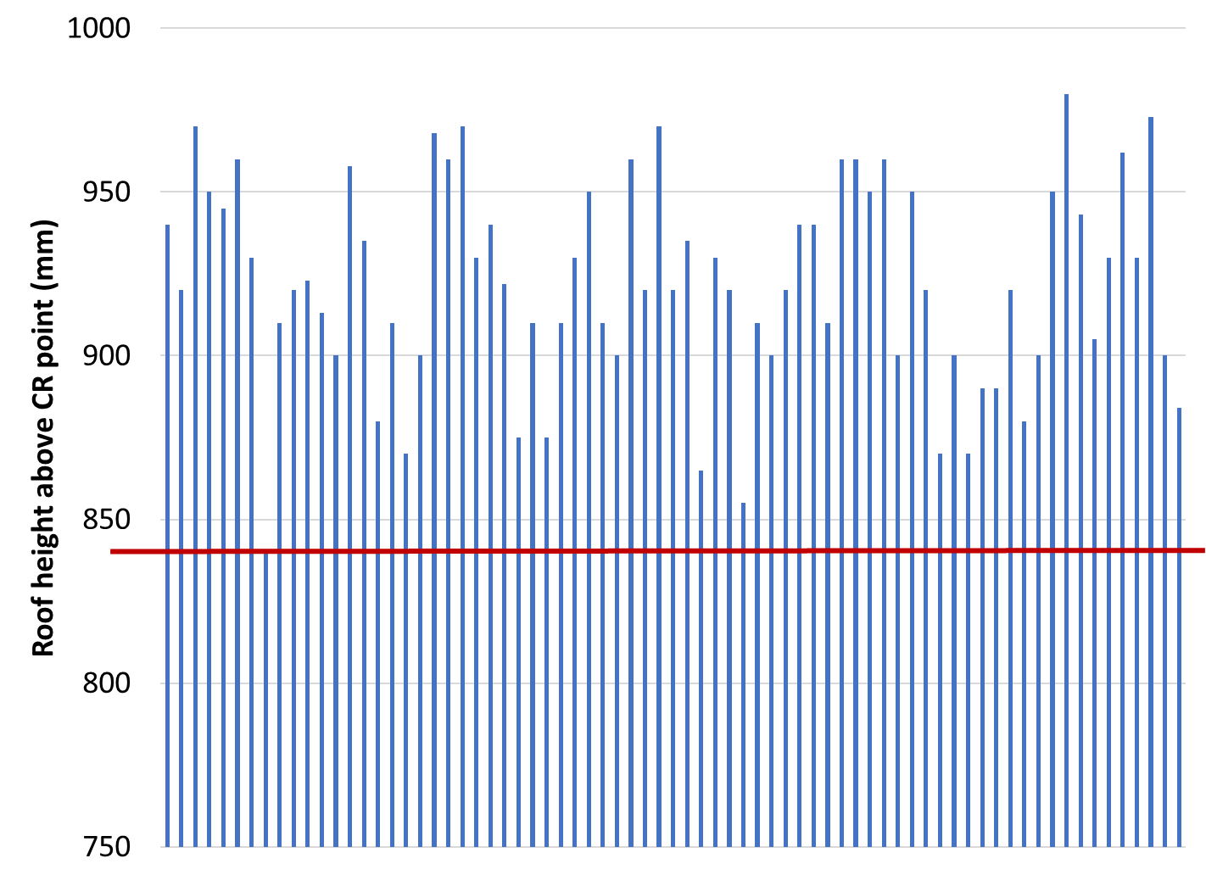
Harmonising R129 vertical head excursion
Space above the CR point in cars
Cars provide 840 mm
  Top 70 by sales (2019) plus 9 new models
  All segments included:

