Slide 1
Transmitted by the expert of the Netherlands
Informal document GRSP-72-28 GRSP 72nd session, 5 – 9 December 2022 Agenda Item 10
Status update GRSP-Ad-Hoc-group on CRS December 2022

Slide 2
Background
At the 71st meeting of GRSP, the representative of the Netherlands presented informal document GRSP-71-19
In this document, the current situation is explained with regard to the inconsistency in UN R129 and R145 concerning the requirements on lower tether anchorages and for the use of a support leg for other situations than i-Size seating positions.
It was decided to start an Ad-Hoc group, to discuss these topics with experts from interested Contracting Parties and NGO’s
The Ad-Hoc group with representatives from: NL, DE, FR, SE, ES, OICA, CLEPA, ISO, ANEC met on: - 29 June 2022 in Paris (hybrid) - 11/13 July 2022 (Teams) - 9 September 2022 (Teams) - 21 October 2022 (Teams) - 10 November 2022 (workshop at BASt, Bergisch Gladbach)

Slide 3
Support leg for other than i-Size applications
Only vehicle-specific in case non-i-Size seating position; e.g. - booster seat with support leg (see GRSP/2021/20 and GRSP-70-03) - RWF belted CRS using lower tether anchorages manufacturer has to declare the vehicle type to be suitable for a support leg.
CLEPA showed (See AdHocCRS-06-01) that loading on the vehicle floor is in line with what’s common for i-Size.
Use of a support leg in combination with ISOFIX attachments may affect the way the seat cushion senses the occupant’s weight (which may be relevant for SBR systems and adaptive load limiters). This is also the case with a booster seat itself
Conclusion: UN R 16 already requires vehicle manufacturers to declare which seating positions in the vehicle are suitable for use in combination with a support leg. This does not seem to introduce any incompatibility issues.

Slide 4
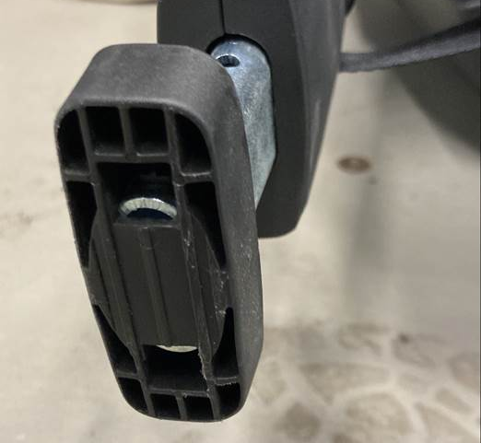
UN R129 definitions
2.15.2. "Support-leg foot contact surface" means the surface of the support-leg foot physically in contact with the vehicle floor contact surface and designed to spread the loads across the vehicle structure.
Some current designs are not in line with this definition…
Foot dimensions fulfil requirements of paragraph 6.3.5.3. but effectively, only the footprint of the tube spreads the loads accross the vehicle structure creating a “pinpoint load”
Vehicle manufacturer => responsible for a floor with sufficient strength
CRS manufacturer => responsible for a foot designed to spread the loads.

Slide 5
UN R129 definitions (cont.)
Conclusion: maybe wording needs to be improved
6.3.5. i-Size Enhanced Child Restraint System support-leg and support-leg foot requirements
Conclusion: Foot dimensions (6.3.5.3.) now seem not to apply to non-i-Size => to be updated

Slide 6
Lower Tether Anchorages
Three stages:
Short term: What can be approved under UN R129.03 and UN R145.00
Mid term: Introduction of new series of amendments to UN R129, UN R145 and UN R16 Proposals to be expected in May 2023 session of GRSP
Long term: ISOFIX 2.0 ?!

Slide 7
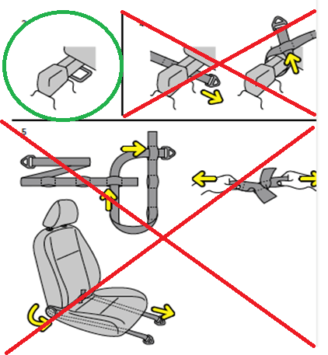
Short term solution – guidance document
Only approve ECRS with lower tether anchorages using top tether hook, for use in vehicles where the vehicle manufacturer provides the brackets (or integrated solution to attach the top tether hook directly to the rail)
General strength and durability requirements apply to straps and retractors (UN R129 §6.7)
In line with ISO 13216-4:2020

Slide 8
Midterm solution – update of UN R16, R129 and R145
General:
Introduce definitions on LTA
Facilitate the use of LTA in combination with (top) tether hook only
Facitilate the situation whereby - the vehicle manufacturer provides the vehicle with brackets - the vehicle manufacturer provides an integrated solution in the rails - the vehicle manufacturer provides for the anchorage only and the “universal bracket(s)” is supplied by the CRS manufacturer - the vehicle manufacturer recommends the top tether anchorage of the front seat to be used as LTA and it is tested as such.
UNR16:
Instructions to consumers on LTA

Slide 9
Midterm solution – update of UN R16, R129 and R145
UN R145:
Basic requirements are taken from ISO 13216-4:2020
UN R129:
Update of Annex 24

Slide 10
Longterm solution – ISOFIX 2.0 !?
Development of a uniformal ISOFIX system dates back to the 90’s and resulted in ISO 13216-1:1999
As part of the developments in ISO and the UN 1958 Agreement (R44, R129), we have seen the introduction of the top tether, support leg … … and any other means to prevent rotation, e.g. rebound bar, lower tether anchorages.
This has come with some challenges: - complexity - chance of misuse - limitation on max. mass - dependence on vehicle seat design

Slide 11
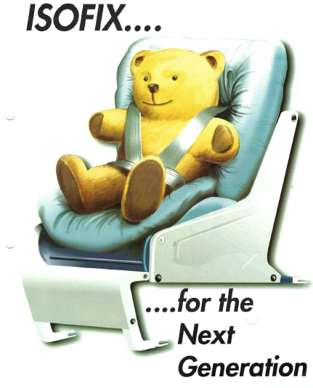
Longterm solution – ISOFIX 2.0 !? (cont.)
What is it we actually need ?
simple means of attaching a CRS to the vehicle’s hard point
ideally consisting of 3 (or 4) fixed points
“click and play”
no rotation possible
no interaction with the vehicle’s seat
worldwide harmonised
© TRL

Slide 12
Longterm solution – ISOFIX 2.0 !? (cont.)
For GRSP to consider:
Is there still interest to develop a GTR on Child Safety ?
In order to take “ISOFIX 2.0” on board, cooperation with ISO would be helpful !?

Slide 13
Thank you for your attention !

