Slide 1
Submitted by the expert from Republic of Korea
Informal document GRSP72-13
72nd GRSP, 5-9 Dec. 2022 agenda item 5
SBR Issues (UN R16)
KATRI
The Republic of Korea

Slide 2
Background
The SBR amendment(Revision 8 Amendment 4) has been in effect since 1st September 2019
There were 3 issues on the SBR regulation - due to new design - due to new technology
2p

Slide 3
Issue 1
“8.4.1.3. A safety-belt reminder is not compulsory on folding seats (i.e. normally folded and designed for occasional use, e.g. foldable crew seats in the buses and coaches) as well as seating positions fitted with an S-type belt (including Harness belt).”
[i.e. normally folded and designed for occasional use] ⟹ This provision was for excluding folding seats, which are supposed to be normally folded and designed for occasional use because the seats are located on the steps or in the aisle, for instance.
Is the Interpretation of folding seats consistent?
3p

Slide 4
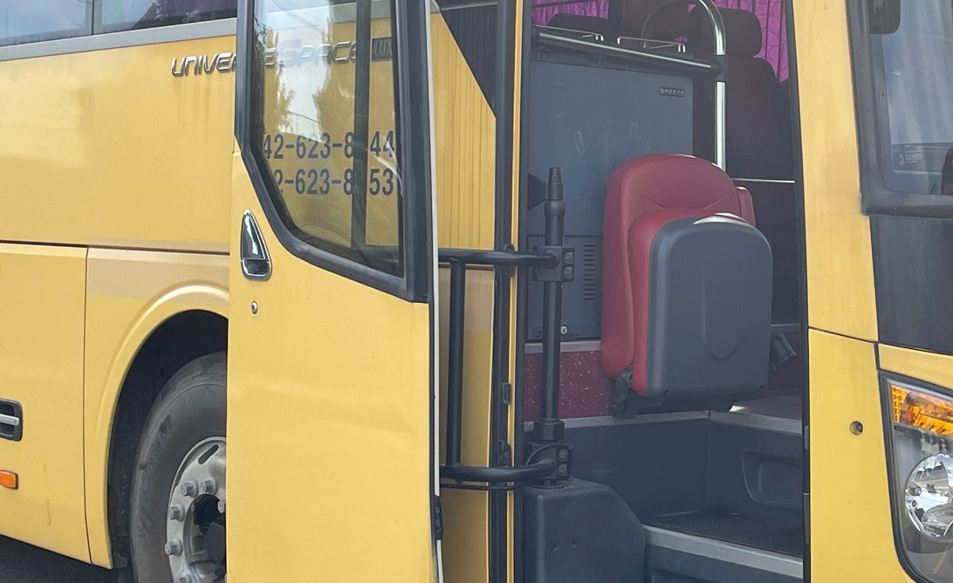
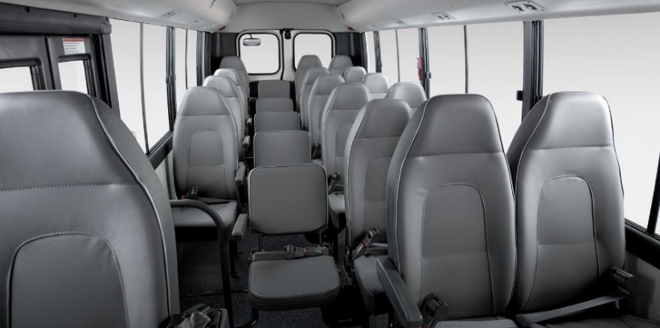
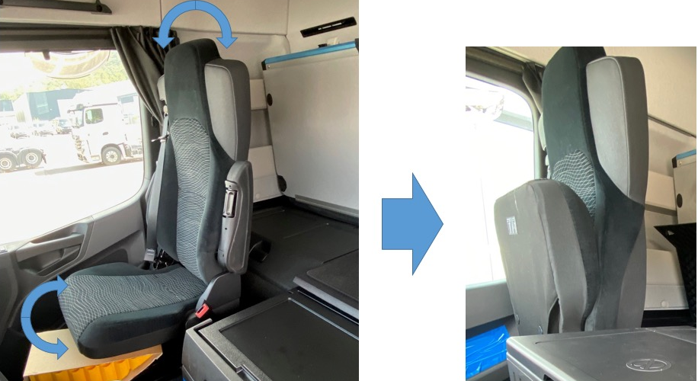
Issue 1
Exception examples during the amendment discussion
Not compulsory on this folding seat?
◀ (1)
Foldable crew seat
◀ (2)
Foldable aisle seat
◀ (3)
Truck front passenger seat
(European technical service decision: not compulsory)
* Source
- (1): taken by KATRI
- (2): Hyundai Motors Homepage
- (3): Provided by Daimler Truck Korea
4p

Slide 5
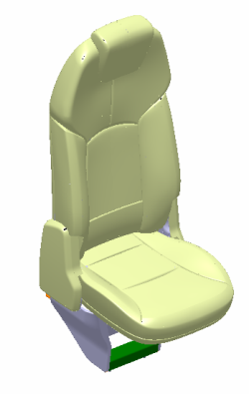
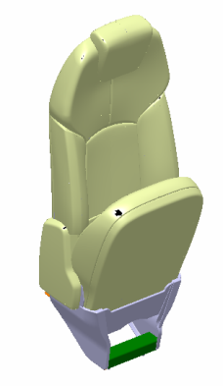
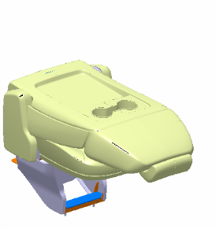
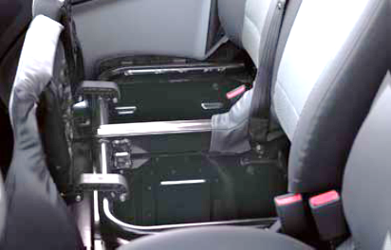
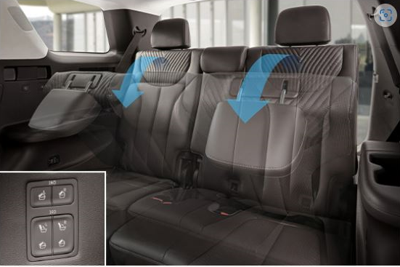
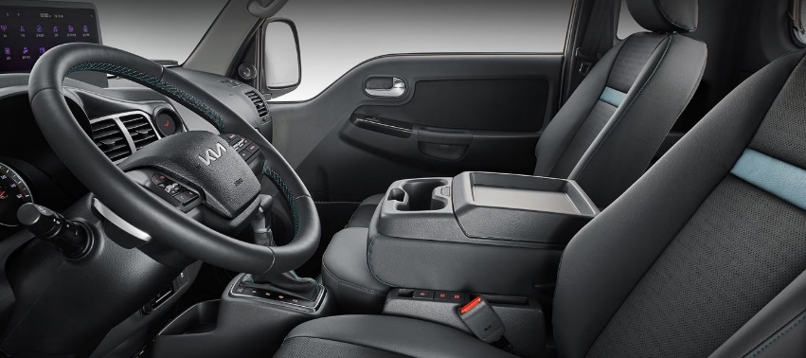
Issue 1
CPs(Korea, EC, Japan) have discussed the similar seat type due to a OEM request , and agreed this is not the folding seat
How about these folding seats?
▲ (4) FRT Passenger seat of a truck
▲ (5) Passenger seat
(only cushion is foldable)
▲ (6) 3rd row seat of SUV
▲ (7) Front passenger middle
seat of small truck
* Source
(4), (5): provided by Hyundai motors, (6): Hyundai Motors Homepage, (7): KIA Motors Homepage
5p

Slide 6
Issue 1
Proposal
- The exception shall apply to folding seats normally folded and
designed for occasional use
- or GRSP needs to review and discuss the intention of “folding
seat” in the current regulation,
- and define clearly the “folding seat” in the regulation
- So, CPs including technical laboratories and stakeholders
understand in the same way what folding seats are for the
exception
6p

Slide 7
Issue 2
Current regulation requires SBR must be tested according to the test procedure in Annex 18 (8.4.2.3.3, 8.4.2.4.6)
- “Annex 18 Safety-belt reminder tests
1. The first level warning shall be tested according to the following
conditions
(a) Safety-belt is not fastened;
(b) Engine or propulsion system is stopped or idling, and the
vehicle is not in forward or reverse motion. (c) Transmission is in neutral position; (d) Ignition switch or master control switch is activated; (e) A load of 40kg is placed~ (about occupancy conditions) (f) The state of the safety-belt reminder is checked for all of the
relevant seat(s), in conditions (a) to (e).”
7p

Slide 8
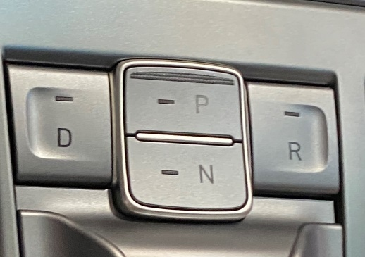
Issue 2
(c) Transmission is in neutral position; ⟹ For testing, “transmission is in neutral position” is necessary? - How about a vehicle equipped with button-type transmission?
Proposal - Delete (c) ⟹ Thus, the first level warning shall be activated whether
transmission is in neutral position or not
◀ (8) button type transmission
* Source
(8): taken by KATRI
8p

Slide 9
Issue 2
(d) Ignition switch or master control switch is activated; ⟹ What if a vehicle doesn’t have ignition switch or master
control switch? ⟹ From which moment, the duration of the first level warning
must be measured? - There are electric vehicles without “ignition switch or
master control switch” in the market
Proposal
- revise (d) into ” Engine or propulsion system is activated;” or new wordings need to be discussed possibly with new
definition if necessary
9p

Slide 10
Issue 3
There is a device(including a smart phone) to remotely start an engine or propulsion system when occupants are not in the vehicle
According to Annex 18, it would be testable, but any unexpected hazards?
Proposal - include a provision for the case; “[8.4.6.] Any devices capable of remotely start an engine or propulsion system shall not prevent a safety-belt reminder from activating any warnings when occupants are seated in the vehicle.”
10p

Slide 11
고맙습니다.
Thank you for your attention.
11p

