Slide 1
UN R154: Annex B9 for Level 1B and Level 2.
Submitted by the expert of OICA Informal document GRPE-87-11 87th GRPE, 10 - 13 January 2023 agenda item 3.(a),
“Alternative Methods”

Slide 2
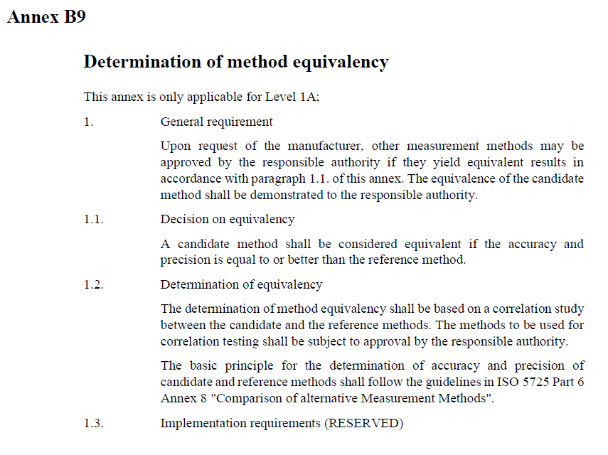
UN-R154: Annex B9, “Alternative Methods”. Addition to Level 1B and Level 2 Requirements.
§
Summary:
Annex B9 to UN R154 specifies the option to use alternative testing methods compared to those given in the Regulation, if they yield equivalent results and is approved by the responsible authority.
Usage of equivalent methods for homologation can reduce the testing efforts while maintaining, by definition, equal or even higher accuracy and precision.
The option for alternative methods in the context of emission type-approval was first introduced with European Regulation (EU) 2017/1151 and was also included within UN R154, but Level 1A only.
In order to achieve a higher level of harmonisation of emission Regulations worldwide, it is proposed to include the requirements of Annex B9 to UN R154 for Level 1B and Level 2 as well.

