Slide 1
Transmitted by the expert of the Netherlands
Informal document GRSG-124-27
GRSG 124th session, 11 – 14 October 2022
Agenda Item 18(g)
Three dimensional H-point machine
State of Play
October 2022

Slide 2
Background
GRSG-124-XX
This item has been on the GRSP agenda for a long time…
No documents from the IWG 3-D HPM available on the UNECE website !?
GRSP-55: May 2014
when discussing the new draft Regulation [135] on Pole Side Impact, it was noticed that a different reference to the ISO standard was included from other Regulations
GRSP-56: December 2014
Germany presented informal document GRSP-56-37
In their June 2014 sessions, WP.29 and A.C.3. agreed to start the IWG 3-D HPM
GRSP-57: May 2015
the IWG presented informal document GRSP-57-30

Slide 3
Background (cont.)
GRSG-124-XX
GRSP-58: December 2015
the IWG would start drafting an Addendum to the M.R.1 which would reproduce the specifications of the 3-D H machine from SAE J826
GRSP-59: May 2016
the chair of the IWG (on harmonization of) 3-D HPM from Germany resigned
GRSP-60: December 2016
new chair assigned from Spain
GRSP-61: May 2017
work of the group would start as of 24 May 2017 with first WebEx meeting
GRSP-62: December 2017
Informal document GRSP-62-24 was presented

Slide 4
Background (cont.)
GRSG-124-XX
GRSP-63 ~ GRSP-65: May 2018 ~ May 2019
the IWG had not progressed as expected, the activity of this IWG could eventually be handed over to a new group on the development of the M.R.1
GRSP-66: December 2019
discussion moved to the May 2020 session
GRSP-67: July 2020
item not on the agenda and has not been discussed
GRSP-68: December 2020
Intention of the IWG to submit a proposal of amendment to R.E.3 to the May 2021 session of GRSP. However, GRSP noted that the IWG had the objective to harmonise specifications and include them in M.R. 1, whereby both UN Regulations and UN GTRs would refer to

Slide 5
Background (cont.)
GRSG-124-XX
GRSP-69: May 2021
discussion moved to the December 2021 session
GRSP-70: December 2021
No new information has been provided

Slide 6
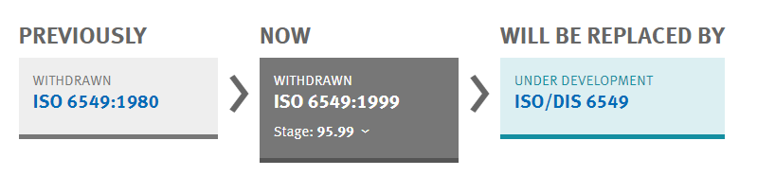
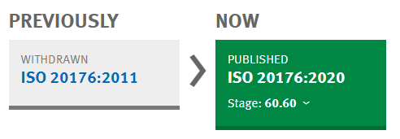
References
GRSG-124-XX
ISO 6549
- ISO 6549: 1980
- ISO 6549: 1999
ISO 20176
- ISO 20176:2020
Refers to SAE J826 => HPM-I/”OSCAR”
Refers to SAE J4002
HPM-II/ASPECT; (currently)
not used by UN ECE

Slide 7
Key differences ISO 20176 from ISO 6549
Compared to the H-point machine (HPM-I) specified in ISO 6549, the HPM-II provides:
- improved repeatability,
- greater ease of use,
- additional features and measurement capabilities.
While:
minimizing their impact on the location of reference points and measurements.
IRCOBI conference 2021; IRC-21-49
HBM-I not suitable for reclined seats
(for torso angles well in excess of 25 degree)
GRSG-124-XX

Slide 8
Key differences ISO 20176 from ISO 6549 (cont.)
1) Separate components
- the legs (upper and lower), shoe, cushion pan and back pan are all separate pieces.
- greatly improves the ease of installation.
2) “Legless” manikin
- Use of legs is optional.
3) Shoe tool
Several improvements were made to the shoe tool and how it is positioned in the vehicle, including:
  i) replacing the pedal reference point (PRP) with a new ball of foot reference point (BOFRP);
  ii) specifying a new procedure for positioning the shoe on the pedal.
4) Cushion angle
The cushion angle is measured independently of thigh angle, and at the same time the other measurements are made. (With the ISO 6549 HPM, cushion angle was measured from the thigh line, and required a separate installation of the HPM).
5) Lumbar support
- The articulation of the back pan assembly allows the HPM-II to be better seated in contoured seats.
- Provides a measurement of lumbar support prominence (LSP). With LSP=0, no difference between HPM-I/II
GRSG-124-XX

Slide 9
References (cont.)
GRSG-124-XX
R.E.3.
- Rev. 2 (30 June 2011)
- Rev. 3 (23 January 2014)
- Rev. 4 (27 January 2016)
- Rev. 5 (7 June 2017)
- Rev. 6 (11 July 2017)
SAE J826 (HPM-I/OSCAR); includes calibration procedure for HPM-I.
- 1962, 1980, 1987, 1991, 1992, 1995, 2002, 2008-03, 2008-11, 2015, 2021
SAE J4002 (HPM-II/ASPECT)
- 2004, 2005, 2010, 2022

Slide 10
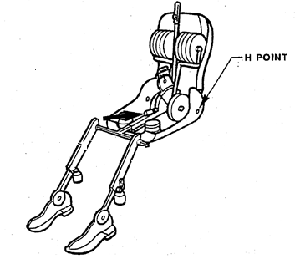
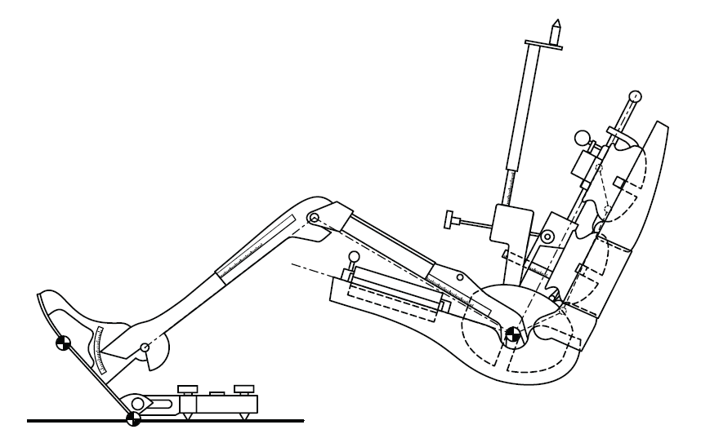
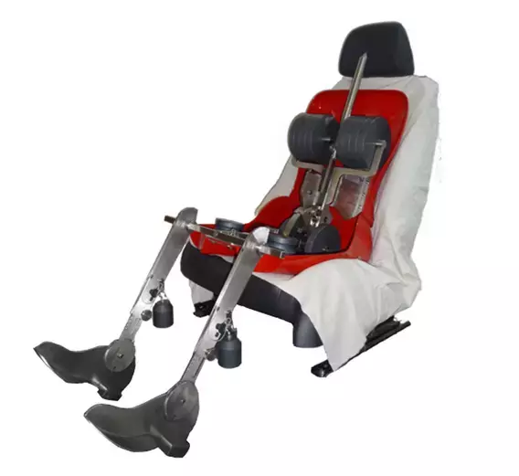
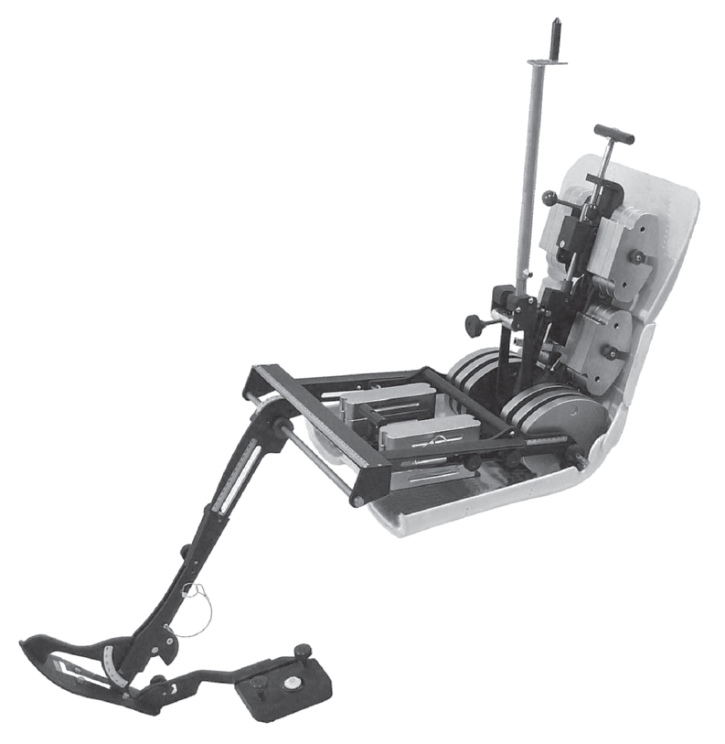
HPM-I (“Oscar”, “Japie”)
GRSG-124-XX
HPM-II incl. opt. equipment (“[ASPECT]”)
© Copyright Humanatics

Slide 11
GRSG-124-XX
Consideration:
- HPM-II relevant for Type Approval ? Or only more suitable for development
purposes
What about Type Approval requirements with regard to reclined seats in future ?
- HPM-I OK to be continued to be used !?
Statement from SAE (as found in SAE J826 – November 2008):
“SAE J4002 (HPM-II) and SAE J826 (HPM) shall co-exist for a transition period of at least 10 years, preferably no longer, from the first publication date of SAE J4002 (August 2005). Following this transition period SAE J826 will be withdrawn.
During the transition period, it remains up to the vehicle designers to decide which HPM to use. Regulatory bodies and other parties that need to know shall be informed regarding which HPM was used”.

Slide 12
Overview 1958 Agreement/1998 Agreement
GRSG-124-XX
Regulation | ISO reference: | Reference to: | Action:
R.E.3 Rev. 6 | ISO 6549-1980 | Annex 1 - Appendix 1 | To be updated
GTR 06 | ISO 6549 | Section 3.13.2. | Should mention version ?!
GTR 07 | ISO 6549:1999 | Annex 13 footnote 1 | Annex 13 figure 11-2 refers to the dimensions from ISO6549:1980. To be updated. Legs set at 50 pecentile
GTR 14 | ISO 6549:1999 | Par. 107 and Annex 3 footnote 1 | Upper leg set at 10 percentile; to be updated
UN R14.09 | (ISO 6549-1980) | Annex 4 Appendix 1 refers to R.E.3. Rev. 2 | To be updated
UN R16.08 | (ISO 6549-1980) | Annex 15 Appendix 1 refers to R.E.3. Rev. 6 | To be updated
UN 17.10 | (ISO 6549-1980) | Annex 3 Appendix 1 refers to R.E.3 Rev. 6 | To be updated
UN R21.01 | ISO 6549-1980 | Annex 5 Appendix 1 footnote /* | To be updated
UN R25.04 suppl. 1 | ISO 6549-1980 | Annex 3 footnote 1 | To be updated
UN R32.00 suppl. 1 | ISO 6549-1980 | Annex 3 footnote * | To be updated
UN R33.00 suppl. 2 | ISO 6549-1980 | Annex 3 footnote * | To be updated
UN R35.00 suppl. 1 UN R35.01 | ISO 6549-1980 (ISO 6549-1980) | Annex 3 footnote * Annex 3 refers to R.E.3 Rev.6 | To be updated
UN R43.01 suppl. 9 | ISO 6549 | Annex 22 paragraph 2.3 | To be updated
UN R46.04 suppl. 9 | (ISO 6549-1980) | Annex 8 Appendix 1 refers to R.E.3 Rev. 4 | To be updated
UN R80.04 | ISO 6549-1980 | Annex 4 Appendix 1 footnote 1 and 2 footnote 1 refers to R.E.3 Rev. 2 footnote 2 refers to ISO 6549-1980 | To be updated
UN R94.04 suppl. 1 | (ISO 6549-1980) | Annex 6 Appendix 1 footnote 1 refers to R.E.3 Rev. 6 | To be updated
UN R95.05 suppl. 2 | (ISO 6549-1980) | Annex 3 Appendix 1 footnote 1 refers to R.E.3 Rev. 3 | To be updated
UN R114.00 | ISO 6549-1980 | Annex 8 footnote * | To be updated
UN R125.02 | (ISO 6549-1980) | Annex 3 footnote 1 refers to R.E.3 Rev. 2 | To be updated
UN R135.01 suppl. 3 | ISO 6549:1999 | Annex 5 footnote 1 scope 1.1.b refers to R.E.3. Rev. 6 definition 2.18b refers to R.E.3. Rev. 3 | Upper leg set at 10 percentile; to be updated Check origin of change to Rev. 6 in WP.29/2021/157
UN R137.02 suppl. 2 | (ISO 6549-1980) | Annex 3 footnote 1 refers to R.E.3 Rev. 6 | To be updated

Slide 13
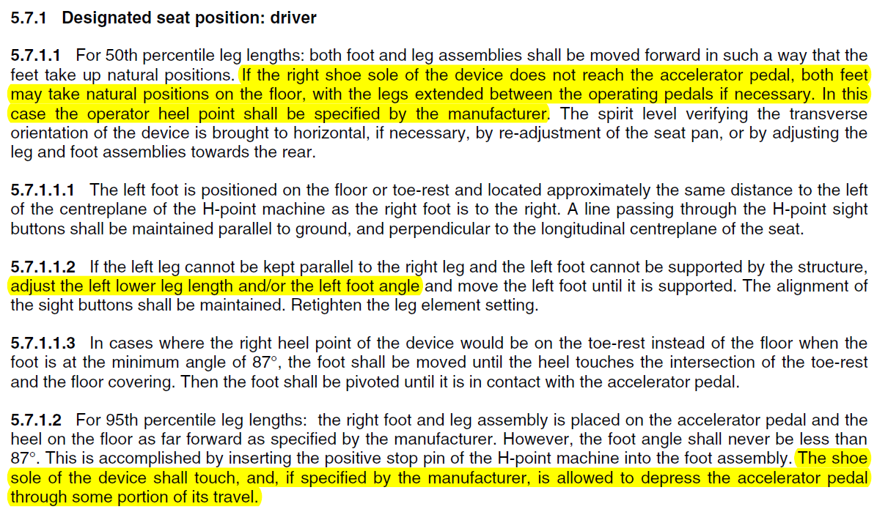
ISO 6549:1980 versus 1999
GRSG-124-XX
In common:
- both versions cover procedure for 50 percentile and 95 percentile
Main differences:

Slide 14
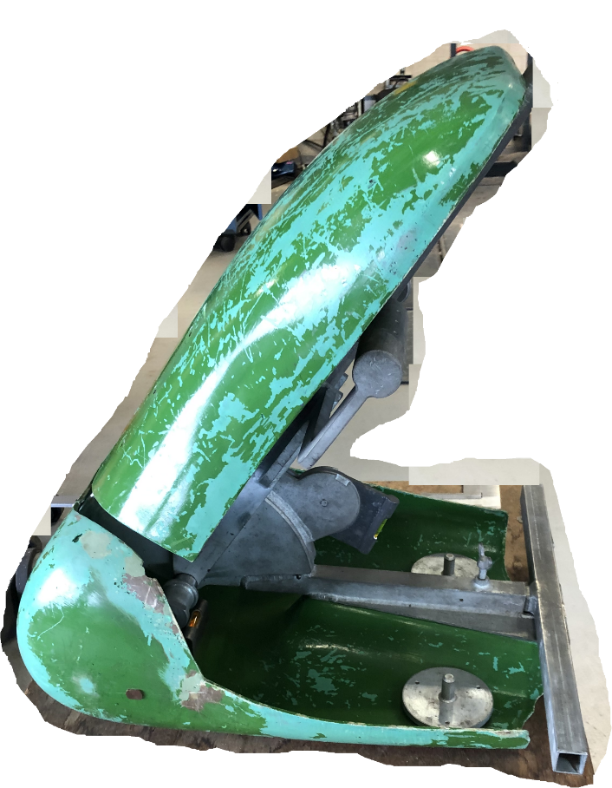
Issues
GRSG-124-XX
One vehicle type comes with one SRP per seating position.
Measuring the H-point according to each Regulation should result in the same value and match with the SRP within the tolerances given.
Setting of the H-point stature unclear and not consistent.
(5/50/95%) not given in ISO 6549; follows from R.E.3.
(where does 401 mm upper leg come from ? 49 CFR § 571.214 ?)
This results in problem when issuing a WVTA; which R-point to mention
if they differ among different Regulations ?
R.E.3. Rev. 2/3/4 have different upper and lower leg settings.
R.E.3 Rev. 2/3/4/5/6 all based upon withdrawn ISO 6549:1980
Test labs accredited to ISO 17025 run into problems to get
their test procedures accredited since HPMs available on the
market do not meet/cannot be calibrated according to
old specifications.
old HPM meeting ISO 6549:1980 spec

Slide 15
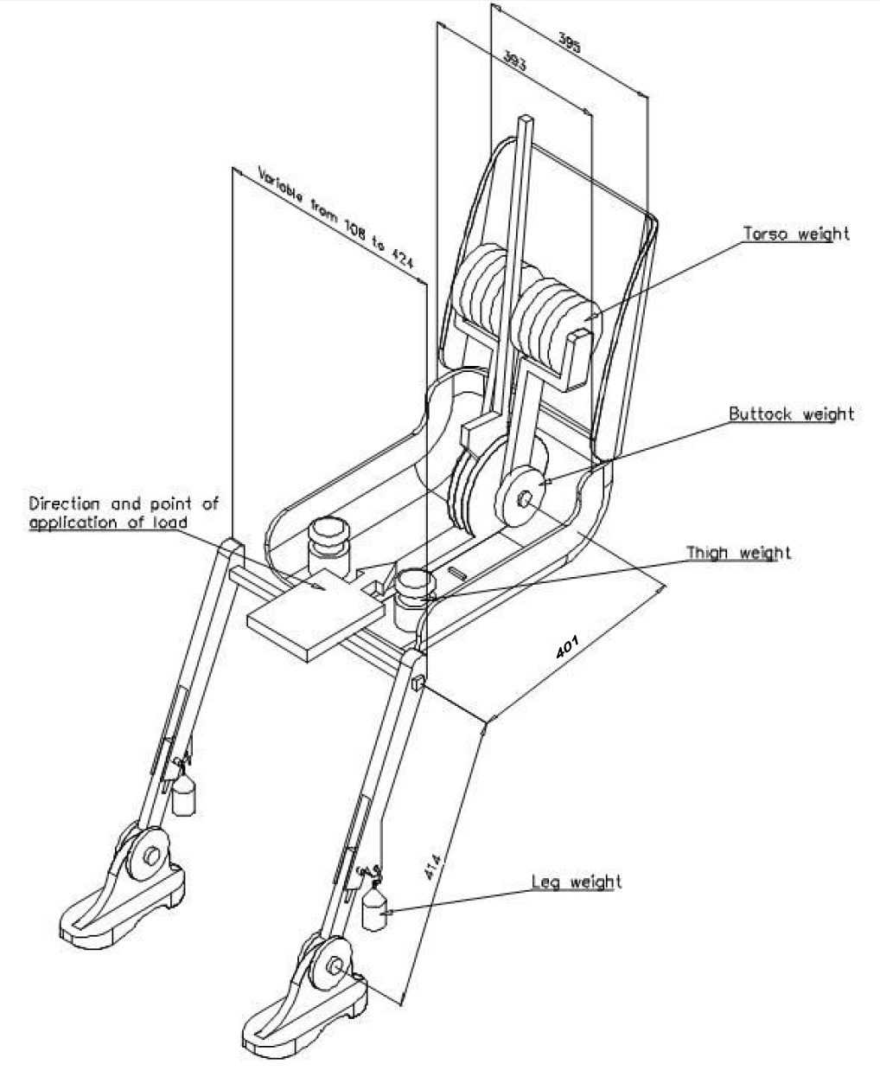
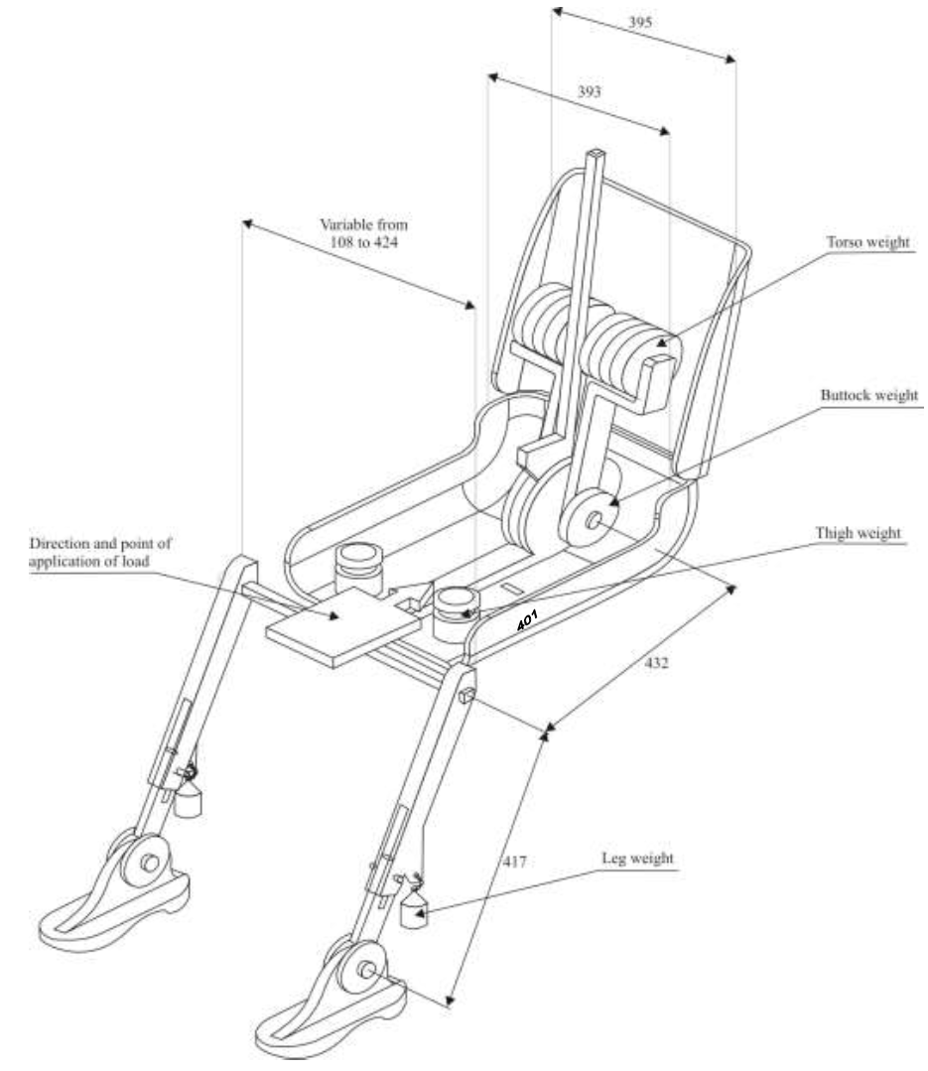
R.E. 3
GRSG-124-XX
Rev. 2
Rev. 3
~5/50
percentile ?!
~5 percentile
50 percentile
~50 percentile

Slide 16
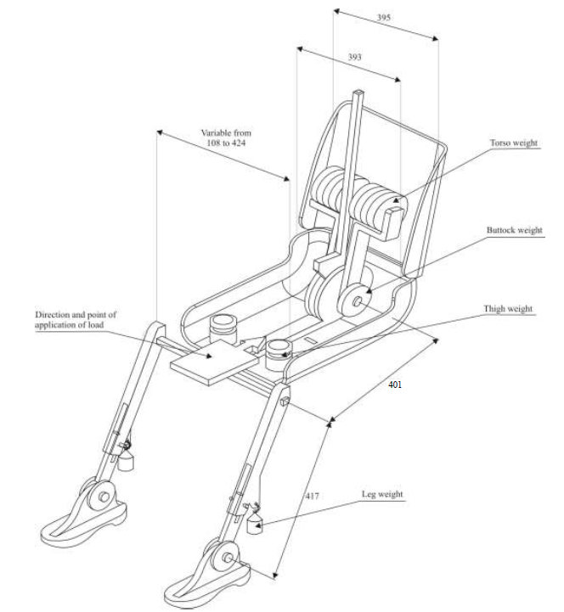
R.E. 3 (cont.)
GRSG-124-XX
Rev. 4 ~ 6
~5 percentile
50 percentile

Slide 17
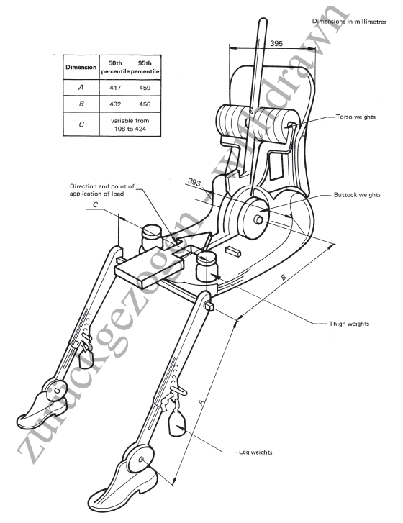
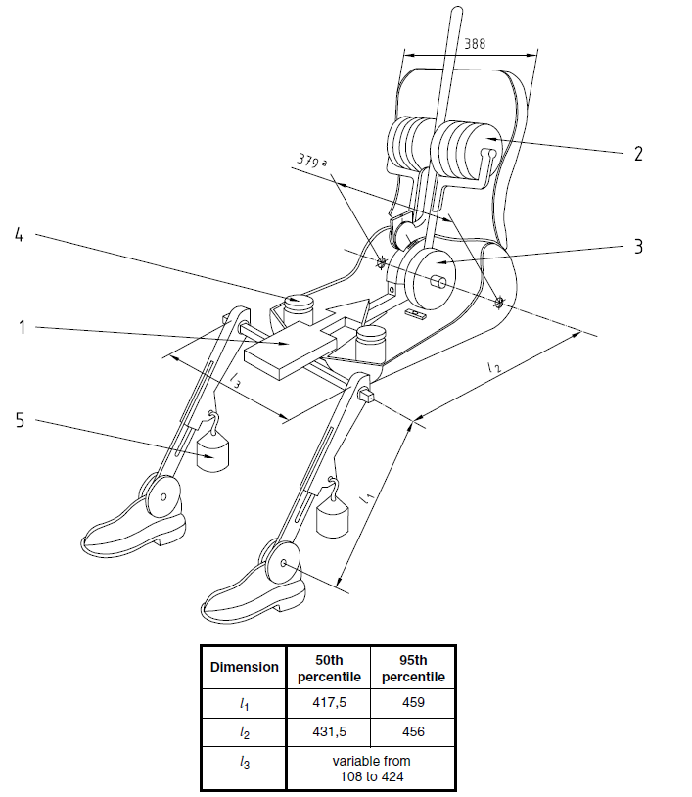
ISO 6549
GRSG-124-XX
1980
1999

Slide 18
Way forward
GRSG-124-XX
NL proposes:
to restart the discussion in order to come to a common understanding and position supported by GRSG
to copy ISO 6549:1999 procedure into R.E.3. and copy the SAE J826
into M.R.1.
In the UN Regulations and GTRs, reference shall be made to the new revision of R.E.3. which will refer to M.R.1.
to set the HPM at 50 percentile upper leg and lower leg length.
to get proposal(s) at the GRSP-72 session (December 2022) and GRSG-125 session (March 2023) and GRSP-73 session (May 2023) ready for adoption.

Slide 19
GRSG-124-XX
Any input from GRSG is welcome !
Thank you for your attention

