Slide 1
Progress Report GRE TF AVSR
Transmitted by the Chair of the GRE TF “Autonomous Vehicle Signalling Requirements” (AVSR) | Informal document GRE-87-17 (87th GRE, 25–28 October 2022 agenda item 11)
Dr. K. Manz, DE – Chair
L. Schwenkschuster, GTB - Secretary
AVSR-08-04e

Slide 2
Task
The task of the Task force is given by the following questions:
1. Is there a safety requirement for AV’s to provide signals to indicate their status and to communicate their next intended actions?
2. If so, shall such signals
- be visual,
- audible,
- or a combination of both?

Slide 3
Conclusions in Informal Document GRE 81-12
1. The Task force discussed the question #1 and came to the conclusion that the decision about this principal question is not in the mandate of this task force. The following discussion based on the assumption, that a “driving mode indicator” is needed.
As a consequence of the discussion about the second question the group concluded, that it should be a visible function (under normal traffic conditions and active autonomous driving). For the visible function it must be defined, when and under which conditions this signal should be activated. In this context, e. g. interaction with police, the interaction with other road users shall be taken into account, depending from the level of autonomous driving. This does not exclude in further discussions that audible signals, which could support e.g. handicapped peoples in communicative scenarios, may be taken into account.
This outcome should be addressed by the chairman of GRE to WP.29 and GRVA with the question whether WP.29 could support the view of the task force and to ask for further guidance to continue the work and change the status of the group from a Task force to an informal working group.

Slide 4
Subsequent discussion schedule
WP. 29
WP.1
GRVA
FRAV
At least FRAV responded to GRVA with the
Informal document GRVA-14-15/Rev.3 and the corresponding PPP GRVA-14-35

Slide 5
FRAV Status Report GRVA 14-15 or GRVA 14-35
External ADS vehicle signalling
FRAV does not recommend mandatory requirements for additional light-signalling devices under WP.29 beyond those requirements established for manually driven vehicles.
Use of existing light-signalling devices may be suitable (if permitted) to signal an automated fallback to place the ADS vehicle in an MRC.
FRAV recommends establishment of uniform provisions for a light signal to communicate the operational status of the ADS if fitted on an ADS vehicle and under certain conditions (i.e., address risk-benefit trade-offs).
FRAV notes that means other than light-signalling may be suitable to achieve safety needs (e.g., telecommunications).
FRAV recommends monitoring research into ADS signalling and the safety of interactions between other road users and ADS vehicles.

Slide 6
With the Presentation of GRVA 14-35 were mentioned:
Therefore, FRAV does not believe that WP.29 should pursue mandatory requirements for ADS-specific signalling devices.
However, FRAV does believe that GRE may wish to consider the use of existing devices to signal an automated fallback to bring an ADS vehicle to a safe stop.
FRAV also recognized the special interests of law enforcement with regard to distracted driving laws.
In the case of an external signal, FRAV notes that light-signalling may not be the only solution; however, should Contracting Parties wish to use a light signal to indicate ADS operation of a vehicle, GRE may wish to provide uniform requirements to ensure a common signal.
In developing such provisions, FRAV recommends that GRE consider trade-offs between potential risks and benefits: the signal should not risk confusion with other signals and should be designed to convey the information only to recipients for whom a safety need has been identified.
FRAV’s views are based on current research and data.
FRAV does not exclude the possibility that additional safety needs may be identified; however, decisions on signalling should be based on clear evidence and consideration of risk-benefit trade-offs.
Therefore, FRAV recommends continued attention to the safety of interactions between ADS and other road users.
The current position has been provided for GRVA consideration as informal document GRVA-14-15.
FRAV would welcome any comments by the end of October.

Slide 7
Relevant available studies / Statements European Commission, Directorate-General for Mobility and Transport, Montalvo, C., Willemsen, D., Hoedemaeker, M. (2020). Study on the effects of automation on road user behaviour and performance: final report, Publications Office. https://data.europa.eu/doi/10.2832/431870.
On page 82 of this document, it is stated under item 7.2.:
7.2. External HMI
The following issues concerning the interaction of the vehicle within its context of operation for e-HMI were identified: to make clear that no additional e-HMI for interaction with the environment is needed (thus, no new standards are required); the need to have a signal that the vehicle is under ADS control; and rural platooning for safe overtaking. The key stakeholders to lead the necessary actions outlined in Table 11 (further below) are the European Commission (DG Grow and DG R&I), OEMs, logistic companies and UNECE WP.29 Similar to external HMI, the actions required and outlined in the table can be completed within one to three years for Level 3 automation.

Slide 8
Relevant available studies / Statements European Commission, Directorate-General for Mobility and Transport, Montalvo, C., Willemsen, D., Hoedemaeker, M. (2020). Study on the effects of automation on road user behaviour and performance: final report, Publications Office. https://data.europa.eu/doi/10.2832/431870.
And table 11 on page 83 of this document, as stated under item 7.2.:
But with two exceptions

Slide 9
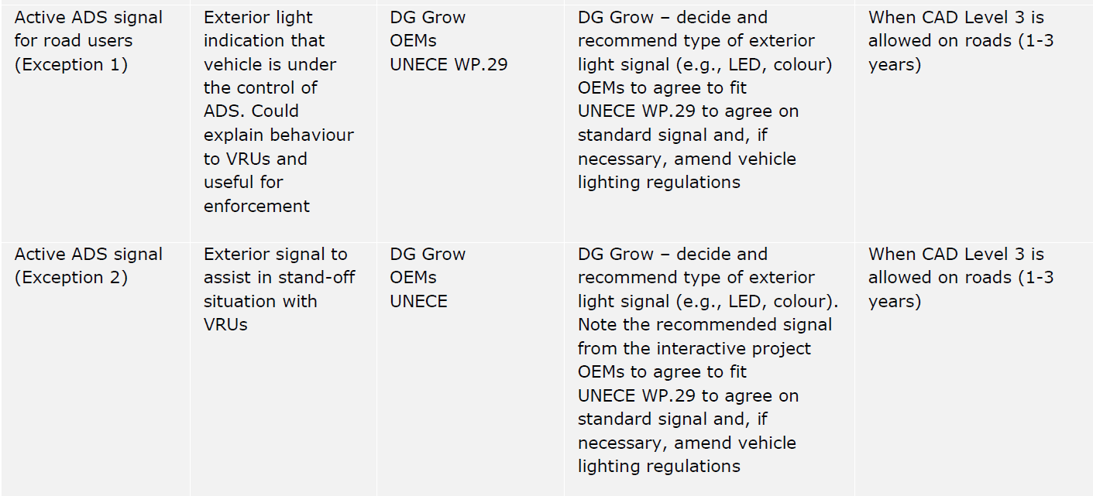
Relevant available studies / Statements European Commission, Directorate-General for Mobility and Transport, Montalvo, C., Willemsen, D., Hoedemaeker, M. (2020). Study on the effects of automation on road user behaviour and performance: final report, Publications Office. https://data.europa.eu/doi/10.2832/431870.
And table 11 on page 83 of this document, as stated under item 7.2.:
But with two exceptions:

Slide 10
Relevant available studies / Statements WP.1-2021 - Informal document No.3 Brief Comments on Requiring Automated Vehicles to Communicate a Mode of Operation: The Importance of Avoiding Unintended Consequences Bruce Mehler (bmehler@mit.edu) March 4, 2021
I should make it clear at the start of this brief comment that I am not firmly opposed to the idea of requiring an automated vehicle to signal in some manner it’s mode of operation. At first consideration, I expect that many people see this as a very reasonable and desirable proposal. However, as we look at research data, particularly considering pedestrian interactions with “automated” vehicles, there are both data and antidotal evidence that suggest that attempts to communicate the status of a vehicle and its “intended” behavior can cause confusion and may have unintended negative consequences when vehicles are in mixed traffic situations where both automated and manually controlled vehicles are present. ……
….
Again, this is, indeed, a complex topic as there may be good reasons for some knowability as to whether a vehicle is currently in automated or manual control. For example, this may be important when the police or other safety or management related officials need to understand the status of a vehicle. However, as outlined above, there can be unintended consequences and overall safety may be better served by proceeding very cautiously before requiring overt distinction between automated and manually driven vehicles. In particular, it will be important to carefully test specific signaling methods to ensure they do not increase confusion or have unacceptable levels of misinterpretation. Simply specifying that a visual and/or auditory method of signaling status be employed runs the risk of unintended, negative consequences.

Slide 11
Relevant available studies / Statements WP.1-2022 - Informal document No. 6 Convention on Road Traffic (1968):- Driving permits Human factors and automated driving as key issues for future road traffic Optical and/or audible signals in DAS and ADS vehicles Submitted by the International Federation of Pedestrians (IFP)
1. The issue discussed in this paper was brought to the attention of WP1 by Germany and the GRE Task Force on “Automated Vehicle Signaling Requirements (AVSR)” in the informal document 13 of March 2020. ……
2. Signals allowing automated vehicles (AV) to communicate their intended actions to other road users have often been tested with pedestrians. Different types of communication interfaces have been proposed and trialed. Such interfaces include: text messages displayed on the vehicle windscreen or projected on the roadway (e.g. “walk”……..
7. In conclusion, the IFP is opposed to the introduction of signals (optical or audible) indicating AVs’ intended actions to pedestrians. The IFP is not opposed to signals indicating the status of the vehicle (whether the autonomous mode is on or not) as long as pedestrians are not expected to change their behavior in the presence of this signal.

Slide 12
Possible schedule how to further continue the task:
First, GRVA and the Informal Working Group on Functional Requirements for Automated Vehicles (FRAV) to determine the conditions, if any, under which an ADS external light signal should be activated and recommend to GRE to whom the signal should be displayed (drivers in other vehicles, other road users) and from where it should be visible (e.g. front, rear, side);
Then, GRE (and its Task Force on AVSR or an IWG) to harmonize performance requirements for an ADS external light signal according to the conditions prepared under (a). GRE will specify the requirements for ADS external light signal and their installation if needed, in cooperation with GRVA (and the IWG FRAV);
GRE and GRVA (and their respective IWG’s) to align the proposal on ADS external light signal, if any;
GRVA to inform WP.1 and GE.3 of the activities on ADS external light signal.

Slide 13
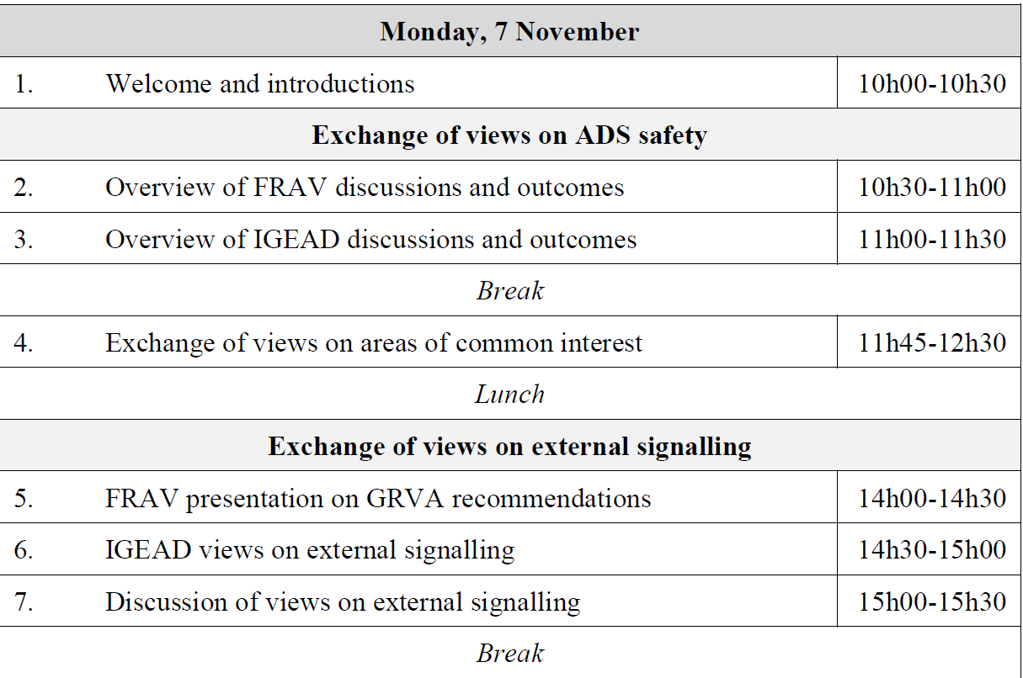
Further activities: FRAV and IGEAD workshop 7.-8.11. – The Hague
Agenda (Indicative Draft)

Slide 14
Open Questions to GRVA / FRAV:
- Is there agreement, that the autonomous vehicle must identify the scenario, when the external signal should apply?
- Is there agreement, that the external signal is only shown in a relevant scenario and not continuously, when the vehicle is in the autonomous mode ?
- For which scenarios FRAV / GRVA see the need, that this external signal should be activated (or deactivated)?
- What are the geometrical arrangements for these scenarios?
- From which positions the external signal must be seen?
- Do you see the need, that the illuminating area of this external signal has a uniform shape or size?
- Do you see the need, that the mounting position of this external signal shall be in a uniform, restricted area?
- Is there agreement, that the colour of this external signal is turquoise?

Slide 15
GRE TF AVSR
Thank you for your attention!

