Slide 1
76TH GRBP session Overview of UN Regulation No.117 documents
Informal document GRBP-76-38
(76th GRBP, 5-7 September 2022, agenda item 4 (c))

Slide 2
UN Reg. No. 117 amendment proposals
R117.02
3 working documents (GRBP/2022/14, GRBP/2022/19, GRBP/2022/20)
3 informal documents (GRBP-76-21, GRBP-76-22, GRBP-76-35)
R117.03
2 working documents (GRBP/2022/18, GRBP/2022/22)
2 informal documents (GRBP-76-05, GRBP-76-34)
R117.04
3 working documents (GRBP/2022/12, GRBP/2022/17, GRBP/2022/23)
7 informal documents (GRBP-76-02, GRBP-76-17, GRBP-76-23, GRBP-76-24-rev.1, GRBP-76-31, GRBP-76-32, GRBP-76-33)

Slide 3
How to read UN Reg. No. 117 amendment proposals
Last voted by WP.29
Supp.14 to R117.02
Supp.15 to R117.02
New R117.03
based on
Supp.14 to R117.02
Supp.01 to R117.03
New R117.04
based on
Supp.01 to R117.03

Slide 4
For Supplement 15 to 02 SoA to R117

Slide 5
For Supplement 1 to 03 SoA to R117

Slide 6
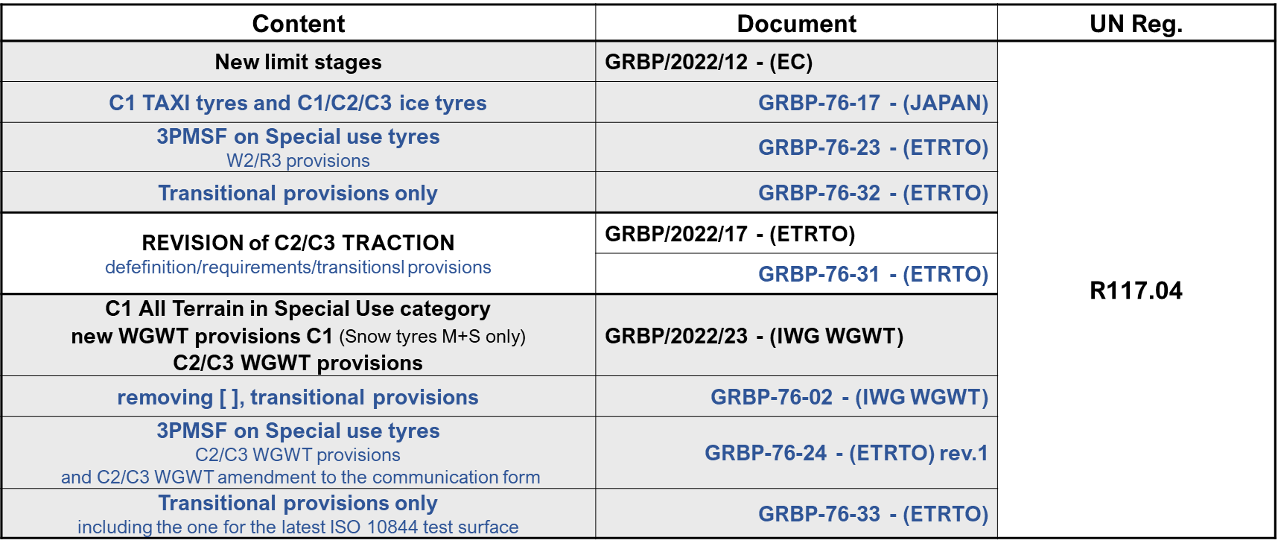
For the New (04) SoA to R117

Slide 7
Thank you!

