Slide 1
SMEs in Economies in Transition: Challenges, Opportunities and UNECE Tools
Dr. Yulia Levashova, Assistant Professor, Nyenrode Business University, the Netherlands
j.levashova@nyenrode.nl

Slide 2
This research paper
Objective
Provide a general overview of SMEs in the economies in transition in UNECE region,
Outline challenges for SMEs and supporting UNECE tools.
Key questions
What are the key challenges for SMEs in the economies in transition in UNECE region?
How to support SMEs in the economies in transition, including through the use of UNECE tools?
Approach
Desk research based on articles and public policy documents

Slide 3
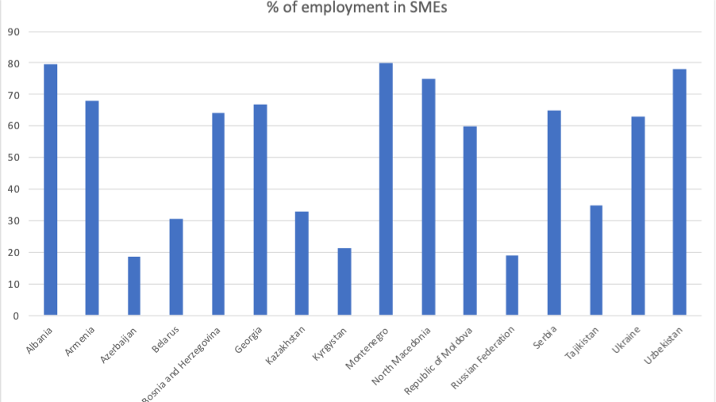
Figure 1: Percentage of employment in the SME sector in selected UNECE member States with economies in transition
Source: UNECE based on OECD, Asian Development Bank Institute, European Bank for Reconstruction and Development, Albanian statistical report and Report of the Commissioner for the Protection of the Rights of Entrepreneurs concerning SMEs in the Russian Federation. Data are not available for Turkmenistan SMEs.

Slide 4
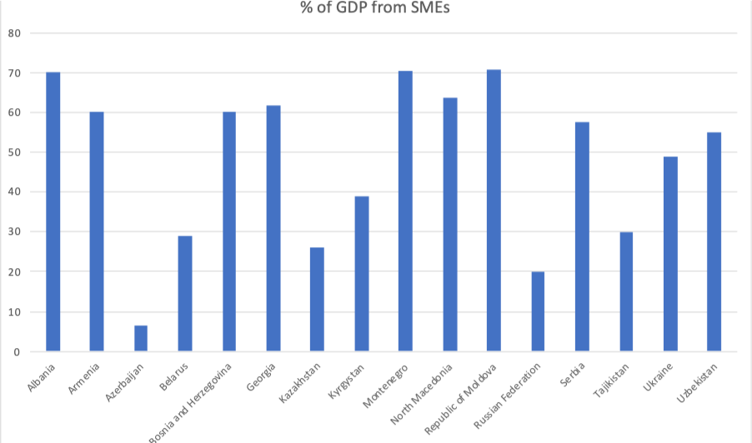
Figure 2: Percentage of GDP derived from SMEs, in selected UNECE member States with economies in transition
Source: UNECE based on OECD, Asian Development Bank Institute, European Bank for Reconstruction and Development, Albanian statistical report on SMEs and Report of the Commissioner for the Protection of the Rights of Entrepreneurs concerning SMEs in the Russian Federation. Data are not available for Turkmenistan.

Slide 5
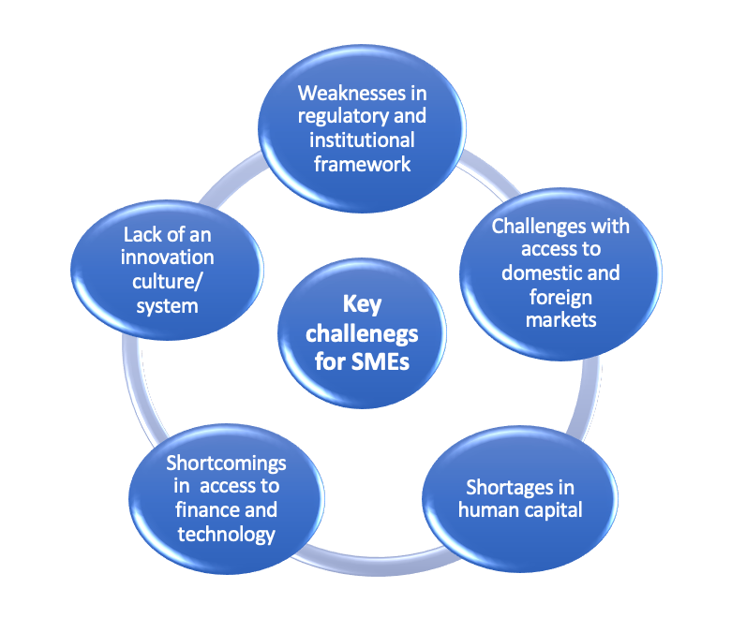
Key challenges for SMEs

Slide 6
Challenges and opportunities: human capital
Human capital
Human capital is central for innovation and economic modernization of SMEs
Specific challenges for economies in transition:
Emotional challenges (fear of failure)
Less attractive than ‘traditional’ employment
A dominant role of SOEs (Belarus, Kazakhstan)
Actions
Support of women’s entrepreneurship (gender-responsive partnerships in Armenia, Azerbaijan, Moldova, Georgia)
1
2
Promotion of skills development and entrepreneurial learning
3
Business and financial literacy

Slide 7
UNECE tools to address the key challenges
Specific attention to challenges and further research:
Entrepreneurial spirit and female-owned SMEs
UNECE inter-agency trainings
Agricultural sector
UNECE hosts over 100 agricultural quality standards
Supporting the green agenda
Role of circular economy
Climate change mitigation policies

Slide 8
