Slide 1
INTRO TO CIRCULAR ECONOMY
CIRCULAR STEP – UNECE stakeholder engagement platform

Slide 2
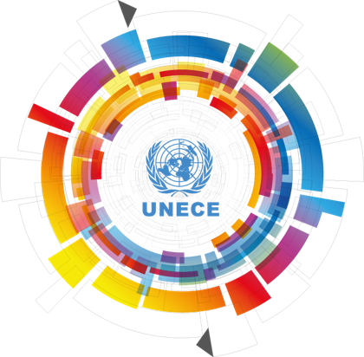
UNECE & Circular Economy
One of the 5 regional commissions of the UN
56 member States in Europe, North America and Asia
Subprogrammes:
Environmental Policy
Transport
Statistics
Economic Cooperation and Integration
Sustainable Energy
Trade
Forest and Forest Industries
Housing and Land Management
“Circular Economy and the Sustainable Use of Natural Resources” is the high-level theme of the 69th Commission Session of UNECE
Theme is being integrated into the relevant workstreams
Activities include: Capacity building, guideline development, measuring tools, technical assistance projects

Slide 3
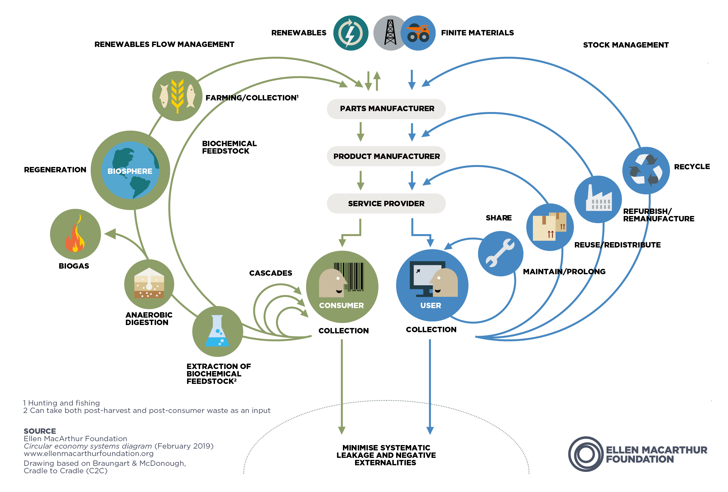
WHAT IS A CIRCULAR ECONOMY?
An economic system that focuses on reducing, reusing, recycling and recovering materials
What is the goal?
Economic sustainability through cost & resource savings, new jobs and business opportunities
Environmental quality & social equity
How can it be achieved?
On micro level e.g. through new business models, product design, behavior change
On macro level e.g. through updated legislation, strategies, incentives

Slide 4
WHAT IS CIRCULAR STEP?
Interested in CIRCULAR STEP? Join our LinkedIn Group (Link in Chat)
Objectives:
Disseminate knowledge of the definition and principles of the Circular Economy
Showcase Circular Economy regulatory frameworks, institutional approaches, policy measures, and business practices
Encourage impactful cooperation among policymakers, businesses, and other stakeholders
Activities include:
Policy research & analysis in specific areas
Development of standards & normative tools
Sharing of experiences
Technical assistance

