Slide 1
SMEs in SPECA Countries: Challenges, Opportunities and UNECE Tools
Dr. Yulia Levashova, Assistant Professor, Nyenrode Business University, the Netherlands
j.levashova@nyenrode.nl

Slide 2
This research paper
Objective
Provide a general overview of SMEs in SPECA countries.
Outline challenges for SMEs and supporting UNECE tools.
Key questions
What are the key challenges for SMEs in SPECA countries?
How to support SMEs in SPECA countries, including through the use of UNECE tools?
Approach
Desk research based on articles and public policy documents
https://unece.org/sites/default/files/2022-05/SMEs%20Paper-forwebsite.pdf

Slide 4
Figure 1: Percentage of GDP derived from SMEs
Source: UNECE based on OECD, Asian Development Bank Institute, European Bank for Reconstruction and Development, Albanian statistical report and Report of the Commissioner for the Protection of the Rights of Entrepreneurs concerning SMEs in the Russian Federation. Data are not available for Turkmenistan SMEs.

Slide 5
Figure 2: Percentage of employment in the SME sector
Source: UNECE based on OECD, Asian Development Bank Institute, European Bank for Reconstruction and Development, Albanian statistical report and Report of the Commissioner for the Protection of the Rights of Entrepreneurs concerning SMEs in the Russian Federation. Data are not available for Turkmenistan SMEs.

Slide 6
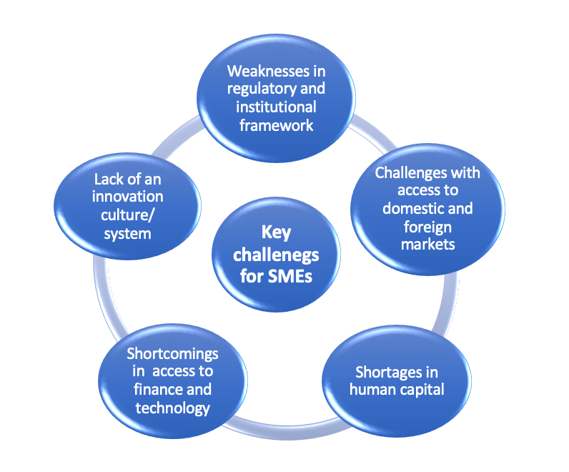
Key challenges for SMEs

Slide 7
Challenges and opportunities: human capital
Human capital
Human capital is central for innovation and economic modernization of SMEs
Specific challenges for SPECA:
Emotional challenges (fear of failure)
Less attractive than ‘traditional’ employment
A dominant role of SOEs (Azerbaijan; Kazakhstan)
Actions
1
Support of women’s entrepreneurship
2
Promotion of skills development and entrepreneurial learning
3
Business and financial literacy

Slide 8
UNECE tools to address the key challenges
Specific attention to challenges and further research:
Entrepreneurial spirit and female-owned SMEs
UNECE inter-agency trainings
Agricultural sector
UNECE hosts over 100 agricultural quality standards
Supporting the green agenda
Role of circular economy
Climate change mitigation policies
UNECE - Business incubators for sustainable development in the SPECA subregion

Slide 9
