Slide 1
Informal document GRSP-71-22
(71st GRSP, 9 – 13 May 2022,
agenda item 21(b))
UI
270650
Proposal for extension of DETA to improve the use
of the UNIQUE IDENTIFIER for UN Regulations
On behalf of the WP.29 IWG on DETA
DETA-44-03e
(follow-up of DETA-41-06e Rev.1)
1

Slide 2
UNIQUE IDENTIFIER / DETA Database
Legal Basis / Motivation
Legal Basis: 1958 Agreement Revision 3 Schedule 5:
“… the approval markings required by UN Regulations may be replaced by a Unique Identifier (UI) preceded by the symbol , unless specified otherwise in the UN Regulations.”
(This overrides the mandatory marking in UN Regulations unless specified otherwise)
UI
Device markings (depending on Regulation text):
Approval marking
Other marking
….
Marking example for lighting & light-signalling Regulations
R1 S1 2aY F1 AR
P21W
P21/5W
PY21W
MD E4 3349
E1
3169
3170
12V
148R00
Light sources / modules used in the device
Trademark / Logo of manufacturer
Approval marking
Rated voltage

Slide 3
UNIQUE IDENTIFIER / DETA Database
Motivation / Text of the Regulation (R148, R149, R150)
The (traditional) Approval Marking specifies (Example R148):
The number of the type approval
The contracting party (country) who is responsible for the type approval
The Regulation Number the device was type approved to
The status of the Regulation at the time of type approval
The different functions that are included in the device
Any possible restrictions in mounting height
Any possible restrictions in mounting position
Any possible restriction to the number of devices necessary (D or Y)
ALL these markings must be visible after the installation of the device on the vehicle
3170
E1
148R
(series) 00
R1 S1 2aY F1 AR
(2a)Y
R1 S1 2aY F1 AR
E1
3170
148R00
MAY BE REPLACED BY:
The (new) Unique Identifier Marking specifies:
The unique number for accessing the DETA
ALL these markings must be visible after the installation of the device on the vehicle
270650
UI
270650
With the UI, presently required information on the product is no longer present,
but is available in DETA to only users with access rights.
Persons without DETA access will get this information via a new “summary document” (see next slides).

Slide 4
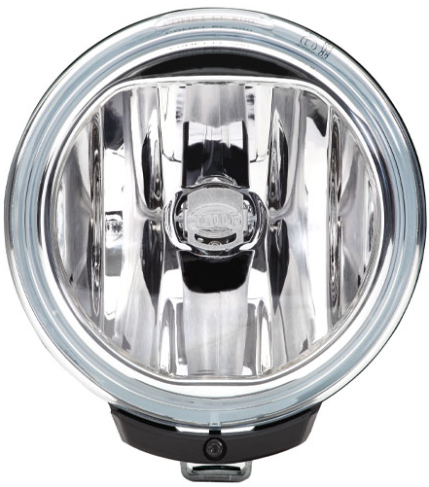
UNIQUE IDENTIFIER / DETA Database
Motivation / Reason for the chosen solution
Example: Device used as a beam contributor for different AFS systems
Approval marking
Unique Identifier
(On any fixed part visible after installation i.e. lens)
(On any fixed part visible after installation i.e. lens)
60+ mm
F3 K PL
00 XEWR 11111 22222 33333 44444
00 XCV 55555 66666 77777
00 XCWT 88888 99999
00 XCVR 121210 112211
00 XCWR 14441 14442
00 XCWR 552200 552201
Marking
Electronic database
20 mm
35+ mm
E6
9 mm
UI
+
1234567
DETA
- certificates
- information documents
- test reports and others
- summary documents
R14900
1122
NEW
4

Slide 5
UNIQUE IDENTIFIER / DETA Database
Details of the amendment to DETA
Part A: Document management
Create a new “Summary Document“ in DETA (A4, PDF)
showing for example, depending on GRs decisions, for each Regulation:
Part B: Usergroup management
Create a new usergroup in DETA
Usergroup level: Public (e.g. law enforcement, repair shops, public, etc.)
Usergroup rights: Read only access to the “Summary Documents“
Description
Traditional markings (as currently present on the product) / Explanatory text
If applicable, restrictions to the installation and/or use of the device
The public has only access to the “Summary Documents“ stored in DETA via a separate web application

Slide 6
UNIQUE IDENTIFIER / DETA Database
Summary document layout
Summary Document
HEADLINE
UI marking:
UI
270650
UNIQUE IDENTIFIER MARKING as on the actual device.
Approval marking:
TRADITIONAL APPROVAL MARKING(S) The marking(s) required by the UN Regulation(s), including
additional marking(s), as on the device.
R1 S1 2aY F1 AR
E1
3169
3170
148R00
Depending on
GRs decisions
EXPLANATORY / ADDITIONAL TEXT
Explantory text to the symbols / markings /devices if necessary. (Intention is to provide equivalent information to existing
markings).
Photographs/drawings of the product may be added by the manufacturer on a voluntary bases.
Additional information:
Information text
Note: This is an example only. After the GRs feedback is received, a harmonized template will be developed and can be used for supplementing each UN Regulation, where applicable.
The summary document will be supplied by the manufacturer in pdf format on A4 size and uploaded to DETA by the approval authority together with all other approval documentation.
The summary document can be accessed via a public web portal upon entering the UI number.

Slide 7
UNIQUE IDENTIFIER / DETA Database
Considerations for all GRs
Summary:
It is not currently specified which markings are part of the “approval marking“;
by default, the UI marking may replace the “approval marking“ on a product and thus some additional information may not be shown on the product anymore;
the missing information may be made publically available by a summary document in DETA accessible through a public web portal.
All GRs need to consider for each UN Regulation under its responsibility:
Does a UN Regulation need to prohibit the replacement of the approval marking by a UI marking (as currently for UNR22, 44, 129). Consideration: is the ‘E-mark’ on the product necessary for consumers.
Are some of the markings to be considered not part of the “approval marking“ and must those remain on the product. Considerations: e.g. is the particular (additional) marking necessary for consumers, or, is the marking unique for that product and cannot be identified from the approval documentation or summary document, like the ‘trade name‘.
For all other cases, the content for a Summary Document may need to be specified (see previous slide) and included in a Supplement to the UN Regulation. A harmonized template will be developed.

