Slide 1
Informal document GRSP-71-21
(71st GRSP, 9 – 13 May 2022,
agenda item 3)
Overview of Hydrogen Fuel Cell Vehicle
Phase 2 Project
Global Technical Regulations No.13
GRSP-71-09
Martin Koubek UNECE/WP.29/GRSP

Slide 2
Outline
Chair: USA NHTSA
M. Koubek
Hydrogen fuel cell vehicle (HFCV) GTR background
Scope of work
Summary of work in 6 taskforces of IWG
Vice Chair: JPN METI
K. Sato
Vice Chair: KOR KATRI
S. Kim
CP: CN CATARC
Y. He
CP: EU
B. Acosta-Iborra
R. Ladret Piciorus
CP: USA NHTSA
I. MacIntire
Secretary: Toyota
Y. Fujimoto/A. Ryan
CP: Transport Canada
K. Hendershot
Government
OICA
CLEPA
Container mfrs
Standards Orgs
Laboratories
Academia
CP: UK DFT
M. Levet

Slide 3
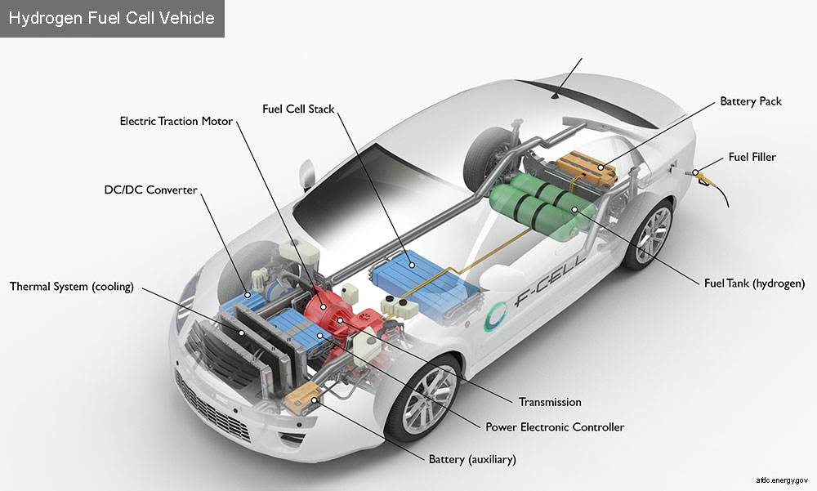
HFCV GTR Background
In 2009, a working group was established under the 1998 Global Agreement to develop a GTR that would address the safety and environmental concerns associated with fuel-cell compressed gaseous and liquid hydrogen vehicles.
Sub-group on Safety (SGS): GTR for hydrogen vehicles ensuring high pressure container safety, hydrogen fuel system including FC and exhaust system, and high voltage electrical safety.
Photo: NREL

Slide 4
HFCV GTR Background
GTR 13-Phase 1 was adopted by AC3 in June 2013 – see also UN R134 for its transposal into 58 Agreement.
Development of Phase 2 started in 2017 – see TOR (doc WP29/2018/75).
IWG meetings have been taking place since Oct 2017
IWG mandate was extended till December 2022
Technical work taking place in 5 taskforces, headed by government/industry leaders

Slide 5
Phase 1 Scope
This GTR applies to all hydrogen-fueled light vehicles with a gross vehicle mass (GVM) up to 10,000 pounds:
Category 1-1, 1-2
Compressed gaseous hydrogen system for FCEV
Liquefied hydrogen system
GTR establishes safety requirements for:
High pressure fuel container system: 35/70 MPa NWP
Fuel system at vehicle level: in-use and post-crash hydrogen leakage limits
Electrical integrity of high voltage system: in-use and post-crash

Slide 6
Phase 2 Scope
GTR for Hydrogen-Powered Vehicles was adopted in June 2013 as GTR 13
Phase 2 is being sponsored by EU, Japan, Korea and US
Expected completion of Phase 2 by the end of 2022
Main topics:
Expand scope to other vehicle classes
Requirements for fueling receptacle design
Performance-based test for long-term stress rupture
Update test procedures based on research data of phase 1
Revised initial burst pressure requirement
Service life extension

Slide 7
Taskforce #1: Heavy Duty Vehicles & Buses
Co-led by A. Schuessling and Y. He
Goal: Address safety issues associated with heavy vehicles and buses
Extension of the scope to cover Commercial/Heavy Duty Vehicles
Service life of the container (15 → 25 years)
Crash requirements/sled test
Thermally activated pressure relief device (TPRD) venting direction
Container permeation and pneumatic cycling
Notes:
This is a combined fire test on a container: localized and engulfing fire
NHTSA and Transport Canada had jointly conducted a series of research: TC identified the need for localized fire test and developed the test procedures; NHTSA picked up the second phase of the research by conducting a series of test to identify the mitigation materials.

Slide 8
Taskforce #2: Fuelling Receptacle
Led by L. Gambone
Goal: To standardize references to fuelling receptacle designs
Specifying fuelling receptacle profile ensures that vehicles of lower Nominal Working Pressure (NWP) are not fuelled at hydrogen dispensers operating at a higher NWP
Ensures vehicles fuelled by hydrogen are not fuelled by other gaseous fuel dispensers
Notes:
This is a combined fire test on a container: localized and engulfing fire
NHTSA and Transport Canada had jointly conducted a series of research: TC identified the need for localized fire test and developed the test procedures; NHTSA picked up the second phase of the research by conducting a series of test to identify the mitigation materials.

Slide 9
Taskforce #3: Test Requirements & Procedures
Led by L. Gambone
Goals:
To correct editorial errors and test specs from Phase 1
To modify test procedures based on industry experience
To incorporate requirements for medium and heavy-duty vehicles
To incorporate requirements for new storage technologies
Notes:
This is a combined fire test on a container: localized and engulfing fire
NHTSA and Transport Canada had jointly conducted a series of research: TC identified the need for localized fire test and developed the test procedures; NHTSA picked up the second phase of the research by conducting a series of test to identify the mitigation materials.

Slide 10
Taskforce #4: Fire Test
Led by G. Scheffler
Goal: To improve the repeatability and reproducibility of the fire test
Burner specifications
Pre-test check of fire test
Accommodate vehicle specific components
Extend the application of the fire test to containers on heavy vehicles and to conformable containers
Notes:
This is a combined fire test on a container: localized and engulfing fire
NHTSA and Transport Canada had jointly conducted a series of research: TC identified the need for localized fire test and developed the test procedures; NHTSA picked up the second phase of the research by conducting a series of test to identify the mitigation materials.

Slide 11
Taskforce #5: Interoperability
Led by A. Tchouvelev
Goal: To review safety dependencies between hydrogen refuelling station and HFCV
Fueling station components (e.g., dispenser)
Fueling protocol
Vehicle to station communication
References to relevant industry documents (ISO, SAE)
Notes:
This is a combined fire test on a container: localized and engulfing fire
NHTSA and Transport Canada had jointly conducted a series of research: TC identified the need for localized fire test and developed the test procedures; NHTSA picked up the second phase of the research by conducting a series of test to identify the mitigation materials.

Slide 12
Taskforce #0: Phase 2 Drafting and Editing
Co-led by: A. Ryan and I. MacIntire
Goal: To develop informal draft of GTR13
TF0 members include CP and industry
Take agreements among CP, industry from various discussions and taskforces to draft language for Part 1 (Rationale) and Part 2 (Mandatory Requirements)
Notes:
This is a combined fire test on a container: localized and engulfing fire
NHTSA and Transport Canada had jointly conducted a series of research: TC identified the need for localized fire test and developed the test procedures; NHTSA picked up the second phase of the research by conducting a series of test to identify the mitigation materials.

Slide 13
Next Steps
Review of informal document
IWG scheduled for June to discuss comments from GRSP
Formal document submission for December GRSP
Notes:
This is a combined fire test on a container: localized and engulfing fire
NHTSA and Transport Canada had jointly conducted a series of research: TC identified the need for localized fire test and developed the test procedures; NHTSA picked up the second phase of the research by conducting a series of test to identify the mitigation materials.

Slide 14
Thank You

