Slide 1
Transmitted by the expert of the Netherlands
Informal document GRSP-71-18 GRSP 71st session, 9 – 13 May 2022 Agenda Item 21 (g)
Hydrogen-fuelled vehicles (HFCV)
practical issue May 2022

Slide 2
Background
GRSP-71-YY
At the 69th session of GRSP in May 2020, proposal 2021/12, as amended by informal document GRSP-69-22 Rev. 2; both prepared by OICA were discussed.
Japan had some comments included in informal document GRSP-69-31.
Finally, consensus was reached and the amended proposal was adopted by GRSP. It was consequently adopted as: - WP.29/2021/123 (supplement 4 to the original version of UN R134) and - WP.29/2021/124 (supplement 1 to the 01 series of amendments to UN R134) at the November 2021 session of WP.29 and A.C.1. Expected date of entry into force: [22 June 2022]
In the initial OICA proposal, tanks installed at a height > 1000 mm would be exempt from having to meet the 200 mm requirement as stated in section 7.2.4.2.

Slide 3
Background (cont.)
GRSP-71-YY
If the vehicle type is within the scope of UN R95, it shall meet the post-crash requirements as specified in Annex 5 and paragraph 7.2. scope of UN R95: This Regulation applies to vehicles of category M1 with a maximum permissible mass not exceeding 3,500 kg, vehicles of category M1 with a maximum permissible mass exceeding 3,500 kg where the "R" point of the lowest seat is not more than 700 mm from ground level when the vehicle is in the condition corresponding to the reference mass defined in paragraph 2.10. of this Regulation, and to vehicles of category N1.
If the vehicle type is not within the scope of UN R95: - sled testing to be performed to check the mounting of the containers and - the containers must be mounted 200 mm inside outer edge or - lateral impact on compressed hydrogen storage system whereby: - container shall be adjusted in a way that the middle of the front plate of the barrier matches the middle of the container in the horizontal and vertical.

Slide 4
What does it mean ?
GRSP-71-YY
Testing M1, N1 vehicle according to UN R95 - vehicle and barrier both on ground level - centre of barrier in line with R-point of the driver’s seating position (i.e. not related to the position of the hydrogen storage system in the vehicle)
© copyright Latin NCAP

Slide 5
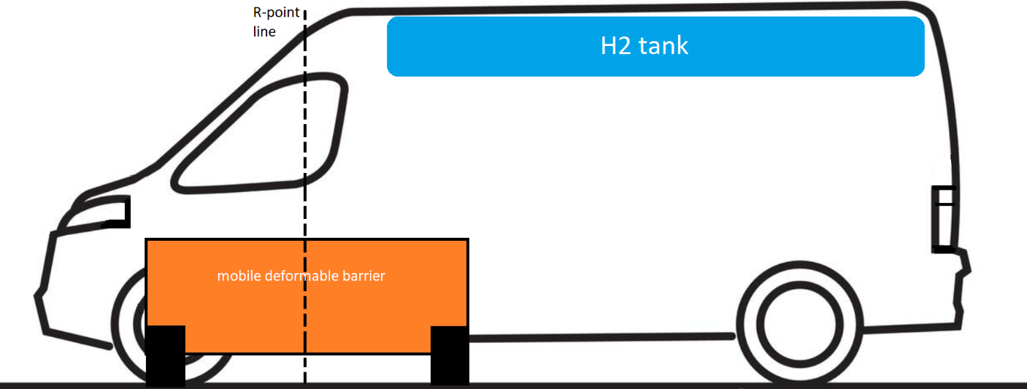
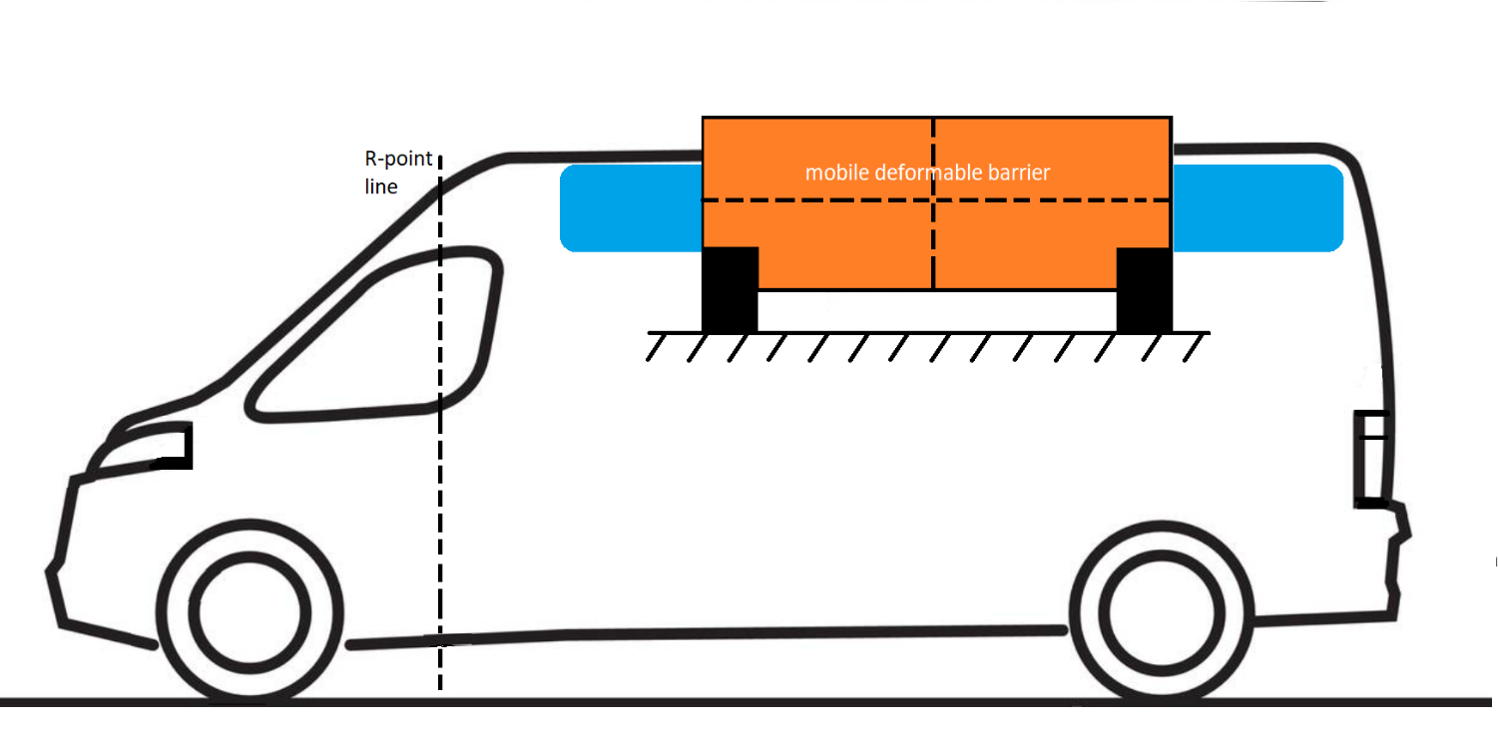
What does it mean ?
GRSP-71-YY
N1 van
N2 van
???

Slide 6
So how to test… ?
GRSP-71-YY
Observations:
Procedure for vehicles within scope of R95 and outside scope differs - no justification - not practical
Alternative:
7.2.4.3.4. A calculation method may be used instead of practical testing if its equivalence can be demonstrated by the applicant for approval to the satisfaction of the Technical Service and in agreement with the type-approval authority. => not usable; validation can only be done by physical testing

Slide 7
Proposal
GRSP-71-YY
Paragraph 7.2.4.3.3., amend to read
7.2.4.3.3. Lateral impact on compressed hydrogen storage system
The MDB speed at the moment of impact shall be 50 ± 1 km/h. However, if the test was performed at a higher impact speed and the compressed hydrogen storage system met the requirements, the test shall be considered satisfactory. The impact direction shall be in an angle of 90° to the longitudinal axis of the test set-up as defined in paragraph 7.2.4.3.1. and the container shall be adjusted in a way that the middle of the front plate of the barrier matches the middle of the container in the horizontal and vertical axis.
…
Insert new paragraph 7.2.4.3.5., to read:
7.2.4.2.5. If the height at which the hydrogen storage system is mounted is such, that contact with the barrier is unlikely to happen nor has any adverse effect, the Technical Service may, in agreement with the type-approval authority waive this test. Explanation and rationale shall be provided in the test report. In such case the container shall be mounted in a position which is between the two vertical planes parallel to the centre line of the vehicle located > 0 mm inside from both outermost edges of the vehicle in the proximity of its container(s).

Slide 8
justification
GRSP-71-YY
In order to have a consistent approach, the background of UN R12, R94 and R95 need to be considered. These crash Regulations all relate to a crash of a vehicle (M1/N1) towards a passenger car. They are not intended to cover the impact of a crash between a truck or bus with another vehicle.
No crash requirements apply for regular N2/N3/M2/M3 vehicles.
“Unlikely to happen nor has any adverse effect” was added to make it clear that also deformation outside of the container(s) attachments shall not affect their fixation and strength.
To make sure that the container does not constitute the extreme outermost edge of the vehicle an additional requirement “> 0 mm” was added to paragraph 7.2.4.2.5.

Slide 9
Way forward
GRSP-71-YY
NL requests input from other Contracting Parties and NGOs until 1 September 2022
prepare a working document for the 72nd session of GRSP (December 2022)

Slide 10
GRSP-71-YY
Thank you for your attention !

