Slide 1
86th UNECE GRPE session
PMP IWG Progress Report
Informal document GRPE-86-34
86th GRPE, 30 May - 2 June 2022
Agenda item 7.
B. Giechaskiel,T. Grigoratos
Geneva, 30th May – 2nd June 2022
UNITED NATIONS

Slide 2
PMP meetings in 2022
2022-03-22: PMP Webconference (exhaust)
2021-03-29: PMP Webconference (non-exhaust)
2021-05-25: PMP Webconference (non-exhaust)
2021-06-15: PMP Webconference (non-exhaust)
Several ad-hoc webconferences to discuss specific issues related to exhaust and non-exhaust particle measurement procedures
NEXT F-2-F MEETING: tbd

Slide 3
Summary of activities
Exhaust emissions
Resolution for heavy-duty engines (laboratory sub-23 and direct tailpipe sampling) and experimental campaigns (adopted at GRPE 85)
Light-duty sub-23 nm PN-PEMS technical specifications (finalized in 2021)
Heavy-duty sub-23 nm PN-PEMS experimental campaign (finalized in 2021)
Instrumentation calibration procedures (on-going)
Monitoring of new procedures (on-going)
Other non-PMP topics discussed: PN-PTI, Total particles

Slide 4
Summary of activities
Non-exhaust emissions
Tires: Task force (TF) on tire abrasion (TA) UNR under GRBP. PMP and GRPE participants directly participating in this TF TA. The progress will be presented to GRPE and GRBP by TF TA chair
Brakes: GTR to be delivered

Slide 5
DRAFT GTR ON BRAKE EMISSIONS
PROPOSED WAY FORWARD

Slide 6
BACKGROUND
June 2016: GRPE-73-15-Rev.1 Revised PMP ToR – Mandate for the development of a suggested common test procedure for sampling, measurement and characterization of brake wear particles;
June 2019: GRPE-79-14-Rev.1 Revised PMP ToR – The method development includes (a) Validation of the novel test cycle; (b) Definition of the requirements for brake particles generation and sampling; (c) Selection of the appropriate instrumentation; (d) Validation of the proposed approach;
June 2020: GRPE-81-13 Revised PMP ToR – Include all elements from June 2019 and (e) Extend the proposed methodology to include regenerative braking and future technologies;
June 2021: GRPE-83-10 Revised PMP ToR – “Development of a test procedure to be applied in a GTR for sampling and assessing brake wear particles both in terms of mass and number”.
Overall, a there has been a development phase of almost five years – without taking into account 2020 when the activity was temporarily suspended for almost one year.

Slide 7
BACKGROUND
TF1
WLTP-Brake Cycle
TF2
Sampling & Measurement
TF3 Interlaboratory Study
TF4
Regenerative Braking
WORKING
GROUPS
TF1: 30 meetings – 1 ILS study with 8 labs – Completed its activities in 2019;
TF2: 44 meetings – 1 workshop (30.05) – Activities on-going;
TF3: 6 meetings – 1 ILS study with 16 labs – Completed its activities in 2022;
TF4: 20 meetings – Activities on-going.
A total of 100 technical group meetings, two completed Interlaboratory campaigns (ILS), numerous testing campaigns that supported with data, and numerous exchanges over the last years;
17 non-exhaust related PMP meetings with more that 50 technical presentations on the topic of brake emissions that supported with data the method development;
1 dedicated workshop “Towards a regulation on brake wear emissions” organized at the 82nd GRPE session with more than 200 participants.

Slide 8
AIMS AND STATUS OF THE GTR– ECE/TRANS/WP.29/2021/150 (1/2)
(a) 06.2021: Timeline and framework for mandate request are presented in GRPE – Item was completed on-time;
(b) 06.2021: Request for authorization submitted to AC.3 – Item was completed on-time;
(c) 06.2021: TF2 finalizes the discussion on the definition of the minimum requirements for brake wear particles generation and sampling – Item was completed on 14.07.2021 – There was a delay of half month with no influence on the planned work;
(d) 06.2021: TF2 finalizes the selection of the appropriate instrumentation and sampling methodology for the measurement and characterization of brake wear particles – Item was completed on 14.07.2021 – There was a delay of half month with no influence on the planned work;
(e) 06–09.2021: PMP IWG (TF3) organizes the Round Robin exercise with the aim of collecting information and data on the proposed approach for the measurement and characterization of brake wear particles – Item was completed on-time;

Slide 9
AIMS AND STATUS OF THE GTR– ECE/TRANS/WP.29/2021/150 (2/2)
(f) 09–12.2021: PMP IWG (TF3) executes the RR exercise with the aim of collecting information and data on the proposed approach for the measurement and characterization of brake wear particles – Item completed on 31.01.2022 – 1 month delay with influence on the planned work;
(g) 12.2021 – 02.2022: Collection of the results and data processing from the Round Robin exercise – Item was completed on 31.03.2022 – There was an one month delay due to previous step with influence on the planned work;
(h) 03.2022 – 04.2022: Preparation of the PMP Brake protocol for sampling and measuring brake wear PM and PN emissions – Item is on-going – It is planned to be completed for full-friction brakes by 10.06 with approximately one month delay;
(i) 06.2022: Submission of informal document with draft GTR: On-going subject of discussion – It is kindly requested from the GRPE to be submitted on the 1st of July 2022;
(j) 10.2022: Submission of working document with final GTR for January 2023 GRPE – Foreseen to be submitted on-time.

Slide 10
ROADMAP TO THE GTR – TIMELINE PMP 01.12.2021
Submission of the draft GTR at the June GRPE session – Request for comments on the draft GTR
Submission of the final Working Document (GTR) for adoption at the January 2023 GRPE session
Submission of the “technical report” and “technical rationale and justification” – Adoption of the GTR
Preparation of the draft GTR
Refinement of methodologies
Introduction of "lessons learnt" from the ILS to the proposed method
Completion of the draft GTR to be submitted in June GRPE session
Deadline for comments to the draft GTR - Final modifications
Completion of the ILS exercise – Submission of the results to the SC
High level PM/PN results for repeatability and reproducibility of the proposed method
Incorporation of the regenerative braking concept to the method
DEC
2021
JAN
2022
FEB
2022
MAR
2022
APR
2022
MAY
2022
JUN
2022
JUL
2022
AUG
2022
SEP
2022
OCT
2022
NOV
2022
DEC
2022
JAN
2023
PMP Activities
TF2 Activities
TF3 Activities
TF4 Activity

Slide 11
TF2 CURRENT STATUS BASED ON THE PLANNING
PRESENTED AT THE PMP ON 29.03.2022 (1/2)
TF2 engaged in weekly 2h meetings between March and end of May to improve and extend the set of the defined specifications in the protocol – So far, 10 meetings have been completed – More than 300 comments have been received for all clauses of the protocol – A workshop to finalize open items took place on 30.05;
The process included: The preparation of a proposal for amendments in each clause of the original protocol based on the GRPE-81-12, the ILS data analysis, and the experiences gained during the ILS. As a second step, the proposal was presented to the TF2 members and feedback was requested. As a final step, a consolidated version with the group’s feedback was prepared and submitted to the TF2;
The overall aim was to render the protocol stricter – where necessary – and properly define the technical specifications with the aim of harmonizing it to the extend possible.

Slide 12
TF2 CURRENT STATUS BASED ON THE PLANNING
PRESENTED AT THE PMP ON 29.03.2022 (1/2)
Clause | Item | Most important new or amended elements
Clause 1 | WLTP-Brake Cycle | Specifications for initial temperature control, direction for handling of possible interruptions, introduction of cycle execution quality criteria
Clause 2 | Cooling Adjustment | Definitions including LCVs, updated temperature targets, more detailed description of the cooling adjustment method, introduction of quality criteria
Clauses 3-4 | Flow settings | Flow measurement specifications, stricter flow control requirements, newly introduced background limits, updated dyno climatics, newly defined reporting requirements
Clause 5 | Temperature Measurement | Specifications for the embedded thermocouples, modification to the initial approach for the pad temperature measurement
Clause 6 | Bedding Procedure | Accurate definition of the bedding protocol, requirements for initial temperature during cycles, requirements for rear brakes bedding
Clause 7 | Enclosure | Design specifications, dimension specifications, restricted design options, validation of the enclosure, restriction of the flow direction and the caliper position
Clause 8 | Losses in the duct | Used as a placeholder – Not applicable any longer
Clause 9 | PM Measurement | Definition of the sampling plane, duct design requirements, nozzle, tubes, classifier requirements, flow and isokinetic sampling requirements, filters and weighing procedure, PM emission factors calculation
Clause 10 | PN Measurement | Definition of the setup, TPN and SPN, sampling plane, nozzle, tubes, pre-classifier requirements, sample conditioning, flow and isokinetic sampling requirements, measurement devices, PN calculation
Clause 11 | Reporting | Definition of the required types of files, registration requirements, test report and definition of the reported parameters
TF2 Feedback completed
TF2 Feedback on-going

Slide 13
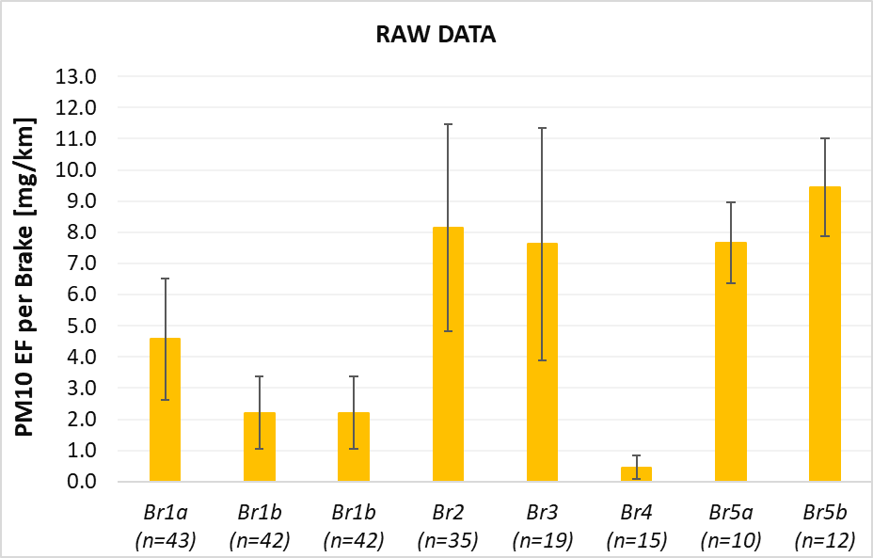
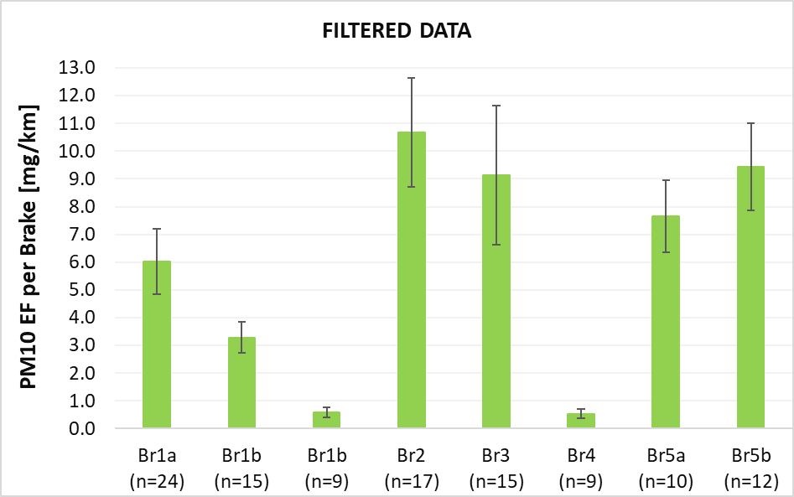
ILS HIGH-LEVEL PM10 RESULTS
The measurement variability for PM is high when all data are considered. However, labs did not meet important specs of the TF2 protocol - Filtering the data shows a significant improvement in the measurement variability
*Br1b emission behavior was not uniform –
Data separated to two sets based on the wear behaviour
Error bars correspond to 1 StDev
Error bars correspond to 1 StDev
PM10 EFs | Unfiltered Variability | Filtered Variability
Br1a | 42.6% | 19.5%
Br1b* | N/A | 16.9%
Br2 | 40.6% | 18.3%
Br3 | 48.8% | 27.4%
Br5a | 16.9% | 16.9%
Br5b | 16.6% | 16.6%
Lab-to-lab variability is expected to further decrease when the GTR becomes available because i. testing facilities will comply to the specifications and ii. stricter specifications and harmonization will improve method’s variability.

Slide 14
TF4 PLANNING PRESENTED
AT THE PMP ON 29.03.2022
The TF4 is working intensively on finalizing a proposal for incorporating the regen feature in the PMP procedure;
There are two proposals that are being evaluated at the moment – Both of them incorporate best and worst case testing scenarios;
The objective of TF4 is to submit its final proposal by the end of April – Still to be discussed if a short testing campaign including 2-3 labs will be feasible at this point;
The final TF4 proposal on how to generalize the PMP procedure to vehicles with regen braking capabilities will be presented – along with the overall method – to a PMP meeting for feedback and the final approval of the group in the end of May

Slide 15
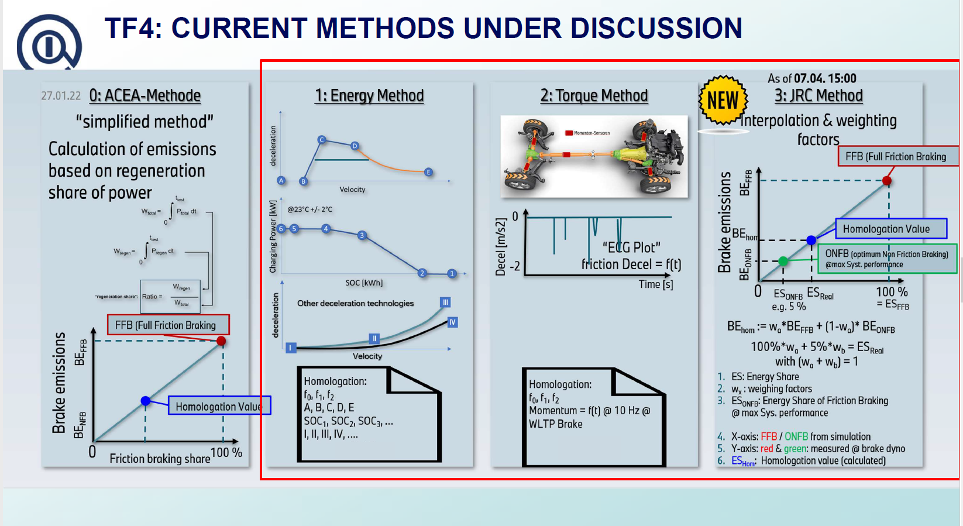
TF4 CURRENT STATUS
Currently, there are two proposals that are being elaborated;
There are still several elements required to finalize the proposal(s);
We need first to reach an agreement at the TF4 level and then submit the proposal(s) to the PMP for the final decision;
Still to be discussed if a short testing campaign including 2-3 labs will be feasible.
Overall, it is not possible to have a method ready for incorporating regenerative braking to the protocol in the next couple of months. However, it is absolutely feasible to have it ready by the end of the year.

Slide 16
GTR ON BRAKE EMISSIONS – PROPOSAL (1/2)
Submit the draft GTR for FULL-FRICTION brakes of LDVs as an informal document to the upcoming GRPE session – The document will need to be submitted with 1 month delay at the end of June.
Timeline
01 June 2022: Presentation of the status at the GRPE – Kindly request from the GRPE to submit the informal document with the draft GTR on full-friction brakes in the beginning of July (late submission);
15 June 2022: If GRPE grants approval presentation of the draft GTR to the PMP – Request for feedback and finalization of the draft GTR for full-friction brakes by the end of June;
01 July 2022: Submission of the draft GTR to the GRPE – Feedback and comments by beginning of September – Preparation of a consolidated version of the final GTR;
Beginning of October 2022: Submission of the working document of the GTR for full-friction brakes;
Mid-December: Preparation and submission of informal document amending the working document to include regenerative braking;
January 2023 GRPE session: Adoption of the working document with the GTR on brake emissions.

Slide 17
GTR ON BRAKE EMISSIONS – PROPOSAL (2/2)
Why submit it now?
The submission of the draft GTR now will give the chance to external entities and third parties to carefully examine the proposal and provide their feedback for further improvements without losing more time;
The submission of the draft GTR will give the chance to the testing facilities to start programming and equipping their laboratories accordingly to meet the new demanding specifications;
Substantial changes with respect to the previous protocol have been applied; therefore, the testing facilities will use this time to adopt to the changes and check the new requirements;
Further delaying the submission of the draft GTR will not help improve the technical specifications or further reduce lab-to-lab variability since no testing facility actually carries out tests with the new specifications as we speak;
Further delaying the submission of the draft GTR might induce a further delay to the finalization of the method to test regenerative braking since there will be no reference protocol to follow – Furthermore, the submission of the draft GTR for full friction brakes does not cause any negative impact to the development of the method for regenerative braking.

Slide 18
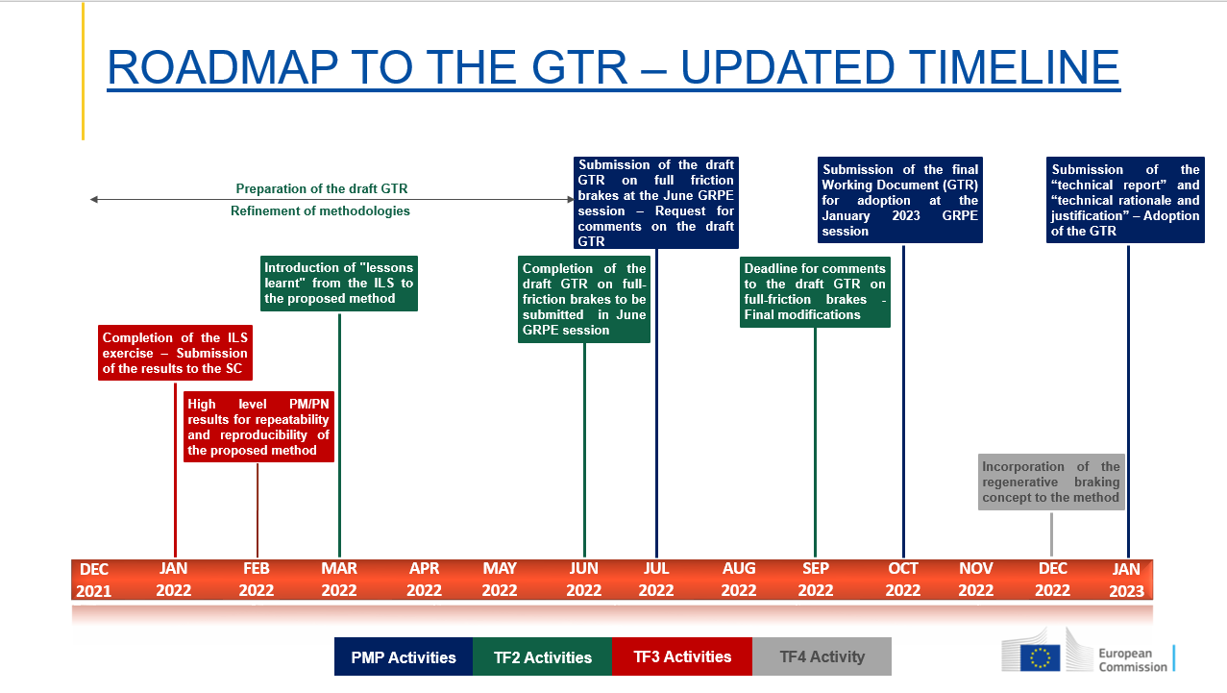
ROADMAP TO THE GTR – TIMELINE PMP 01.12.2021
Submission of the draft GTR at the June GRPE session – Request for comments on the draft GTR
Submission of the final Working Document (GTR) for adoption at the January 2023 GRPE session
Submission of the “technical report” and “technical rationale and justification” – Adoption of the GTR
Preparation of the draft GTR
Refinement of methodologies
Introduction of "lessons learnt" from the ILS to the proposed method
Completion of the draft GTR to be submitted in June GRPE session
Deadline for comments to the draft GTR - Final modifications
Completion of the ILS exercise – Submission of the results to the SC
High level PM/PN results for repeatability and reproducibility of the proposed method
Incorporation of the regenerative braking concept to the method
PMP IWG Meeting to present the draft GTR
DEC
2021
JAN
2022
FEB
2022
MAR
2022
APR
2022
MAY
2022
JUN
2022
JUL
2022
AUG
2022
SEP
2022
OCT
2022
NOV
2022
DEC
2022
JAN
2023
PMP Activities
TF2 Activities
TF3 Activities
TF4 Activity

Slide 19





Keep in touch
EU Science Hub: ec.europa.eu/jrc
@EU_ScienceHub
EU Science Hub – Joint Research Centre
EU Science, Research and Innovation
Eu Science Hub
Notes:
Delete/update as appropriate

Slide 20

Thank you
© European Union 2022
Unless otherwise noted the reuse of this presentation is authorised under the CC BY 4.0 license. For any use or reproduction of elements that are not owned by the EU, permission may need to be sought directly from the respective right holders.
Slide xx: element concerned, source: e.g. Fotolia.com; Slide xx: element concerned, source: e.g. iStock.com
Notes:
Update/add/delete parts of the copy right notice where appropriate.
More information: https://myintracomm.ec.europa.eu/corp/intellectual-property/Documents/2019_Reuse-guidelines%28CC-BY%29.pdf

