Slide 1
Periodic Technical Inspection: Particle Number (PN) Measurements
Transmitted by the expert from EC (JRC)
Informal document GRPE-86-30
86th GRPE, 30 May - 2 June 2022
agenda item 13.
Joint Research Centre

Slide 2
National regulations
In Switzerland, a PN measurement is conducted for non-road machineries during PTI
Starting from July 2022, the Netherlands and Belgium will be the first countries to introduce a PN-PTI for vehicles. Germany and Switzerland will follow from January 2023
The PN-PTI limit, the technical specifications of the PN-PTI sensors and the measurement procedures differ in national regulations
Country | Test | Duration (s) | Limit (#/cm³) | Application
NL, BE | Low idling | 15 | 1 x 10⁶ | Euro 5 & 6 (in NL also older vehicles)
DE | Low idling | 3 x 30 | 2.5 x 10⁵ | Euro 6
CH | Low or high idling | 3 x 5 | 1 x 10⁵ or 2.5 x 10⁵ | All vehicles with DPF

Slide 3
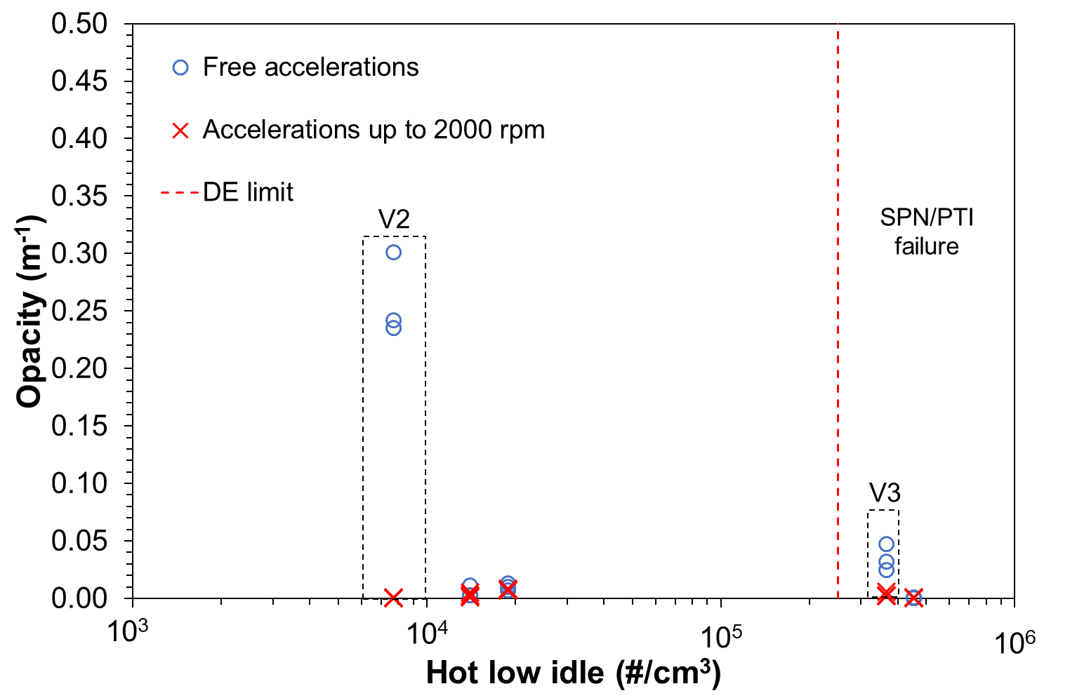
Opacity tests
JRC data
Five vehicles (V1-V5) were tested with the opacity test (3 Diesel). During idle tests opacity was almost zero for all vehicles.
During acceleration tests only for one vehicle (PFI) the opacity meter measured ~0.3 m⁻¹. The PN emissions during this test (free acceleration) were ~10⁸ #/cm³
Two vehicles that would have failed the PN-PTI test with a limit of 2.5 × 10⁵ #/cm³, passed the opacity test. This finding is in agreement with previous studies
PN-PTI failure

Slide 4
European Commission PN-PTI guideance
European Commission is currently working on a guidance document for harmonising approaches for PN PTI measurements but leave the MS with the possibility to introduce PN measurements as an additional measure within their own national competence, pending the revision of the PTI Directive
Current status
The first draft guidance was shared with the Roadworthiness group and members provided comments. A revised version is currently under preparation

Slide 5
Outline of the PN-PTI guidance
Scope
Description of PN-PTI instruments
Metrological controls
Measurement procedure
Regulation limit

Slide 6
Measurement procedure
Warmup of instrument and error free indication
Instrument self-checks and/or functional checks
Probe insertion at the tailpipe (recommended 30 cm, min 5 cm)
Idle operation of the vehicle (for hybrids: ICE on, no DPF regeneration)
Optionally 2-3 free accelerations, min 15 s low idle
At least one measurement of (at least) 15 s (earlier stop if concentration 2xLimit)
If fail: conditioning of 5 min (driving or accelerations) and repeat
Continue to all tailpipes

Slide 7
Thoughts on gasoline vehicles
Modern GDIs emit <1×10¹² #/km even without GPF.
The low idle methodology (and limit) will not necessarily detect removal of GPF
To consider: will tampering of GPFs be an issue? What are the emissions of GDIs without GPF? Is the low idle the right method?
First generation GDIs
pre Euro 6b
GDI = Gasoline Direct Injection
GPF = Gasoline Particulate Filter
PFI = Port Fuel Injection
LPG = Liquefied Petroleum Gas
CNG = Compressed Natural Gas
Sensors 2020, 20(20), 5790; https://doi.org/10.3390/s20205790

Slide 8
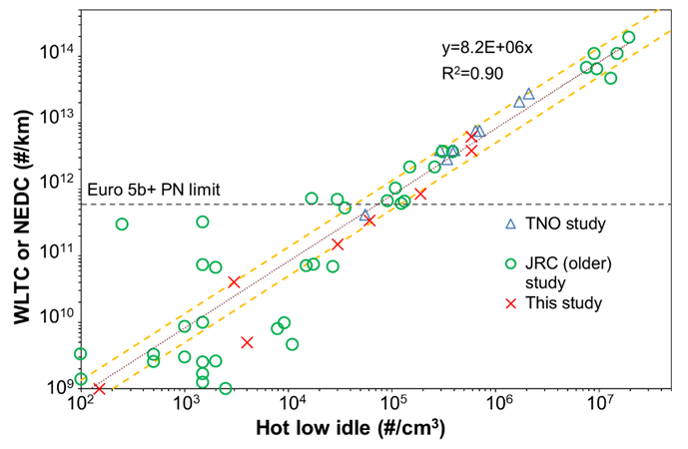
Regulation limit (diesel vehicles)
JRC investigated the correlation between type-approval and PN-PTI emissions of diesel vehicles. Our results agree with older studies. Correlation factor can be defined: ~10⁷ cm³/km
Considering that the type approval limit is 6 x 10¹¹ #/km, vehicles with >10⁵ #/cm³ low idling emissions will fail the type-approval tests.
Considering the method and instrumentation uncertainty a limit ≥ 250,000 #/cm³ is reasonable and will depend on the stringency.
A limit of 1,000,000 #/cm³ can detect removed DPFs of older vehicles
Yellow lines: +/- 65%
https://doi.org/10.3390/s20205790 and new JRC results

Slide 9
Scope (on-going work)
Gasoline vehicles are out of the scope at this stage due to lack of experimental data to support a robust measurement procedure
According to the draft guidance, the PN-PTI test can be applied to all M and N category vehicles equipped with compression ignition engine.
It is suggested to include in the scope vehicles registered after 01/01/2013 (date of introduction of a PN limit for these vehicles)
For Heavy Duty Vehicles (HDVs), DPF malfunctioning can be detected with low idling tests according to the literature. JRC does not have currently experimental data.

Slide 10
Description of the PN-PTI instrument
The PN-PTI instrument shall be comprised of a sampling probe, a sampling line (optional), a device/technique to avoid water condensation, a pre-conditioning unit for removing volatiles (optional), and a particle detector
With dash lines the optional parts

Slide 11
Controls over life-time of instrument
Type approval
At least 1 PN-PTI instrument of definitive type (family)
Initial verification
Every new PN-PTI instrument
Subsequent verification
Every PN-PTI instrument at least every year
NMi facilities
Manufacturer facilities
Manufacturer facilities or on-site
Metrological requirements:
Complete Linearity 9 points (25%)
Counting efficiency
Volatile removal efficiency (>95%)
Rated operating conditions (50%)
Disturbances (50%)
Technical Requirements
Simple Linearity 5 points (25%)
Functional tests
-Leak check
-High PN response (optional)
-Flow check
-Response time
Simpler Linearity 3 points (50%)
Functional tests
NMI: National metrology institute

Slide 12
Metrological requirements (efficiency – linearity)
Soot | 23 nm | 30 nm | 41 nm | 50 nm | 70 nm | 80 nm | 100 nm | 200 nm | Linearity * | 30 nm C40
NL, BE | 0.2 – 0.6 | - | - | 0.6 – 1.3 |  | 0.7 – 1.3 | - | - | 80 nm | <5%
DE | 0.2 – 0.6 | 0.3 – 1.2 | - | 0.6 – 1.3 | 0.7 – 1.3 | - | 0.7 – 1.3 | 0.5 – 2.0 | 70 nm | <10%
CH * | <0.5 | - | >0.4 | - | - | 0.7 – 1.3 | - | <3.0 | 80 nm | <5%
JRC ** | 0.2 – 0.6 | recom. | - | 0.6 – 1.3 | 0.7 – 1.3 |  | recom. | recom. | 70 – 80 nm | <5%
* Polydisperse aerosol
** Monodisperse or polydisperse
Soot *** | MPE | zero | L / 10 | L / 5 | L / 2.5 | L / 1.67 | L / 1.25 | L limit | L × 1.2 | L × 1.6 | L × 2.0
Type approval | 25% | Yes | Yes | (Yes) | (Yes) | (Yes) | (Yes) | Yes | (Yes) | (Yes) | Yes
Initial | 25% | Yes |  | Yes |  | (Yes) |  | Yes |  | (Yes) | Yes
Subsequent | 50% | Yes |  | Yes |  |  |  | Yes |  |  | Yes
*** Other material can be used at initial and subsequent verification if correlation factor during type approval is established
() In brackets recommended (indicative)

Slide 13
Next steps
A second draft version of the PN-PTI guidance is under preparation
The revised guidance will be presented at the next experts roadworthiness group meeting
The guidance will undergo a second round of comments by the members of the roadworthiness group
JRC is working on technical details (are minimum requirements sufficient? What calibration factors can be applied by manufactures, what calibration materials are allowed etc).
The guidance could be the basis of PN-PTI regulations of future MS

Slide 14
Thank you
© European Union 2021
Unless otherwise noted the reuse of this presentation is authorised under the CC BY 4.0 license. For any use or reproduction of elements that are not owned by the EU, permission may need to be sought directly from the respective right holders.
Slide xx: element concerned, source: e.g. Fotolia.com; Slide xx: element concerned, source: e.g. iStock.com
Notes:
Update/add/delete parts of the copy right notice where appropriate.
More information: https://myintracomm.ec.europa.eu/corp/intellectual-property/Documents/2019_Reuse-guidelines%28CC-BY%29.pdf

Slide 15
Metrological controls: Open points
Critical
The counting efficiency during type-approval of instruments differs in national regulations.
Uncertainty of reference instrumentation during type approval and initial verification
Maximum permissible errors
Less critical
Differences at volatile removal efficiency tests

Slide 16
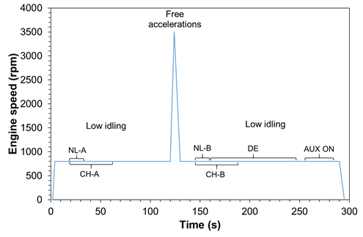
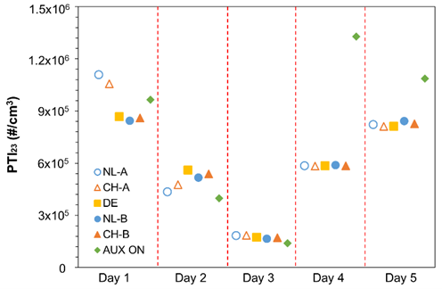
Measurement procedure (1/2) (on-going work)
JRC results: EURO 4 vehicle with DPF
Regeneration
After Day 3: 9x10¹¹ (1/km)
Before Day 4: 6x10¹² (1/km)
A repeatability study performed by JRC showed that the main factors that have impact on PN-PTI are the DPF fill state and EGR status change.
PN-PTI measurements shall be short but at least 15 s (total measurement time)
Cold engine PN-PTI tests are permitted but in case of failure the test shall be performed with hot engine

Slide 17
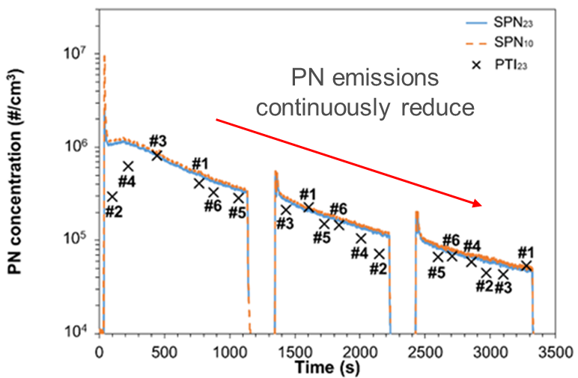
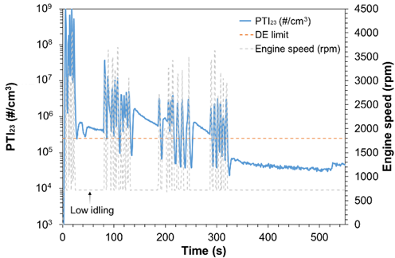
Measurement procedure (2/2) (on-going work)
EURO 6 vehicle with DPF
EURO 6 vehicle with DPF
https://doi.org/10.3390/s21248325
JRC data
Low idling PN concentrations are very high just after a DPF regeneration raising the danger of false fails for well-functioning DPFs
Proposal: When the vehicle fails at the 1st test then a conditioning of 5 minutes is done and the PN-PTI test is repeated

